Slide 1
SQL vs NoSQL: Which One Fits Your Data Needs?
Presented by: Rishabh Goyal
Class: CSCI - 608
Name

Slide 2
Overview
Introduction to SQL
Introduction to NoSQL
SQL vs NoSQL Comparison
Challenges
Code Snippets

Slide 3
Introduction to SQL
Definition
Structured query language designed to create and manage relationship between databases, enabling efficient CRUD operations.
Core Characteristics
Operates with predefined schemas and tabular structures.
Emphasizes relationships among data through foreign keys and joins.
Use Cases
Banking and financial applications.
Customer Relationship Management (CRM) systems.
Data warehousing for analytical processing.

Slide 4
Introduction to NoSQL
Definition
Class of database systems designed to handle unstructured, semi-structured, or structured data.
Core Characteristics
Schema-less and highly flexible.
Supports diverse data models like key-value pairs, documents, columns, and graphs.
Use Cases
Real-time web applications.
IoT data processing.
Social media platforms and content management systems.

Slide 5
Comparison
Features | SQL | NoSQL
Structure | Relational | Non relational
Query Language | SQL | Varies by databases
Consistency | ACID compliance | BASE compliance
Performance | Optimized for complex queries | High speed read/write operations for unstructured data
Flexibility | Rigid | Flexible
Schema | Predefined schema | Schema-less
Examples | MySQL, PostgreSQL, Oracle. | MongoDB, Cassandra, Redis, Neo4j.
Use Cases | Transactional systems, analytics, and reporting. | Real-time analytics, IoT, and social media.

Slide 6
Challenges
Challenges of SQL Databases
Limited scalability for massive datasets.
Rigidity in schema design.
Performance issues with large-scale distributed systems.
Challenges of NoSQL Databases
Lack of standardization across implementations.
Potential trade-offs in consistency due to CAP theorem.
Learning curve for developers familiar with relational databases.

Slide 7
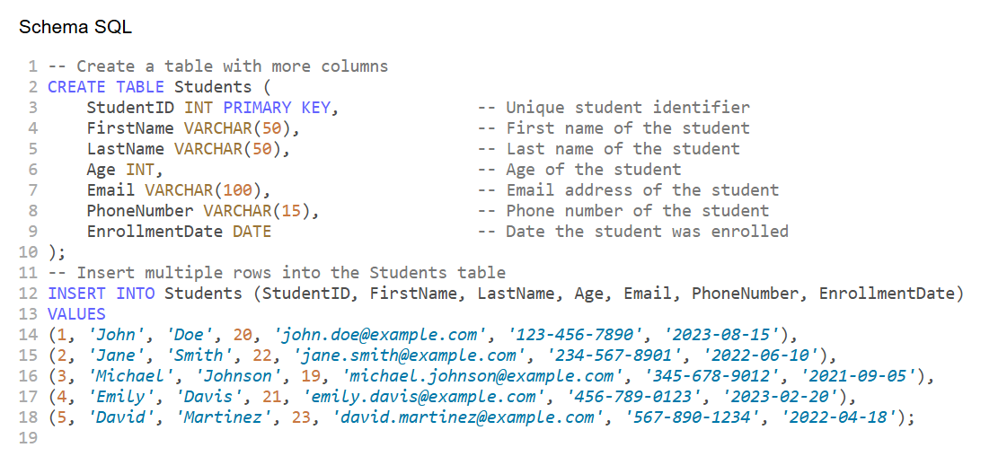
SQL Code

Slide 8

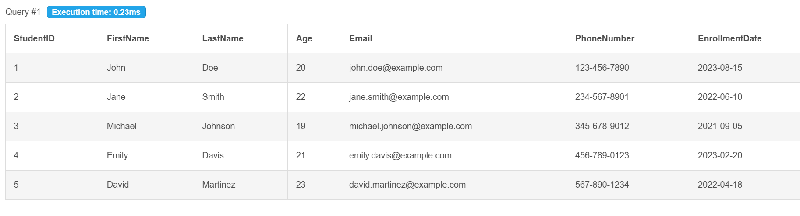
Simple Query

Slide 9
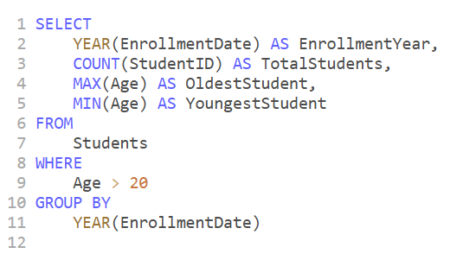
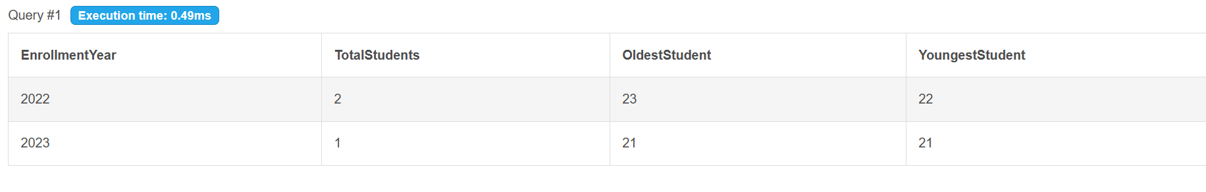
Complex Query

Slide 10
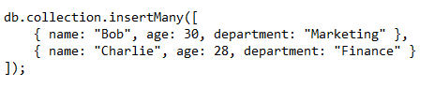
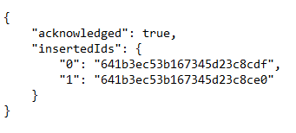

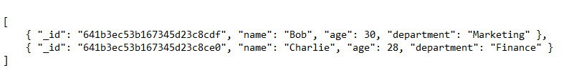
NoSQL Queries

Slide 11
Thank
you !
Name

