Slide 1
NBA Lineup Prediction
Group 24
By: Rishab, Faisal, Saieashan

Slide 2
Introduction
Predicting the optimal fifth player for an NBA home team using machine learning. The model analyzes historical data (2007-2015) to identify lineup patterns and maximize team performance.

Slide 3
Methodology
Data Exploration: We began by inspecting raw NBA game data (2007-2015) to understand patterns related to player lineups, match outcomes, and team compositions.
Feature Engineering: Using the allowed features from the dataset, we constructed variables like home_lineup and away_lineup by sorting player IDs for consistency.
Modeling Objective: Predict the optimal fifth player for the home team based on partial lineup data and other game features.

Slide 4
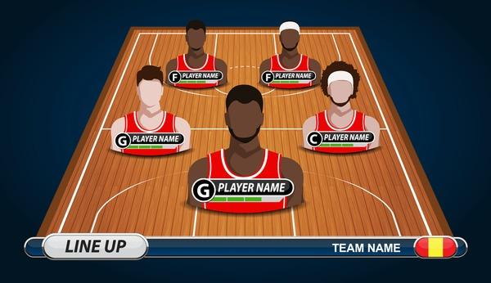
Feature Engineering
Allowed Features: We strictly adhered to a provided list of allowed features, which include team compositions (home_0, home_1, etc.) and game outcomes.
Data Transformation: Cleaned data by removing unnecessary features and handling missing values.
Player Lineups: Formed tuples representing home and away lineups for comparison.
Team Mapping: Adjusted team acronyms for consistency (e.g., NJN → BRK).

Slide 5
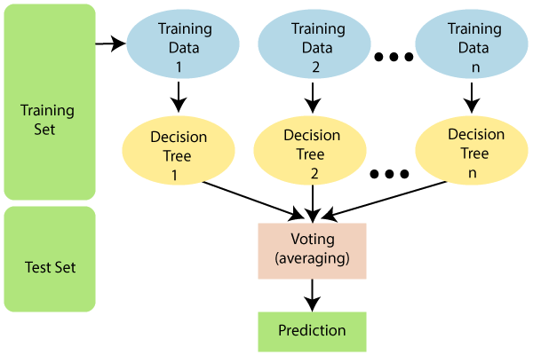
Selected Model
Model Choice: We opted for a supervised machine learning model, a classification algorithm such as Random Forest based on its ability to handle complex feature interactions and its historical success in sports analytics.
Model Goals: The model predicts the optimal fifth player, maximizing team performance based on historical data.

Slide 6
Training Process
ACTIONS
Training Data
Test Data
Cross-validation
We used historical NBA game data, focusing on games where the home team performed better (outcome=1).
The model was tested on game segments with partial lineups (four home players, five away players) to predict the fifth player.
Split data into training and testing sets to evaluate performance across multiple game scenarios. Aim to reduce overfitting

Slide 7
Pre and Post Processing
Cleaned dataset by handling missing values.
Standardized formats and encoded categorical variables (e.g., teams, player IDs).
Predicted player recommendations were filtered to ensure that only available players (not injured) were considered.
Results were formatted for submission: Game ID, Home Team, Fifth Player.
Preprocessing
Post Processing
&

Slide 8
Evaluation
Evaluation Metric:
Evaluated the model's predictions based on how well the chosen fifth player contributed to team success in similar matchups.
Performance was measured using prediction accuracy and historical success metrics.
Model Explainability: Detailed the rationale behind choosing the predicted player, using feature importance and decision-making processes.
Analyzed top-1, top-3, and top-5 probable players for reliability
Features used to understand player position, past performance, or lineup stability

Slide 9
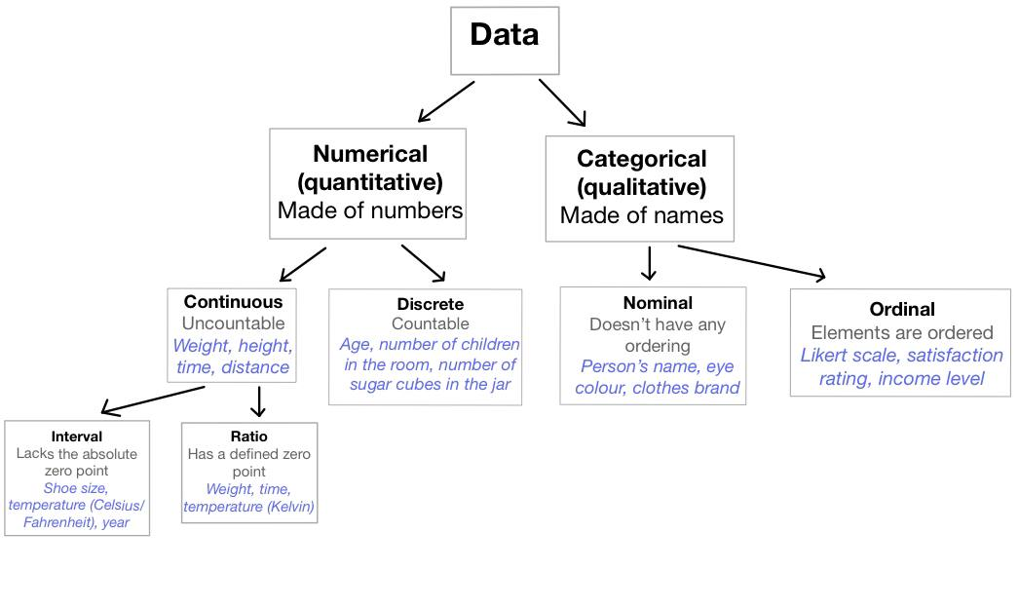
Unique Encoding in Player Performance Modeling
Performance-Based: Weighted by playing time.
Contextual: Computed per season & team.
Fallback: Uses overall mean if missing.
Efficient: Fast dictionary lookups.
Data-Driven: Captures player & team impact.

Slide 10
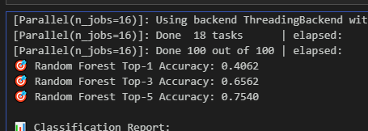
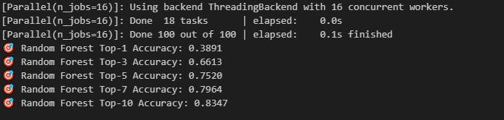
Performance
Top - 3 Accuracy
66.1%
38.9%
75.2%
Top - 1 Accuracy
Top - 5 Accuracy

Slide 11
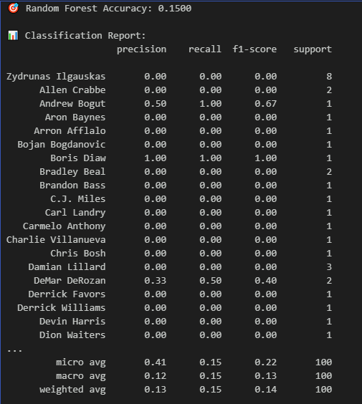
Performance
NBA 2016 Accuracy
15%

Slide 12
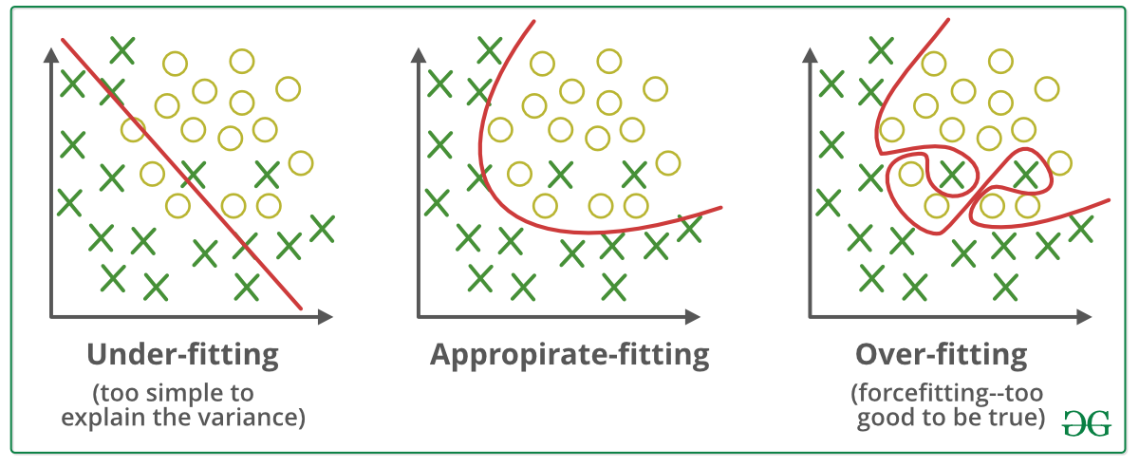

Problems Faced
Removing a player from the lineup during training seemed logical, but it could lead to overfitting by over-relying on the remaining players.

Slide 13
Thank You

