Slide 1


Slide 2
Objectives
End Of the Class You need to understand
  What is Domain
  What is Data
  Types of Data
  Types of Data Bases
  DW Architecture

Slide 3
Data
Any thing which giving some meaningful information is known as data
Data is two types
  Transactional Data
  Analytical Data

Slide 4
Transactional Data
Is run time data or day to day data
is current and detail
Is useful to Run the business
Is stored in OLTP(On Line Transactional Processing)
Source of transactional data is Applications
Example : ATM Transactions , Share market transactions..etc

Slide 5
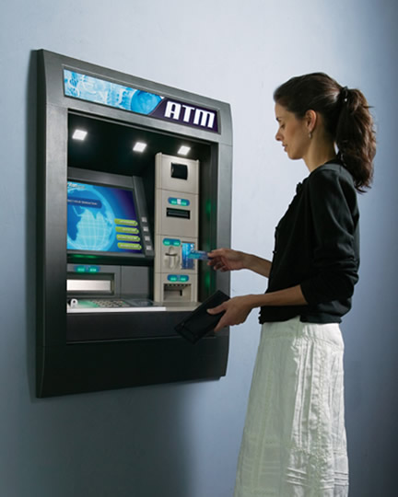
Transaction
Application
Data Base
OLTP
Withdraws

Slide 6
Analytical Data
Is usuful to ANALYSE the business
Is Historical and summarized
Is stored in OLAP(On Line Analytical Processing) or DW(Data Warehouse )
Source of Analytical data is OLTP

Slide 7
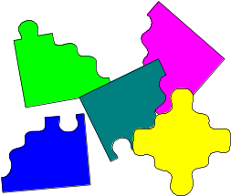
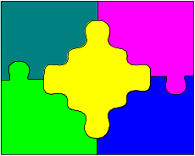

OLTP Vs OLAP
OLTP
OLAP
  Primarily concerned with current data
  Generally concerned with historical data
Notes:
Dimensional Modeling
5 -<number>
Data Warehousing Fundamentals
Time variance means that all data in the data warehouse is accurate as of some moment in time. In the operational environment data is accurate as of the moment of access.
Another way of looking at time variance is that, in operational systems, data is kept for a smaller time horizon such as 90 days, 180 days etc. A data warehouse in the contrary stores data spanning several years such as 5 years, 10 years etc.
The data warehouse schema represents the time variant nature by having a time element in the key structures. This usually is not a practice in most applications as it is not necessary.
The time variant nature of a data warehouse stems from the requirement that the data warehouse should provide historical snapshots of data about an organization which is accurate as of some moment in time.

Slide 8
DW Architecture
Application Layer
Source
Staging Area
Target
Reporting Layer
Dashboards
Layer
Cust
T
R
A
N
S
F
O
R
M
A
T
I
O
N
S
E
M
A
N
T
I
C
L
A
Y
E
R
C
R
M
R1
OLTP
Extract
OLAP
or
DW
D
A
S
H
B
O
A
R
D
Loading
SIEBEL
SAP
ORACLE
R2
Emp
E
R
P
OLTP
Extract
R3
ETL
Reporting

Slide 9
DW ToolS
ETL
Reporting
Talend
Alteryx
Informatica
Data Stage
Abintio
SSIS
ODI
OWB
BODI
Power BI
Tableau
SSRS/SSAS
OBIEE
Cognos
SAP-BO
DOMO
Qlick View
MSTR

Slide 10
OLTP Vs OLAP
OLTP
OLAP(read only DB)(DSS)
Is useful to store Transactional data
Is useful to run the business
The nature of data is current and detail
OLTP Supports CRUD(Create ,Partially read,update,delete)
Is useful to store Analytical Data
Is useful to analyze the business
The nature of data is historical and summarized
OLAP supports only Read operations

Slide 11
OLTP Vs OLAP
OLTP
OLAP(read only DB)(DSS)
It is a application oriented DB
It is volatile
In OLTP data storage time is fixed
OLTP DB are isolated as per applications
No of users are more(customers+emp)
It is a Subject oriented DB
It is non Volatile
In OLAP data storage time is variant
OLAP is Integrated as per subject area
No of users are less (MM+HM)

Slide 12
OLTP Vs OLAP
OLTP
OLAP(read only DB)(DSS)
In OLTP we will use Normalized schema
In OLAP we will use denormalized schema

Slide 13
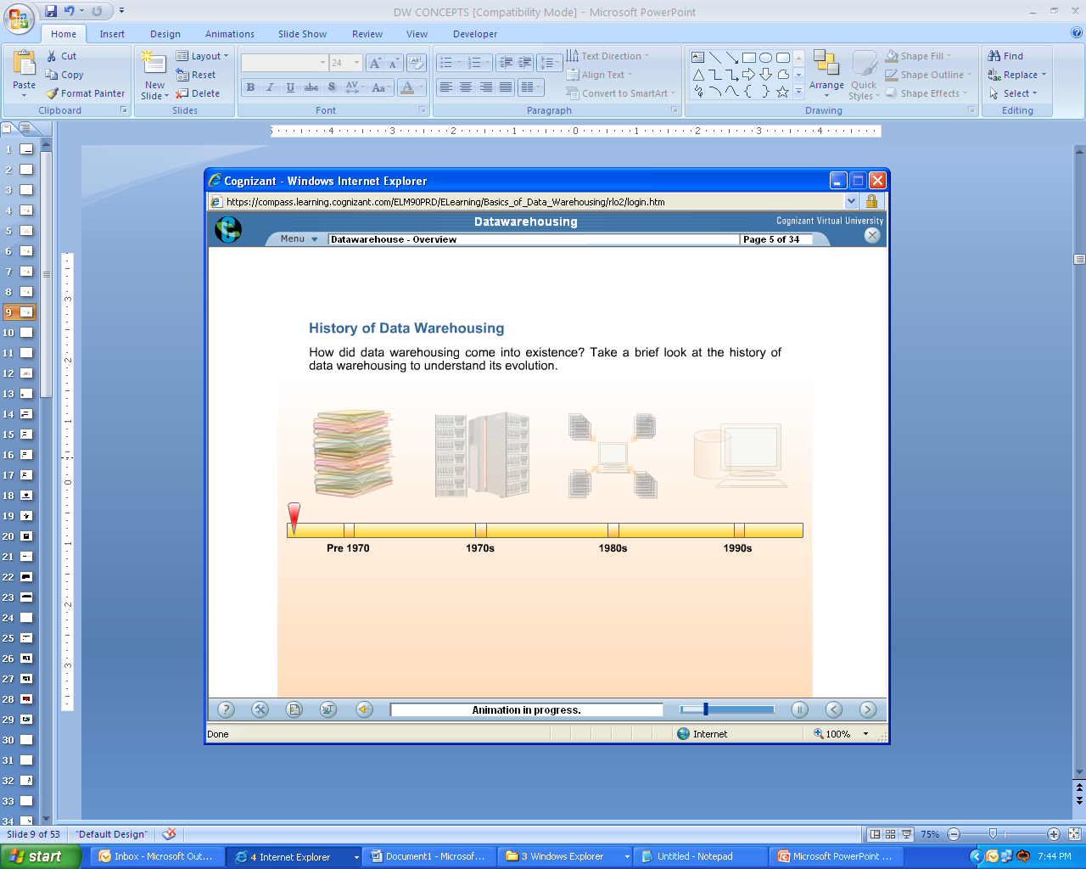

Slide 14
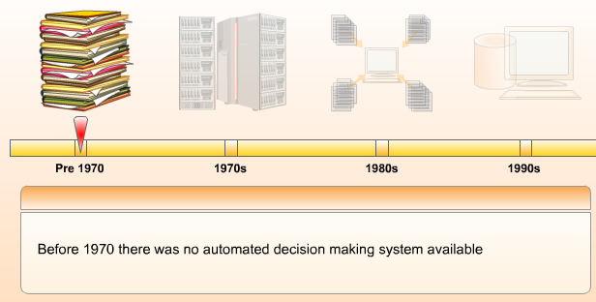

Slide 15
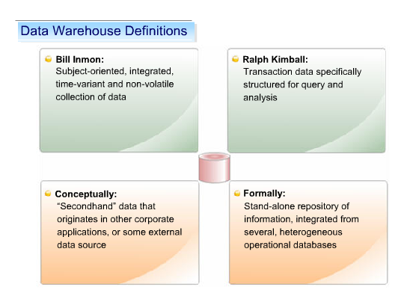

Slide 16
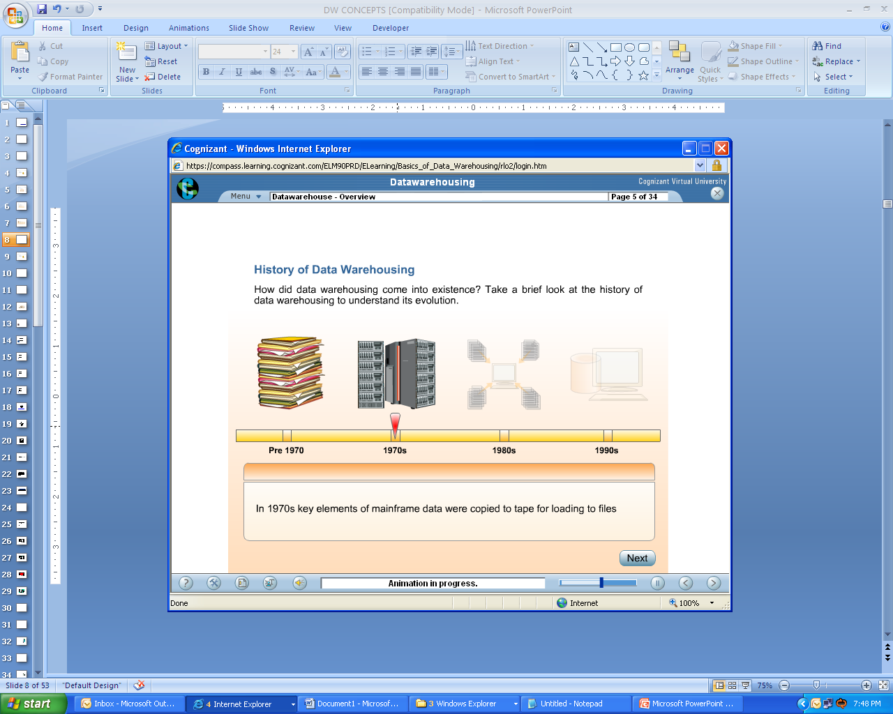

Slide 17


Slide 18
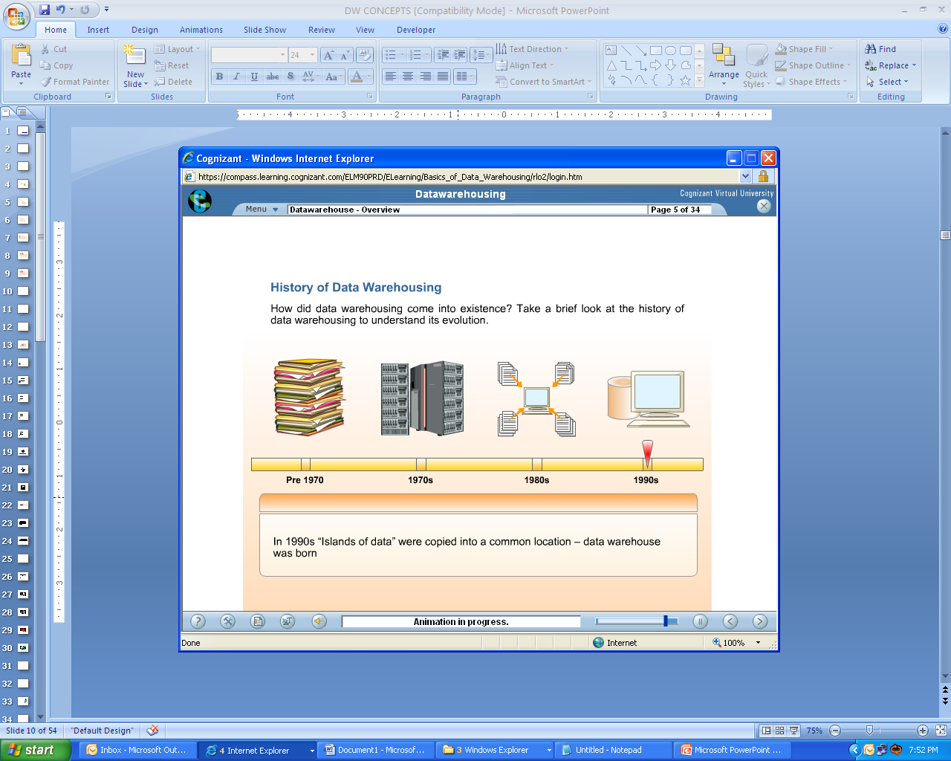

Slide 19
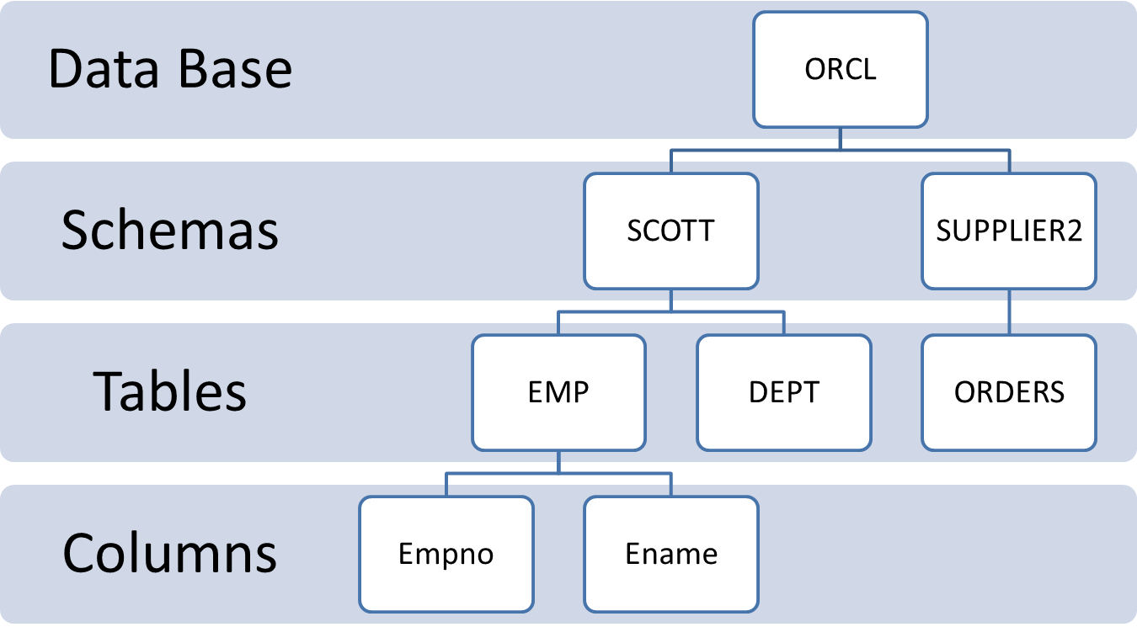
DW or DB Flow

Slide 20
Schemas
A group of tables are called as schema
Star
Snow Flake
Constellation or mixed

Slide 21
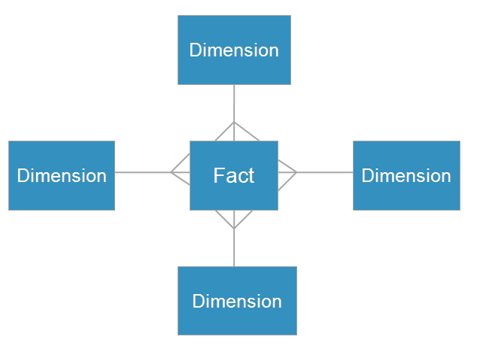
Star Schema
  Organizes data into a central fact table with surrounding dimension tables
  Each dimension row has many associated fact rows
  Dimension tables do not directly relate to each other
  All Dimension Tables are de normalized
  Optimized to read data
  User friendly ,easy to understand
  In OBIEE BMM layer
  Star schemas and Mixed star schemas
  are used

Slide 22
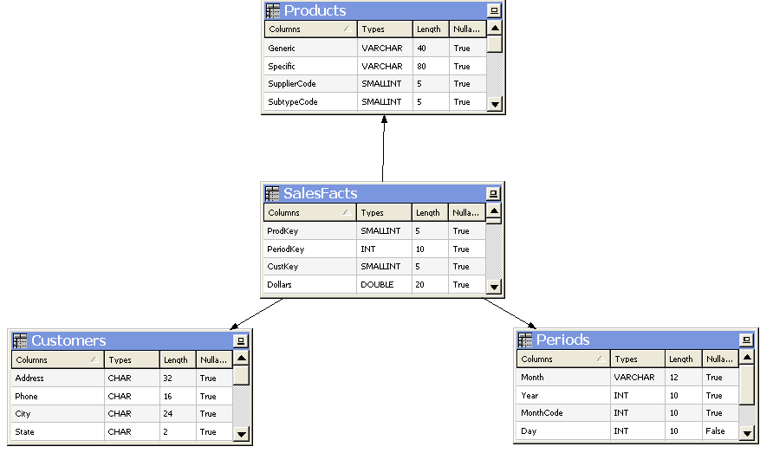
Star Schema

Slide 23
Star Schema Fact
  Contains business measures or metrics
    Data is often numerical
  Is the central table in the star
Sales Revenue
Units Sold
Units Shipped

Slide 24
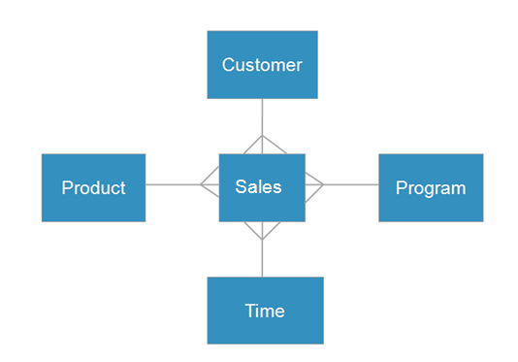
Star Schema Dimension
  Contains attributes or characteristics about the business
    Data is often descriptive (alphanumeric)
  Qualifies the fact data
Name
Address
Name
Format
Name
Product Line
Month
Year

Slide 25
Example: Star Schema
  Sales fact table with dimension tables and relationships
CUSTOMER DIMENSION
ROW_WID | CUST_NAME | OTHER
17023 | A.K.Parker | …
17054 | Betta Builders | …
17056 | Cost Cutter StoreS | …
PRODUCT DIMENSION
ROW_WID | PROD_NAME | OTHER
12091 | Widget | …
12093 | Super Widget | …
12095 | Lite Widget | …
SALES FACT
ROW_WID | CUST_ID | PER_ID | PROD_ID | QTY_ORDERED | QTY_SHIPPED | AMT
1 | 17023 | 26031 | 12093 | 5 | 4 | 100
2 | 17054 | 26031 | 12091 | 15 | 10 | 50
3 | 17023 | 26033 | 12091 | 5 | 3 | 20
PERIOD DIMENSION
ROW_WID | DATE | OTHER
26031 | 1/1/2004 | …
26033 | 2/1/2004 | …
26075 | 3/1/2004 | …

Slide 26
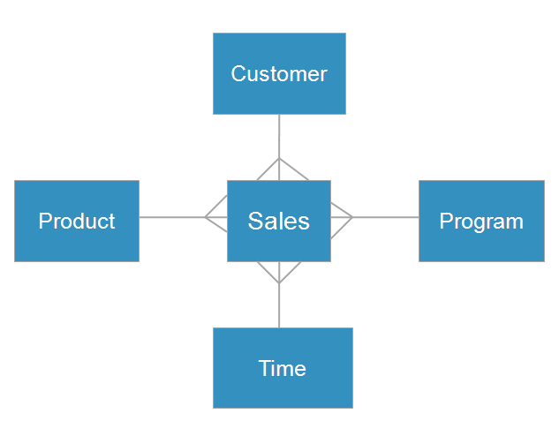
User Friendly
  Models the way users think about data
  Enables data to be understood and analyzed
Sales Revenue, Units Sold, Units Shipped by Customer
Sales Revenue, Units Sold, Units Shipped by Product
Sales Revenue, Units Sold, Units Shipped by Time
Sales Revenue, Units Sold, Units Shipped by Program

Slide 27
Snow Flake Schema
  Normalized tables are used
  Extended star schema
  Two dimesiontables will be directly joined
  Like star schema ,it has only one fact table

Slide 28
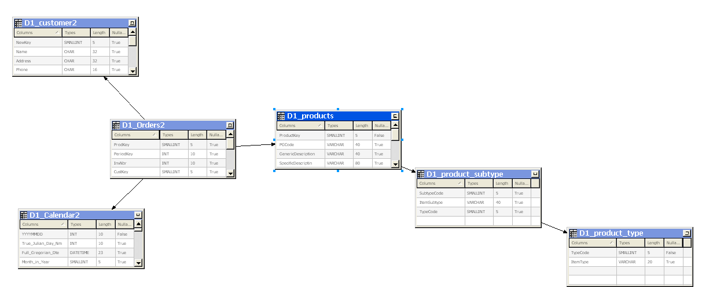

Snow Flake Schema

Slide 29
Snow-flake schema
Customer
Time
Revenue
Units Sold
Net Profit
City
Product
Region
Brand
Country
Color
Notes:
Dimensional Modeling
5 -<number>
Data Warehousing Fundamentals
The snowflake schema is simply a variation of the star schema with some relational Characteristics. The fact table in the data warehouse is naturally highly normalized.
No level in dimension tables. Best performance when queries involve aggregations.Snow flaking is the tendency to store dimensional data in third normal form. This is similar to the ERD modeling concept where operational systems create separate code or look up tables. This reduces the data \redundancy in the dimension tables.
Snowflakes may be used to avoid joins to the dimension table when an aggregate is used in a query.

Slide 30
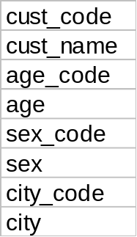

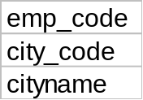
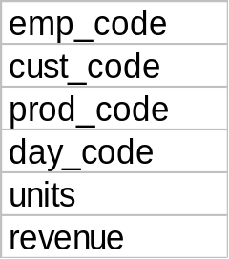
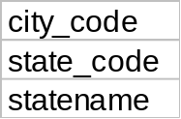
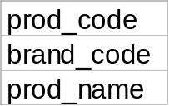
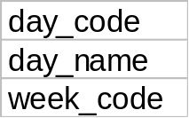
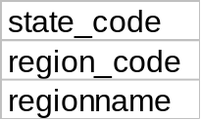
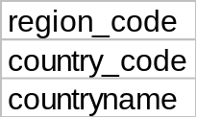
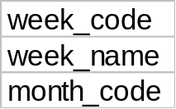
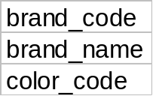
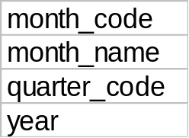

Snow-flake: Physical view
Notes:
Dimensional Modeling
5 -<number>
Data Warehousing Fundamentals
Snowflake general guidelines
Snowflaking requirements depend on the end users usage and access patterns in the Data warehouse.
Snowflakes can also be used if there is an end user requirement to use the look up tables frequently
Snowflake only large dimension tables.
Snowflake is suggested for query performance and not just to save space.
Consider storage versus performance tradeoffs.
Do not snowflake the lowest level dimension element.

Slide 31
Mixed Schema
Galaxy schema contains many fact tables with some common dimensions (conformed dimensions).
This schema is a combination of many schemas

Slide 32
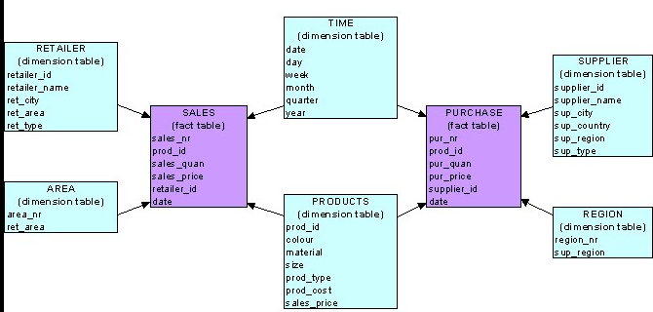
Mixed Schema

