Slide 1

SMART INDIA HACKATHON 2026
Problem Statement ID - 26100
Problem Statement Title - AI-Powered Integrated Bid Compliance Verification Platform for GeM Procurement
Theme - Smart Automation
PS Category - Software
Team ID -
Team Name - BidNova

Slide 2
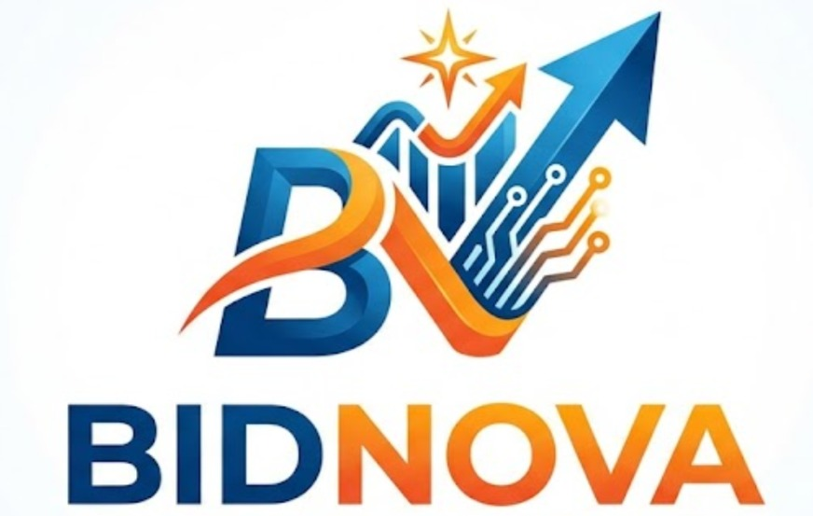
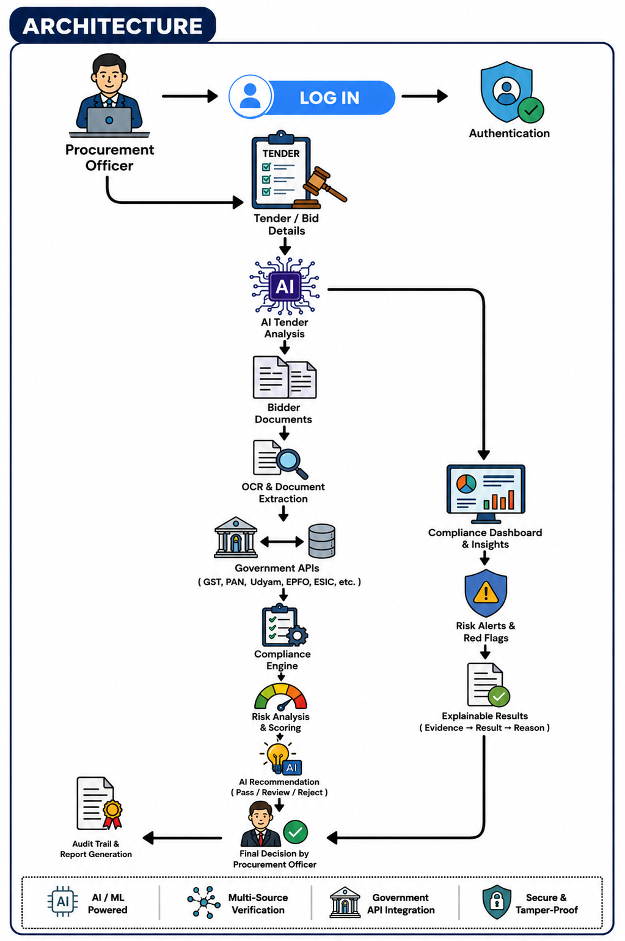
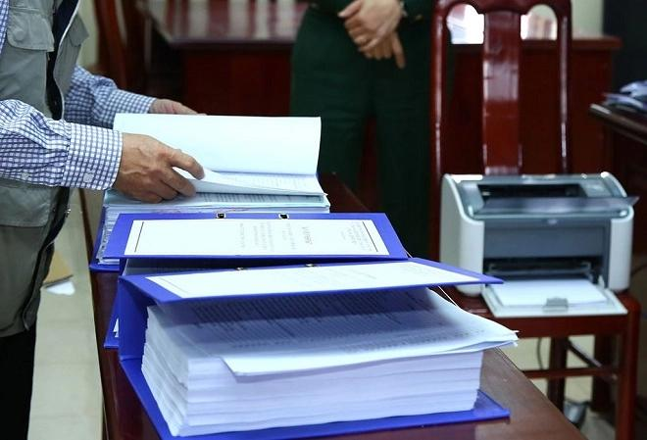
BIDVERIFY
(AI-Powered Compliance for Smarter GeM Procurement)
PROBLEM EXISTING
Time-Consuming Verification : Why spend hours checking every bidder document?
Multiple Portal Hassle : How can bidder details be verified across different portals?
Hidden Compliance Risks : What if a missing or mismatched document goes unnoticed?
PROPOSED SOLUTION
➢ AI-Powered Bid Verification : Automatically analyses tender requirements and bidder documents for compliance.
➢ Smart Cross-Portal Validation : Verifies GST, PAN, Udyam and other credentials through a unified platform.
➢ Real-Time Compliance Score : Instantly identifies missing, mismatched and risky requirements with clear status.
➢ Explainable AI Recommendation : Provides evidence-based compliance insights while keeping the final decision with the officer.
UVP (UNIQUE VALUE PROPOSITION)
➢ Tender-to-Trust Intelligence : Converts every tender and bidder submission into a single AI-powered compliance profile for faster evaluation.
➢ Clause-to-Proof Mapping : Automatically links tender requirements → bidder documents → verification evidence, eliminating repetitive checking.
➢ Digital Bidder Trust Passport : Creates a reusable compliance identity with verified credentials, risk indicators and verification history.
➢ Predictive Compliance & Risk : Detects hidden gaps, inconsistencies and potential risks before the procurement decision.

Slide 3
TECHNICAL APPROACH
Start Here
Upload Tender +
Bidder Documents
AI Document Processing
OCR + LLM + RAG
Tender clauses
Eligibility criteria
Bidder details
Required documents
▶
▶
▼
▼
What Needs to be Verified?
▼
▼
▼
Mode 1
DOCUMENT VERIFICATION
Mode 2
PORTAL CROSS-VERIFICATION
Mode 3
AI COMPLIANCE ASSESSMENT
Upload Bidder Documents
Extract Bidder Details
Tender + Bidder Data
▼
▼
▼
OCR + AI Extraction
Query Authorized
Government Source
Apply Tender Rules
▼
▼
Extract GST / PAN / Udyam /
Certificates
▼
Detect Compliance Gaps
Retrieve Official Data
▼
▼
▼
Validate Information
Cross-Check with Documents
Generate Compliance Score
▼
▼
▼
Document Status
Generate Verification Evidence
Risk Level + AI Recommendation
▼
▼
✓ Valid
⚠ Missing
✗ Mismatch
GST | PAN | Udyam | MCA | EPFO/ESIC
Final Decision →
Procurement Officer
(Authorized Government APIs)
🗄️ TECH STACK
OUTPUT
⚛️
⚡
🐘
📄
🧠
🔒
🏛️
✅
Compliance Score + Risk Level + Pending Requirements + Verification Evidence
React.js
FastAPI
PostgreSQL
OCR
LLM + RAG + ML
JWT + RBAC +
Encryption
Authorized
Government APIs
▶
(Frontend)
(Backend)
(Database)
(Document Processing)
(AI)
(Security)
(Integration)

Slide 4
FEASIBILITY AND VIABILITY
FEASIBILITY:
Technical: Uses proven technologies — React, FastAPI, PostgreSQL, OCR, LLM, RAG & ML.
AI: Reads tender documents, extracts requirements and matches them with submitted documents.
Integration: Uses authorised government APIs where available; mock APIs for the prototype.
Security: JWT, role-based access, encryption and audit logs protect procurement data.
Human Oversight: AI assists with verification; final decisions stay with the Procurement Officer.
VIABILITY:
Operational: Reduces manual document checking and saves time.
Economic: Cuts repetitive work and improves evaluation efficiency.
Scalable: Can support new departments, tender types and compliance checks.
Standardised: Provides one consistent verification process.
Auditable: Stores evidence, sources and verification history.
TECHNICAL CHALLENGES & MITIGATION:
1.Government API Availability
Risk : Some government sources may not provide a usable public API.
Mitigation : Use official/authorised integrations where possible and mock APIs during the prototype.
2.Poor-Quality Documents
Risk : Blurry or scanned documents can cause OCR mistakes.
Mitigation : Use image preprocessing, OCR confidence checks and human verification.
3.Company Name Confusion
Risk : Two companies may have similar names, which can lead to incorrect matching.
Mitigation : Verify using GSTIN, PAN, CIN and other unique identifiers.
4.Changing Tender Requirements
Risk : Requirements can differ from one tender to another.
Mitigation : Extract requirements dynamically and keep the compliance rules configurable.

Slide 5
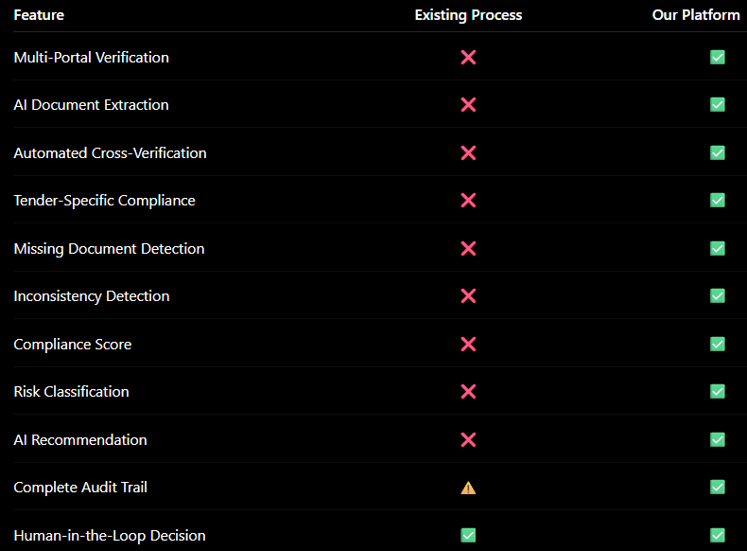
IMPACT AND BENEFITS
Procurement Efficiency: Automated verification of bidder documents and government records can significantly reduce repetitive manual verification effort and speed up tender evaluation.
• Improved Compliance & Accuracy: AI-based extraction and cross-verification help identify missing documents, data mismatches and potential compliance issues, reducing human errors and inconsistencies.
• Transparency & Governance: Evidence-based verification, compliance scores and complete audit trails provide procurement officers with a transparent and traceable basis for review.
• Better Risk Identification: Early detection of discrepancies, missing requirements and potential blacklisting/debarment issues enables faster and more informed scrutiny of bidders.
HOW OUR PLATFORM WORKS
MODE 1: DOCUMENT VERIFICATION
MODE 2: PORTAL CROSS-VERIFICATION
MODE 3: AI COMPLIANCE ASSESSMENT
For: Bidder documents submitted through the platform
Process:
Upload Documents → AI/OCR Extraction → Information Validation → Document Status
Time: Seconds–Minutes*
Best For: GST, PAN, Udyam, OEM authorization, certificates and declarations
For: Information that needs verification against authorized government sources
Process:
Extract Bidder Details → Query Authorized Source → Retrieve Data → Cross-Check → Generate Evidence
Time: Minutes*
Best For: GST, Udyam/MSME, PAN/IT, MCA, EPFO/ESIC, Startup India, NSIC and other applicable sources
For: Complete tender-level eligibility assessment
Process:
Portal + Documents → Apply Tender Rules → Detect Gaps → Compliance Score → Risk Level → AI Recommendation
Output:
Compliance Score + Risk Level + Pending Requirements + Evidence
Best For: Final procurement officer review and decision support

Slide 6
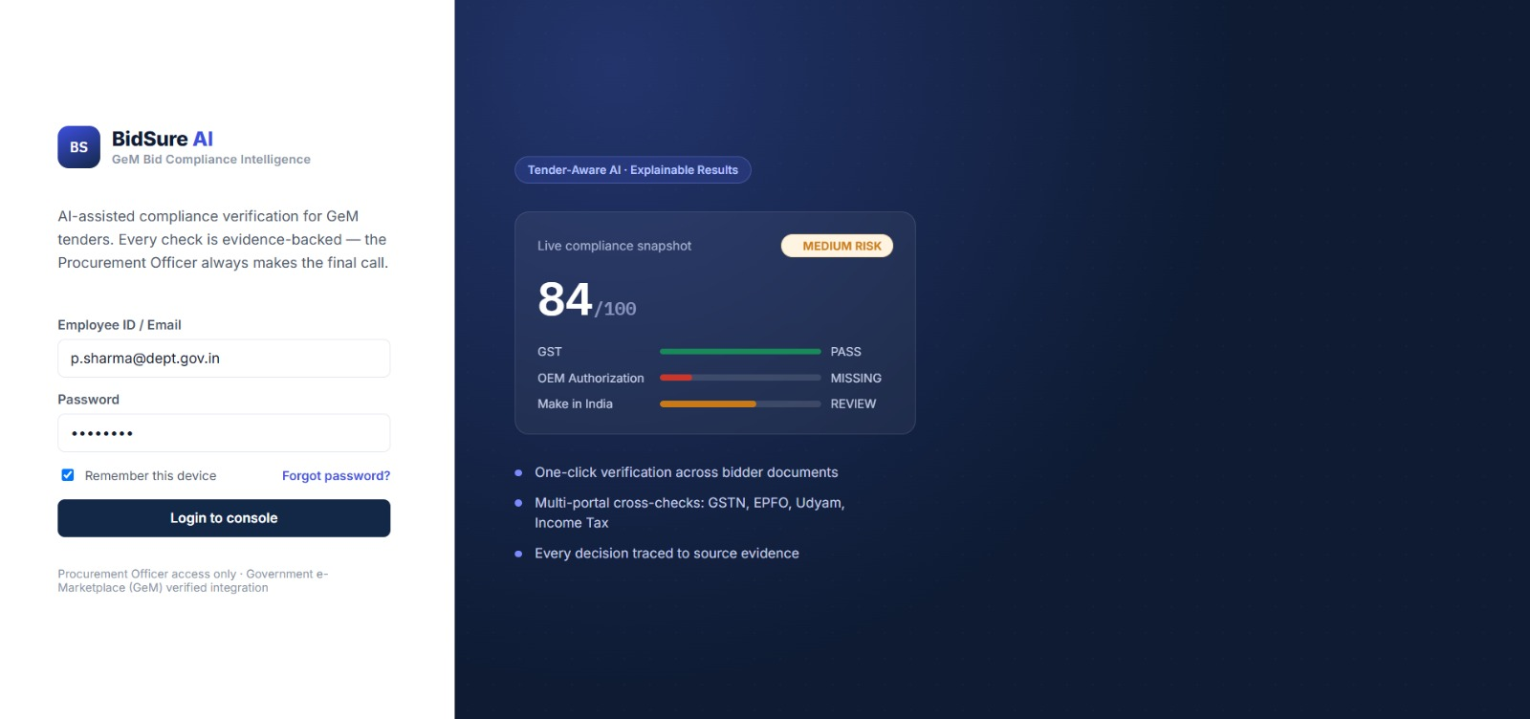
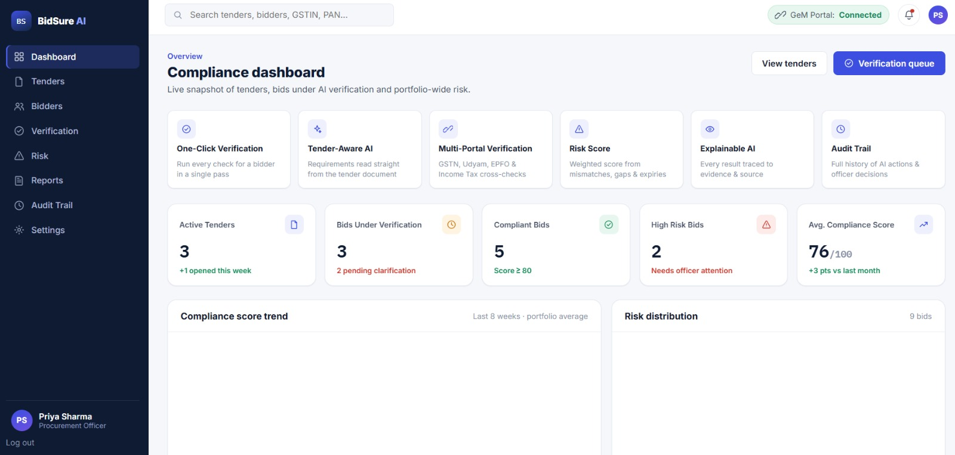
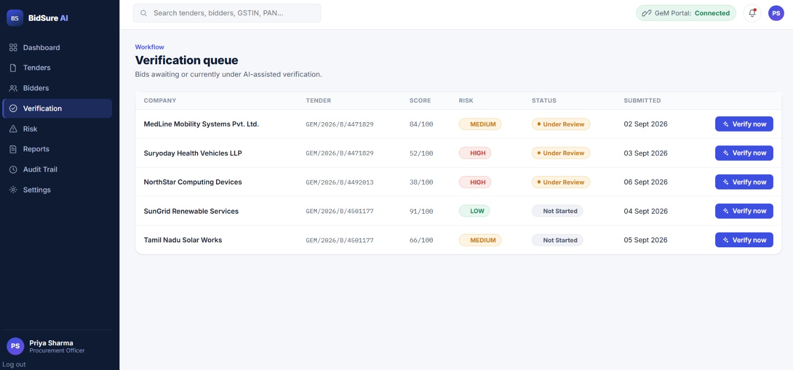
RESEARCH AND REFERENCES
➢ GeM : Government e-Marketplace is India’s national public procurement platform for transparent and efficient government procurement.
Full Details : GeM Handbook
➢ AI in Procurement : Research shows that AI can support supplier evaluation, compliance screening and risk assessment while keeping humans
involved in final decisions.
Links : Scientific Reports
➢ Transparent Procurement : Government procurement guidelines emphasize consistency, clarity, openness and transparency during bidder evaluation.
Links : Department of Expenditure / GePNIC
SOLUTIONS ALREADY EXIST
Most platforms focus on tender discovery, not complete bidder compliance verification.
AVAILABLE PLATFORMS : GeM AI / GemSetu / Bid India / GemEdge
OUR SOLUTION STANDS OUT
One-Click : Easy compliance verification
Tender-Aware : Checks tender requirements
Risk Score : Identifies compliance risks
Safe & Verified : Evidence-based verification
PROJECT RESOURCES
Prototype link: Prototype
Ai model link: AI_Model
Dataset link : Dataset Link

