Slide 1
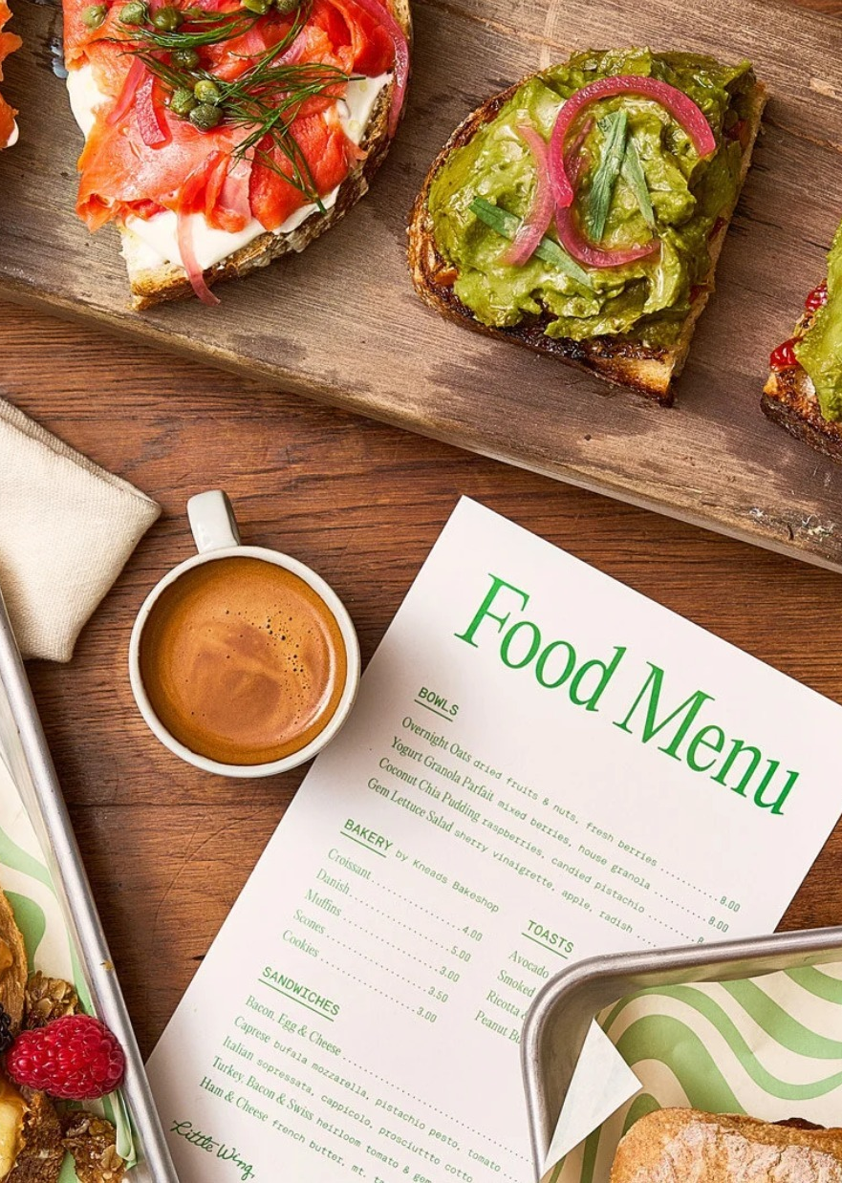

ROOST BALTIMORE
The Little Wing & Vessel
Plan of Action
July 2026
Notes:
Little Wing loses money because of its staffing model. This plan keeps the product, the margin and the brand, and changes three things: how the room is staffed, what the owner charges, and what sits on the shelves. Prepared for ownership review, July 2026.

Slide 2
CURRENT ECONOMICS
A cost-structure problem, not a concept problem
$288.7K
($164.0K)
59%
2026 revenue — Jan–Jun actuals + Jul–Dec forecast
2026 net operating loss · −57% of revenue
of revenue goes to labor — $170.3K/yr
95.2%
$65.4K
($18.6K)
prime cost (COGS + labor) · healthy runs 60–65%
flat management fee + rent charged today
discounts & comps given away · −6.4% of sales
Source: 2026 Act/For P&L (June close). The concept works — the cost structure doesn’t: labor, owner charges and giveaways absorb the entire gross margin.
Notes:
The loss has three structural causes and labor is only the largest: the staffing model at 59.7% of revenue, a $48K flat management fee, and rent. The product itself works — 65.1% gross margin, 52% of sales are beverage, and monthly revenue is up about a third since January. This is a cost-structure problem, not a concept problem.

Slide 3
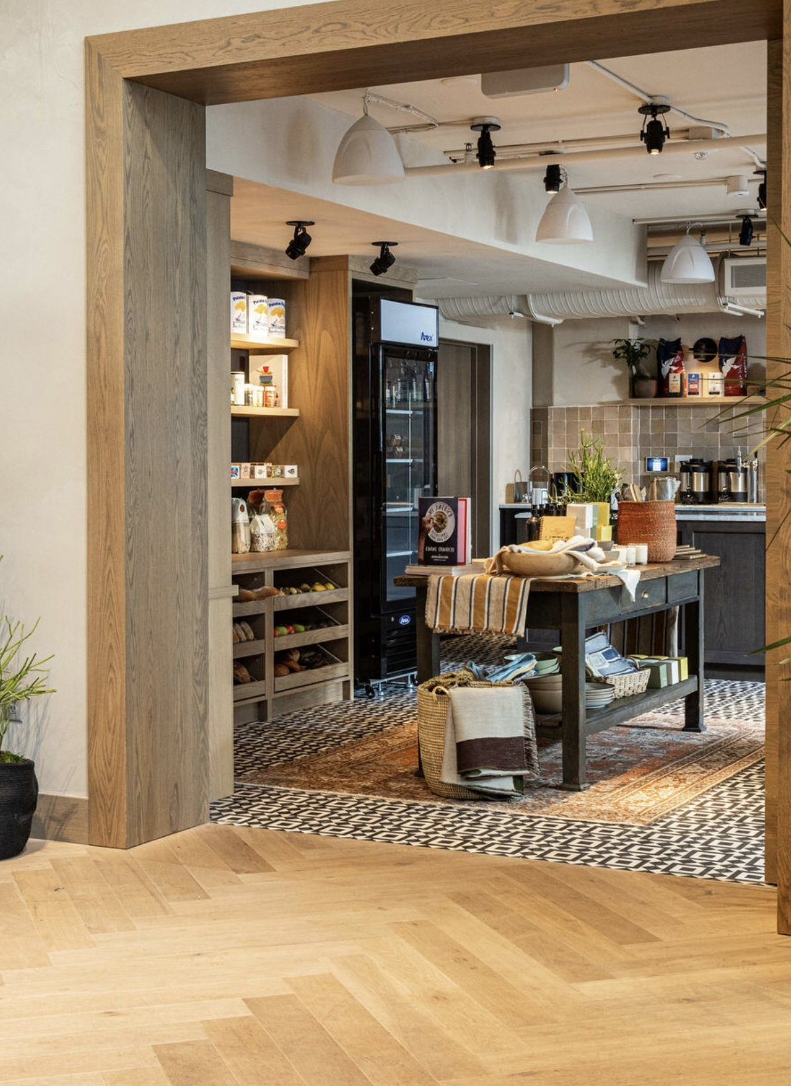
THE OPPORTUNITY
The peninsula has no corner store
I-95 and the rail lines cut the peninsula off from Federal Hill — no way to buy milk, a bottle of wine, or other everyday essentials. Four customer groups already come in for coffee:
1,000+
80 keys
residential units nearby
of furnished ROOST stays upstairs
75%
40 acres
of 440K SF of office leased
of parks & waterfront foot traffic

Slide 4
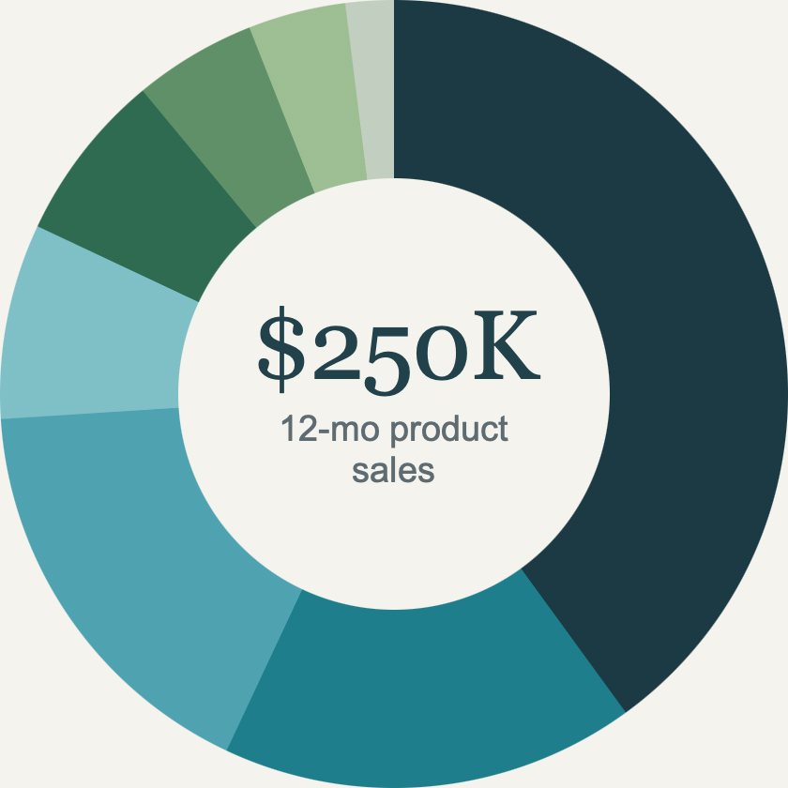
PRODUCT MIX
What Little Wing sells
Coffee & tea drinks
40%
$100.6K
Sandwiches
17%
$43.1K
Retail beverages
17%
$42.7K
Pastries
8%
$20.6K
Grocery, snacks & goods
7%
$18.3K
Grab & Go
5%
$11.4K
Deals, specials & toasts
4%
$9.3K
Smoothies
2%
$4.5K
Notes:
Before the plan, here's what actually sells, straight from twelve months of Toast. Coffee and tea drinks are the engine at 40 percent of product sales, with sandwiches and retail beverages tied for second at 17 percent each. The read that matters for the plan: it's beverage-led — coffee, cooler cans, and smoothies together are 59 percent of sales — and retail already sells. Canned beer, wine and NA drinks are already the number-three category before we touch the shelves, which is exactly why the merchandising lever is low-risk. This excludes Vessel events, gift cards and open-item rings.

Slide 5
PRODUCT MIX
What Little Wing sells
SELF-SERVE WINDOW · 17%
7–9am
$600
$500
The peak — the three biggest hours are ~34% of the day. One barista covers all of it under the plan.
$400
$300
11am–1pm
$200
Lunch runs food-led — sandwiches top the mix through midday, then taper hard after 2p.
$100
6a
7a
8a
9a
10a
11a
12p
1p
2p
3p
4p
5p
6p
7p
4pm+
$0
The tail skews beverage — coffee fades while the cold case, snacks, wine, beer & canned cocktails carry the window. It sells itself.
Coffee & tea
Sandwiches
Pastries
Cold case
Snacks & grab-go
Wine, beer & bar

Slide 6
THE PLAYBOOK
Structural levers to improve profitability
01
02
03
04
05
Labor model
Increase pricing
Remerchandise
Programming
Operating Expenses
Single shift
+$0.10–$1.00
+$24K GP
+$500 / wk
$65.4K → $14.8K
+$39K / yr
+$24K / yr
+$9K / yr
−$51K / yr
−$51K / yr
Shift 6:00a–4:00p · doors open 6:30a
Single barista shift
Self-serve, cold case & shelves after 4pm
Increase drink pricing $0.10–$0.50
Increase sandwiches & smoothies +$0.75–$1.00
Adjust the top-selling latte $0.50 to hold volume
More convenience items
Add travel category
Add zero-labor everyday staples
Frees ~200 barista hours a year
Replace nightly/weekly programming with intentional 2x/month activations
Focus on low-cost, high-impact events
Use brand/vendor partnerships to offset costs and drive traffic
Traffic support already reflected in the revenue plan — no incremental revenue claimed
4% management fee replaces the $48K flat fee
Rent waived
Owner charges drop from 22.6% to 4.0% of revenue
Notes:
Four levers, pulled in order. Labor is the largest and already moving — one 10-hour shift, 76 hours a week, a second barista only on peak weekend days. Pricing is the fastest: a $0.50 lift on coffee and tea and a $1.00 lift on sandwiches and smoothies, our highest-volume items. Cutting controllable cost — a 4% management fee replacing the $48K flat fee, with rent waived — adds $53.4K. And remerchandising the shelves builds retail over the quarter. Together they carry the turnaround.

Slide 7
01 | LABOR MODEL
Close staffed service at 4pm — keep the register open
6:00a – 4:00p
4:00p – close
one barista · single 10-hour shift · doors 6:30a
Self-serve · no added labor
WHAT WE'D GIVE UP AFTER 4PM
RECAPTURED WITH ZERO LABOR
~3.7%
1
Toast self-serve kiosk
Guests ring up cooler drinks, grab-and-go, cans & retail themselves — no one behind the counter.
of daily sales
Post-4pm sales = 17.3% of total sales (trailing 12 mo) Only 21.5% of those sales require a barista Net sales at risk = 3.7% of total revenue
2
ROOST front-desk checkout
The hotel desk is staffed 24/7 anyway — it rings the sale or charges it straight to the room.
3
The math is lopsided
Staffing 4–8pm would cost ~$33.8K/yr in labor to defend just $9.1K of barista-required sales (~$6.2K of margin). Even if every made-to-order sale walks, closing at 4pm comes out ~$27.5K/yr ahead.
Notes:
Here's the mechanics behind the single-shift labor model. We close staffed service at 4pm and run one barista from 6a to 4p — a single 10-hour shift instead of two. The question is what happens to the sales after 4pm. It's an estimated 12 percent of the day, roughly $32K a year — confirm that against the Toast daypart export — but the important part is what it's made of: after 4pm it's almost all grab-and-go, cooler drinks, cans, and retail, not made-to-order espresso. So we recapture it with no labor at all: a Toast self-serve kiosk where guests ring themselves up, and the ROOST front desk, which is staffed around the clock anyway, checks people out and charges to the room. We keep the evening revenue and drop the evening labor.

Slide 8
01 | LABOR MODEL
Impact of transitioning to a single shift
CURRENT (ACTUAL WK)
PROPOSED
FOH coverage hours / day
~16 (2 shifts)
11.1
Days open / week
7
7
~$39.0k
FOH counter + supervisor
111.8
78.0
BOH cook
13.3
13.3
Loaded labor / year
Total hourly staff-hours
125.1
91.3
−33.8 hrs
Eliminate duplicate opening and closing FOH shifts
Maintain kitchen support for specialty menu items and prep
Improve labor efficiency while preserving guest experience
FOH hourly (counter + supervisor)
$2,207
$1,560
BOH hourly (cook)
$296
$296
Hourly labor subtotal
$2,503
$1,856
−$647
Management labor
$248
$248
Payroll taxes & benefits (16%)
$440
$337
Total loaded labor / week
$3,191
$2,441
−$750
Notes:
Here's the mechanics behind the single-shift labor model. We close staffed service at 4pm and run one barista from 6a to 4p — a single 10-hour shift instead of two. The question is what happens to the sales after 4pm. It's an estimated 12 percent of the day, roughly $32K a year — confirm that against the Toast daypart export — but the important part is what it's made of: after 4pm it's almost all grab-and-go, cooler drinks, cans, and retail, not made-to-order espresso. So we recapture it with no labor at all: a Toast self-serve kiosk where guests ring themselves up, and the ROOST front desk, which is staffed around the clock anyway, checks people out and charges to the room. We keep the evening revenue and drop the evening labor.

Slide 9
02 | PRICING ADJUSTMENTS
Reprice top sellers & lean into premium
HIGH-VOLUME ITEM
UNITS / 12MO
CURRENT
CHANGE
LA COLOMBE
NEW PRICE
STARBUCKS
DAILY GRIND
5,728
$4.50
+$0.50
$5.00
$5.00
$5.45
Latte · top seller
$3.95
3,537
$3.00
+$0.50
$3.25
$3.50
$3.45
Drip coffee
$2.30
1,869
$4.50
+$0.45
$4.75
$4.95
$4.95
Cold brew
$3.95
319
$5.25
+$0.25
$5.50
$5.50
---
Draft Latte
---
1,305
$4.75
+$0.50
$4.75
$4.75
$4.95
Cappuccino
$3.95
1,212
$4.00
+$0.25
$4.25
$4.25
$4.45
Americano
$3.50
888
$6.00
+$0.50
—
$6.50
$5.95
Matcha latte
$4.50
2,352
$10.00
+$1.00
$11.00
$4.95
Egg & Cheese
$8.95
619
$8.00
+$1.00
—
$9.00+
$5.95
Smoothies
$6.00
Daily specials
510
$6.00
+$0.50
$6.50
—
—
—
Lean into La Colombe
Priced for Convenience
Match La Colombe pricing & lead with their branding where possible. The customer already knows it’s a premium product and pricing is matched
Premium reflects paid-for hotel convenience and a customer base that is 60% internal who have no premium nearby alternative.
02
Notes:
This is lever two in detail, and these are Toast actuals for the trailing twelve months. The increases land on our highest-volume items. Coffee and tea drinks are 20,000 units a year and 53 percent of menu sales, so the fifty-cent lift there is by far the highest-leverage move — the latte alone is nearly 5,700 units. Sandwiches are 3,550 units at a twelve-dollar-plus average, so a dollar there adds up. Little Wing already prices as a specialty cafe, above Starbucks, which is the right position for a captive trade area with no nearby competitor; the lift preserves that position rather than testing it. Starbucks food isn't a real comp — their sandwich is a small grab-and-go item next to our full sandwich.

Slide 10
03 | RETAIL ADJUSTMENTS
Shelf strategy
01
02
03
04
More Beverage & Alcohol
Smarter SKU Mix
Maximize Shelf Productivity
Everyday Essentials
Curated wine selection merchandised like a neighborhood market
Small & large format spirits, RTDs & canned cocktails
6- & 12-pack beer with grab-and-go convenience
Highest sales and margin per square foot
Eliminate slow-moving, specialty products
Expand core everyday essentials with proven demand
Curate assortment using sales data and guest behavior
Increase turns while simplifying operations
Deeper, denser inventory of top performing products
More facings for best sellers & impulse purchasing
Increased sales per SF without labor
Improved visual merchandising
Grocery essentials that drive repeat neighborhood visits
Pantry, household & personal care basics
Capture convenience spend
Notes:
The loss has three structural causes and labor is only the largest: the staffing model at 59.7% of revenue, a $48K flat management fee, and rent. The product itself works — 65.1% gross margin, 52% of sales are beverage, and monthly revenue is up about a third since January. This is a cost-structure problem, not a concept problem.

Slide 11
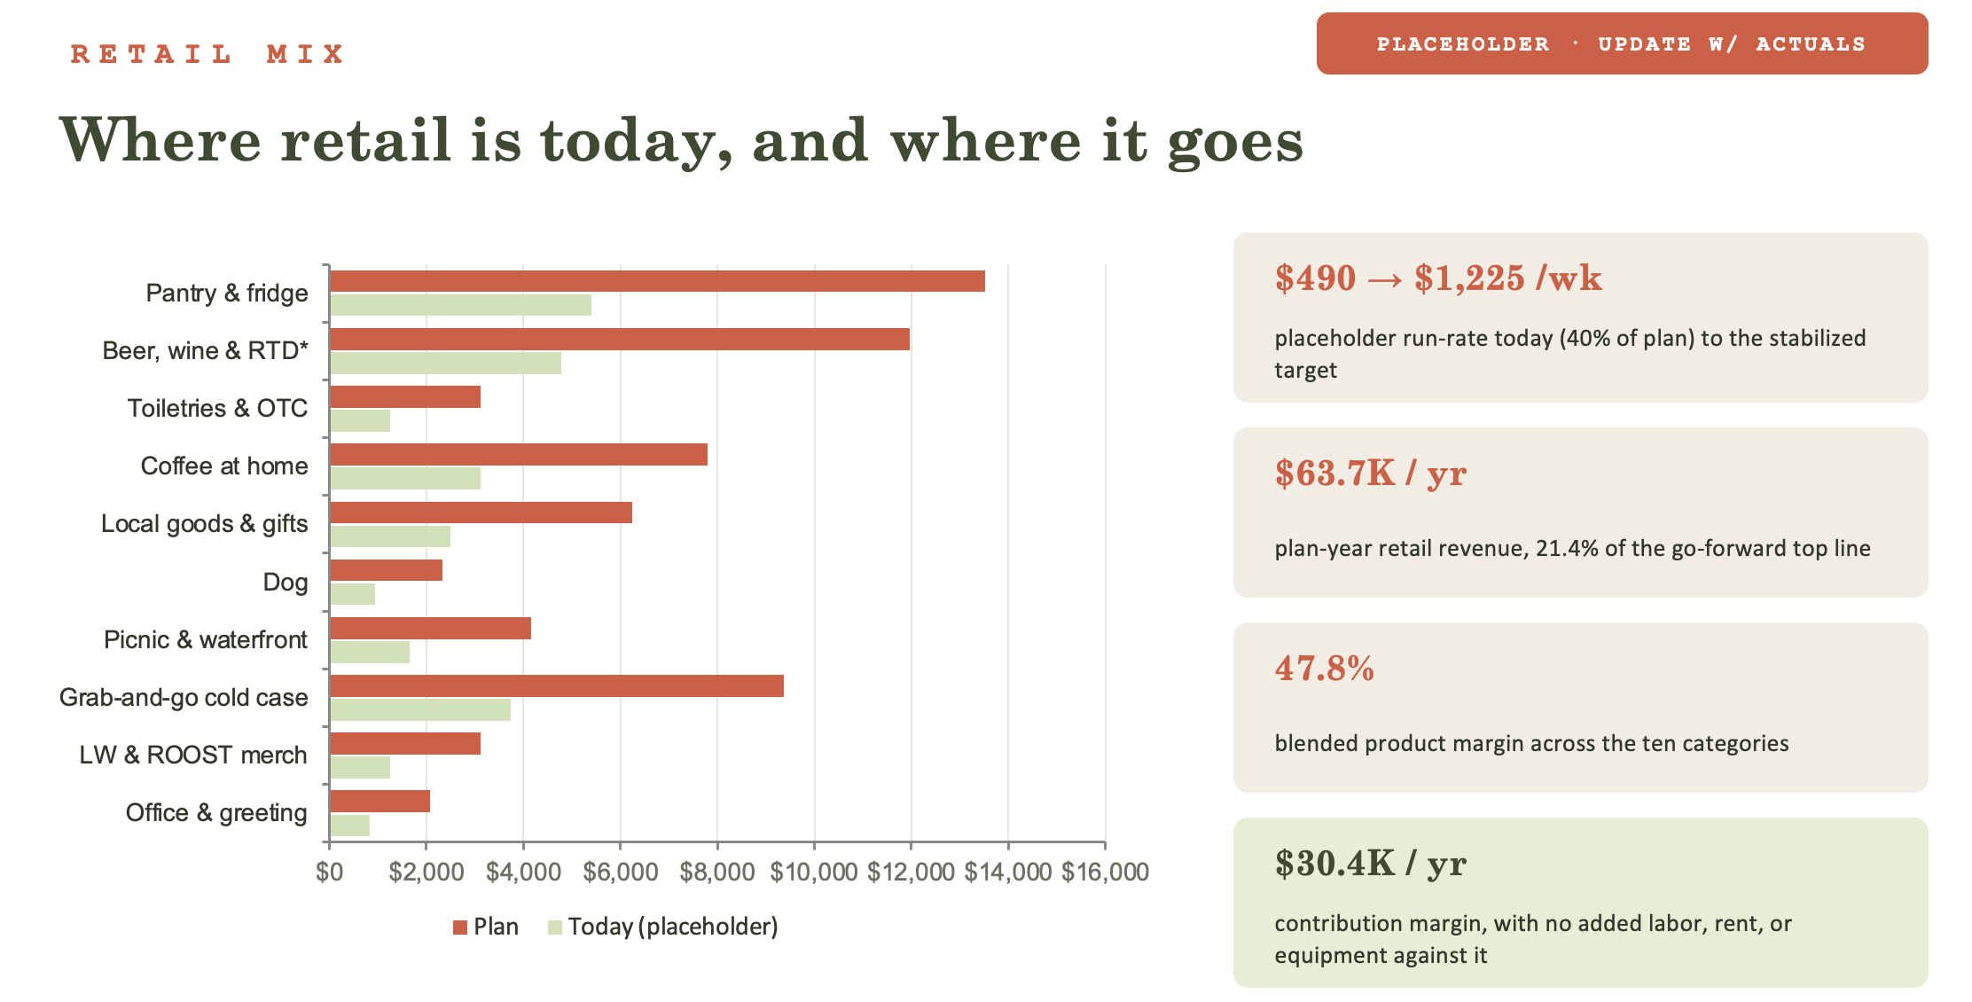
03 | RETAIL ADJUSTMENTS
Shelf strategy
R E T A I L M I X
Where retail is today, and where it goes
$1,346 → $2,210 /wk
today’s actual shelf run-rate (TTM) to the stabilized plan target
$114.9K / yr
plan-year shelf & packaged revenue — 31.7% of the $362.1K go-forward top line
~50%
product margin on the new assortment (model COGS input) — +$44.9K new revenue in the plan
$23.9K / yr
incremental gross profit in the model, with no added labor, rent, or equipment against it
Today = trailing-12-month Toast item detail (Jul 2025–Jun 2026), 404 shelf SKUs, $70.0K. Plan = today + the $44.9K remerchandising increment in the operating model, allocated per the shelf map. 54% of current SKUs sell <$50/yr (6.6% of retail $) — the space funding the new categories.
Notes:
The loss has three structural causes and labor is only the largest: the staffing model at 59.7% of revenue, a $48K flat management fee, and rent. The product itself works — 65.1% gross margin, 52% of sales are beverage, and monthly revenue is up about a third since January. This is a cost-structure problem, not a concept problem.

Slide 12

03 | RETAIL ADJUSTMENTS
Shelf strategy
HOUSEHOLD
PANTRY
SNACKS
ALCOHOL
MERCH
MERCH
MERCH
LIQUOR
TOOTHBRUSH, DEODORANT, SLEEP AIDS, ETC
DRIED PASTA, SAUCE, OLIVE OIL, VINEGAR, RICE, ETC
BARS
SPARKLING
ADVIL, TYLENOL, PROTEIN, LIQUID IV, PROTEIN BARS, ETC
PEANUT BUTTER, NUTELLA, SALSA, HOT SAUCE, ETC
CHIPS, PRETZELS, POPCORN, ETC
WHITE
CHAPSTICK, SUNSCREEN, EYE MASK, WIPES, ETC
PANCAKE MIX, CEREAL, OATMEAL, GRANOLA, ETC
LARGE BAG SNACKS, BEEF JERKY, CANDY, ETC
RED
Notes:
The loss has three structural causes and labor is only the largest: the staffing model at 59.7% of revenue, a $48K flat management fee, and rent. The product itself works — 65.1% gross margin, 52% of sales are beverage, and monthly revenue is up about a third since January. This is a cost-structure problem, not a concept problem.

Slide 13
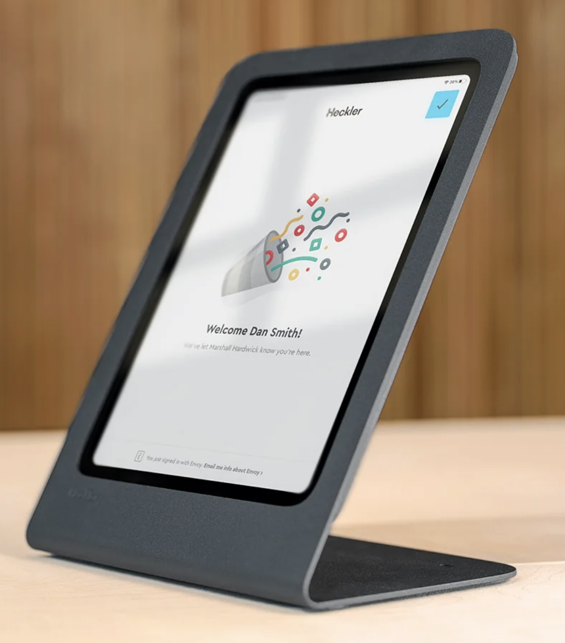
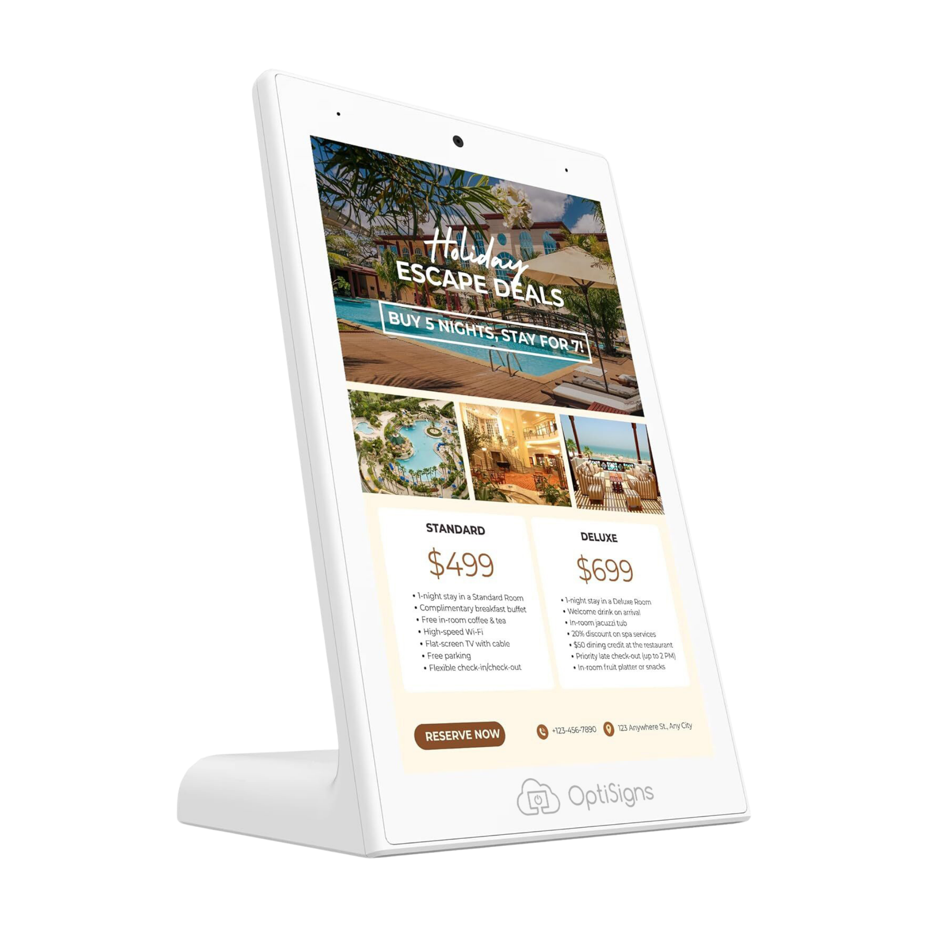
04 | PROGRAMMING
Give people a reason to come….and to buy
LITTLE WING AFTER DARK
POS MARKETING
(+) 2x/month
mobile displays
Transition from weekly evening programming to curated events twice per month. Programming that brings people into the door:
Blossom Martini × La Colombe Pop-Up
Wine Wednesday (monthly)
Acoustic Music Night
Poetry & Spoken Word
Local Artist Showcase
Increase awareness with dynamic digital displays at key guest touchpoints (front desk & Little Wing POS station)
Showcase Little Wing menu items and daily specials.
Highlight upcoming events and resident programming.
Promote seasonal offerings and limited-time products.
Notes:
This is lever two in detail, and these are Toast actuals for the trailing twelve months. The increases land on our highest-volume items. Coffee and tea drinks are 20,000 units a year and 53 percent of menu sales, so the fifty-cent lift there is by far the highest-leverage move — the latte alone is nearly 5,700 units. Sandwiches are 3,550 units at a twelve-dollar-plus average, so a dollar there adds up. Little Wing already prices as a specialty cafe, above Starbucks, which is the right position for a captive trade area with no nearby competitor; the lift preserves that position rather than testing it. Starbucks food isn't a real comp — their sandwich is a small grab-and-go item next to our full sandwich.

Slide 14
05 | P&L
The go-forward plan
 | 2026 ACT/FOR | 2026 MODIFIED · 8/1 GO-LIVE | 2027 PLAN
Total income | $288.7K | $314.9K | $370.9K
Cost of goods sold | $104.6K | $103.8K | $112.3K
Labor | $170.3K | $155.5K | $131.2K
Prime cost | $274.9K | $259.2K | $243.6K
Operating profit | $13.8K | $55.6K | $127.3K
Operating expenses | $112.4K | $109.1K | $111.4K
Management fee | $48.0K | $34.2K | $14.8K
Rent / occupancy | $17.4K | $9.7K | $0
NET OPERATING PROFIT | ($164.0K) | ($97.4K) | +$1.0K
OWNER TERMS — DECIDED
4% management fee replaces the $48K flat fee
Rent waived (was 6% of revenue)
All levers live 8/1/2026 — actuals through June untouched
THE RESULT
Full-year loss ELIMINATED — from ($164K) to a $1.0K profit
Combined with Vessel (+$54.2K), the portfolio turns positive in 2027: +$82.4K
IMMEDIATE IMPACT — AUG 1 THROUGH YEAR-END
($1.2K) with the changes vs ($67.8K) with no changes → +$66.6K in five months
Notes:
FY26 versus the go-forward P&L. Two placeholders drive this page and both get replaced with the Toast actuals: current retail set at 40% of plan ($25.5K), reclassed out of cafe lines to avoid double-counting, and the modeled PM mix behind the 75.8% capture. The structural moves are unchanged either way — labor +$95.7K, owner terms +$53.4K — and the swing from FY26 is roughly +$150K.

Slide 15
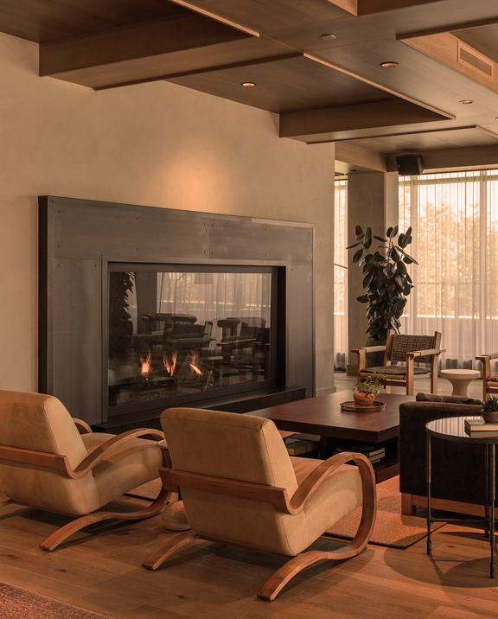
ROOST BALTIMORE
Vessel
July 2026
Notes:
Now to Vessel — our event venue in the same building, upstairs from the cafe. It has been priced by the room with no real floor, staffed ad hoc, and it's been booking events that lose money once you account for the disruption to the building. We're making a few strategic changes to protect margin on every booking: set a floor, standardize the package, and take fewer, better events.

Slide 16
EVENT TERMS
Economic restructure
PLACEHOLDER
01
02
03
04
F&B minimum
Service charge + admin fee
Food markup
Fewer, better events
$4,000
20% + 5%
40%
Cut the tail
PER 4-HOUR EVENT · WAS NONE
≈ $1,000 ON THE MINIMUM
ON ALL EVENT FOOD
EVENTS THAT LOSE ON TRAFFIC
Replaces open-ended, no-minimum bookings
Guarantees revenue before a room is staffed
Applied to food & beverage
Covers the standard service labor; admin fee covers 3% commission payout + 2% credit card processing fees
Standard markup on catered menus
Protects food margin on every plate
Drop low-value bookings that net a loss
Notes:
Four commercial changes. First, an F&B minimum — Vessel had none, so a room could book for almost nothing; now it's four thousand dollars against four hours. Second, a 20 percent service charge, which is roughly eight hundred on that minimum and covers service labor. Third, a flat 40 percent markup on all event food to protect the plate. And fourth, we take fewer, better events — some bookings actually lose money once you account for the traffic and disruption they create in the building, so we cut that tail.

Slide 17
LABOR MODEL
Price labor within a standard event package
PLACEHOLDER
EVERY EVENT INCLUDES
1 bartender + 2 servers
CONFIRM THE SOP
Hourly labor above the standard needs sign-off
$35 / hour × 5-hour shift × 3 staff
$525
No extra shifts or hours are committed to an event until they're approved in writing.
per event · baked into event pricing
Anything beyond the standard is special consideration — the additional labor is billed through to the client, not absorbed.
Brad
Michael
approve above-standard labor
Notes:
And a standard staffing package so every event is priced the same way. Every event includes one bartender and two servers, at thirty-five an hour for a five-hour shift — that's five hundred and twenty-five dollars of labor, baked into the event price. Anything beyond that standard is special consideration and the additional labor is billed through to the client. The one thing we need to confirm is the SOP: any hourly labor above the standard package needs written sign-off before it's committed — Brad or Michael.

Slide 18
06 | P&L — VESSEL
The go-forward plan
 | 2026 ACT/FOR | 2026 MODIFIED · PHASED GO-LIVE | 2027 PLAN
Total income | $352.0K | $354.8K | $350.1K
Cost of goods sold | $122.9K | $122.9K | $136.3K
Labor | $80.0K | $80.0K | $60.7K
Prime cost | $203.0K | $203.0K | $197.0K
Operating profit | $149.0K | $151.8K | $153.1K
Operating expenses | $93.2K | $81.8K | $52.0K
Management fee | $48.0K | $33.1K | $14.0K
Rent / occupancy | $21.3K | $13.8K | $0
NET OPERATING PROFIT | ($13.5K) | +$23.1K | +$87.1K
EVENT TERMS — DECIDED
$4,000 F&B minimum · ~75 events/yr (71% of run-rate — fewer, better events) · 24.9% NOI margin per event
20% service charge + 5% admin fee billed to clients — admin fee is income, covering 3% commission + 2% CC processing
Fees, rent waiver & expense targets live 8/1/2026 · client-billed 5% admin fee live 9/1 (August events contracted at old terms)
THE RESULT
Vessel swings from a ($13.5K) year to +$87.1K in 2027
IMMEDIATE IMPACT — AUG 1 THROUGH YEAR-END
+$45.5K with the changes vs +$9.0K with no changes → +$36.6K by year-end

Slide 19
CONSOLIDATED | P&L
Current, modified & 2027 — both outlets
 | 2026 ACT/FOR | 2026 MODIFIED · 8/1 GO-LIVE | 2027 PLAN
Total income | $640,667 | $669,636 | $720,967
Cost of goods sold | $227,562 | $226,693 | $248,612
Gross profit | $413,105 | $442,943 | $472,355
Labor | $250,304 | $235,512 | $191,929
Operating expenses | $205,587 | $190,925 | $163,440
Management fee | $96,000 | $67,293 | $28,838
Rent / occupancy | $38,722 | $23,522 | $0
NET OPERATING PROFIT | ($177,508) | ($74,309) | $88,148
BY OUTLET — NOP
Little Wing: ($164,007) → ($97,361) → +$1,034 — turns profitable
Vessel: ($13,501) → +$23,052 → +$87,114 (fees 8/1 · client billing 9/1)
THE SWING
($177,508) today to +$88,148 in 2027 — a $265,656 turnaround, every lever tied to the operating model
IMMEDIATE IMPACT — AUG 1 THROUGH YEAR-END
+$103,199 combined by year-end (Little Wing +$66,646 · Vessel +$36,553) vs no changes

Slide 20
CONSOLIDATED | P&L
2027 by month
 | JAN | FEB | MAR | APR | MAY | JUN | JUL | AUG | SEP | OCT | NOV | DEC | FY 2027
Revenue | $74,005 | $44,166 | $74,005 | $44,166 | $64,059 | $60,081 | $60,081 | $60,081 | $60,081 | $60,081 | $60,081 | $60,081 | $720,967
Cost of goods | $26,138 | $14,523 | $26,138 | $14,523 | $22,266 | $20,718 | $20,718 | $20,718 | $20,718 | $20,718 | $20,718 | $20,718 | $248,612
Labor cost | $18,722 | $13,550 | $18,722 | $13,550 | $16,998 | $16,309 | $16,309 | $16,309 | $16,309 | $16,309 | $16,309 | $12,532 | $191,929
Prime cost | $44,860 | $28,073 | $44,860 | $28,073 | $39,265 | $37,026 | $37,026 | $37,026 | $37,026 | $37,026 | $37,026 | $33,250 | $440,541
Operating profit | $29,145 | $16,093 | $29,145 | $16,093 | $24,794 | $23,054 | $23,054 | $23,054 | $23,054 | $23,054 | $23,054 | $26,831 | $280,426
Controllable expenses | $12,974 | $9,285 | $12,974 | $9,285 | $11,744 | $11,252 | $11,252 | $11,252 | $11,252 | $11,252 | $11,252 | $11,252 | $135,029
Uncontrollable expenses | $5,675 | $3,737 | $5,675 | $3,737 | $5,029 | $4,771 | $4,771 | $4,771 | $4,771 | $4,771 | $4,771 | $4,771 | $57,249
NET OPERATING PROFIT | $10,496 | $3,071 | $10,496 | $3,071 | $8,021 | $7,031 | $7,031 | $7,031 | $7,031 | $7,031 | $7,031 | $10,807 | $88,148
Vessel + Little Wing, all levers in effect. ALL twelve months profitable — worst month +$3,071. Vessel scaled to ~75 events at the $1,157-NOP/event card (24.9% margin). Uncontrollable expenses include the 4% management fee; rent waived.
YOY IMPROVEMENT — NET OPERATING PROFIT (2026 w/ changes live 8/1 LW · 9/1 Vessel → 2027)
• Little Wing: ($97,361) → +$1,034 · +$98,395 year over year — turns profitable
• Vessel: +$23,052 → +$87,114 · +$64,062 year over year
• Combined: ($74,309) → +$88,148 · +$162,457 year over year — a $265,656 swing vs the no-changes baseline of ($177,508)

