Slide 1
CONSOLIDATED | P&L
Current, modified & 2027 — both outlets
 | 2026 ACT/FOR | 2026 MODIFIED · 8/1 GO-LIVE | 2027 PLAN
Total income | $640,667 | $666,691 | $777,113
Cost of goods sold | $227,562 | $236,312 | $304,446
Gross profit | $413,105 | $430,379 | $472,667
Labor | $250,304 | $235,512 | $201,838
Operating expenses | $205,587 | $191,218 | $188,385
Management fee | $96,000 | $67,175 | $31,085
Rent / occupancy | $38,722 | $23,522 | $0
NET OPERATING PROFIT | ($177,508) | ($87,048) | $51,360
BY OUTLET — NOP
Little Wing: ($164,007) → ($110,721) → ($30,024)
Vessel: ($13,501) → +$23,673 → +$81,385
THE SWING
($177,508) today to +$51,360 in 2027 — a $228,868 turnaround, with every lever tied to the operating model
IMMEDIATE IMPACT — AUG 1 THROUGH YEAR-END
+$90,460 combined in five months (Little Wing +$53,286 · Vessel +$37,174) vs no changes

Slide 2
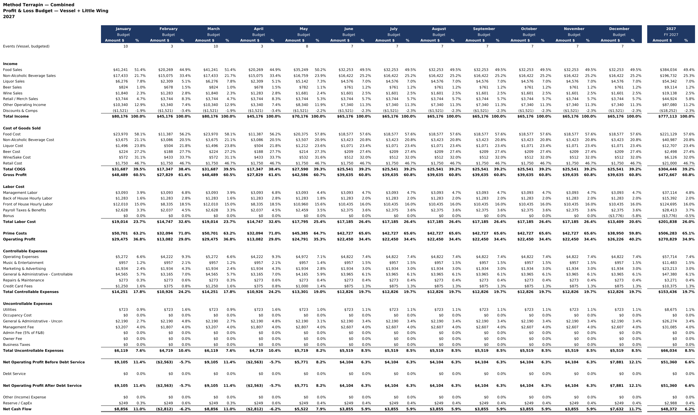
CONSOLIDATED | P&L
2027 by month
 | JAN | FEB | MAR | APR | MAY | JUN | JUL | AUG | SEP | OCT | NOV | DEC | FY 2027
Revenue | $80,176 | $45,176 | $80,176 | $45,176 | $70,176 | $65,176 | $65,176 | $65,176 | $65,176 | $65,176 | $65,176 | $65,176 | $777,113
Cost of goods | $31,687 | $17,347 | $31,687 | $17,347 | $27,590 | $25,541 | $25,541 | $25,541 | $25,541 | $25,541 | $25,541 | $25,541 | $304,446
Labor cost | $19,014 | $14,747 | $19,014 | $14,747 | $17,795 | $17,185 | $17,185 | $17,185 | $17,185 | $17,185 | $17,185 | $13,409 | $201,838
Prime cost | $50,701 | $32,094 | $50,701 | $32,094 | $45,385 | $42,727 | $42,727 | $42,727 | $42,727 | $42,727 | $42,727 | $38,950 | $506,283
Operating profit | $29,475 | $13,082 | $29,475 | $13,082 | $24,791 | $22,450 | $22,450 | $22,450 | $22,450 | $22,450 | $22,450 | $26,226 | $270,829
Controllable expenses | $14,251 | $10,926 | $14,251 | $10,926 | $13,301 | $12,826 | $12,826 | $12,826 | $12,826 | $12,826 | $12,826 | $12,826 | $153,436
Uncontrollable expenses | $6,119 | $4,719 | $6,119 | $4,719 | $5,719 | $5,519 | $5,519 | $5,519 | $5,519 | $5,519 | $5,519 | $5,519 | $66,034
NET OPERATING PROFIT | $9,105 | ($2,563) | $9,105 | ($2,563) | $5,771 | $4,104 | $4,104 | $4,104 | $4,104 | $4,104 | $4,104 | $7,881 | $51,360
Vessel + Little Wing, all levers in effect. Ten of twelve months profitable — the Feb/Apr dips are Vessel’s 3-event months. Monthly shape follows the Vessel event calendar over Little Wing’s flat run-rate. Uncontrollable expenses include the 4% management fee; rent waived.

