Slide 1
HDTV in StreamIT:
A Case Study
Andrew A. Lamb
MIT
Laboratory for Computer Science
Computer Architecture Group
(8/2/2002)

Slide 2
Resources/Acknowledgements
ATSC (Advanced Television Systems Committee) Standard A53, revision B (HDTV standard)
Vanu PowerPoint presentation on their HDTV implementation

Slide 3
Outline
“Cultural” Overview
Reed-Solomon
Convolutional Interleaving
Trellis Coding/Viterbi Decoding

Slide 4
HDTV
HDTV == ATSC A53 rev. B standard
Spec was created by “Digital HDTV Grand Alliance”
  AT&T (now Lucent Technologies), General Instrument, North American Philips, Massachusetts Institute of Technology, Thomson Consumer Electronics, the David Sarnoff Research Center (now Sarnoff Corporation) and Zenith Electronics Corporation
  (http://www.atsc.org/history.html)

Slide 5
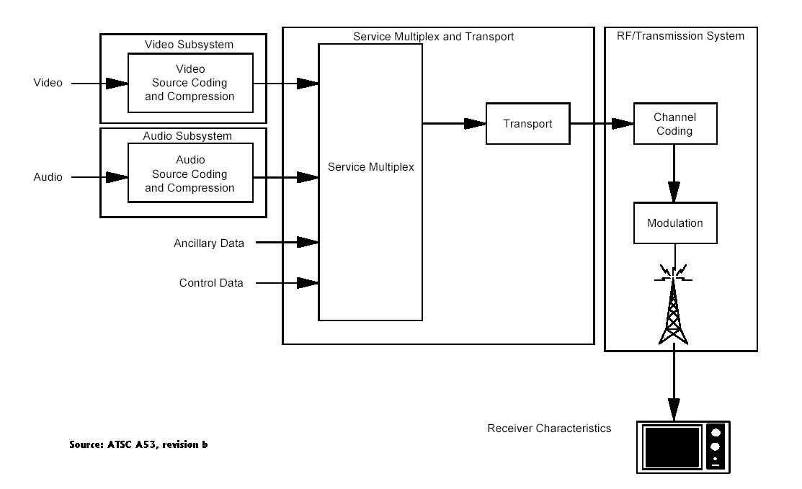
A53 Revision b

Slide 6
A53 Revision b (cont.)
A53b describes service multiplexing and transport along with channel coding.
ISO/IEC IS 13818-2, International Standard (1996) describes MPEG-2
A52a describes AC3 encoding
Doesn’t describe decoding.

Slide 7
A53 Revision b (cont.)
Channel coding has static rates.
Comes in 2 flavors
  8-VSB for terrestrial cable television
  16-VSB for satellite television
  (the 8 means that a transmitted symbol can take on 1 of 8 values.)
We focus on the channel encoding and decoding of 8-VSB.

Slide 8
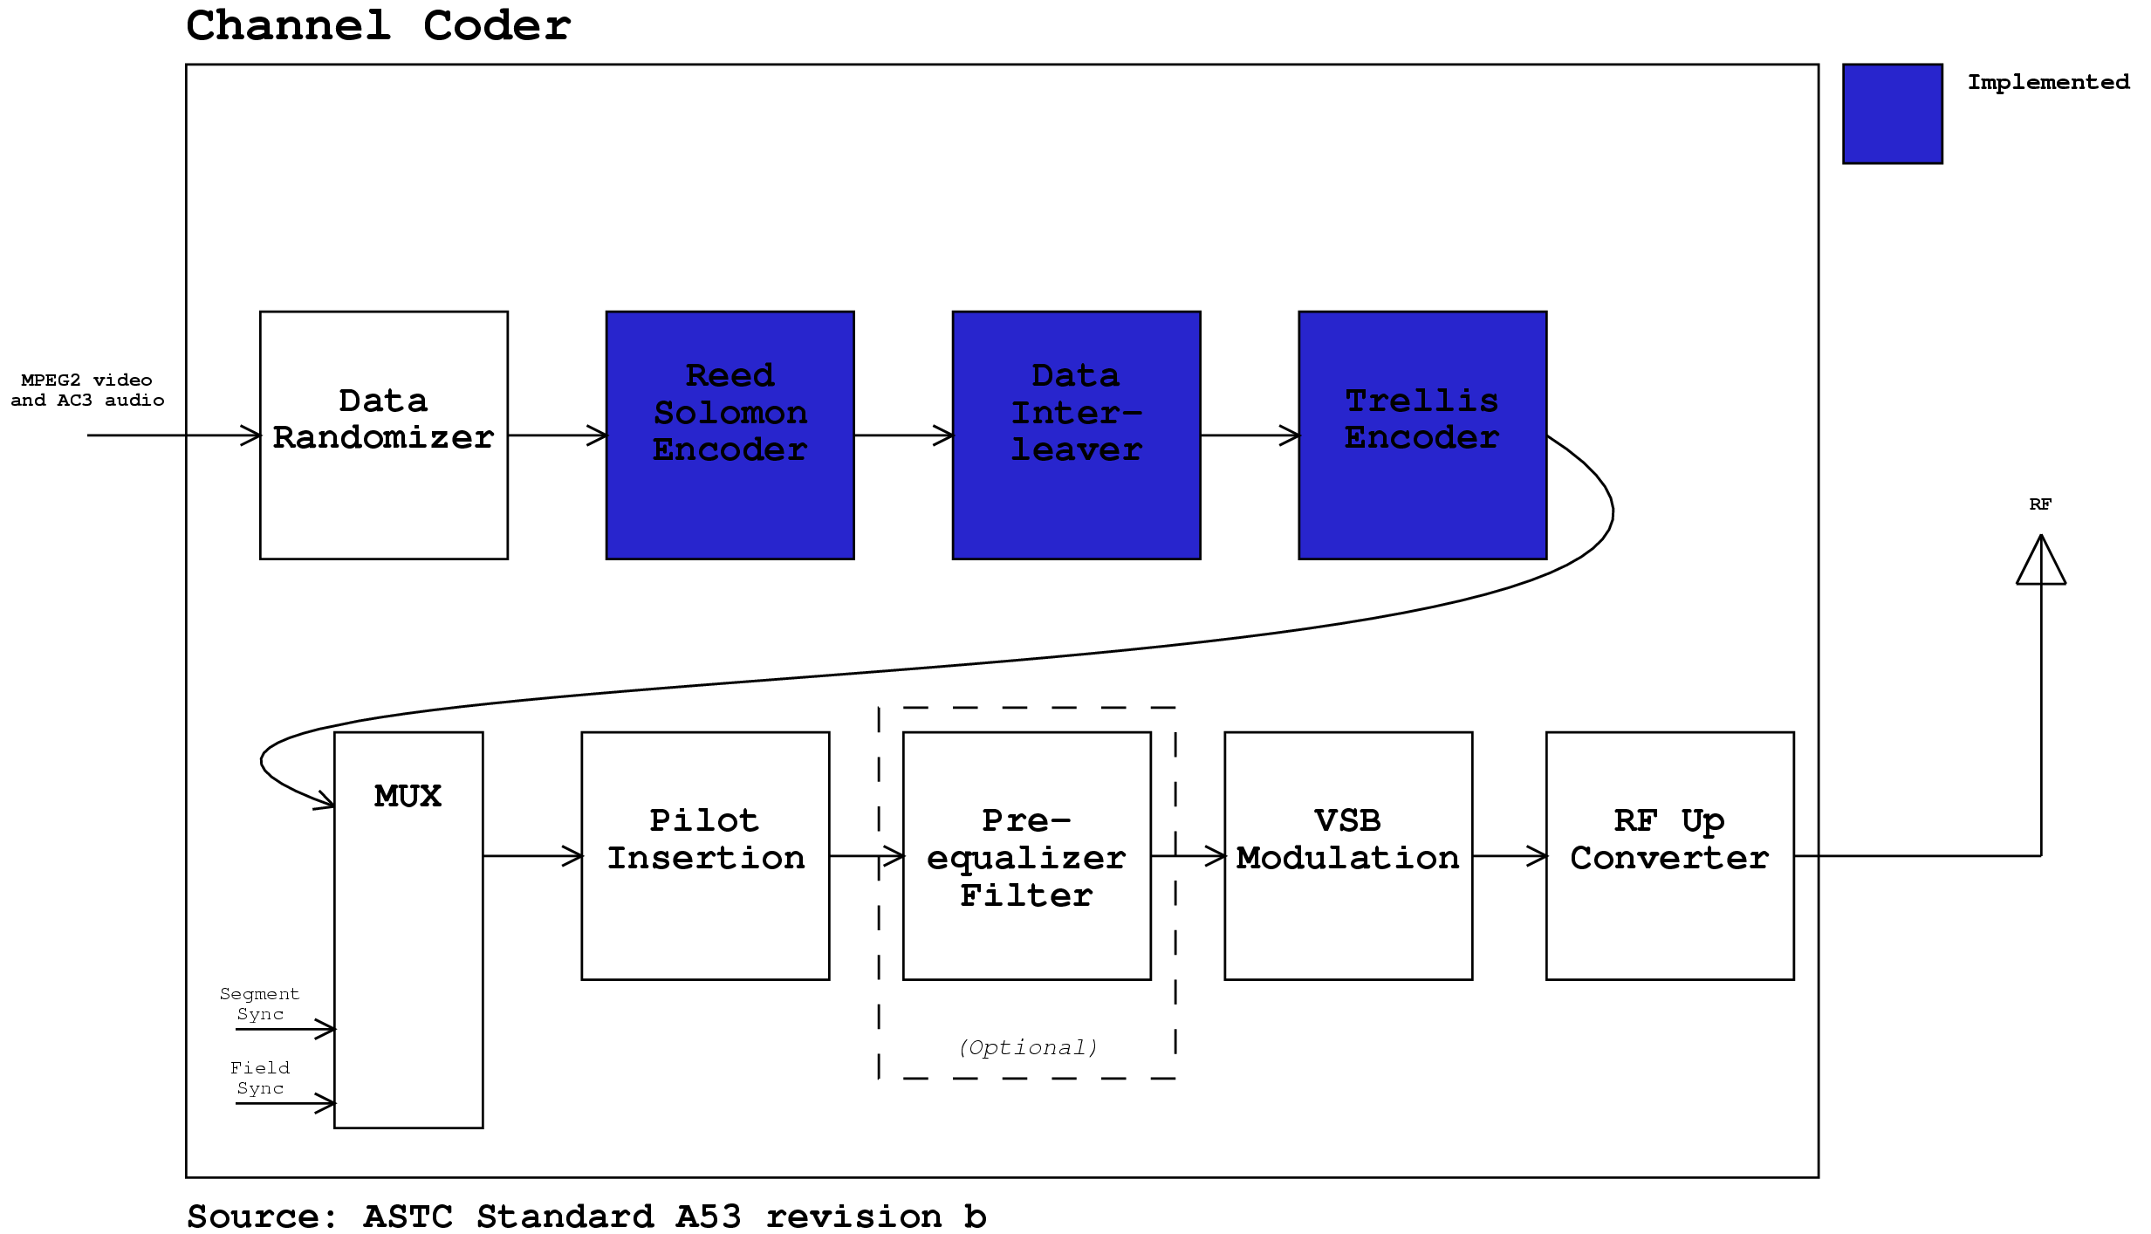
8-VSB Channel Coder

Slide 9
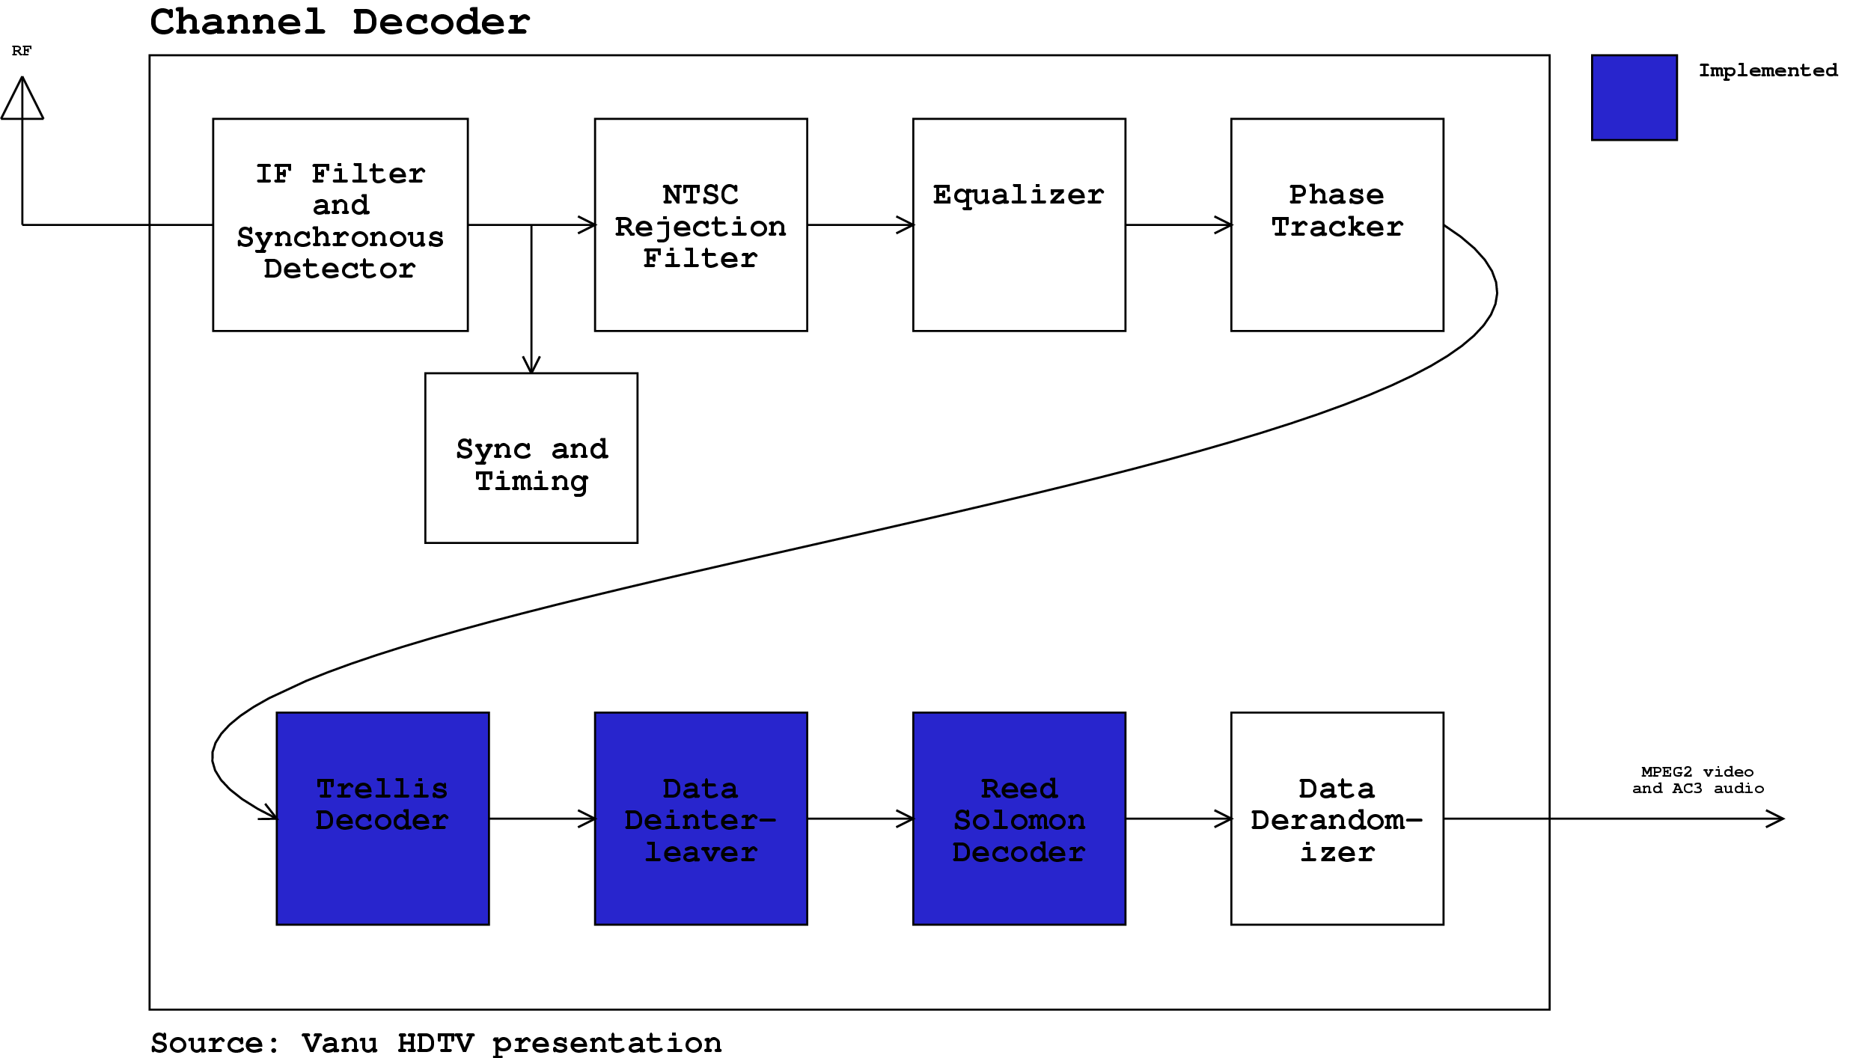
8-VSB Channel Decoder

Slide 10
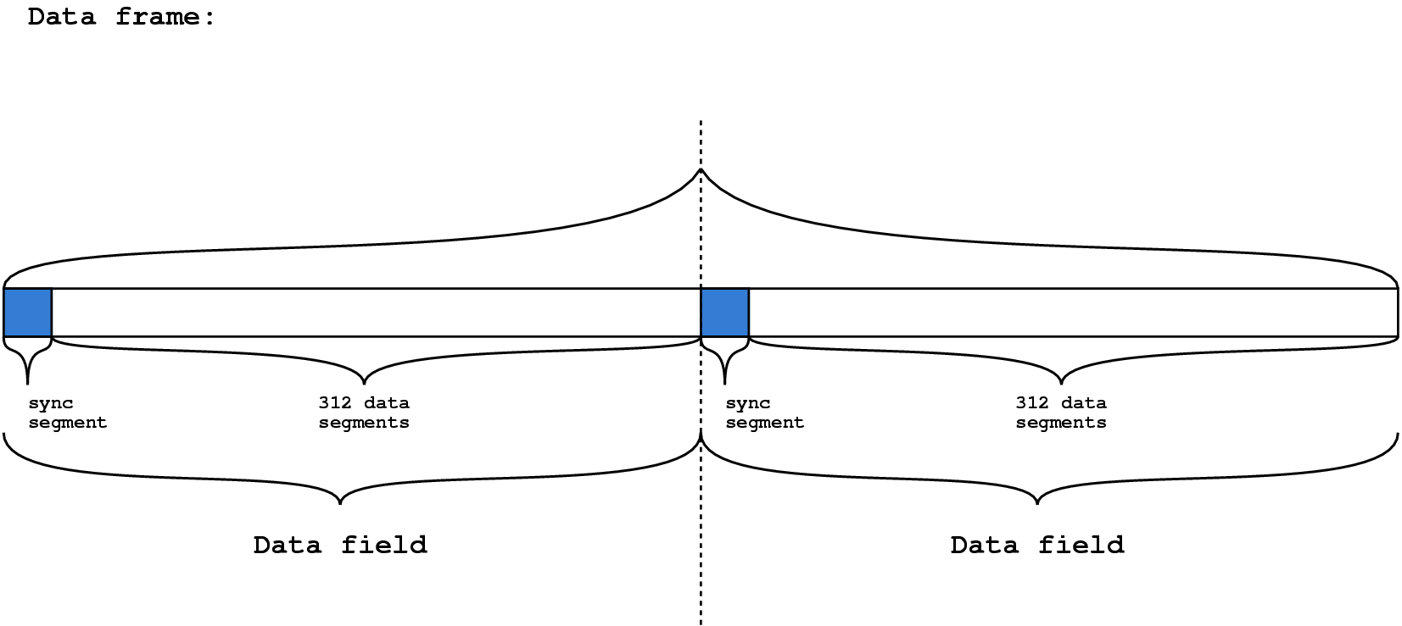
Data rates
Data frame = 2 data fields, each with 313 segements (1 sync, 312 data)

Slide 11
Data rates (cont.)
Each data segment encodes 188 bytes of MPEG-2 stream (1 sync, 187 data).
Transmitted as 828 8 level symbols
+20 parity bytes
187 data bytes 207 bytes
207 bytes 1656 bits
1656 bits 2484 bits
2484 bits 828 symbols
8 bits per byte
2/3 trellis encoder
3 bits/symbol

Slide 12
Outline
“Cultural” Overview
Reed-Solomon
Convolutional Interleaving
Trellis Coding/Viterbi Decoding

Slide 13
Reed-Solomon Codes
Also in CDs, Cellphones, ADSL, DVD, etc.
FEC (forward error correction)
(eg it appends parity symbols to data symbols)
Irving S. Reed and Gustave Solomon (researchers at Lincoln Labs) published original paper in SIAM, 1960.
(http://www.siam.org/siamnews/mtc/mtc193.htm)

Slide 14
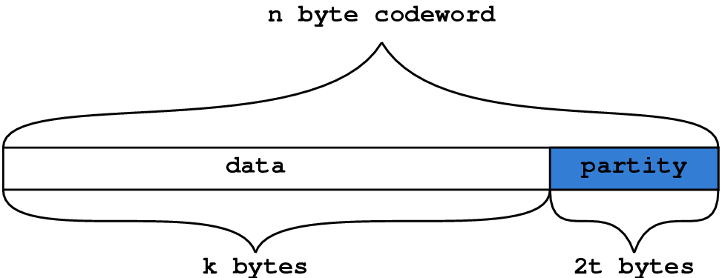
Reed-Solomon Codes (cont.)
Specified as RS(n,k)
Takes k symbols of data and produces an n symbol codeword (e.g. it adds n-k parity symbols)
Can correct up to t symbol errors, where 2t = n-k

Slide 15
StreamIT Implementation
Copied rscode, an open source RS implementation
(written by Henry Minsky, formerly of the AI lab)
Converted the rscode from c to Java and fooled with fields.
Works, and corrects artificially introduced errors as promised.
http://rscode.sourceforge.net/

Slide 16
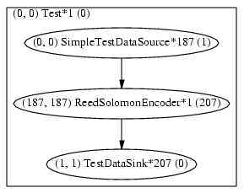

RS Stream Graphs
Monolithic, coarse grained implementation.

Slide 17
StreamIt Implemention Notes
Both the encoder and decoder have the same code b/c you can’t share static code among streams.
It was fairly straightforward for the c to Java conversion – nice feature for migrating existing applications.

Slide 18
Outline
“Cultural” Overview
Reed-Solomon
Convolutional Interleaving
Trellis Coding/Viterbi Decoding

Slide 19
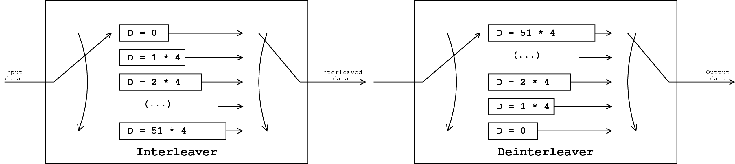
Convolutional Interleaver
Spreads a burst of channel errors out in space over encoded data.

Slide 20
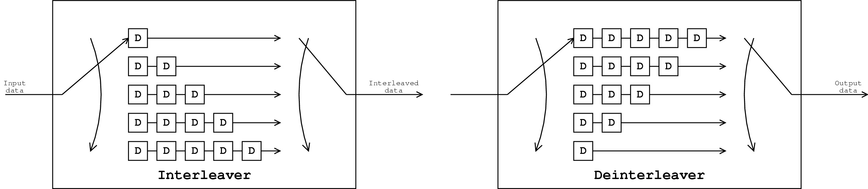
Delay
I found it easier to understand the convolutional interleaver this way:
Need to “prime” with 30 elements.

Slide 21
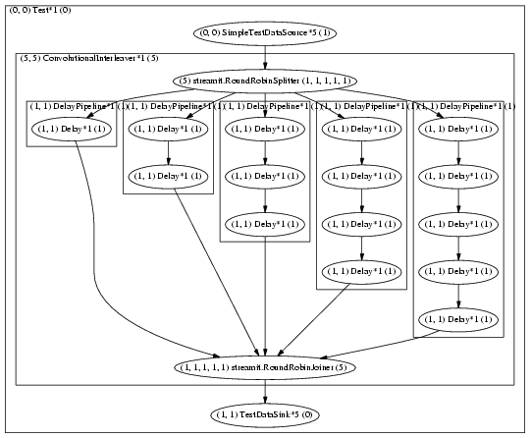
Interleaver Stream Graph

Slide 22
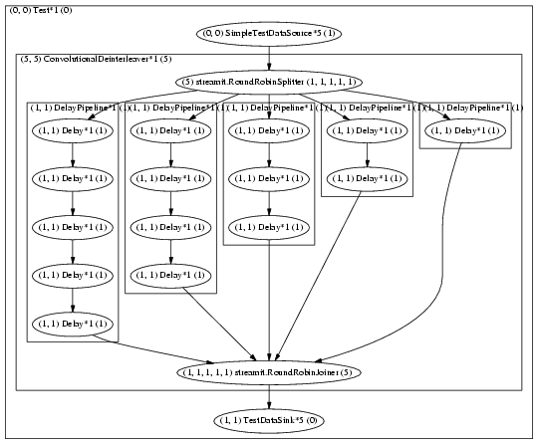
Deinterleaver Stream Graph

Slide 23
StreamIt Implemention Notes
The stream graphs closely resembles the block diagram, which is good.
It was very easy, once we figured out what a convolutional interleaver did, to implement in StreamIt.
No way to ignore first 30 elements

Slide 24
Outline
“Cultural” Overview
Reed-Solomon
Convolutional Interleaving
Trellis Coding/Viterbi Decoding

Slide 25
Trellis Encoding
In HDTV, the trellis encoder is a convolution encoder followed by a symbol mapper.
This provides good noise immunity (somehow)
HDTV encoder uses 12 trellis coders in parallel

Slide 26
Convolution Encoding
Input is an m bit symbol
Output is an n bit symbol
m/n is the rate (HDTV uses 2/3)
K is the reach: the number of output symbols that each input symbol affects (HDTV has K=3)

Slide 27
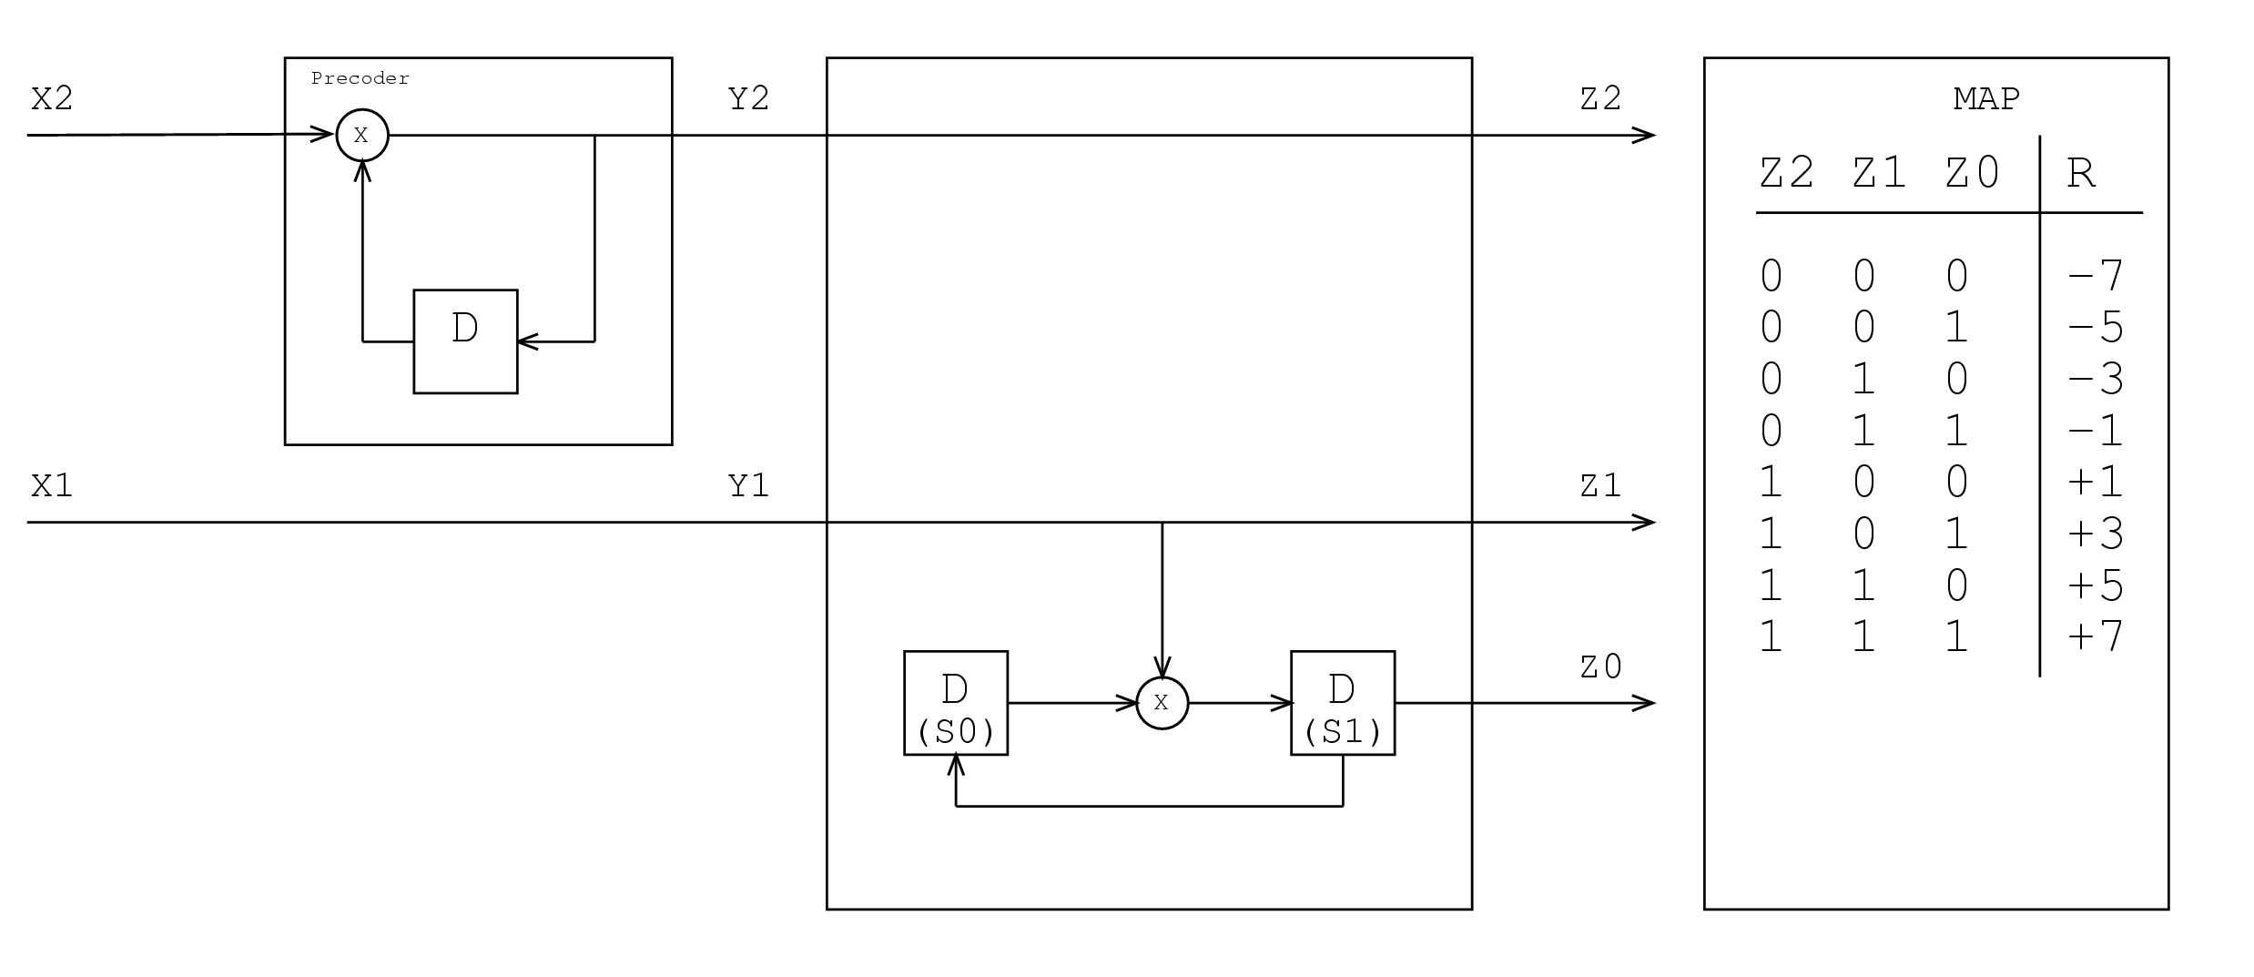
Trellis Encoding (cont.)
Trellis Encoder used in HDTV
“pre-coder”
“ungerboeck encoder”
Source: ATSC standard A53, revision b

Slide 28
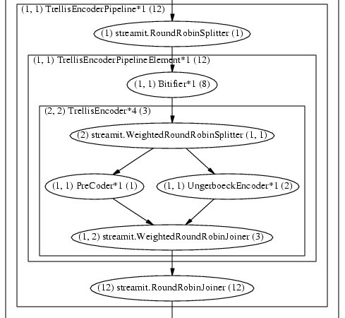
Trellis Encoder Stream Graph

Slide 29
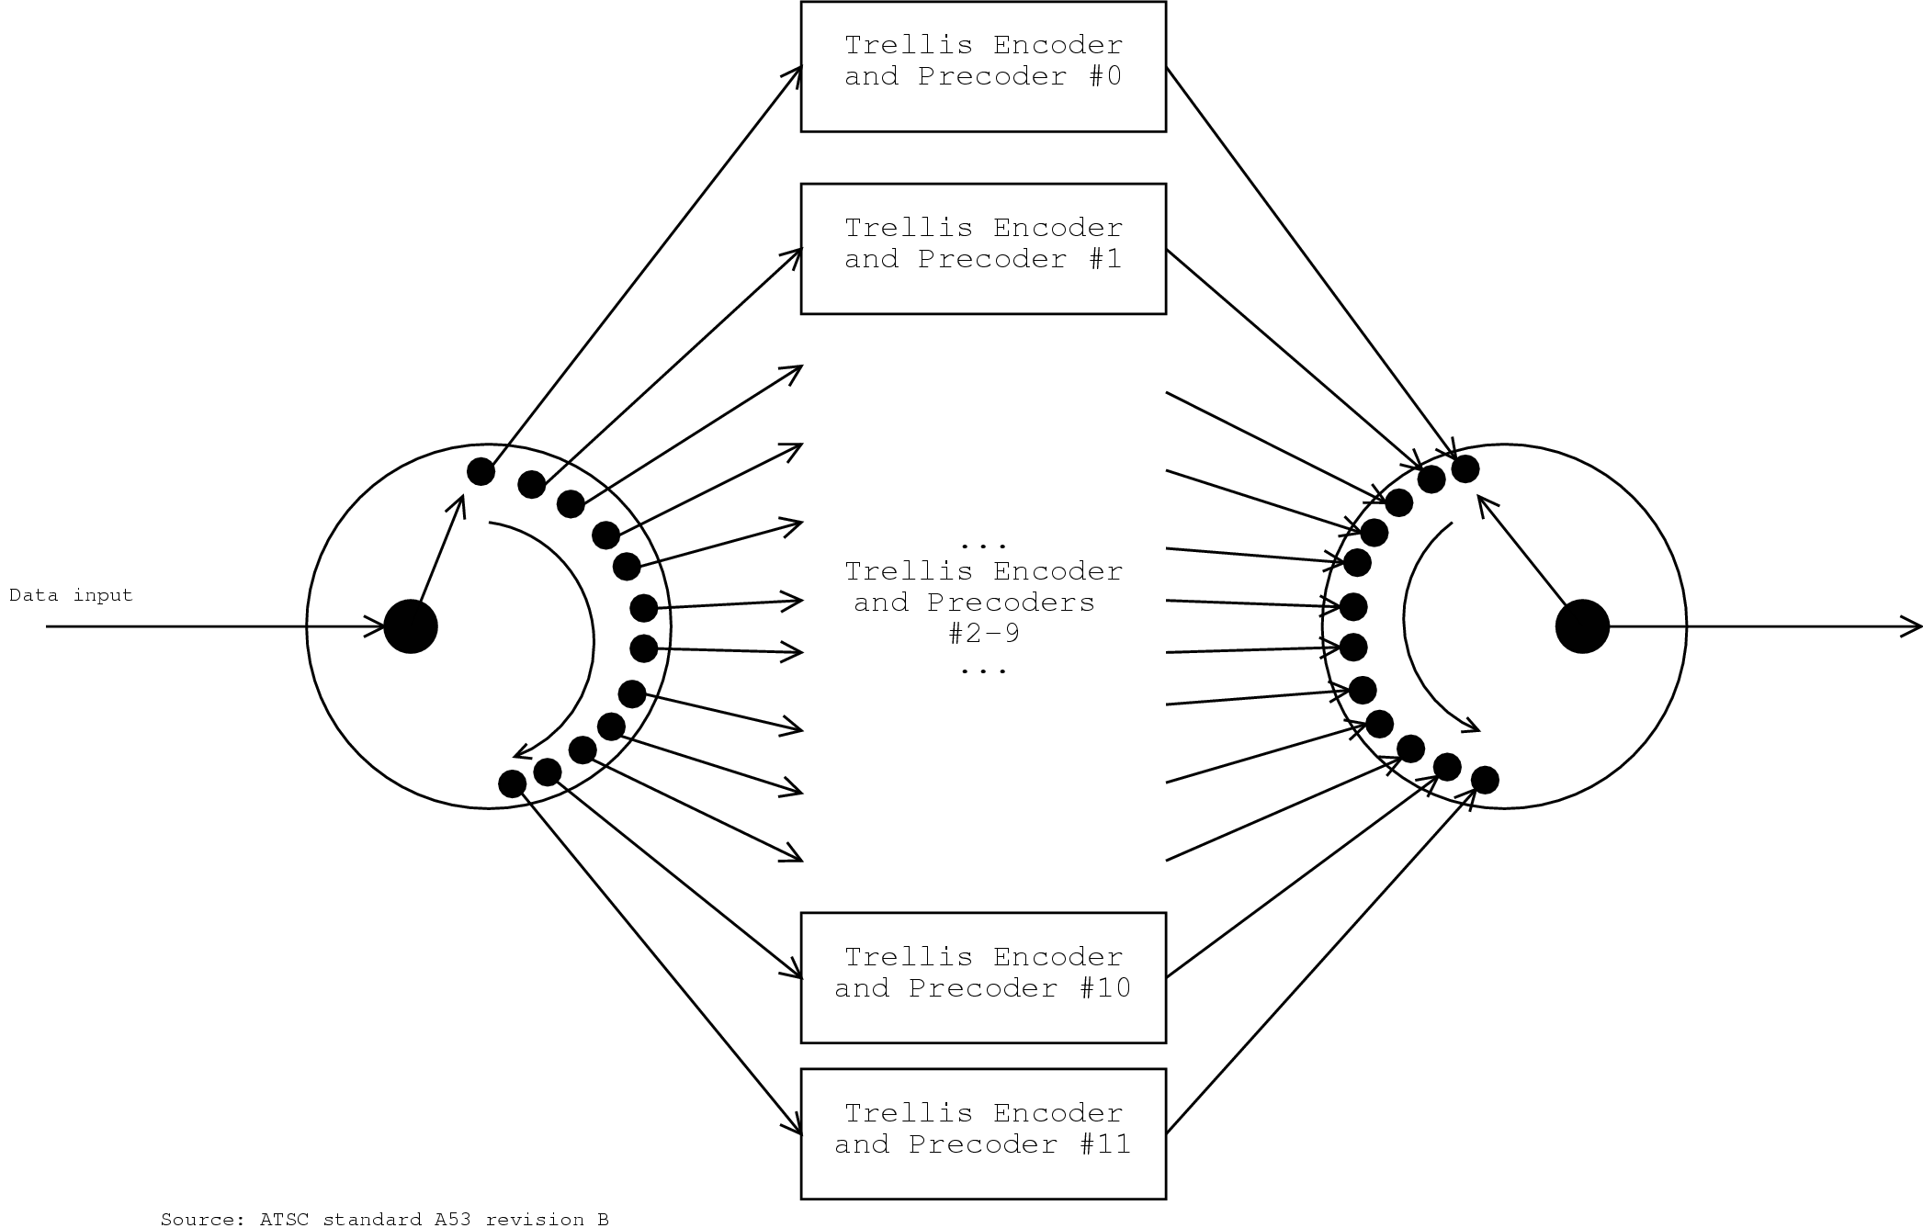
Trellis Encoding (cont.)
12 Trellis Encoders
Source: ATSC standard A53, revision b

Slide 30

Trellis Split-Join Stream Graph

Slide 31
Trellis Decoding
Not specified by A53b, I chose to use Viterbi decoding.
(after Andrew Viterbi, founder of Qualcomm. B.S., M.S. MIT ’57, PhD USC ’62. Also VI-A at Raytheon)
Uses a dynamic programming approach
Reads in a lot of input before producing a lot of output.
Not fine grained (currently?).

Slide 32
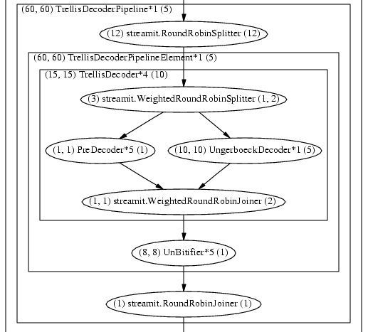
Trellis Decoder Stream Graph

Slide 33
StreamIt Implemention Notes
The stream graph is reasonably close to the block diagram. The Ungerboeck decoder (which implements the Viterbi algorithm) is monolithic.
The encoders are naturally written to operate on bits (implementation uses integers) and so it is very inefficient.

Slide 34
HDTV Decoder (again)

Slide 35
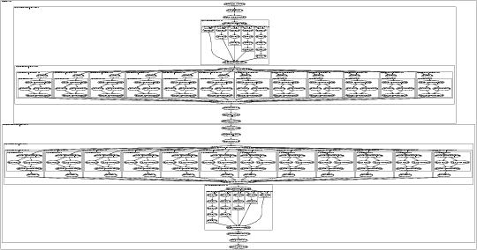
Whole Stream Graph

Slide 36
Source Code Comparison
 | StreamIT |  | Vanu
Block | Code lines | Total lines | Lines(?)
RS Encoder | 190 | 364 | (?)
RS Decoder | 195 | 367 | ~450
Interleaver | 41 | 83 | (?)
Deinterleaver | 49 | 83 | ~250
Trellis Encoder | 52 | 118 | (?)
Trellis Decoder | 207 | 417 | ~500
Randomizer(?) | — | — | ~210

