Slide 1
What is this “Viterbi Decoding”
Andrew A. Lamb
MIT
Laboratory for Computer Science
Computer Architecture Group

Slide 2
Trellis Encoder
Use Viterbi Algorithm to undo Convolution Coding (not signal symbol unmapping)
Two flavors of determining unmapping
  Hard: make a decision as to which symbol the received signal most closely matches.
  Soft: Assign weights to all symbols based on their respective likelihood given received signal
Viterbi implementation we present assumes a hard decision model.

Slide 3
State Machine/Trellis Encoding?
You can also represent the convolution encoder as a finite state machine
The possible state evolution of the convolution encoder trace out a “trellis” like structure in state-time space.

Slide 4
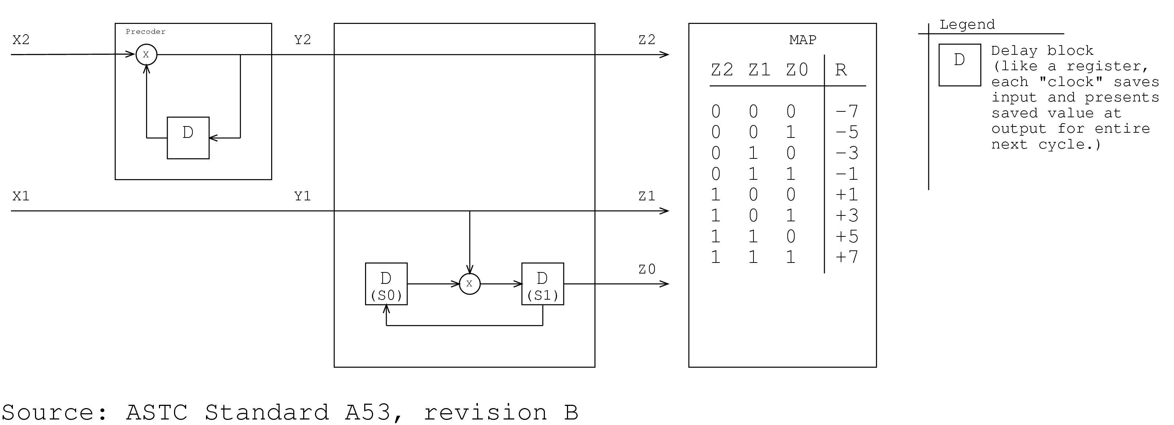
Convolutional Encoder

Slide 5
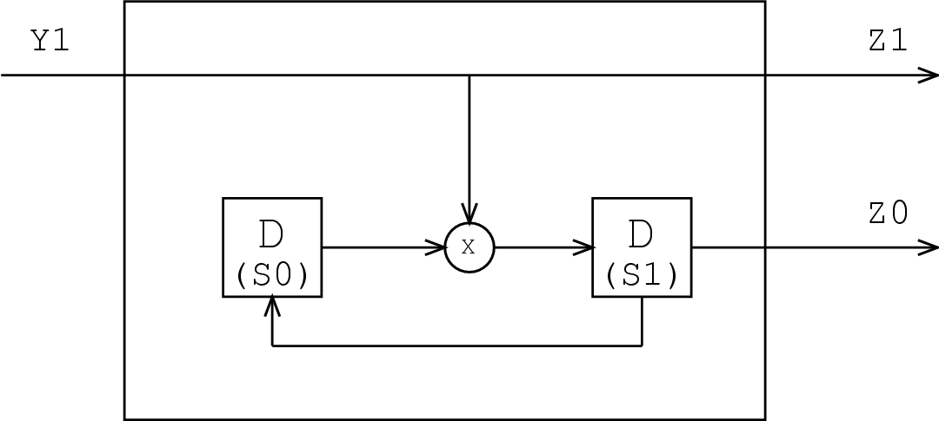
Interesting Part

Slide 6
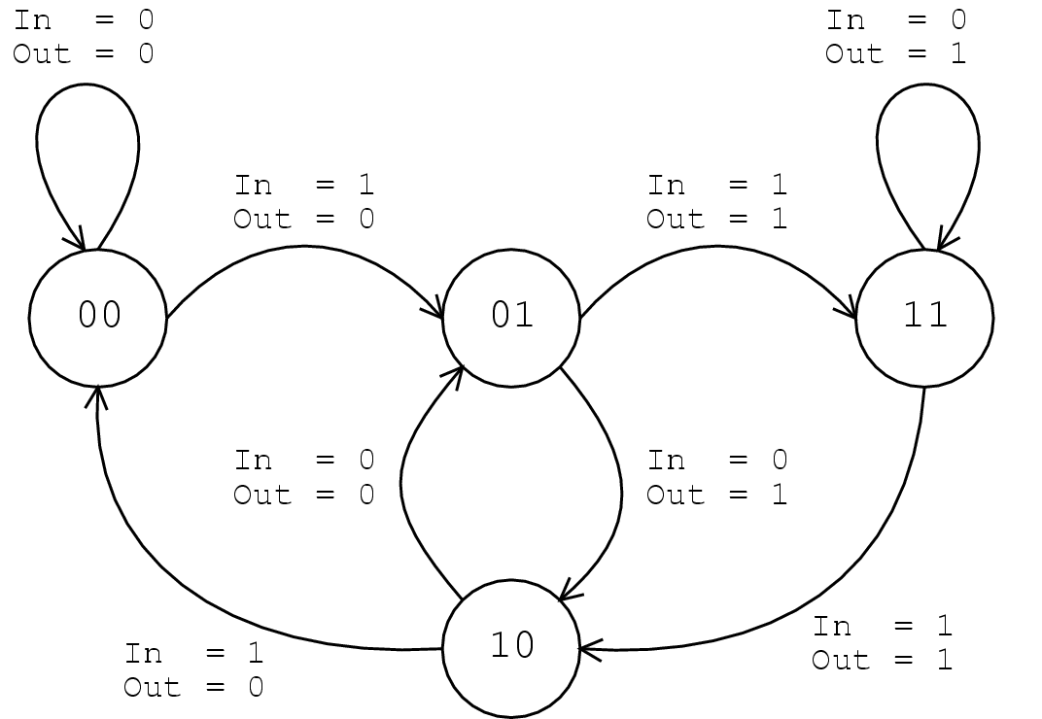
State Transition Diagram

Slide 7
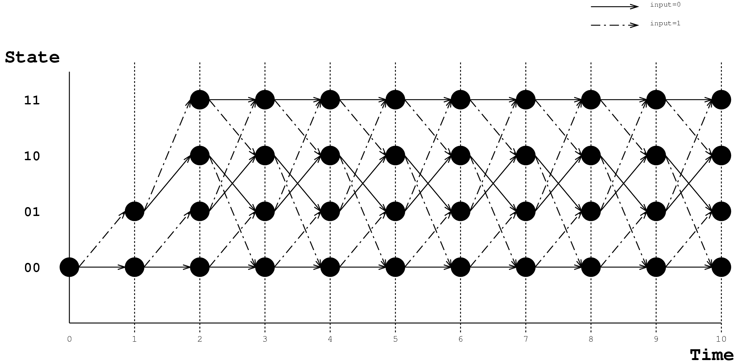
Trellis Diagram

Slide 8
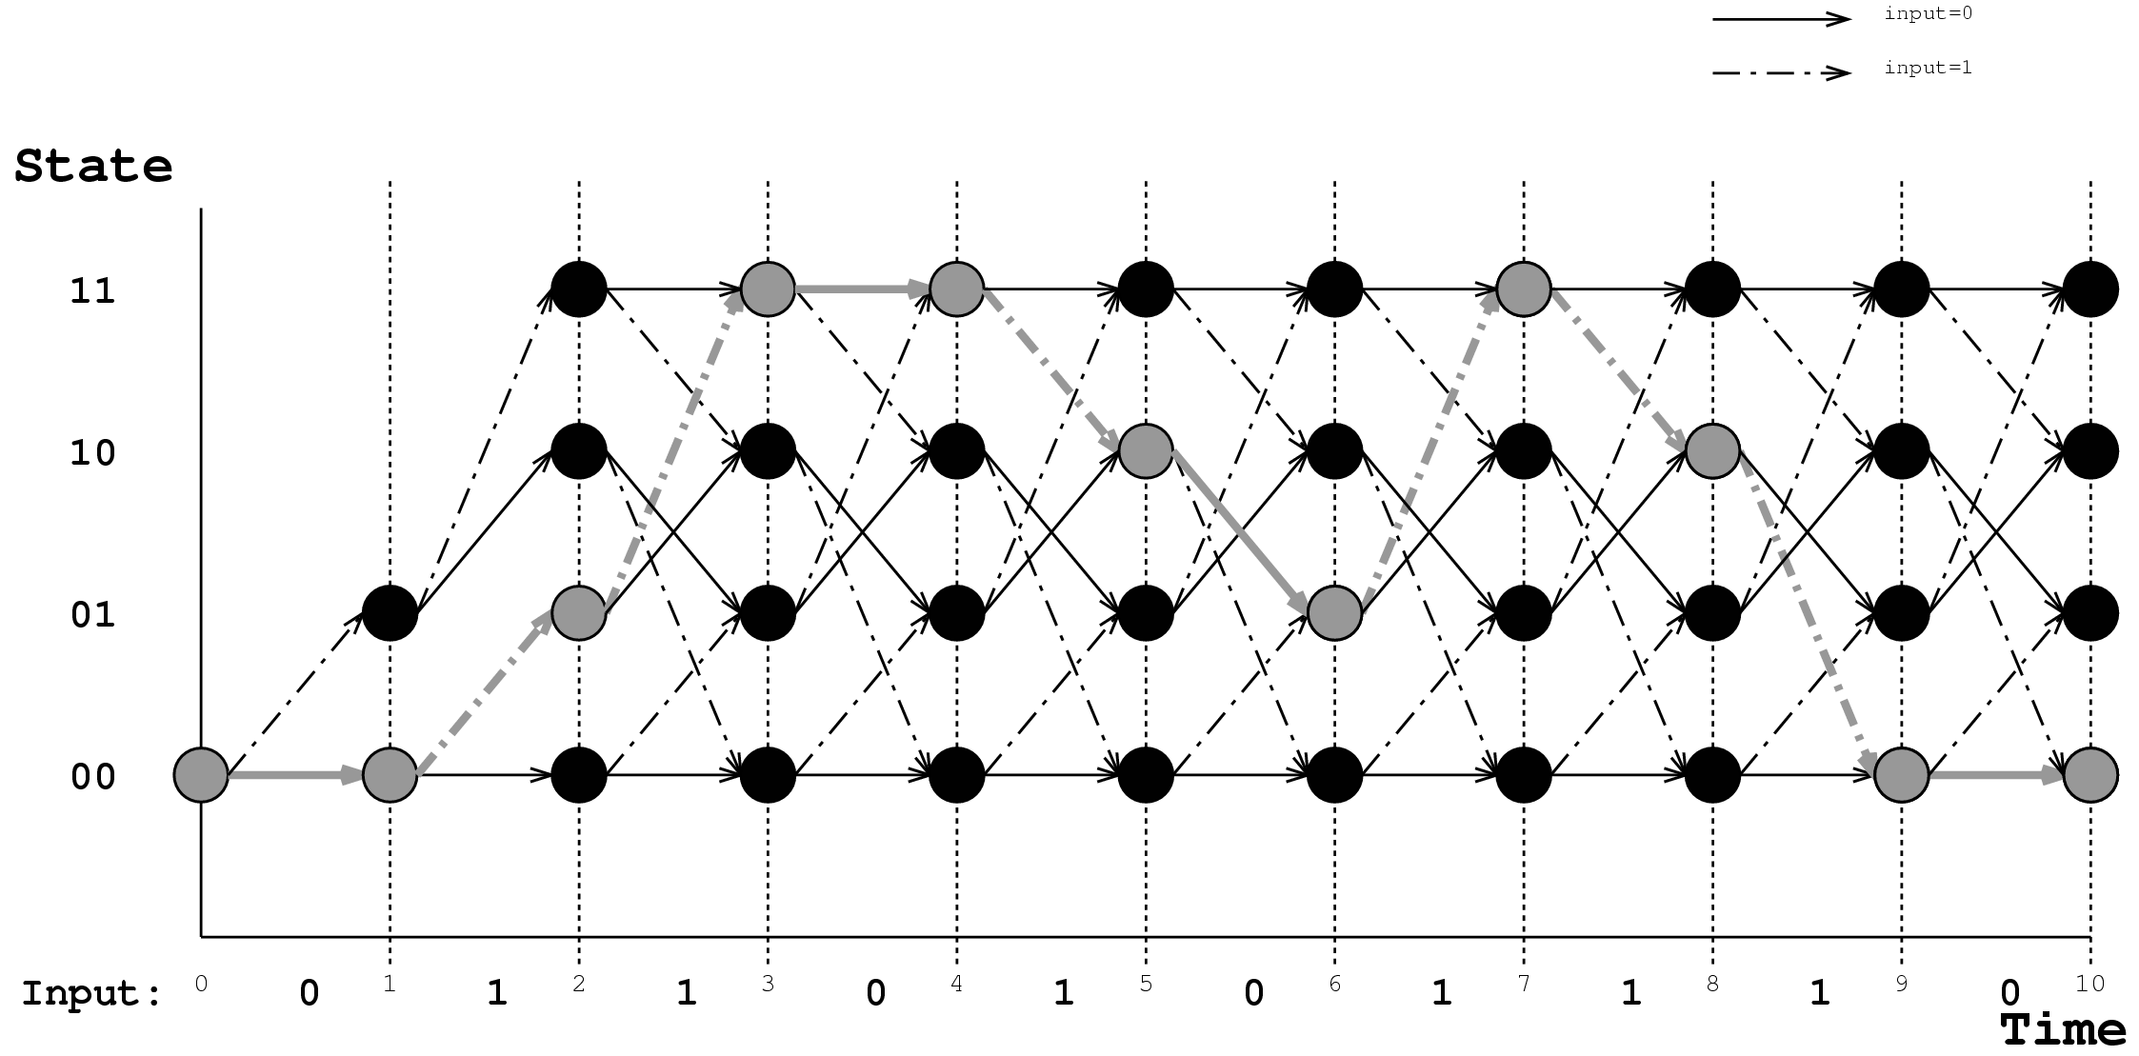
Trellis Paths
Each set of inputs traces a unique path through the trellis.
Input:
0110101110

Slide 9
Viterbi Decoding
The Viterbi algorithm:
  Given a sequence of received symbols, (that were produced by a convolution encoder)
  Determine what the input to the convolution encoder was
It does this by determining the most likely path through the trellis

Slide 10
Main Idea
Dynamic Programming
  Keep a table c[s,t] that records the number of bit errors that would have been produced if the encoder was in state s at time t.
  Also keep a table p[s,t] which records the state that the encoder would have been in at time t-1 if it were in state s at time t.

Slide 11
Filling out the tables
At time t, we receive the symbol R_{t}.
For each state s,
  Let q₀ and q₁ be the two possible previous states of s.
  Let e₀ be the error between Rt and q₀ s
  Let e₁ be the error between Rt and q₁ s
  c[s,t]← min(c[q₀,t-1]+e₀, c[q₁,t-1]+e₁)
  Update p[s,t] appropriately

Slide 12
Traceback
When the algorithm has examined T input symbols, it looks for the minimum entry among all states in c[s,T ].
Then the algorithm traces back through the trellis using the entries of p[s,t ].

Slide 13
Example
Input to Encoder:
  0110101110
Output of Encoder:
  00 10 11 01 11 00 11 11 10 00

Slide 14
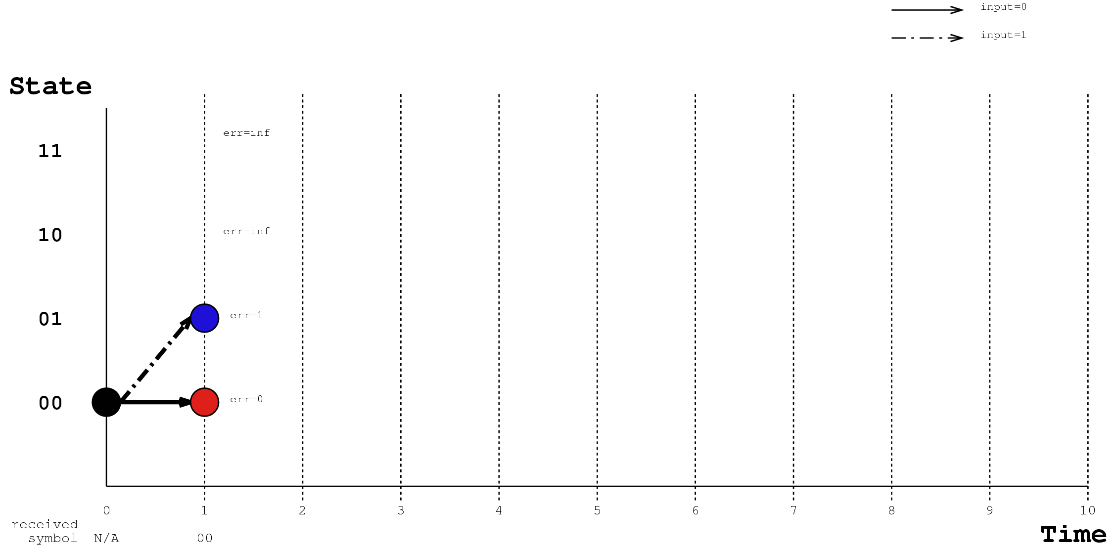
Decoder, time = 1

Slide 15
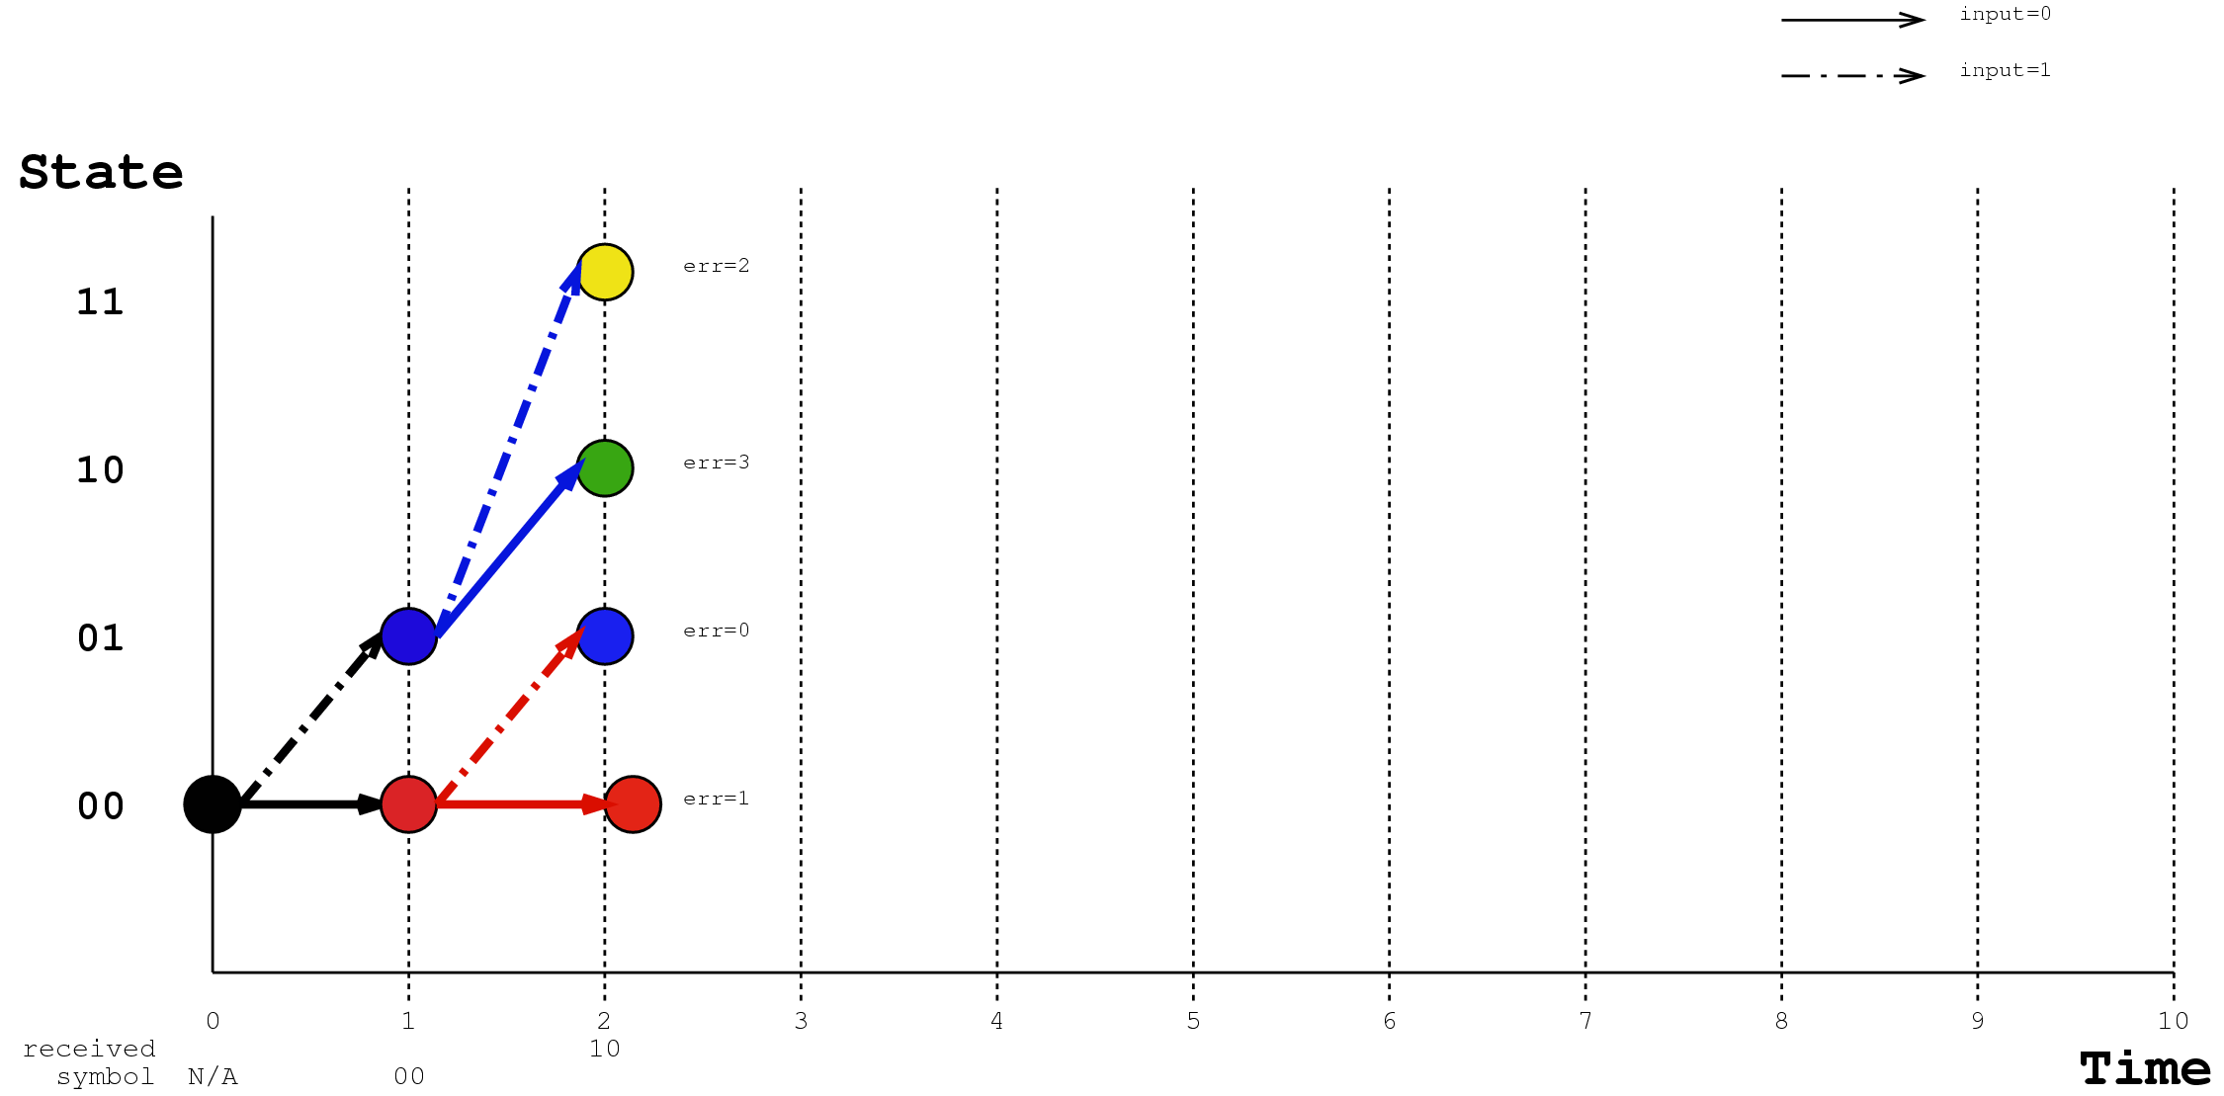
Decoder, time = 2

Slide 16
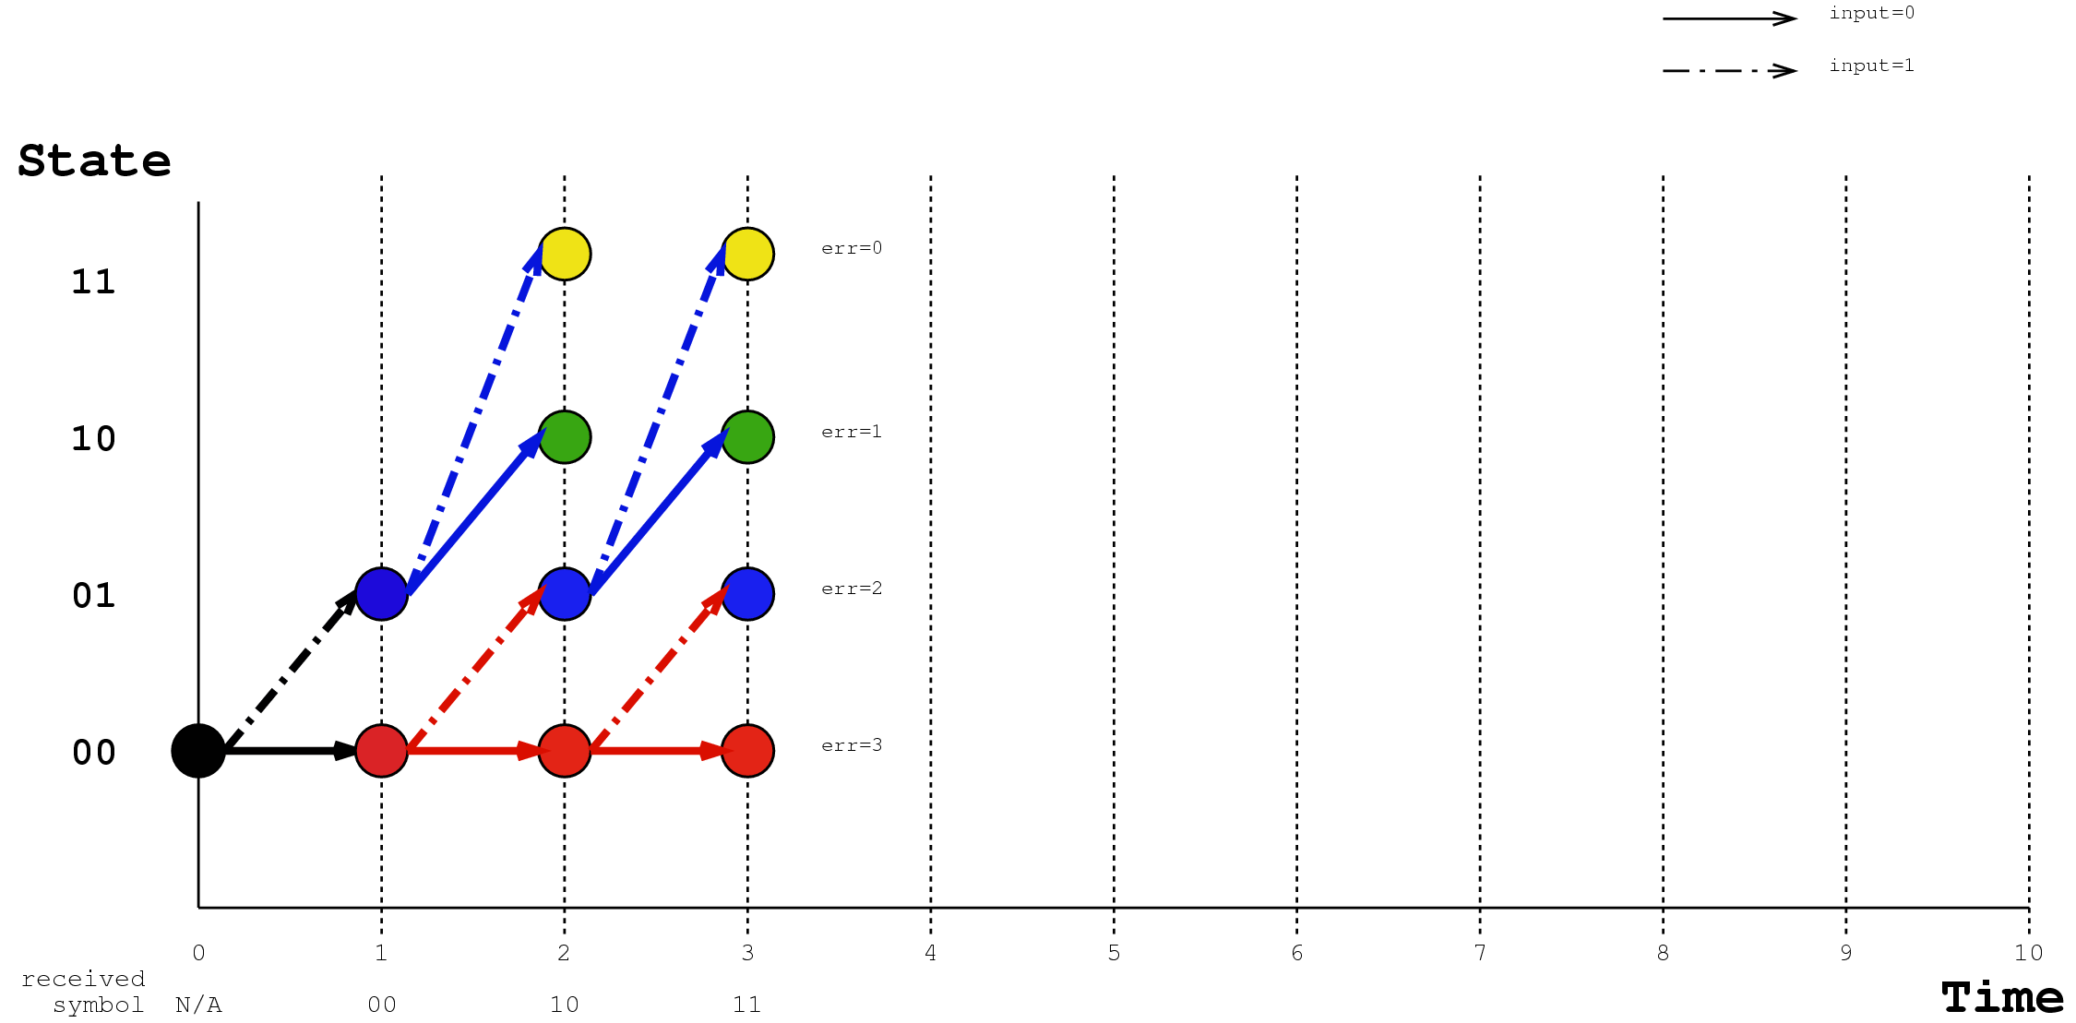
Decoder, time = 3

Slide 17
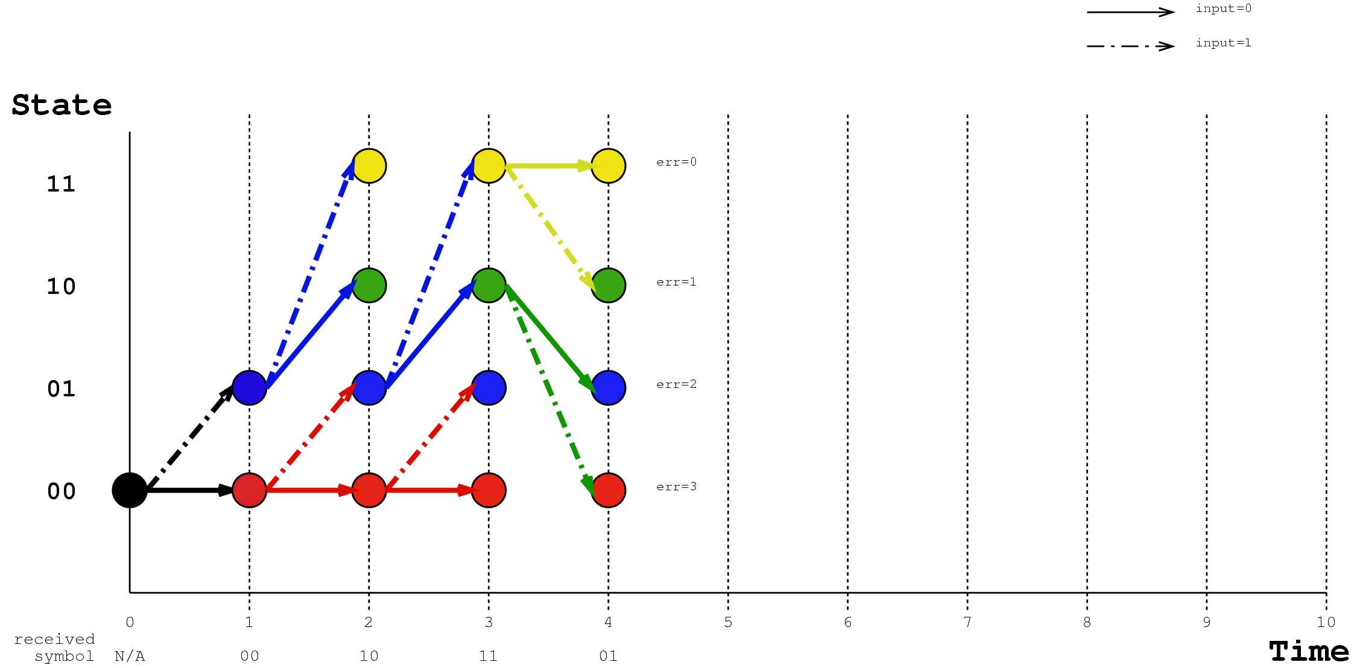
Decoder, time = 4

Slide 18
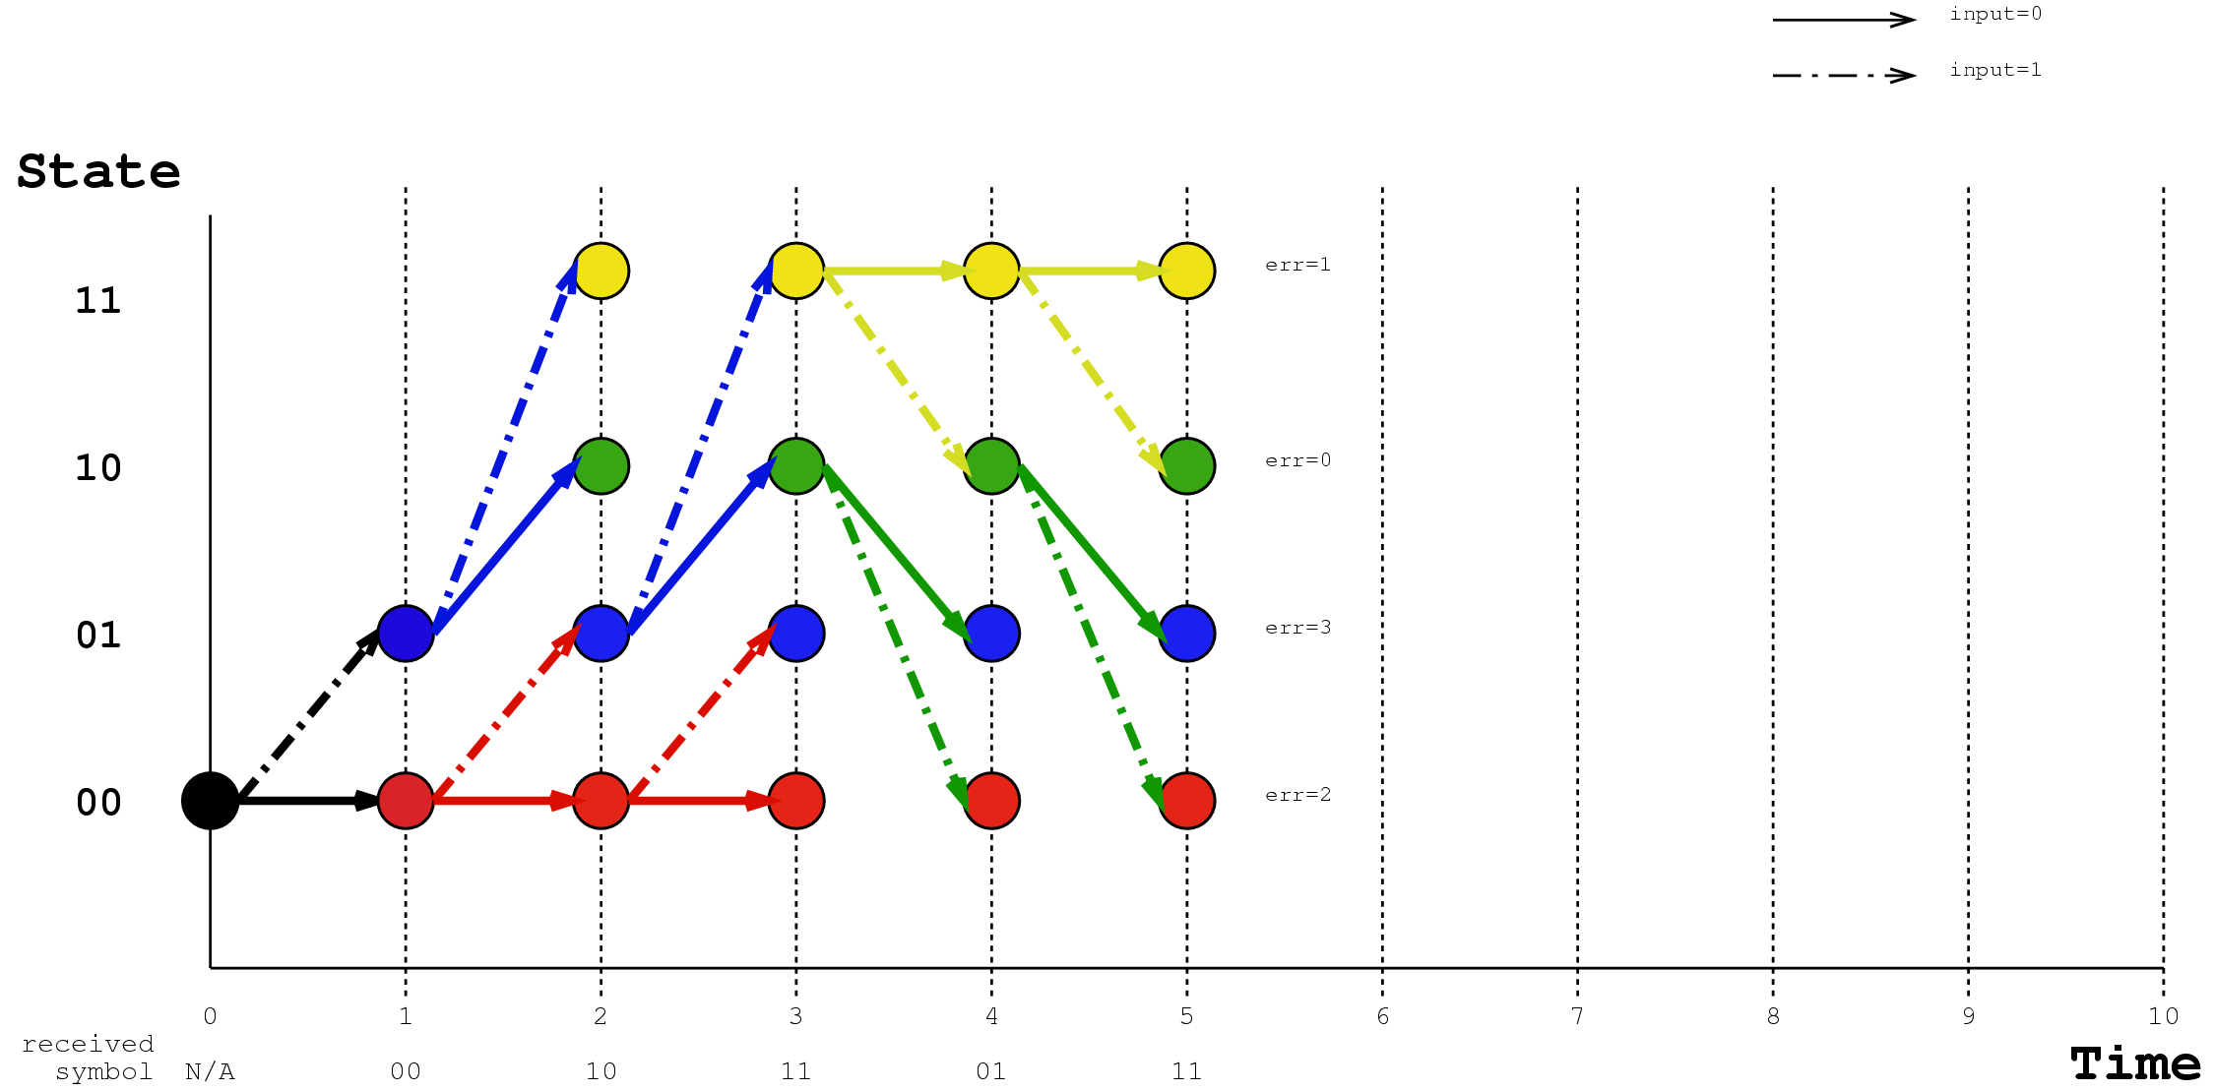
Decoder, time = 5

Slide 19
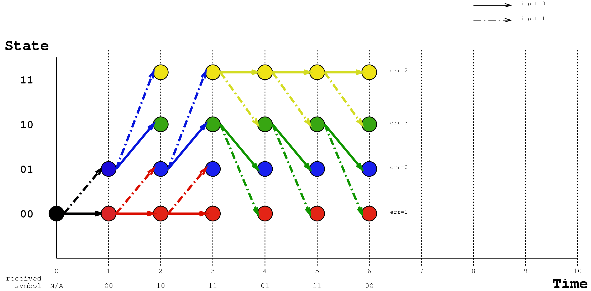
Decoder, time = 6

Slide 20
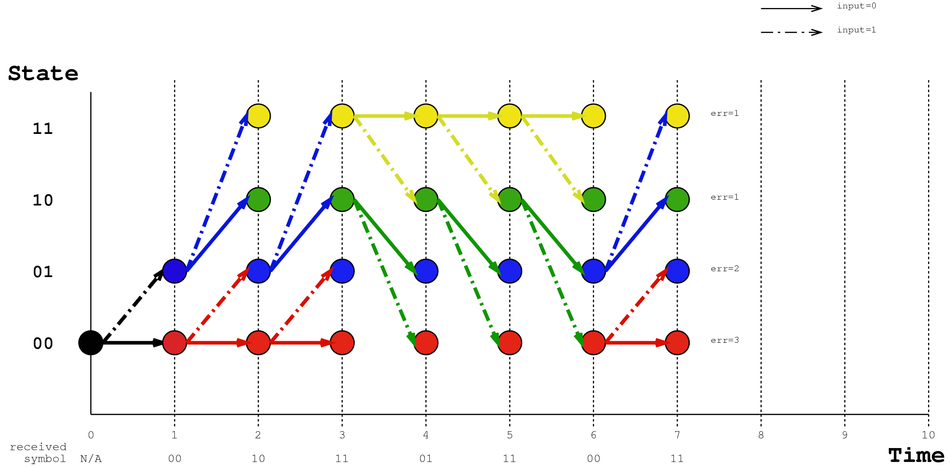
Decoder, time = 7

Slide 21
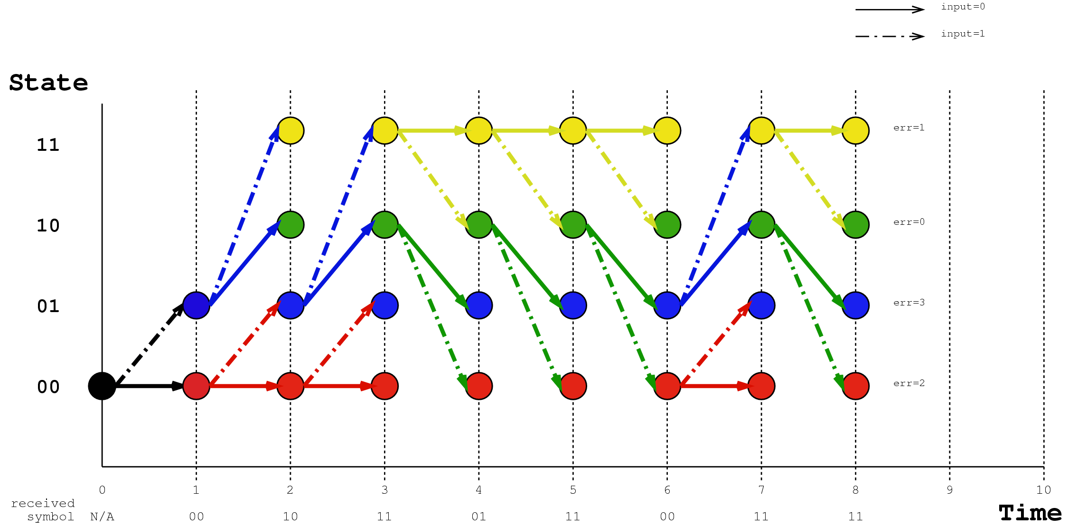
Decoder, time = 8

Slide 22
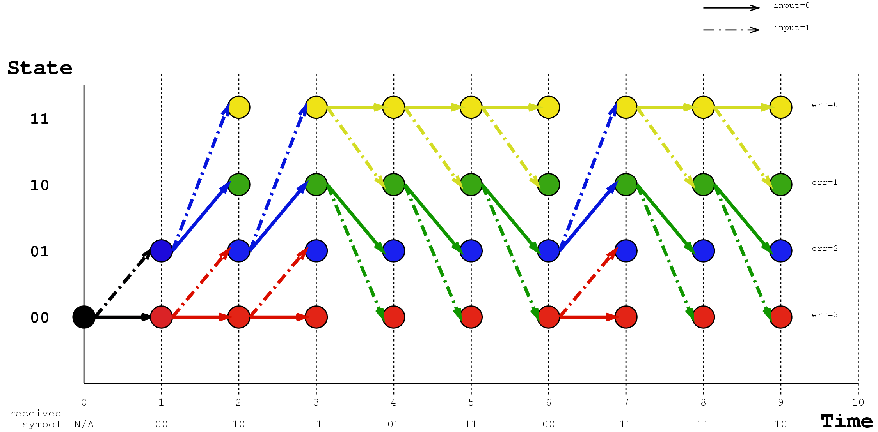
Decoder, time = 9

Slide 23
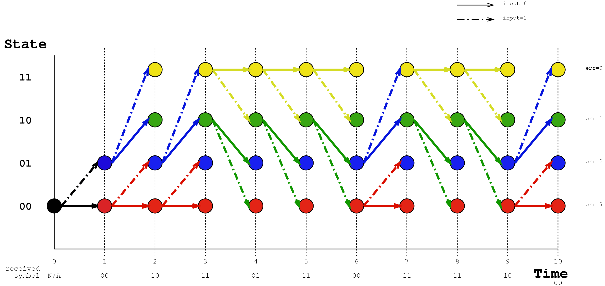
Decoder, time = 10

Slide 24
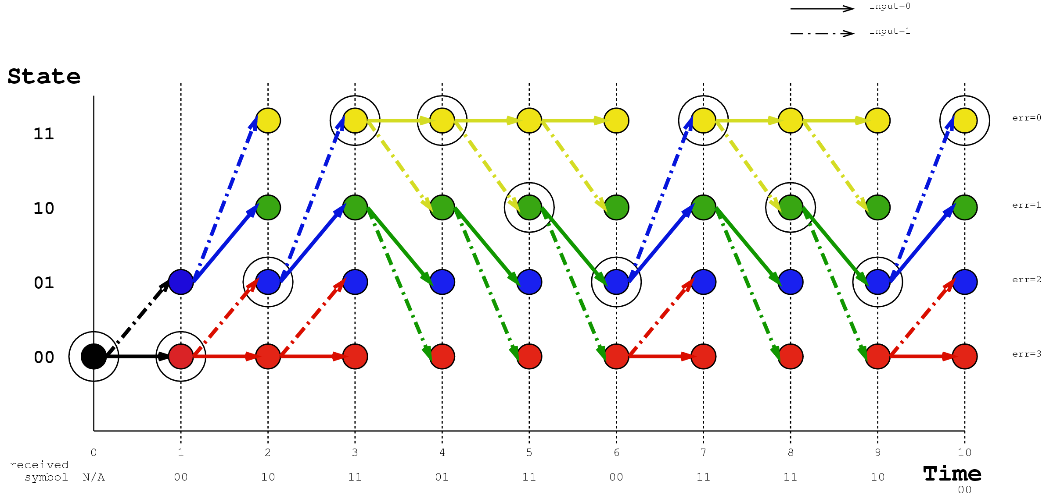
Decoder, Traceback

Slide 25
Decoder, Original Path

Slide 26
Questions
Is there a way to express the Viterbi algorithm in a fine grained stream graph?
Variable rates for this decoder would mean pop(2) for 10 times, and then push(10). This is deterministic, if not constant rate.
Perhaps 2 stage filters?

