Slide 1
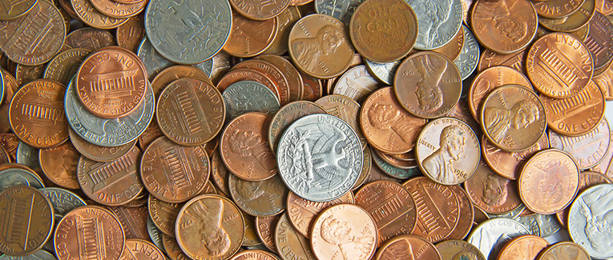
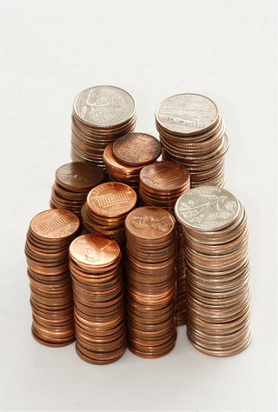
Make Change
There was a time when people carried
change in their pockets and purses to make change. Now it's a game. Pick a version and try it.
Easy (Minimum Coins)
Medium (Finite Coins)
Hard (Maximum Coins)

Slide 2

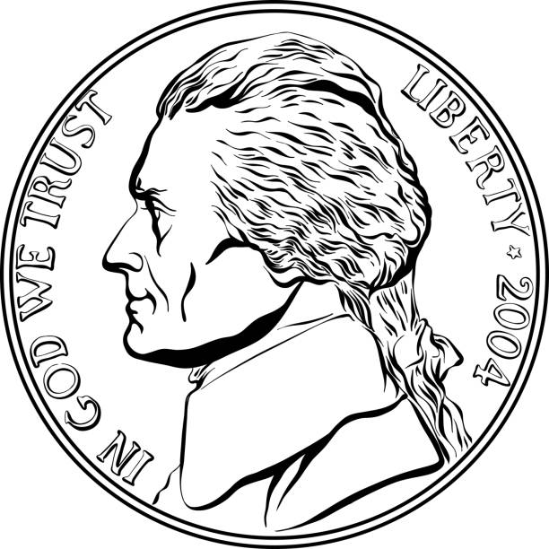

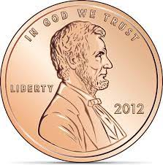
Make Change – Minimum Coins
You have unlimited number of quarters, dimes, nickels, and pennies. Make change for the amount below for the amount using the fewest (minimum) coins.
Amount: xx¢
0
0
0
0
Clear
Check
Feedback

Slide 3
Make Change – Finite Coins
You have a limited number of quarters, dimes, nickels, and pennies. Make change for the amount below. If this is impossible enter all zeros. You must match the amount exactly.
Amount: 39¢
2
0
2
3
0
0
0
0
Clear
Check
Feedback

Slide 4
Make Change – Maximum Coins
You have a limited number of quarters, dimes, nickels, and pennies. Make change for the amount below using the largest (maximum) number of coins. If this is impossible enter all zeros. You must match amount exactly.
Amount: 39¢
2
0
2
3
0
0
0
0
Clear
Check
Feedback

Slide 5
Make Change – Finite Coins
3 of 5
Perfect! You have mastered this game.
Home

Slide 6
Index Page State Transitions
Penny Worth
Make Change
Help
Penny
Minimum
Help
Nickel
Nickel Worth
Finite
Help
Dime
Maximum
Help
Dime Worth
Quarter
Quarter Worth
GAME/PLAY
GAME/HELP

Slide 7
Game Play State Transitions Red -> User
GAME_START
PROBLEM_NEXT
PROBLEM_SHOW
Clear
Check
PROBLEM_MARK
Correct
<
<
Incorrect
Solution
PROBLEM_INCORRECT
PROBLEM_SOLUTION
PROBLEM_CORRECT
Retry
>=
Next
Next
PROBLEM_ RETRY_TEST
PROBLEM_ COUNT_TEST
Game Over
>=
GAME_SCORE

Slide 8
Game Play Interior / Exterior Transitions
Happy Path
Try, try, try again Path
I Give Up Path
NEXT
NEXT
NEXT
SHOW
Clear
SHOW
Clear
SHOW
Check
Check
Check
MARK
Next
MARK
Retry
Next
MARK
Next
Correct
Incorrect
Incorrect
CORRECT
INCORRECT
INCORRECT
Solution
INDEX
GAME/PLAY
SCORE
SOLUTION
Minimum
Finite
Maximum

Slide 9
Game Help State Transitions Green -> Animation Red -> User
HELP_START
EXAMPLE_NEXT
Animations start here
EXAMPLE_SHOW
EXAMPLE_MARK
Correct
<
Incorrect
EXAMPLE_INCORRECT
EXAMPLE_CORRECT
Next
Next
EXAMPLE_ COUNT_TEST
Help Over
>=
GAME_START

Slide 10



I'm Bob Rodini software developer, educator, and puzzle lover.
I make educational apps (videos too) that are FREE with absolutely NO advertising.
My current offerings are below. Just click on the image to play and learn.
Make Change
Math/logic game
Pizza Problem
Math video
More to come…

