Slide 1

Analysis of Win Percentage of NBA Teams in the 2015-2016 season
Mohammad, Rodrigo, Meixi, Anil, Yves
Notes:
Image source :
http://a4.espncdn.com/combiner/i?img=%2Fi%2Fespn%2Fmisc_logos%2F500%2Fnba.png

Slide 2
Description of the Relevant Variables
WinPer (Win Percentage)
PTS (Points)
FGPer (Field Goals Percentage)
ThreePer (Three Points Percentage)
FTPer (Free Throw Percentage)
STL (Steal)
AST (Assists)
REB (Rebound)
BLKA (Blocks Against Team)
PF (Personal Fouls)
TOV (Turnover)
DREB (Defensive Rebounds)
OREB (Offensive Rebounds)
PREV (Previous Year’s Win Percentage)
REG (Region) - qualitative
Notes:
That we think relevant

Slide 3
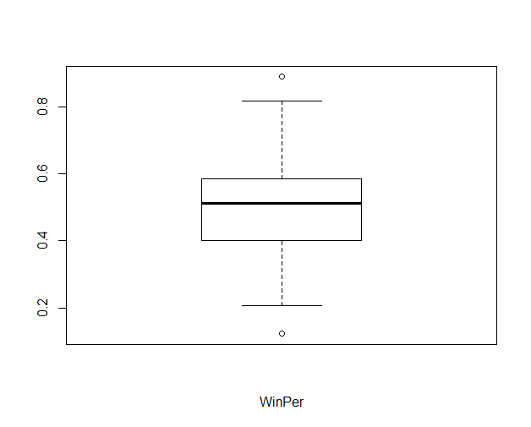
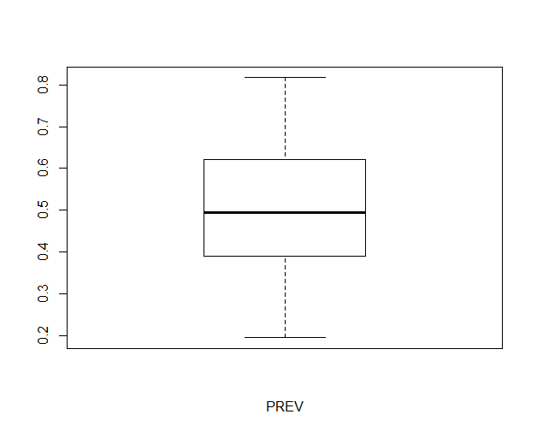
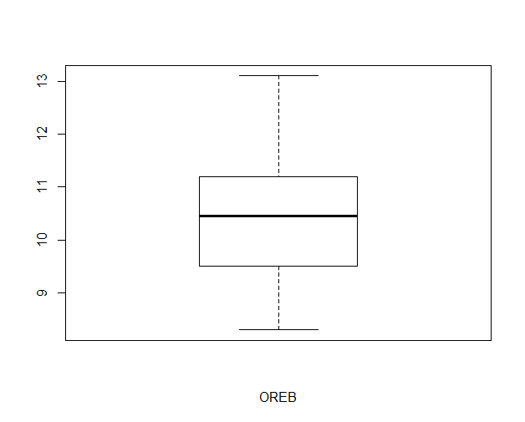
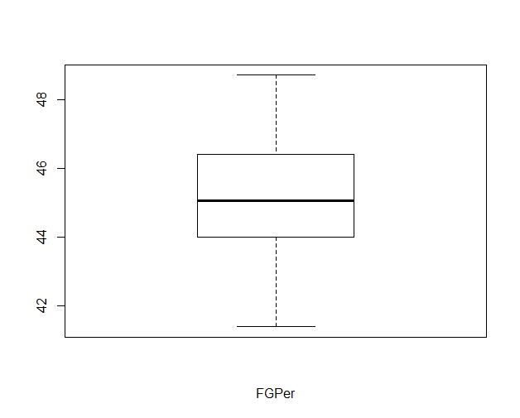
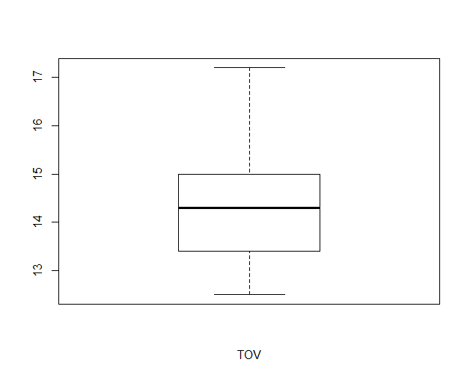
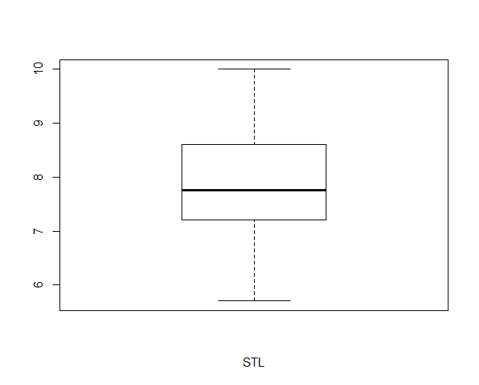
Analysis of Variables
(outliers: Philadelphia 76ers, GS Warriors)
Notes:
GS Warriors had a very good season whereas Philadelphia had a very bad one. Even though they are away from the mean, we think removing it might not be a good idea. They might be statistically useful.

Slide 4
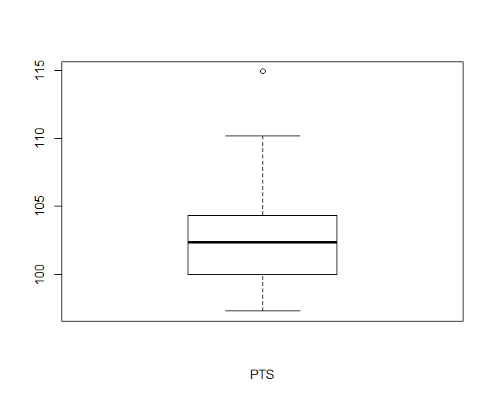
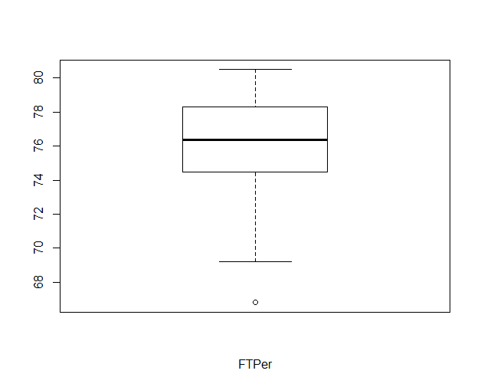
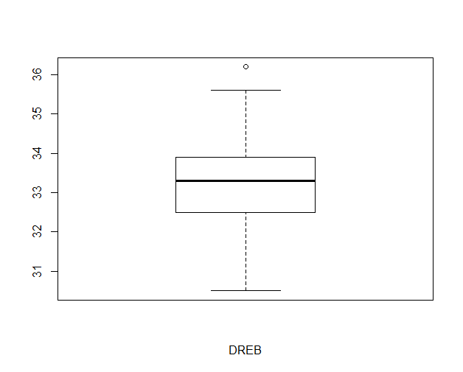
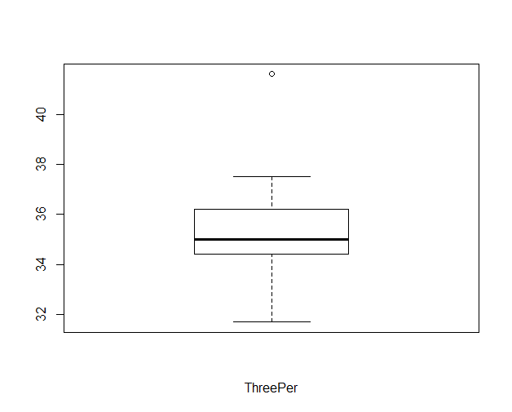
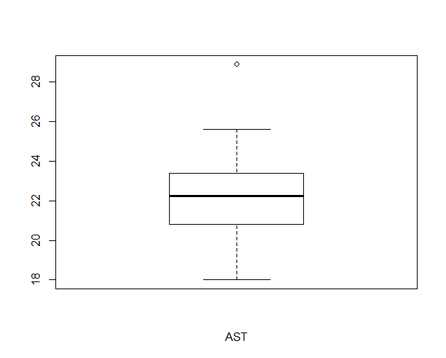
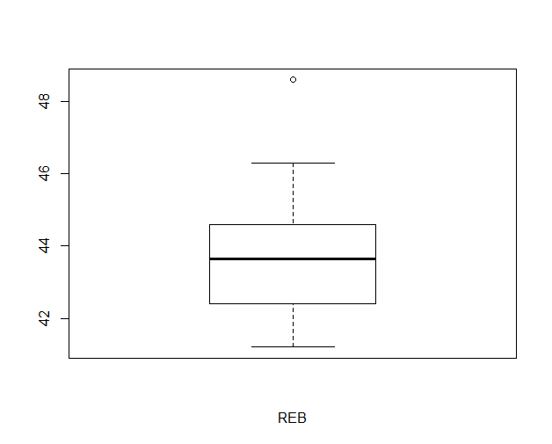
Analysis of Variables
(outliers: GS Warriors)
(outlier: Detroit Pistons)
(outlier: GS Warriors)
(outlier: GS Warriors)
(outlier: GS Warriors)
(outlier: OKC)
Notes:
Most of the boxplots show that the data is distributed evenly.
GS Warriors stands out in most of the graphs.

Slide 5
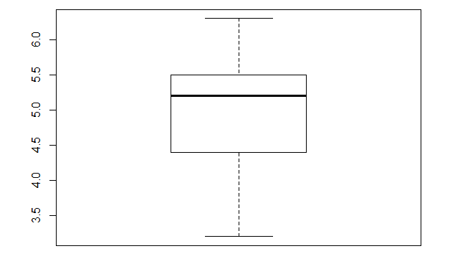
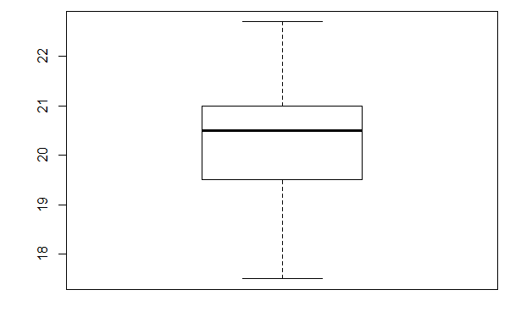
Analysis of Variables
Notes:
Most of the boxplots show that the data is distributed evenly.

Slide 6
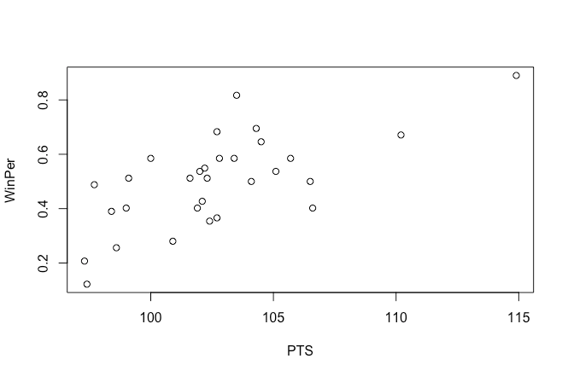
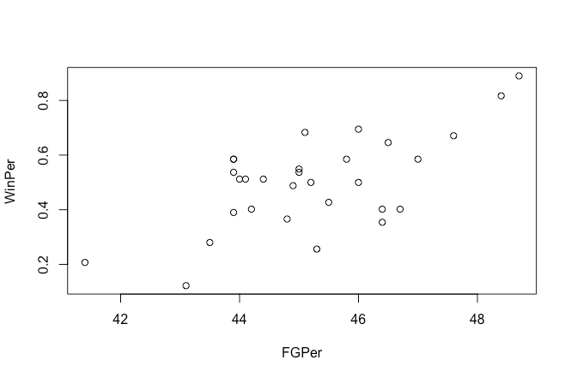
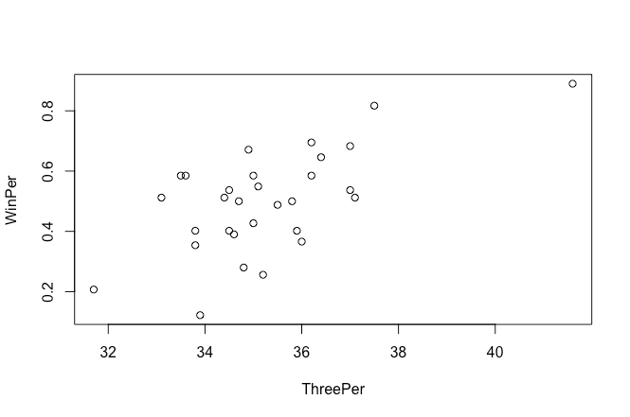
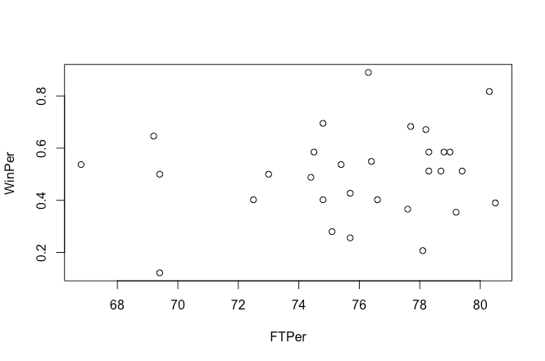
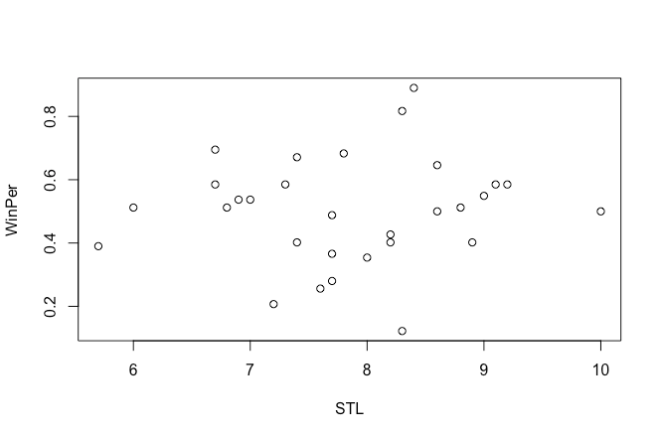
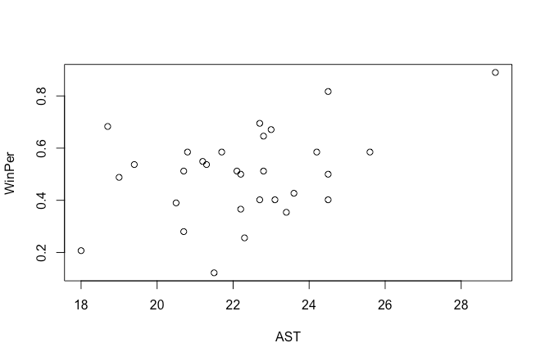
Scatter Plot of Response variable and each predictor variable
Notes:
Talk about the linear trend and randomness of some of the scatter plots.
Talk about transformation: log and sqrt do not work.

Slide 7
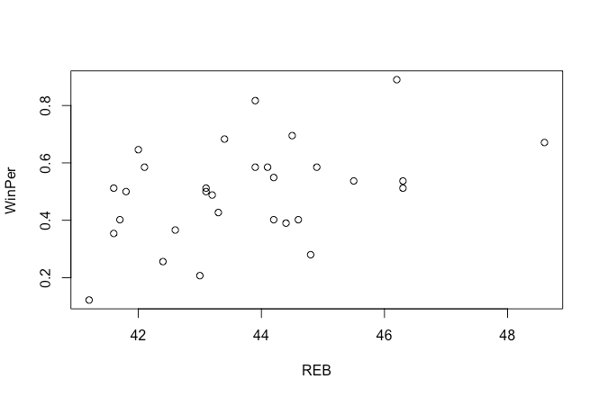
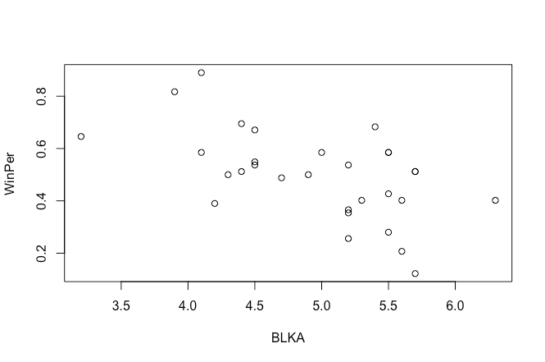
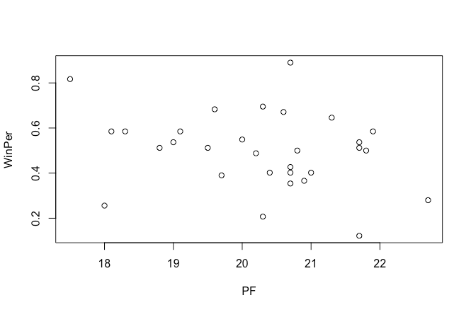
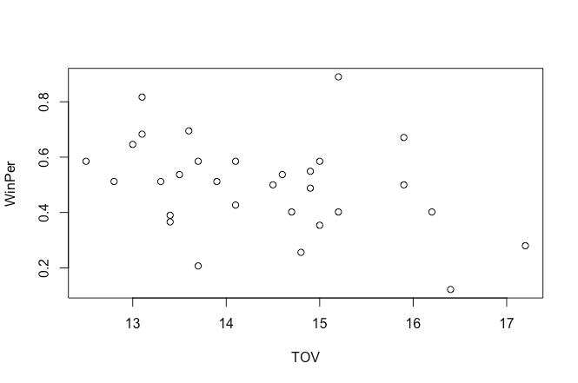
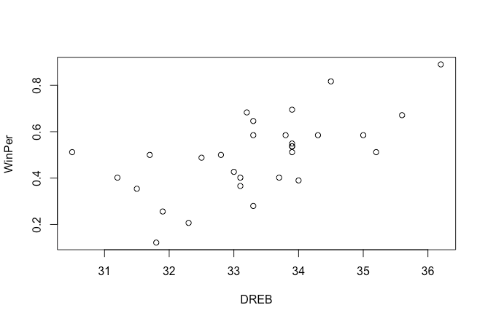
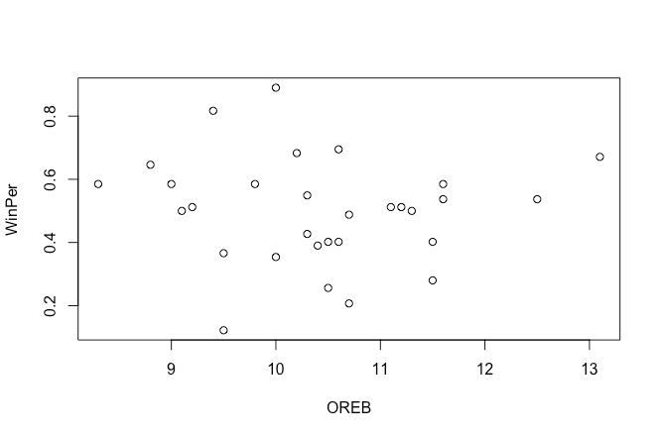
Scatter Plot of Response variable and each predictor variable

Slide 8
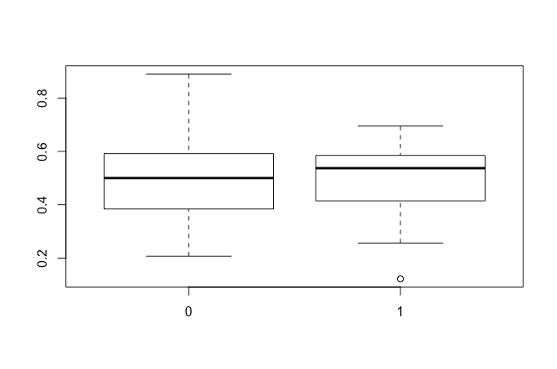
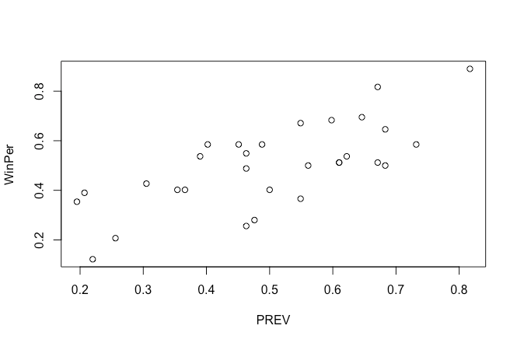
Scatter Plot of Response variable and each predictor variable
West
East

Slide 9
Full Model

Slide 10
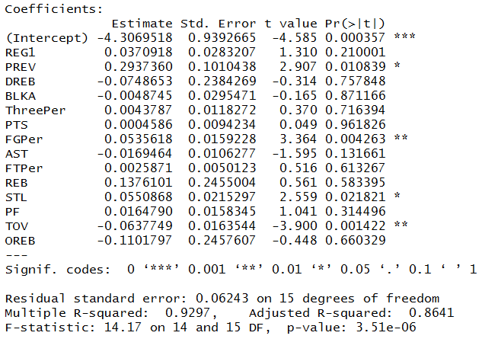
Analysis of Full Model
Notes:
1)R2 is really high but variables are not significant (sign of collinearity)
2)Interpret the inconsistent coefficients (does not make sense)
Our approach to create the model: We started with creating a model using all of the variables to see the big image because we were not sure which variables would be more useful to predict the WinPer . We expected to see collinearity issue because of relevant predictor variables. (REB,OREB, DREB-PTS,PREV) Since we knew collinearity would be a major issue we decided to eliminate some of the variables before looking any other assumptions. (PTS, AST, REB)

Slide 11
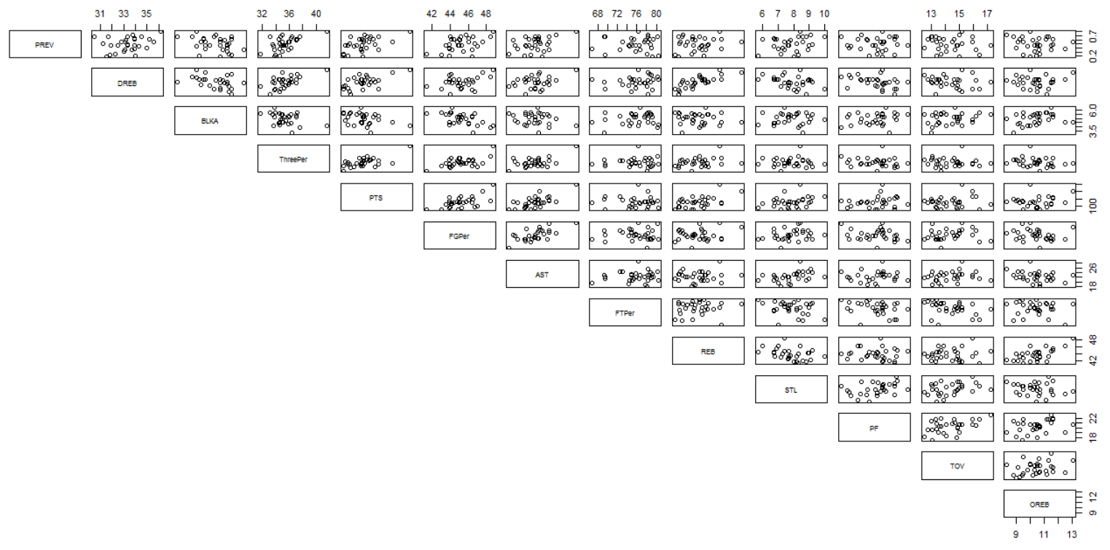
Scatter Plot of Predictor Variables

Slide 12
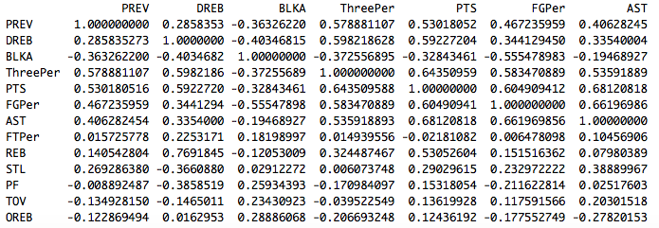
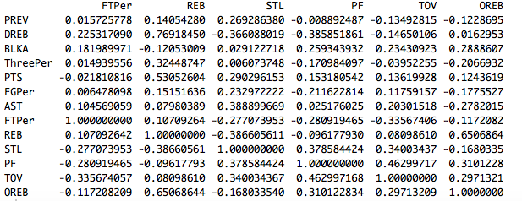
The Correlation Matrix of the Predictor Variables
Notes:
PTS & ThreePer, PTS & AST, PTS & FGPer,
AST & FGPer, REB & DREB, REB & OREB

Slide 13
VIF (Variance Inflation Factors) Values
Notes:
We kept DREB (Defensive Rebound) and OREB (Offensive Rebound) because we thought removing REB(Rebound) would fix the collinearity problem.

Slide 14
Pulling out Less Significant Variables - Reduced Model
We decided to remove the following variables:
PTS
AST
REB
For the following reasons:
Inconsistent coefficient
Correlation coefficients and scatter plots of the predictor variables
VIF Values

Slide 15
Reduced Model
Notes:
Having removed AST, PTS, REB from our previous model, we then proceeded to create our next model which is shown here on the screen
Collinearity
We removed AST, PTS, REB

Slide 16
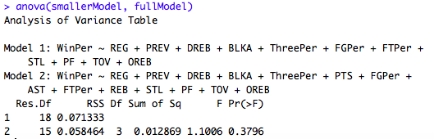
Anova test between Reduced Model and Full Model
Ho: AST = PTS = REB =0 (The reduced model is adequate)
Ha: AST = PTS = REB <>0 (The full model is adequate)
FAIL TO REJECT NULL hypothesis, so reduced model is adequate
Notes:
To test if our reduced model was more adequate than our original model, we ran an ANOVA test comparing both models and the ANOVA table spit out a p-value of .3796. This is a relatively high value suggesting our reduced model is more adequate. In fact, the only time we reject the null is when we use an alpha value of 1.

Slide 17
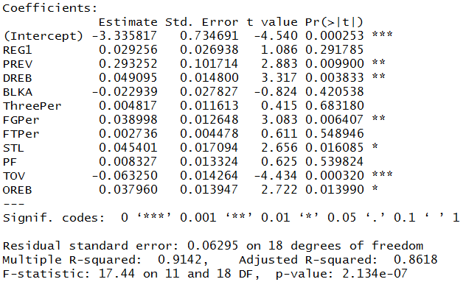
Analysis of Reduced Model
We decided to remove:
REG
BLKA
ThreePer
FTPer
PF
because they had high p-values.
Notes:
Next we ran a regression table. First thing to note, offensive rebound coef was corrected after removing rebound, it now has positive sign which makes sense because..explain offensive rebound.
We also note that some of our remaining coefficient estimates are more statistically significant than before.
However, we still see some coefficient estimates that seem to not add value to our model, these are [point coeff]. We Run a VIF test to ensure that collinearity is not a problem

Slide 18
Reduced Model VIF (Variance Inflation Values)
Collinearity has been removed
Notes:
As we can see the results of the VIF test seem to suggest that there is no collinearity. Regardless we remove the the variables that seem to not add value to model to see if we are left with a better model. Our new model is [change slide]

Slide 19
Final Model

Slide 20
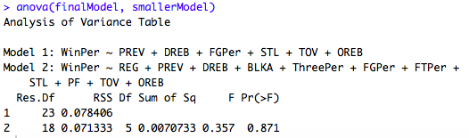
Anova test between Reduced model1 and Final Model
Ho: REG = BLKA = ThreePer = FTPer = PF = 0 (The reduced model is adequate)
Ha: REG = BLKA = ThreePer = FTPer = PF <> 0 (The full model is adequate)
FAIL TO REJECT NULL hypothesis, so reduced model is adequate
Notes:
# p-value is large, fail to reject null -> reduced model is adequate
# Confirms reduced model is OK

Slide 21
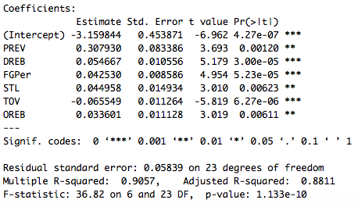
Final Model (with the final predictor variables)
Notes:
R^2 fell a bit but this is not a concern because ANOVA test suggested this model is indeed better and all coefficient estimates a re statistically significant
Mention there’s no longer a reason to remove variable and we can move forward with checking assumptions

Slide 22
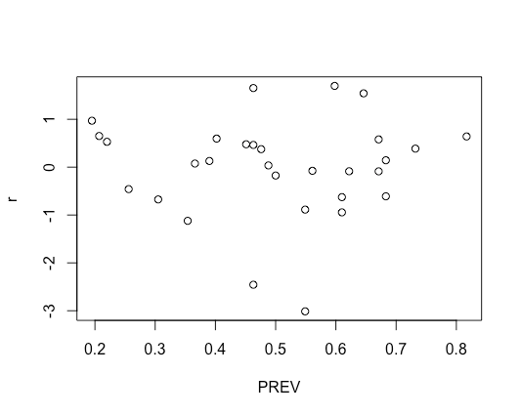
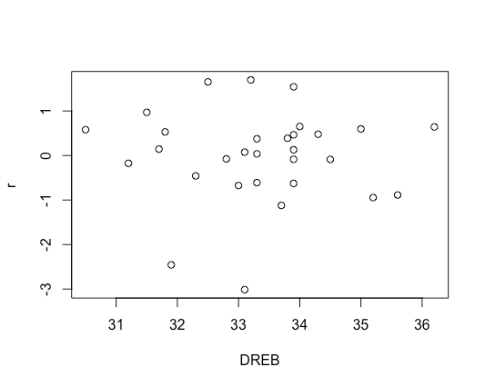
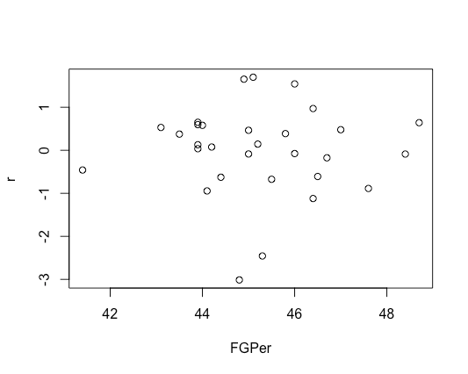
Vif values of the predictor variables in the final Model
Testing Assumptions
Checking linearity between the predictor and response variables. (variables vs. r)
Notes:
shotgun , random scatter
No clear signs of heteroscedasticity
Mean and centered around 0

Slide 23
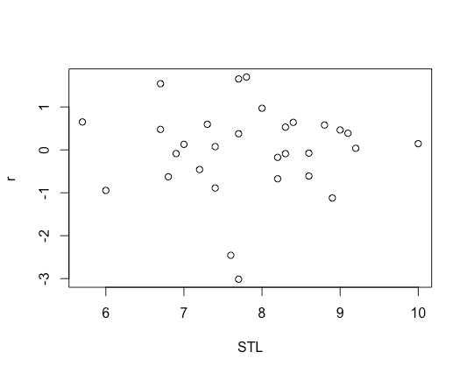
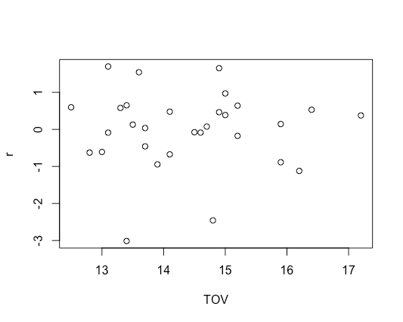
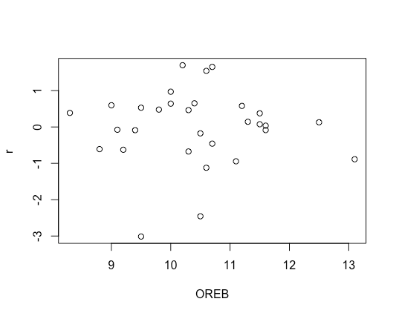
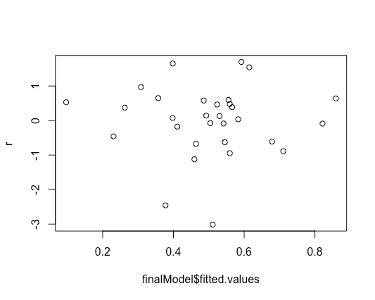

Slide 24
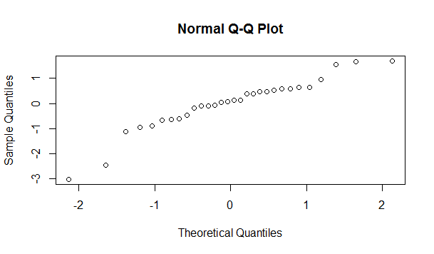
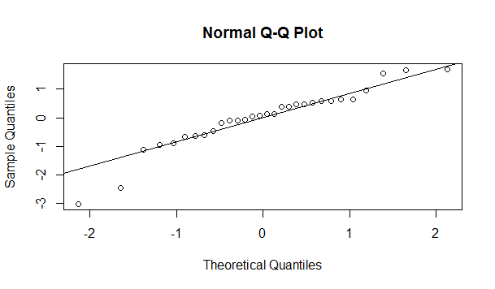
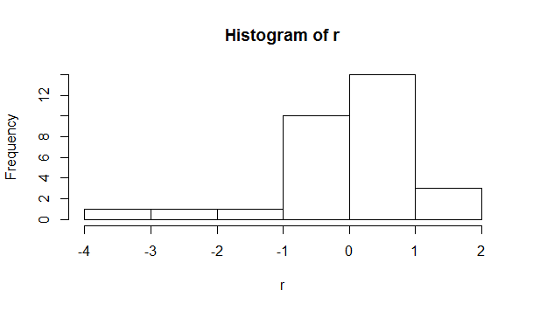
Normality of error terms
Notes:
Normality of the final model (6 variables) #assumption 2
qqnorm(r) # ideally we want a nice straight line with a slope
#Rows 12 and 28 seem like they are outliers. We might consider removing them and test the reduced model without these points.
##At this point we might consider removing thos two observations to see if the model improves.

Slide 25
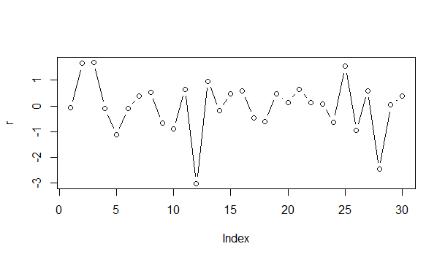
Independence of error terms (checking autocorrelation)
Durbin-Watson test:
DW = 2.397,
p-value = 0.8415
____________________
Ho:p = 0
Ha:p > 0
(E_{t}= p E_{t-1} + e)
FAIL TO REJECT NULL;
No first order autocorrelation
Notes:
plot(r, type = "b")
We think that It might be a good idea to remove rows 12 and 28
1)Autocorrelation does not seem to be a problem. 2) The number of runs seem adequate But we can still test using the DW test.
Talk about rows 12 and 28

Slide 26
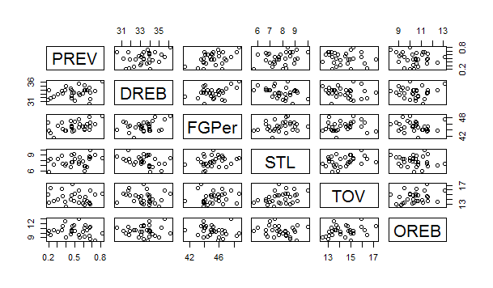
Linear independence between predictor variables
Notes:
This is a linear independence of the final model (all randomly distributed- predictor variables are independent of each other)

Slide 27
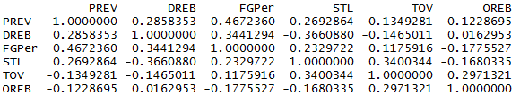
Predictor Correlation
Notes:
cor(data.frame(PREV , DREB , FGPer , STL , TOV , OREB))
None of the values are greater than 0.4672360, So predictor variables are independent of each other.

Slide 28
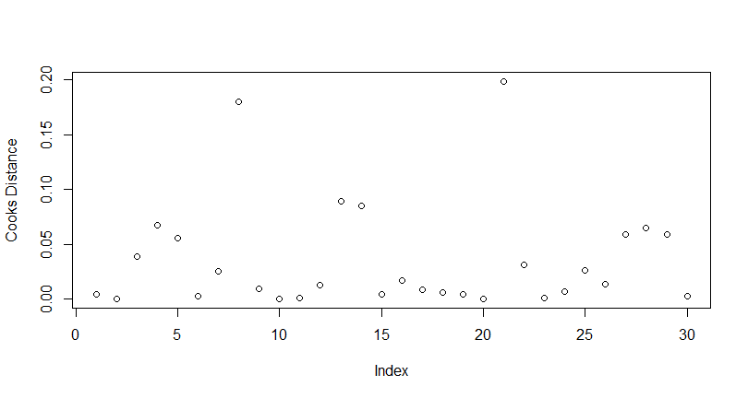



Detecting Data Points of High Influence and Leverage
FGPer
High lev: LA Lakers
PREV
Notes:
For finalModel

Slide 29




Detecting Data Points of High Influence and Leverage
DREB
STL
Notes:
For finalModel

Slide 30




Detecting Data Points of High Influence and Leverage
TOV
High lev: Phoenix Suns
OREB
High lev: Oklahoma City
Notes:
For finalModel

Slide 31
Observations we consider to remove
High leverage: Phoenix Suns
High leverage: Oklahoma City
High leverage: LA Lakers
They are not influential observations.
Outliers in standardized residuals : Rows 12 and 28

Slide 32

Final Model with some Observations Removed
Notes:
As we can see the R^2 has improved.(0.9507) Look at the coefficients.

Slide 33







Residual Plots
(Linearity)

Slide 34


Normality (Comparison)
Notes:
#The normality improves significantly

Slide 35
Confidence Intervals for Predictor Variables
95% Confidence Interval for two predictor variables
We removed 2 rows,so we have 28 observation, 7 variables.
Confidence interval for PREV2 (95%)
0.338407-qt(.975, 21)*0.060203
0.338407+qt(.975, 21)*0.060203
We are 95% confident that PREV2 (slope parameter) falls between 0.213208 and 0.463606,
and that for every unit increase in PREV2, Win percentage increases between .21% and .46%.
Confidence interval for DREB2 (95%)
0.045668-qt(.975, 21)*0.007935
0.045668+qt(.975, 21)*0.007935
We are 95% confident that DREB2 (slope parameter) falls between 0.02916626 and 0.06216974;
And that for every unit increase in DREB2, WinPer increases between .03% and .06%.

Slide 36
Predictions
We are choosing Boston Celtics for prediction of Win Percentage of the 2016 - 2017 season
PREV2 = 0.585 , DREB2 = 32.9 , FGPer2 = 45.4 , STL2 = 7.5 , TOV2 = 13.3 , OREB2 = 9.1
Confidence Interval: We are 95% confident the AVERAGE win percentage when PREV2 = .585 and DREB2 = 32.9, FGPer2=45.4, STL2=7.5, TOV2=13.3, OREB2=9.1 is between 51.314% and 58.04%
Prediction Interval: We are 95% confident the INDIVIDUAL win percentage when PREV2 = .585 and DREB2 = 32.9, FGPer2=45.4, STL2=7.5, TOV2=13.3, OREB2=9.1 is between 45.33% and 64.023%
Celtics actual record in 2016 - 2017 season: 64.6%
____
(Rockets 2015 - 2016 actual win percentage: 50%
Confidence Interval: 45% - 55%
Prediction Interval: 40% - 60%)
Notes:
Confidence: average
Prediction: individual
http://stats.nba.com/teams/traditional/#!?sort=PTS&dir=-1&Season=2016-17&SeasonType=Regular%20Season

