Slide 1
Comparing Different Pricing Mechanisms for Single-Minded Bidders
By: Rodrigo Rogel
Advisor: Christine Chung
Notes:
Hello everyone, I’m Rodrigo Rogel, my research advisor is Professor Chung, and it’s my turn to talk to you about my research this semester through my presentation titled “Comparing Different Pricing Mechanisms for Single-Minded Bidders. In short my presentation concerns auctions, specifically the performance of pricing mechanisms which are implemented to assign prices to auction winners

Slide 2
Problem/Objective/Questions
No pricing mechanism is known to outperform every other on every instance.
Given consumer information or through adaptive expectations, we can choose the best pricing mechanism to implement in a single-minded bidder auction
Truthful vs. fair non-truthful mechanisms. Is it ever convenient to implement fair non-truthful mechanisms?
Notes:
Let us begin with the purpose and goals of this short sighted research. Essentially we look at how different pricing mechanism perform, some truthful, some fair in a variety of settings. We do this because No pricing mechanism is known to outperform every other on every instance and we want to see which types of settings our algorithms specialize in. I believe this is helpful because sellers or auctioneers can make use of all available information to form expectations and choose the most appropriate mechanism. I was also interested in seeing how truthful pricing mechanisms performed against non-truthful but fair pricing mechanisms. This comparison in performance is critical perhaps in instances where truthful mechanisms do very poorly in which case it might actually be worth the risk implementing a non-truthful, but fair pricing mechanism.

Slide 3
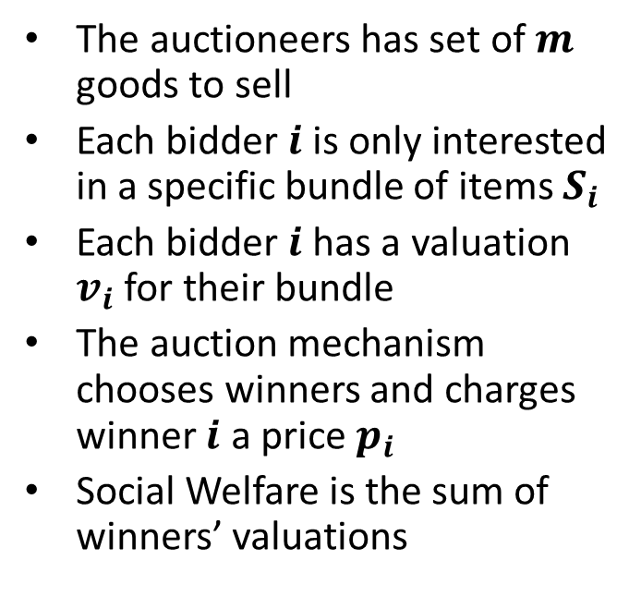
Single Minded Case (Limited Supply)
Definition
Example
The auctioneers has set of $m$ goods to sell
Each bidder $i$ is only interested in a specific bundle of items $S_{i}$
Each bidder $i$ has a valuation $v_{i}$ for their bundle
The auction mechanism chooses winners and charges winner $i$ a price $p_{i}$
Social Welfare is the sum of winners’ valuations
Goods : {A,B,C,D,E}
Input :
Bid 1 : $5, {B,E}
Bid 2 : $10, {A,E,B,C}
Bid 3 : $8, {C}
Bid 4 : $9, {D,A}
Optimal Output :
Bid 1 : $5, {B,E}
Bid 3 : $8, {C}
Bid 4 : $9, {D,A}
Optimal Social Welfare : $22
Notes:
Next I will get you acquaintance with the class of bidders I worked with throughout this semester, the single minded bidder class. This is a single round sealed bid combinatorial auction where the items being sold are all distinguishable and there’s at most 1 copy of each, and where bidders are interested in only a specific bundle of items and will pay for it if and only if their bundle can be sold to them in whole. Now ideally we would love it if the output of any auction is the sub set of compatible players with optimal social welfare, and we would love it even more if we could charge auction winners their “maximum willingness to pay”, but if we truly care about getting bidders to bid their “maximum willingness to pay” and maximize profits in a reasonable amount of time, this can not happen. As of now finding the subset of compatible bidders with the optimal social welfare can not be done in a reasonable amount of time which is at most polynomial time; it is this component of hardness that makes it very difficult for the output of compatible players to equal the optimal combination of compatible players. Furthermore, to even induce players to bid their “maximum willingness to pay”, it must be that the auction is truthful or incentive compatible, otherwise bidders can lie and bid a lower amount; it is this truthful component of auctions that makes it extremely difficult for revenue to equal the social welfare of an auction.

Slide 4
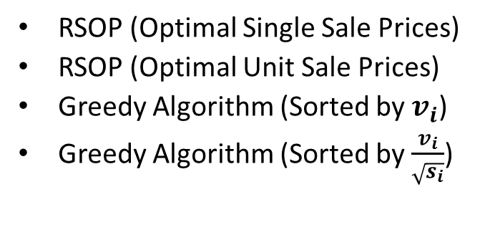
Pricing Mechanisms Used
Truthful
Non-truthful
RSOP (Optimal Single Sale Prices)
RSOP (Optimal Unit Sale Prices)
Greedy Algorithm (Sorted by $v_{i}$)
Greedy Algorithm (Sorted by $\frac{v_{i}}{\sqrt{s_{i}}}$)
Constant Pricing
Proportional Pricing
What makes a mechanism truthful in auctions?
Monotone : A winning bidder keeps winning if she increases her bid
Critical Payments : A bidder who wins pays the minimum value needed for winning
Notes:
So here are two lists of the pricing mechanisms I implemented. They’re labeled truthful and non-truthful respectively. It is worth mentioning that a mechanism is truthful if and only if it is monotone that is players receive no benefit from submitting a bid other than their true valuations, and if it has critical payments, that is a winning bidder pays the price of the bidder who would’ve won if the winning bidder was not considered. Critical payments essentially emphasize that while the offer price to a bidder should be independent of the bidder’s bid, it can and should depend on the bids of all the other bidders. Our fair non-truthful pricing mechanism are monotone, but do not have critical payments.

Slide 5
Experiment Design & Test Cases
Parameters | Description | Implementation
Bids | Number of bids | bids=10; bids<=100; bids+=10
Supply | Number of distinguished goods | supply=10; supply<=100; supply+=10
Bid Dist. | Size of bid value distribution | randInt(min,max), some constant
Bundle Dist. | Size of bundle size distribution | randInt(min,max), some constant
 | Bid value Distribution | Bundle Size Distribution
X-Small | (95,100) | N/A
Small | (1,25) & (75,100) | N/A
Medium | (1,50) & (50,100) | (1,size*.6)
Large | (1,75) & (25,100) | (1,size*.8)
X-Large | (1,100) | (1,size)
Notes:
This slide gives you an overview of my experiment design and test cases. My program takes 4 parameters and on the table below you can see the different sizes of the parameters for our generated bid value and bundle size distributions. Really quick, the reason why there’s an N/A for X-Small & small cells under the bundle size distribution tab is because I couldn’t find a computer that could handle the intense computation of finding the optimal sub set of compatible players with anything less than the medium option as a parameter. I’m using an NP algorithm for that after all.

Slide 6
Continued…
Notes:
And this essentially the output of our program, a 10 by 10 spreadsheet of the average revenue to optimal social welfare percentage. Each cell is the average percentage of 1000 runs with the same parameters

Slide 7
Results (RSOP vs. Greedy)
(1-100)
(25-100)
(50-100)
(75-100)
Notes:
Okay now we discuss my results. We start by comparing the 4 truthful pricing mechanisms against each other in instances with different size of bid value distributions. These graphs shows performance as a function of the number of bids holding the number of goods constant. In all 4 graphs we see in all these four graphs that Greedy 1 performs the best when the number of bids is relatively small. But more importantly we observe the slope of the RSOP1 curve. Specifically we can see it increases as the distribution of bids gets smaller but with the minimum price level increasing.

Slide 8
Continued…
(95-100)
Notes:
And here we have a graph where RSOP 1 actually outperforms Greedy 3 on auctions with more than 60 bids holding the number of goods constant. This can only happen when the distribution of bids is really small

Slide 9
Results (Greedy vs. PCP)
(1-100)
(25-100)
(50-100)
(75-100)
Notes:
Next we compare the greedy pricing mechanisms against constant pricing and proportional pricing, the non-truthful mechanisms. Looking at these four graphs we note CP quickly catches up and outperforms all other algorithms at any number of bids as the distribution of bids gets larger and with the minimum price level increasing. We also note that at a relatively small distribution of bids there’s a somewhat significant gap between CP and Greedy 3, the second best performing mechanism in this case. What this shows is that there is opportunity for higher revenue using a non-truthful mechanism despite the lower bids, however it ultimately depends on how much the average bidder lowers their bid by, and just how “untruthful” the mechanism is

Slide 10
Results (Bundle Sizes)
(1-size)
(1-size*.8)
(1-size*.6)
Notes:
Next we compare performance between the same previous algorithms when the distribution of bundle sizes gets smaller lowering the upper bound. All that is important to note here is that the slope of greedy 1 increases as the distribution of generated bundles sizes gets smaller. Now I wouldn’t be able to tell you just how well it does when the distribution is minimized because of again the trouble of computing for the performance with a smaller parameter.

Slide 11
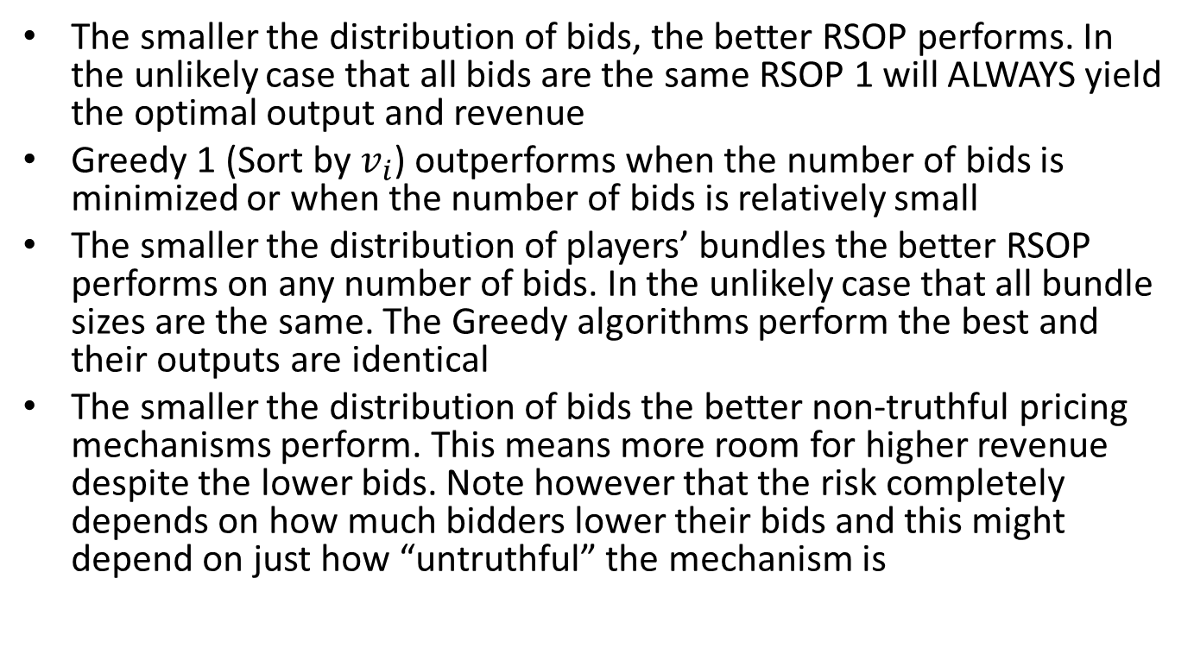
Conclusions
The smaller the distribution of bids, the better RSOP performs. In the unlikely case that all bids are the same RSOP 1 will ALWAYS yield the optimal output and revenue
Greedy 1 (Sort by $v_{i}$) outperforms when the number of bids is minimized or when the number of bids is relatively small
The smaller the distribution of players’ bundles the better RSOP performs on any number of bids. In the unlikely case that all bundle sizes are the same. The Greedy algorithms perform the best and their outputs are identical
The smaller the distribution of bids the better non-truthful pricing mechanisms perform. This means more room for higher revenue despite the lower bids. Note however that the risk completely depends on how much bidders lower their bids and this might depend on just how “untruthful” the mechanism is
Notes:
Here are my conclusions. I won’t read them because I’d rather say the following, but you can. ALTHOUGH PARAMETERS IN SIMULATIONS CAN BE ARBITRARY, WE CAN USE THIS MODEL IF WE HAVE INFORMATION OR EXPECTATIONS About the future. EXAMPLES OF TYPES OF INFORMATION THAT CAN BE OBTAINED AND STILL ALLOW FOR THE POSSIBILITY OF BIDDERS TO BID THEIR “MAXIMUM WILLINGNESS TO PAY” INCLUDE THE NUMBER OF PLAYERS INTERESTED IN PARTICIPATING IN AN AUCTION & THEIR DEMAND OR BUNDLE. AN EXAMPLE OF HOW WE WOULD BE ABLE TO OBTAIN THIS DATA IS SIMPLY TO LET A POPULATION KNOW OF THE GOODS OR SERVICES UP FOR BIDDING AHEAD OF TIME AND ASK THEM WHAT THEY ARE INTEREST IN SHORTLY AFTER. TO OBTAIN INFORMATION ABOUT THEIR BIDDING, WE CAN NOT ASK (AS THIS MIGHT DISCOURAGE THEM FROM TELLING THE TRUTH IF THEY KNOW WHAT YOU INTEND TO DO IS TO USE THE PRICING MECHANISM THAT WILL YIELD THE HIGHEST REVENUE), BUT WE CAN USE THE INFORMATION FROM 1 PERIOD AGO FROM THE SAME POPULATION OF BIDDERS TO FORM EXPECTATIONS ABOUT THEIR BIDDING ON THE NEXT AUCTION, THIS IS WHAT IT MEANS TO HAVE ADAPTIVE EXPECTATIONS

Slide 12
Future Work
Analyze how changes in demand affect revenue when supply is unlimited using different pricing mechanisms
Quantify lost revenue due to ordering heuristics when bid value or per unit value is the same for two or more bidders

Slide 13
Questions ?

