Slide 1
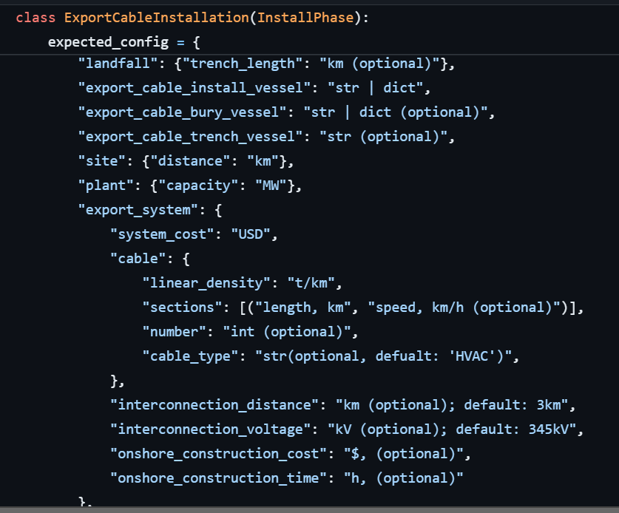
lay_cable,
bury_cable,
dig_trench,
pull_in_cable,
landfall_tasks,
lay_bury_cable,
splice_process,
terminate_cable,
load_cable_on_vessel,

Slide 2
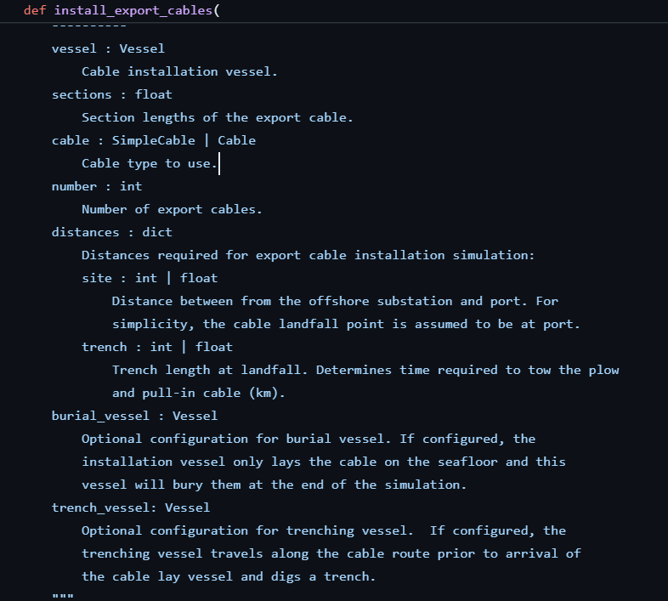

Slide 3
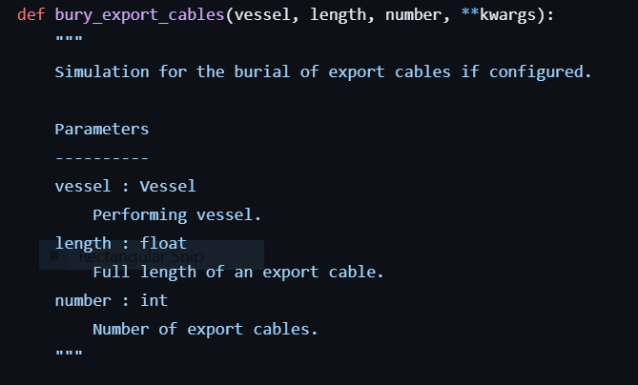
We can bury only a given length of export cable (don’t have to bury all of cable if not needed)

Slide 4
https://github.com/WISDEM/ORBIT/blob/dev/ORBIT/phases/install/cable_install/export.py#L142
https://github.com/WISDEM/ORBIT/blob/dev/ORBIT/phases/install/cable_install/common.py

Slide 5
Varying fraction of cable to be buried as function from distance to shore
One equation for export cable and export cable installation
Vessel changes with depth – more forces in deeper water.
Also the material of the export cable changes in ultradeep water.
Add a percent added mass to the export cable in ultradeep water, deeper than 1300m.
Final deliverable: export cable installation equation. function of distance to landfall. Send to gabe and greg, Leonardo. Can iterate as a function of depth later.
Export cable equation: remake this for HVAC and HVDC lines separately . Use for DC: https://github.com/WISDEM/ORBIT/blob/dev/library/cables/HVDC_2500mm_525kV.yaml

