Slide 1
Regional Wildfire High-Risk Maps
Where future fire weather pushes wildfire risk high
Southern California and TVA regions · July 2026

Slide 2
Approach in brief
Goal: zoom the national high-risk map into two regions (Southern California, TVA), plus versions showing burnable land.
Metric A = future (2025–2059) days/year with extreme fire weather — FWI above each cell's historical (2000–2014) 98th percentile.
A cell is high risk where A ≥ a threshold:
low = 16 days/yr · medium = 18 days/yr · high = 20 days/yr
Regions: TVA = bus-location span; Southern California = standard box (32.5–35.5°N, −121 to −114°W).
Burnable mask: USFS Wildfire Hazard Potential raster — value 0 = non-burnable (water/urban/ag/barren), > 0 = burnable.

Slide 3
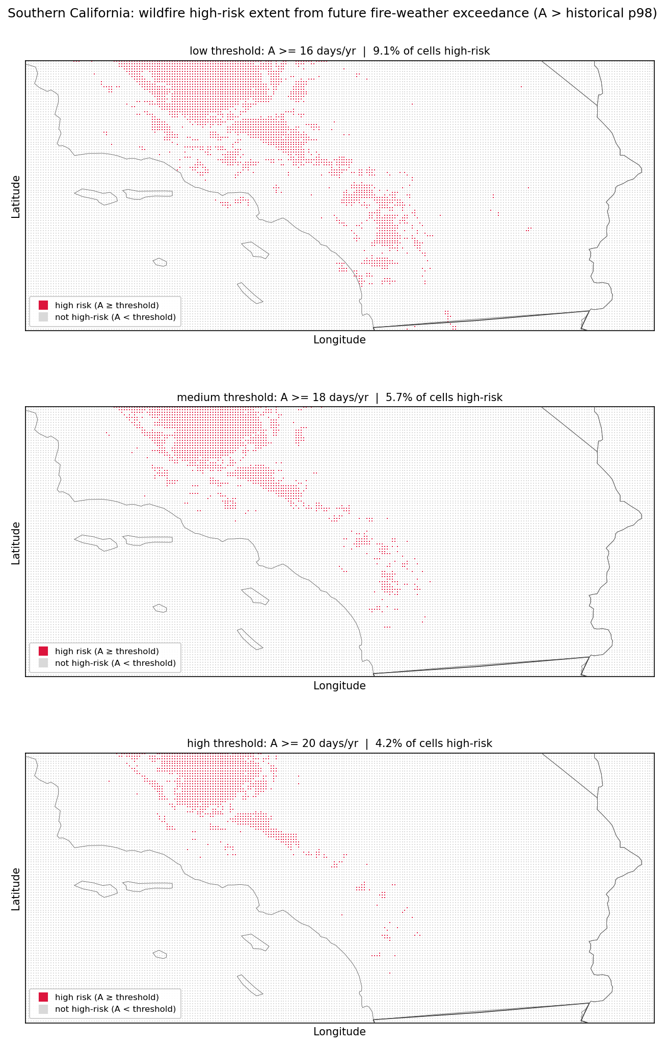
Southern California — high-risk extent
Panels: low / medium / high threshold (16 / 18 / 20 days/yr).
Crimson = high risk (A ≥ threshold); grey = below.
Share of cells high-risk:
low 14.5%
medium 9.4%
high 6.9%
Hot spots concentrate in the interior mountains and LA-area foothills.

Slide 4
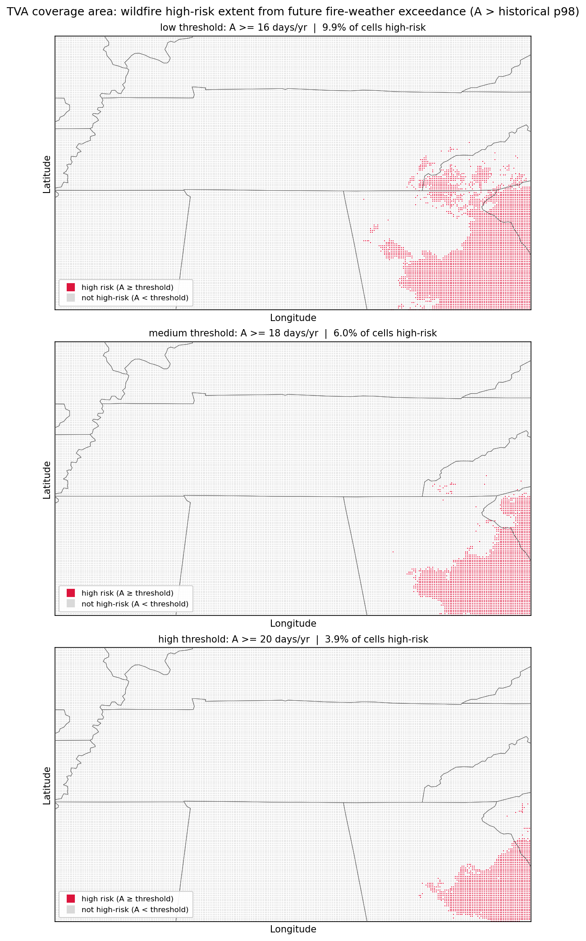
TVA coverage area — high-risk extent
Panels: low / medium / high threshold (16 / 18 / 20 days/yr).
Crimson = high risk (A ≥ threshold); grey = below.
Share of cells high-risk:
low 9.9%
medium 6.0%
high 3.9%
Concentrated in the southern Appalachians (eastern edge of the region).

Slide 5
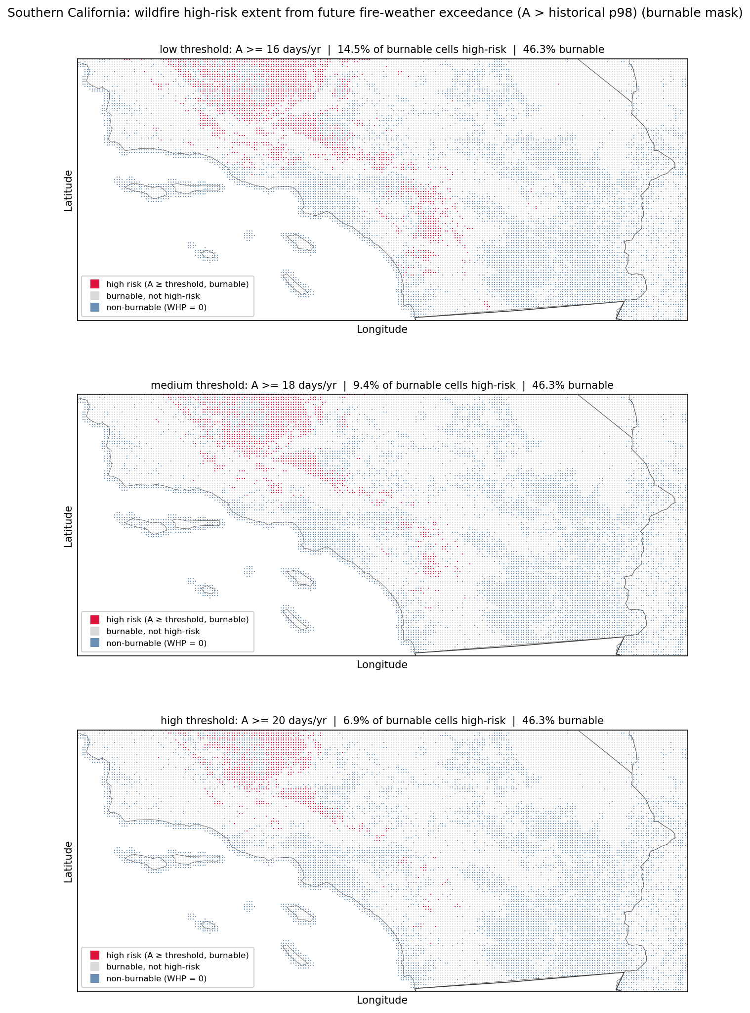
Southern California — with burnable mask
Same thresholds, now with the burnable layer.
Steel blue = non-burnable (WHP = 0: ocean, urban, ag).
Crimson = high risk on burnable land; grey = burnable, below.
46% of the region is burnable.
High-risk, as % of burnable cells:
low 14.5% · med 9.4% · high 6.9%
Coast, Channel Islands, and the LA basin drop out as non-burnable.

Slide 6
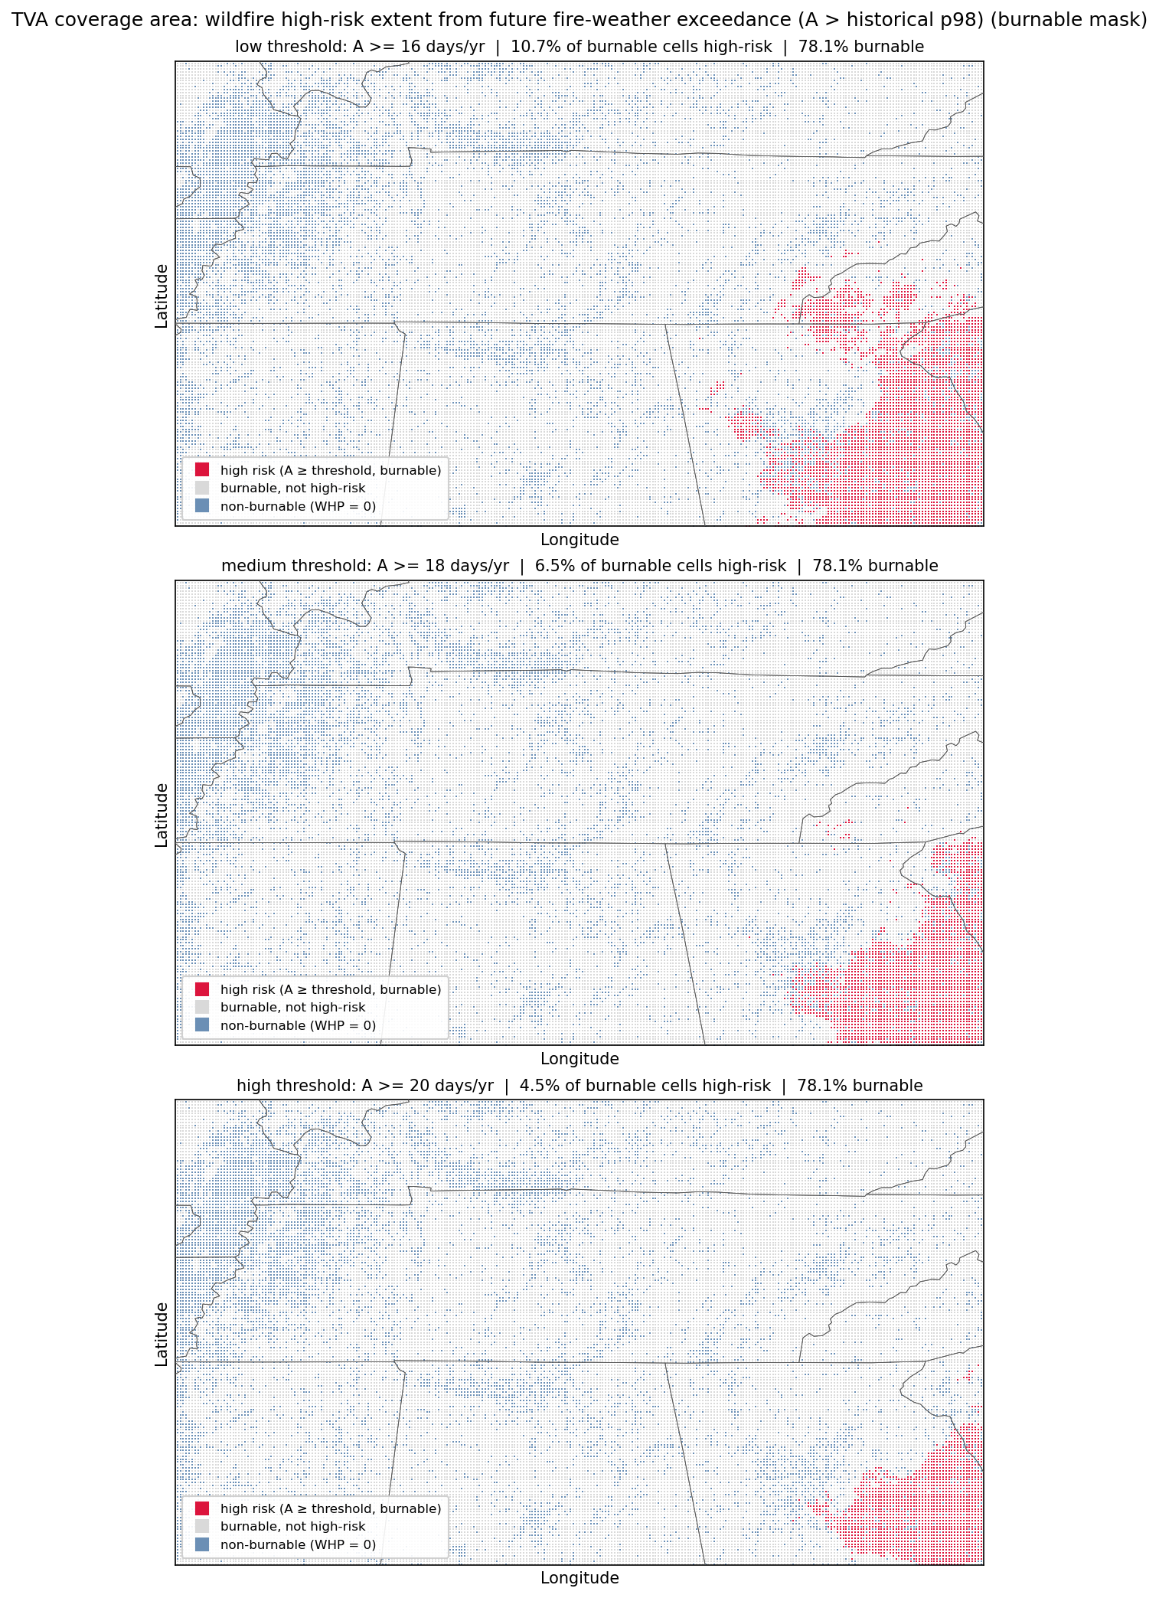
TVA coverage area — with burnable mask
Same thresholds, now with the burnable layer.
Steel blue = non-burnable (WHP = 0: water, urban, ag).
Crimson = high risk on burnable land; grey = burnable, below.
78% of the region is burnable.
High-risk, as % of burnable cells:
low 9.9% · med 6.0% · high 3.9%
Non-burnable cells trace rivers/reservoirs and urban areas.

Slide 7
Results at a glance
Share of cells that are high risk (low → high threshold):
Southern California: 14.5% → 9.4% → 6.9% (of burnable cells)
TVA: 9.9% → 6.0% → 3.9%
Burnable share of each region:
Southern California ≈ 46% (much of the rest is ocean / urban)
TVA ≈ 78%
Higher thresholds mark less area as high-risk; the burnable mask removes non-burnable cells (water/urban/ag) from consideration.

