Slide 1





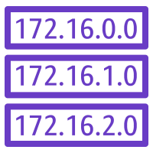

AWS Cloud
Canada Region
Prod VPC
DevStaging VPC
Public subnet (A and B)
Public subnet (A and B)
Prod Server ACL
DevStaging Server ACL
Servers Security group
Servers Security group
Public Route table
Public Route table
Private subnet (A and B)
Private subnet (A and B)
Prod Data ACL
DevStaging Data
ACL
Data Security group
Data Security group
Private Route table
Private Route table

