Slide 1

Big Data NLP with Reddit r/Politics
A project for MScA31013 Big Data Platforms at the University of Chicago
by Chris Lowe, Steve Ronkowski, Roy Roongseang and Jonathan Williams

Slide 2

Outline
Introduction and Business Case
Data Structure, Assembly, and Processing Tools
Data Preprocessing, Visualization and Modeling
Conclusions and Future Work

Slide 3


Introduction and Business Case
The US presidential election of 2016 witnessed unprecedented accusations of foreign interference from all parties.
Meanwhile, the growth of Reddit as a platform for political idea ‘sharing’ has surged. In Jan of 2015, the number of comments in the subreddit r/politics was 181,812, while in Nov of 2016, that number grew to an astounding 2,164,820!
Using a platform like Reddit to better understand the influence of social media on politics in the US can help us improve our elections, reduce misinformation, and identify foreign influence.

Slide 4
Data Structure, Assembly, and processing
All comment and user data was scraped by Jason (u/Stuck_In_The_Matrix), who runs and maintains a project called Pushshift.
The comment data was accessed with BigQuery and covers 5 years (2015-2019) of comment data on the subreddit r/Politics.
The user data was exported from Pushshift, and the banned accounts data was scraped from Reddit announcements.
The period of 5 years was chosen in order to understand the political and misinformation landscape of the 2016 election, build an NLP moderation tool, and utilize for the 2020 election.
After filtering politics and pulling the account data, ~40GB of data was placed into a central (personal) BigQuery database and pushed to GCP Dataproc / RCC for PySpark processing.

Slide 5

Data Structure, Assembly, and processing
To gather the comments dataset, 45 unions were performed in BigQuery to gather each month (Jan 2015 – Sept 2019) table with subreddit = politics.
Additionally, data on users as well as banned accounts (=bots) were pulled into the analysis.
For processing, we used both Google Cloud Platform and the Research Computing Center of the University of Chicago.

Slide 6

Data Structure, Assembly, and processing
After data processing and running the models on both RCC and GCP, we toned down the amount of data used to ~10GB uncompressed, representing 2015-2016 r/Politics comments.
The data was queried out of our BigQuery datastore and exported into JSON.
The JSON file was then compressed and pushed to RCC as a parquet file (~4GB compressed) to speed up the transfer.

Slide 7
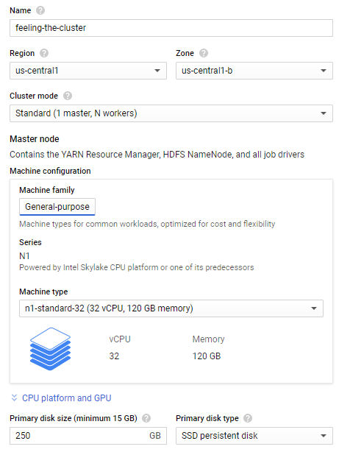
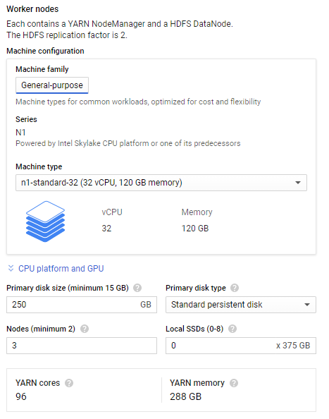
Google cloud platform Cluster used
The GCP cluster used in Dataproc consisted of 1 master node and 3 worker nodes.
Each node had 32 vCPUs with RAM of 120GB.
The total YARN memory ended up at 288GB, with each having a 250GB SSD persistent disk.
The GCP cluster used a BigQuery jar configuration to read tables directly from BigQuery into Spark for data processing.
Although GCP performed our NLP pipeline, RCC performed the modeling.

Slide 8
Data Preprocessing,
Visualization, & Modeling

Slide 9
Conclusions and Future work
As an anomaly detection problem, this was quite a difficult problem to tackle. Distinguishing ‘bots’ from far-left or far-right users is difficult with NLP as the bots’ intentions are to mimic these types of users.
Having the funds to source stronger processing tools could improve both the amount of data and time of process necessary for this project.
To reduce the data size, we tackled specifically the r/Politics subreddit, whereas many ‘bots’ post across all of Reddit. In future work, accounting for these other subreddits (=significantly larger data) could provide a much stronger dataset for increasing prediction accuracy.
As we approach the upcoming election, the dataset grows as does the number of bots to train on.
Questions?

