Slide 1
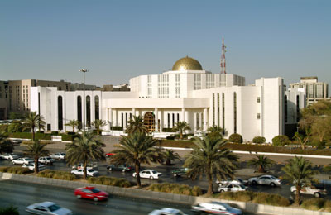
http://static.flickr.com/29/61270156_8142111a33.jpg
Notes:
Good morning everyone & welcome to the National Museum of Saudi Arabia, Today we are going to go on a caravan tour of the Middle East. We will learn about the physical geography, economics, governments, and religions of the region.
We will travel through several countries and see many amazing sites while we learn.

Slide 2
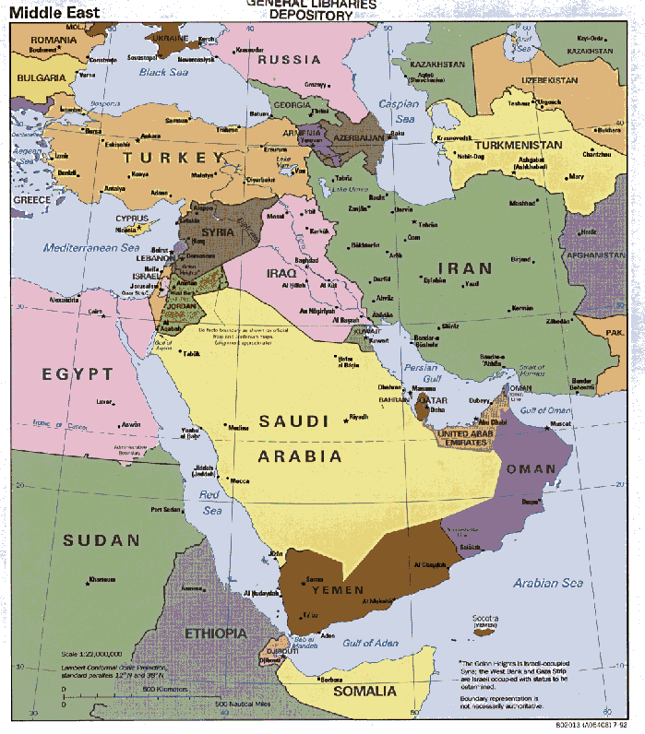
http://www.theodora.com/maps/new8/middle_east.jpg
Notes:
Lets begin with the physical geography of the Middle East. Do you know which two continents the Middle East spans over? PAUSE
There are several important water bodies in the Middle East even though water is their most scarce resource. Does everyone know what the economic term scarce means?
Persian Gulf is an extension of the Gulf of Oman in between the Arabian Peninsula and Iran. This inland sea has an area of 241,000 square kilometers. Who can point at the Persian Gulf?
PAUSE
The two major rivers flowing to the Persian Gulf are the Tigris and the Euphrates rivers. The Tigris and the Euphrates join to form the river-ways called the 'Shat el Arab', and continues to the Persian Gulf.
The entire region between the Euphrates and the Tigris was covered by a network of canals, intended primarily for irrigation but large enough for navigation by small boats. The intakes at the rivers were protected by dams and they are said to have been provided with sluices and gates to regulate the flow of the water. The land around these rivers is very fertile and good for farming because of the irrigation. Does this remind you of a river in Africa?
PAUSE
How about we go meet our companions for our trip?

Slide 3
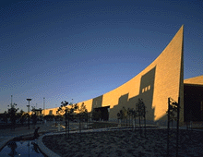
http://www.mtarch.com/mtasaudicurveshadow.gif
Notes:
Make sure you take one last look at the museum. Although our tour will end in Saudi Arabia, it will end in the holy city of Mecca!

Slide 4
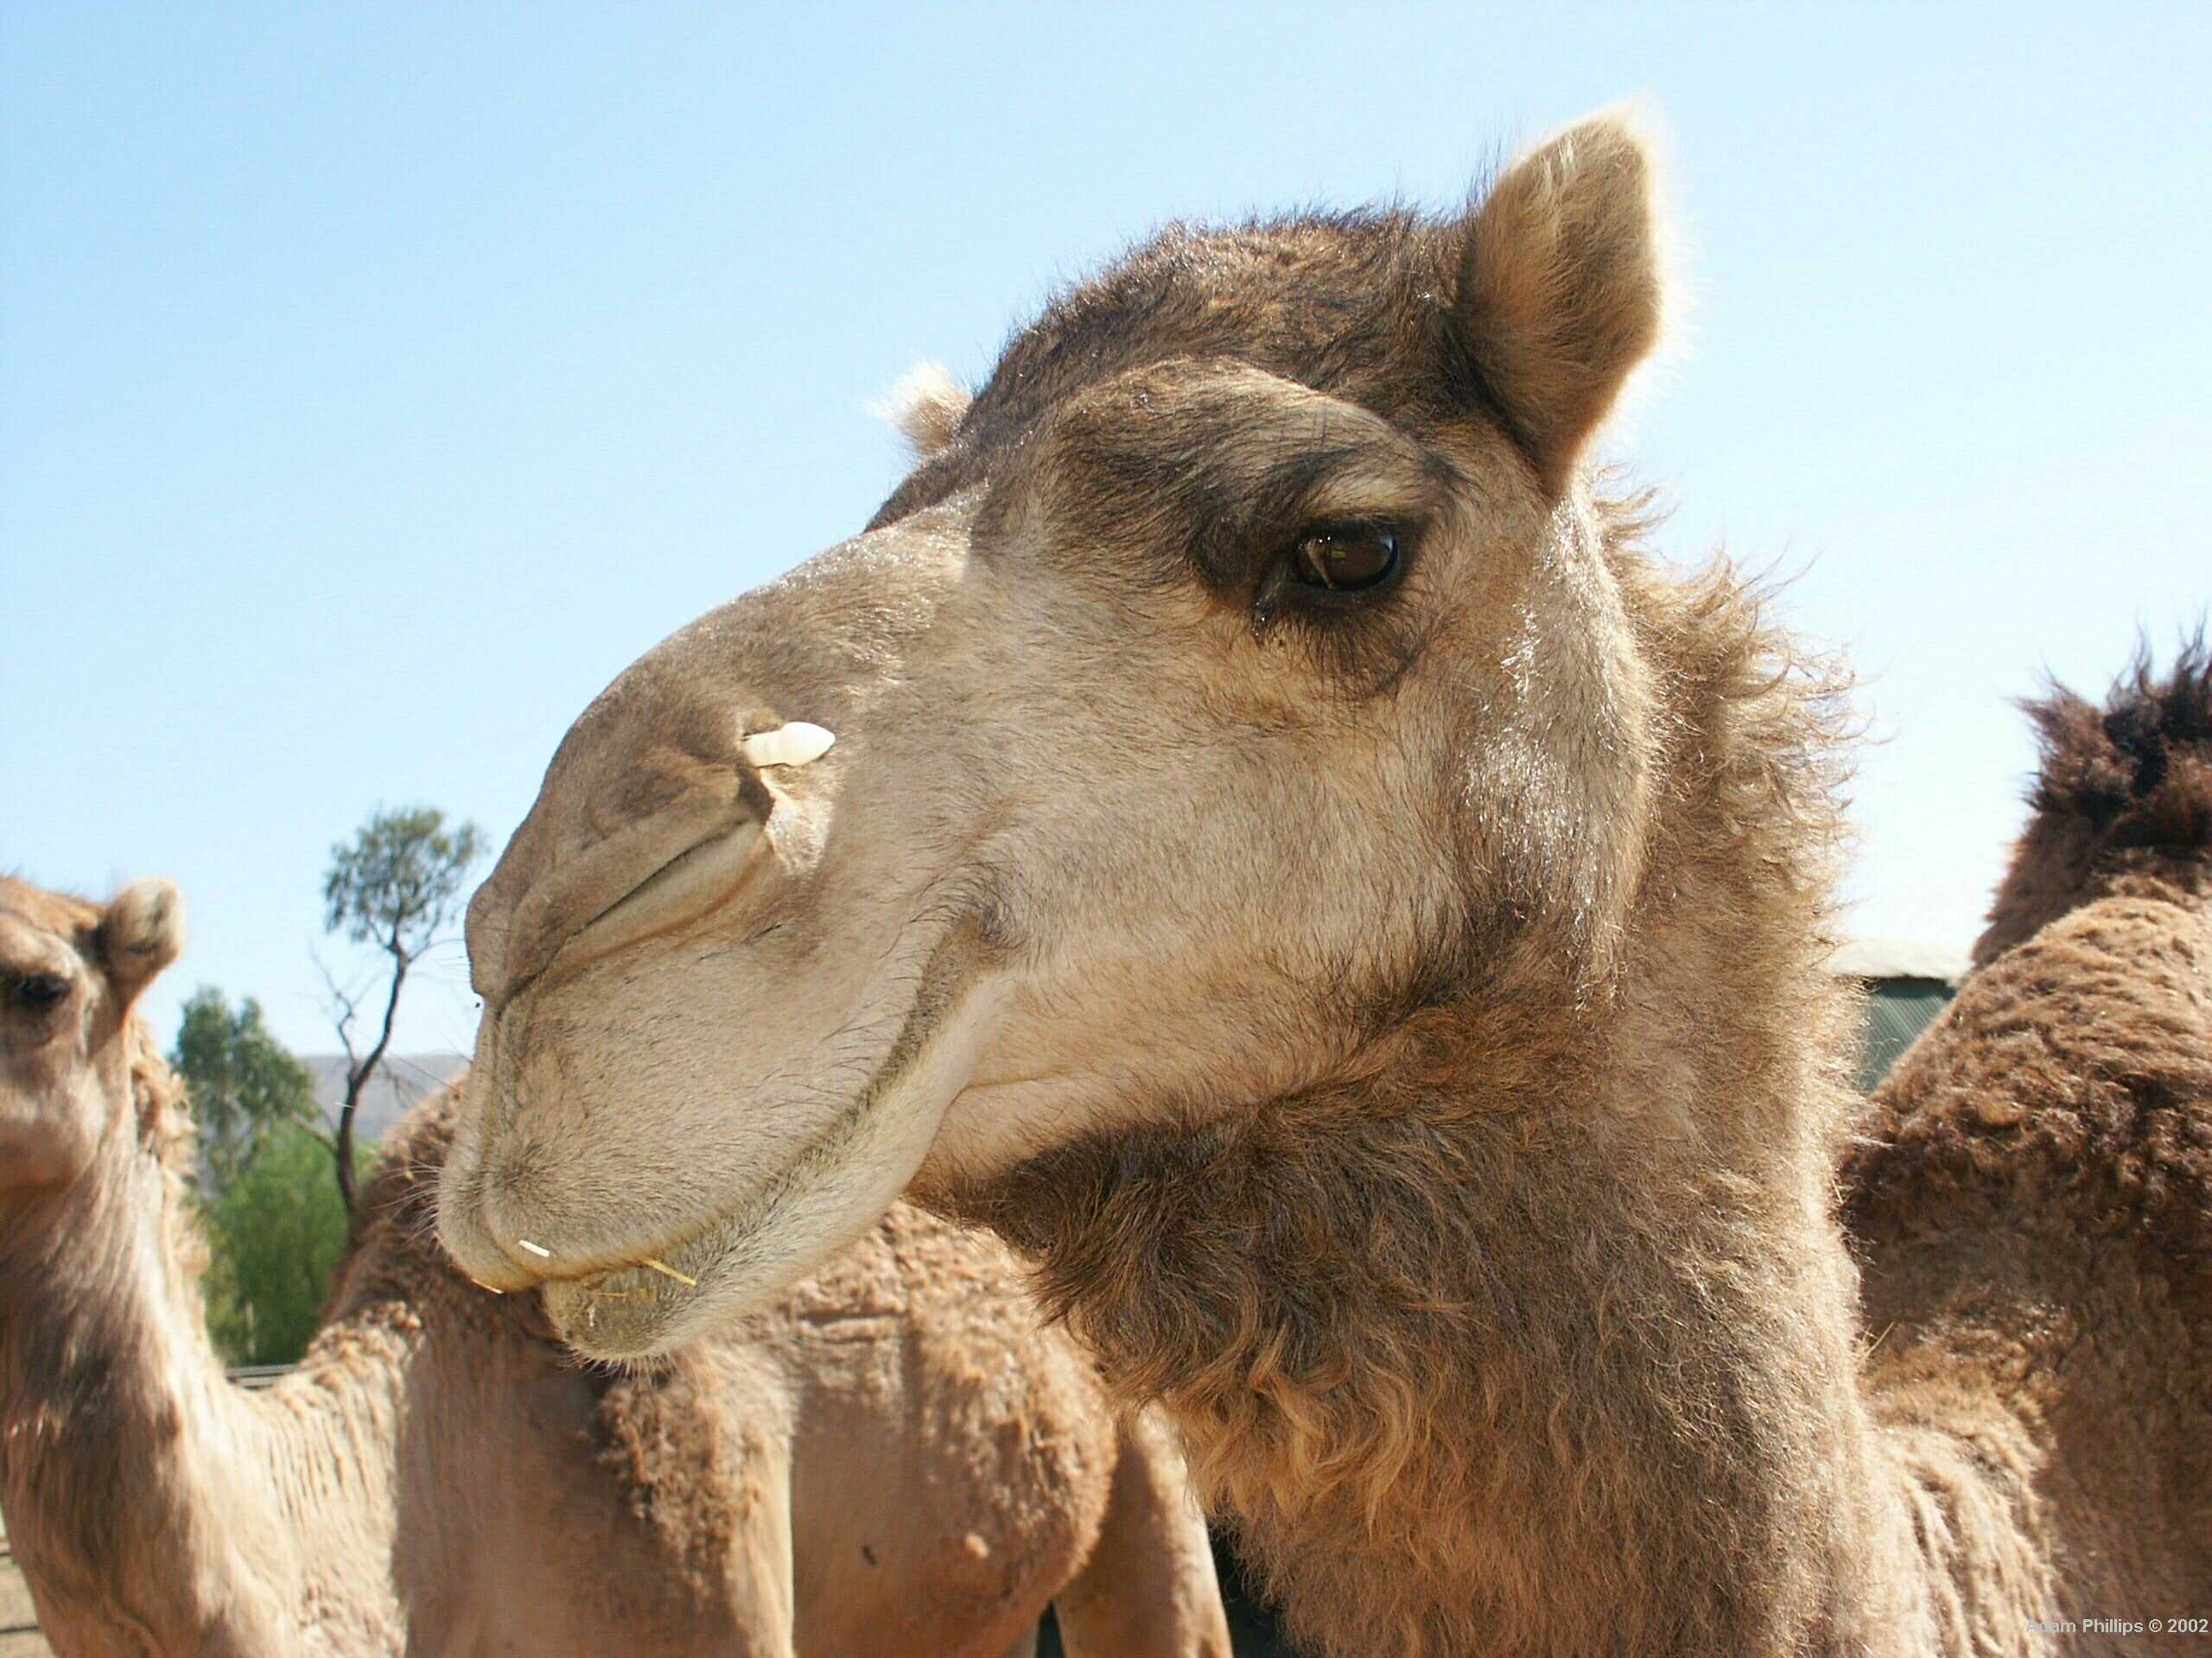
http://www.4am.org/photos/kools/Camel.jpg
Notes:
This is your camel for the caravan. It will be your job to keep your camel clean and fed. These guys may smell a little funny, but they really are clean.

Slide 5
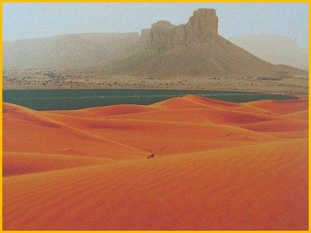
http://p.vtourist.com/145729-Desert_Will_Change_To_GreenSoon-Saudi_Arabia.jpg
Notes:
As we tour through the desert of Saudi Arabia, I think it is important to mention a bit about the religious history of the Middle East. Did you know that Judaism, Christianity, and Islam began in the Middle East? We’ll talk more about that when we visit the city of Jerusalem.
The Middle East has been the center of more than 20 major conflicts from the Persian-Greek Wars to the Crusades to the Iran-Iraq War. After World War I, the decline and dismemberment of the Ottoman Empire marked the beginning of a new stage of conflict over territory centering around the lands of Palestine. Israel, for example, has been the stage for religious struggles between Israelis and Palestinians over religion and land since 1948.
Religion is not the only reasons wars are fought in this part of he world. Disagreements about government can cause problems as well. Saudi Arabia is a monarchy. Who can tell us what a monarchy is?
PAUSE

Slide 6
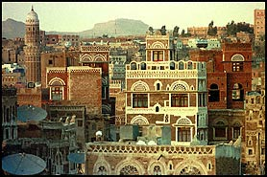
http://www.thewashingtonpost.com/wp-srv/inatl/images/searchtheworld/yemen.jpg
Notes:
Here we are in Yemen. Very different from Saudi Arabia, Yemen is a republic like the United States. Be careful as we pass through this country as it is known for sand storms!

Slide 7
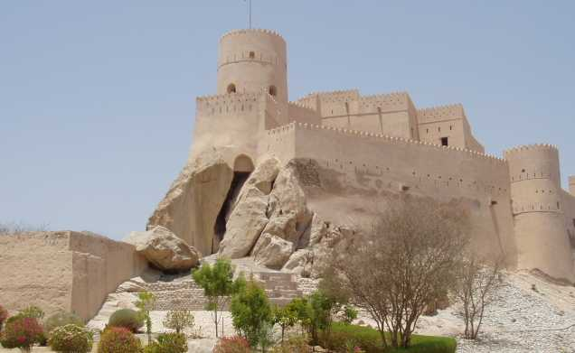
http://www.ross.navy.mil/images/oman/Oman%20Fortress1.jpg
Notes:
If you look to your right you’ll see the Oman Fortress. Lets stop here and let our camels rest. Why don’t we take a moment to write in our journals?

Slide 8
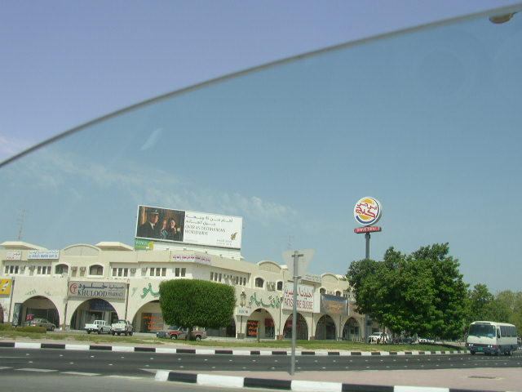
http://www.andrew.cmu.edu/user/skz/pictures/qatar2004/FastFood/Qatar%20Burger%20King.JPG
Notes:
Look at this! A Burger king in Qatar (KUH-tar)! Anyone hungry? We should eat before we get on the boat to cross the Persian Gulf to Iran.

Slide 9
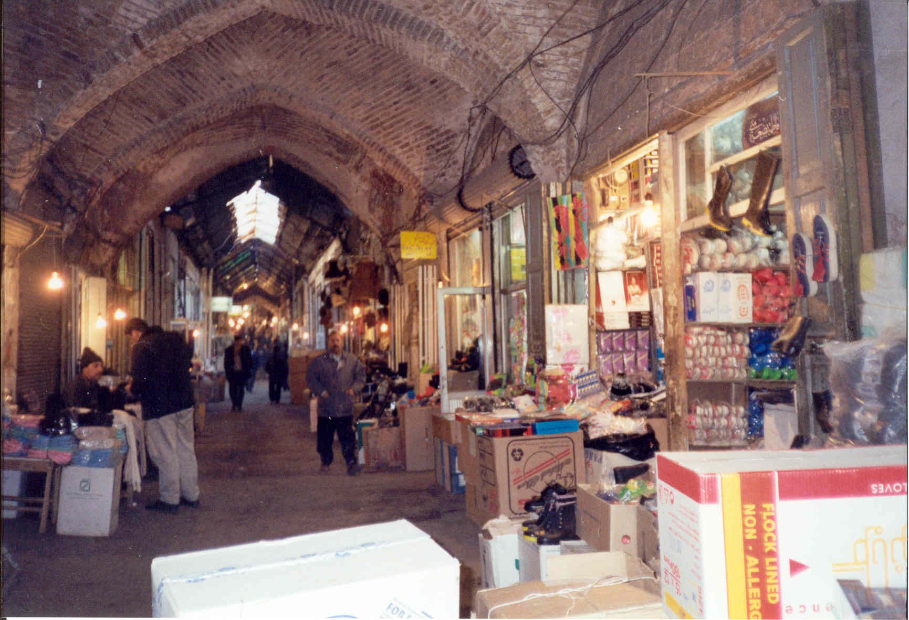
http://www.painetworks.com/photos/hh/hh1214.JPG
Notes:
This is the Old Bazaar in Iran. Iran is a country of about 70 million situated East of Iraq, beyond the Tigris River, Shatt Al-Arab waterway and East of the Persian Gulf, across from Saudi Arabia. To the North, it borders on former Soviet Central Asian countries including Armenia Turkmenistan, Azerbaijan and the Caspian Sea. It also borders on Afghanistan and Pakistan in the East, and Turkey to the West.
As ancient Persia, which included parts of Iraq, Iran has a long, creative and glorious history. Unlike many other Middle Eastern countries, Iran managed to remain independent throughout much of its history. Today it has a population of about 70 million persons.
The overwhelming majority of Iranians--at least 90 percent of the total population--are Muslims who adhere to Shia Islam. In contrast, the majority of Muslims throughout the world follow Sunni Islam.
The Koran, the holy Muslim book, is believed to be the sacred writings of Islam revealed by God to the prophet Muhammad during his life at Mecca and Medina. We will visit Mecca at the end of our journey.

Slide 10
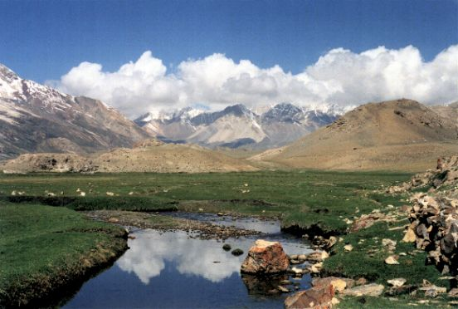
http://www.ramsar.org/pictures/pakistan-wwf3.jpg
Notes:
We are now at high altitudes in the wetlands of Pakistan. Are your ears popping?
Lets enjoy the beautiful scenery and journal a bit.

Slide 11
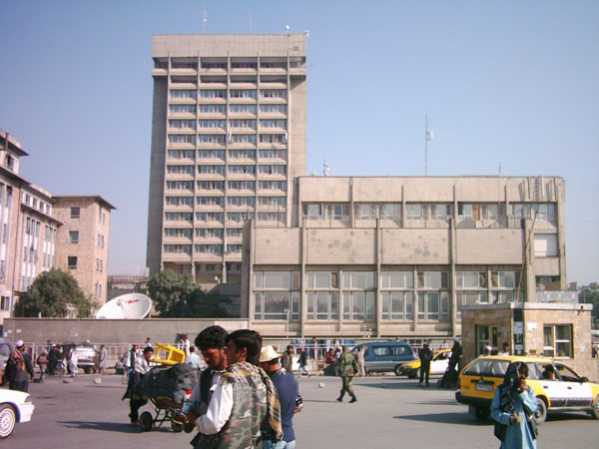
http://www.hazara.com/photo/large/Da%20Afghanistan%20Bank.jpg
Notes:
This is the Kabul da Bank in Afghanistan. Lets take a moment to rest our camels and journal.
Does anyone remember the main idea of The Day the Music Died ?
Resources:
The Day the Music Died
http://www.now.org/nnt/03-98/taliban.html
PAUSE/DISCUSS

Slide 12
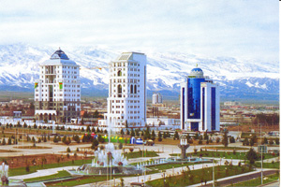
http://www.tatilonline.com/ulkeler/Beauty%20of%20the%20white-stone%20buildings.jpg
Notes:
If you look to the left you can see a beautiful view of the city of Turkmenistan.
Out current location is Central Asia, bordering the Caspian Sea, between Iran and Kazakhstan.
We are leaving our camels here. We need to get on a plane to Lebanon. Although I’d love to show you Turkey and the Greek Isles, we just don’t have enough time.

Slide 13
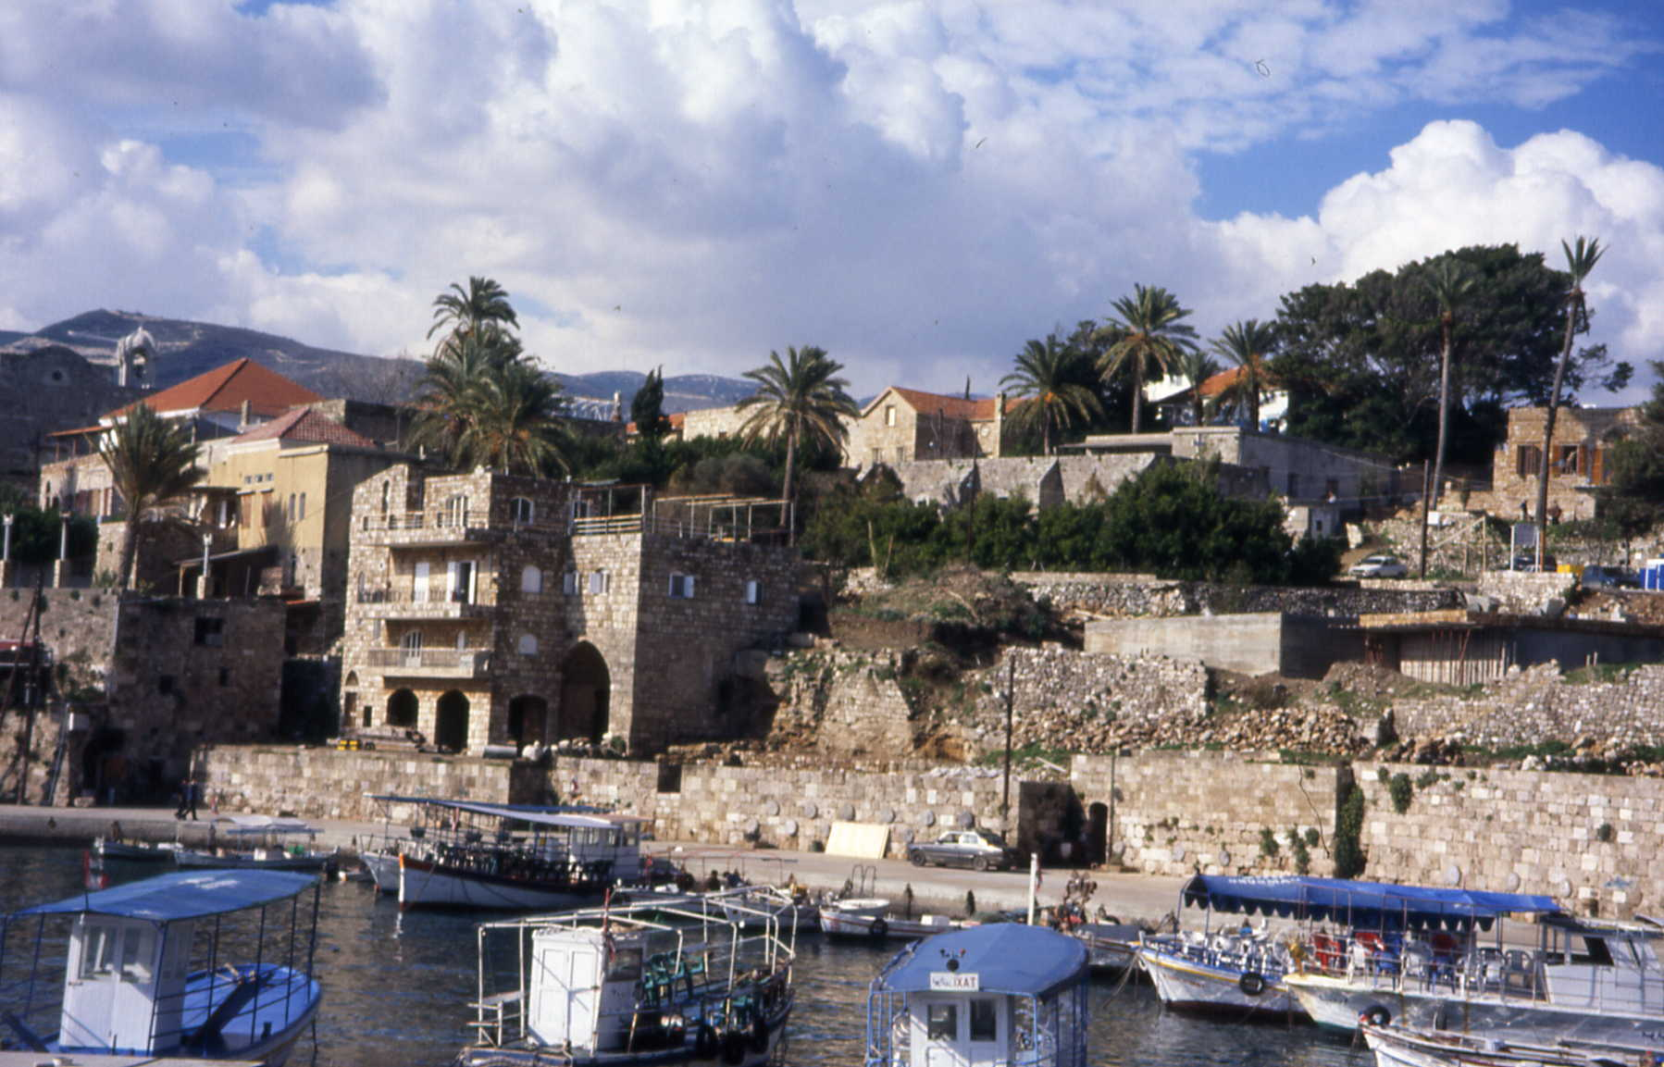
http://www.chass.utoronto.ca/~guenther/images/Byblos,-Lebanon-1.JPG
Notes:
Want to buy some waterfront property in Lebanon? We can pick up our new camels here.
Lebanon has made progress toward rebuilding its political institutions since 1991 and the end of the devastating 15-year civil war. Under the Ta'if Accord - the blueprint for national reconciliation - the Lebanese have established a more equitable political system, particularly by giving Muslims a greater say in the political process while institutionalizing sectarian divisions in the government. Since the end of the war, the Lebanese have conducted several successful elections, most of the militias have been weakened or disbanded, and the Lebanese Armed Forces (LAF) have extended central government authority over about two-thirds of the country.

Slide 14
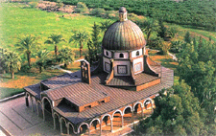
http://www.tcindia.com/cat/O_Bound/imageupload/D76O69Y74_698394870_isreal_.gif
Notes:
We’ve arrived in Tel Aviv in Israel. Who can remind the group what we said earlier about religious disagreements in this region?
Lets move on to Jerusalem.

Slide 15
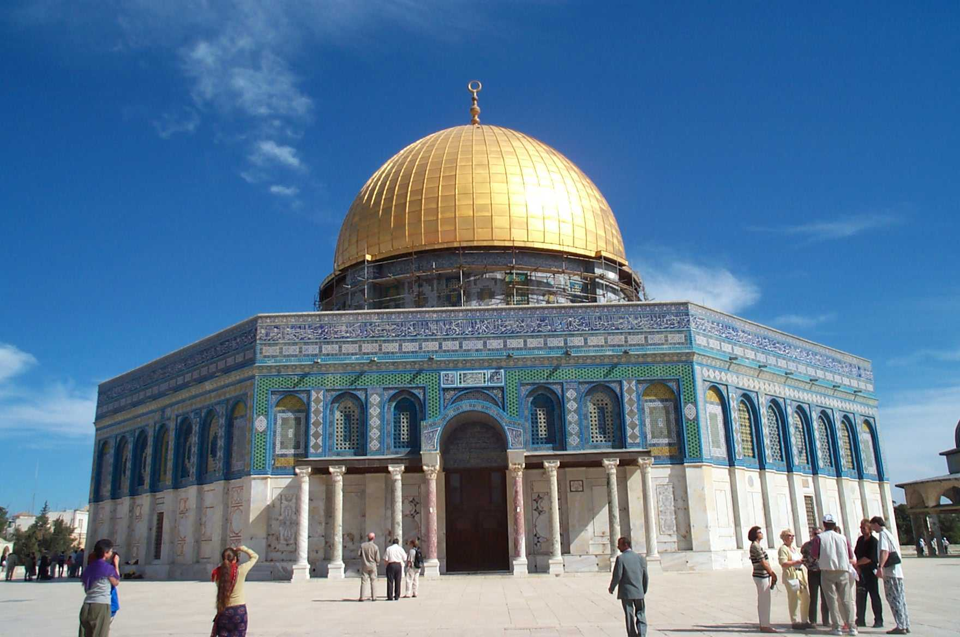
http://users.wsg.net/bedrosian/images/Dome_Rock.JPG
Notes:
This is the Dome of the Rock in Jerusalem. Jerusalem is the capital and largest city of Israel. It is located between the Mediterranean Sea and the Dead Sea. Jerusalem is considered the holiest city of Judaism, Christianity, and Islam. Because of this, Jerusalem has been the center of many battles for the rights of the city. Throughout history, the Persian, Syrian, Jewish, Roman, and Muslim Empires have controlled Jerusalem.
Judaism is the religious culture of the Jewish People and is one of the world's oldest religions. Judaism makes up the cultural system of Jewish law, custom, and practice of the whole individual and community. It is a system in which everyone is under God's rule. Judaism originated in the Middle East and has spread throughout all parts of the world because of both voluntary migrations and forced exile or expulsions. The total world Jewish population is about 15 million, most of whom live in the United States, Israel, and the former Union of Soviet Socialist Republic.
With an approximately 1.7 billion people world wide, Christianity is arguably the largest religion in the world today. Started at around 30 AD, Christianity is based on the teachings and life of Jesus Christ. Christianity was founded in the first century in Palestine by the disciples of Jesus. Many missionaries spread it, despite heavy persecution, throughout the Roman Empire. Perhaps the most notable missionary was Paul. The various books written by Jesus’ followers after his death, called the New Testament, along with the Old Testament makes up the Christian Bible. The Bible holds all the teachings of Jesus on how all Christians should live out their lives.
Islam is a major world religion founded in Arabia. Based on the teachings of a man named Muhammad, one who practices Islam is called a Muslim. A practicing Muslim follows the teachings from the Koran, (sometimes written as Qu’ran). It is the written revelation from Allah to Muhammad. The Muslim population is estimated at more than 1 billion covering many different areas of the world. It is most common in Africa, the Middle East, and sections of Asia and Europe. There are 6 million Muslims in the United States alone.

Slide 16

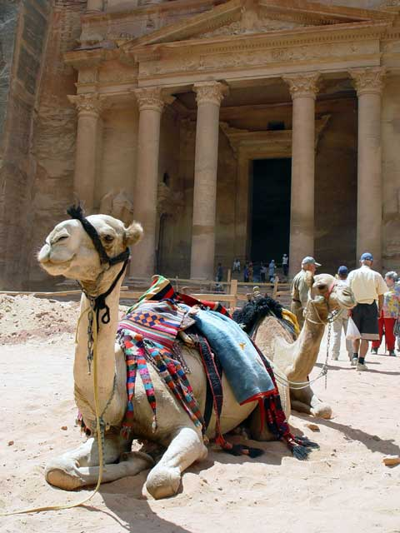
http://www.floridabaptistwitness.com/661.camel_treasury.jpg.image
Notes:
This is the City of Petra in Jordan, another Middle Eastern Monarchy. Looks like some of the camels are already resting. We should join them and journal.

Slide 17
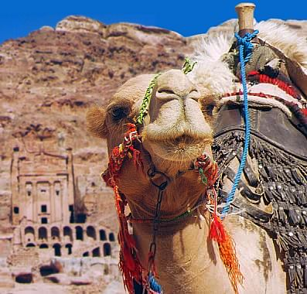
Notes:
Can you see the Rock Tombs behind your camel? If we wanted to visit Egypt from here, we’d just have to cross the Suez Canal!
Maybe next time.

Slide 18
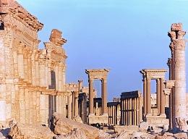
http://www.culturefocus.com/palmyra-1small.jpg
Notes:
Welcome to the abandoned pre-Roman city of Palmyra in Syria. We sure have covered a ton of information.

Slide 19
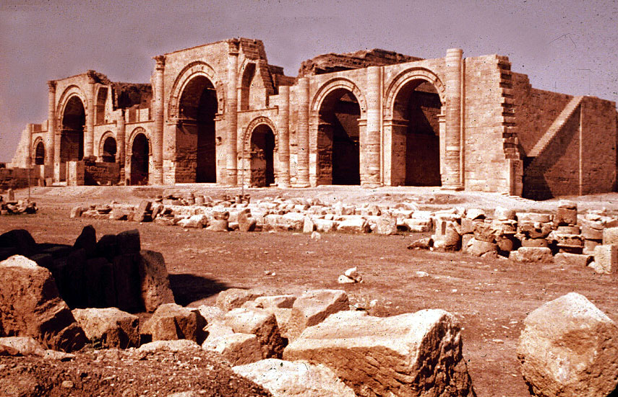
http://www.oberlin.edu/art/Iraq/Iraq-026.JPG
Notes:
This the Mithra Temple in Iraq. We have circled back to the Persian Gulf area and I’d like to take this time to talk a little bit about Middle Eastern economics.
OPEC
Organization of Petroleum Exporting Countries (OPEC) members include Algeria, Indonesia, Iran, Iraq, Kuwait, Libya, Nigeria, Qatar, Saudi Arabia, the United Arab Emirates, and Venezuela. Most of these countries are located in the Middle East near the Persian Gulf. OPEC was founded in Baghdad, Iraq, in September 1960, to unify and coordinate members' petroleum policies. OPEC members' national oil ministers meet regularly to discuss prices.
Simply stated, the economy of the Middle East is based on the largest export of the region, oil.

Slide 20
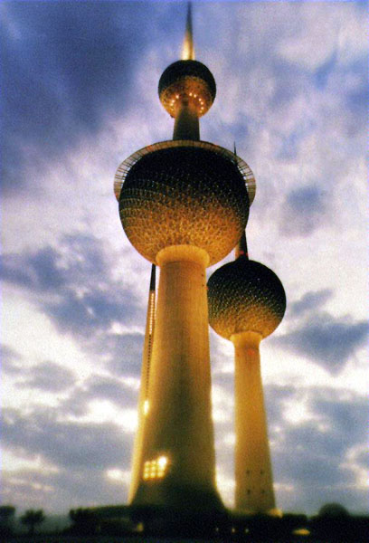
http://images.google.com/imgres?imgurl=http://www.kuwaitboom.com/images/kuwait-pic/towers1
Notes:
Here we are at the Kuwait towers. This is our third monarchy that we will visit on this trip. The proper name is the State of Kuwait and it is considered a nominal constitutional monarchy.
Kuwait is a small, rich, relatively open economy with proved crude oil reserves of about 96 billion barrels - 10% of world reserves. Petroleum accounts for nearly half of GDP, 95% of export revenues, and 80% of government income. Kuwait's climate limits agricultural development. Consequently, with the exception of fish, it depends almost wholly on food imports. About 75% of potable water must be distilled or imported. Kuwait continues its discussions with foreign oil companies to develop fields in the northern part of the country.

Slide 21
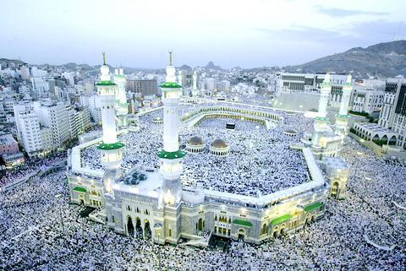
http://www.taipeitimes.com/images/2004/01/30/20040129185134.jpeg
Notes:
Welcome to the holy city of Mecca. This is the most important city for the Islamic religion. Muslims try to make a hajj, or a pilgrimage, to this city at least once in their lives.
The Koran, the holy book of Islam, is a record of the exact words revealed by God through the Angel Gabriel to the Muhammad. Muhammad memorized the words and then taught his Companions. Then scribes, who checked with Muhammad during his lifetime, wrote down the words. Not one word of its 114 chapters has been changed over the centuries.
The Koran is the primary source of every Muslim's faith and practice. It deals with all the subjects that concern all human beings: wisdom, beliefs, worship, and law. However, it focuses on the relationship between God and His creatures. It also provides guidelines for a just society, proper human relationships and equal divisions of power.

Slide 22
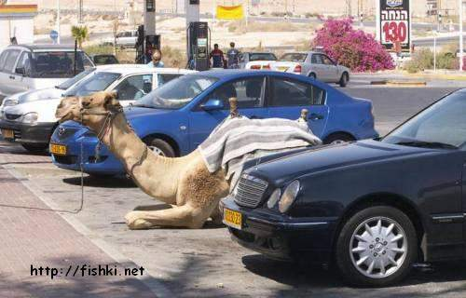
Notes:
Welcome back to OMS. We probably shouldn’t let that camel park next to Mrs. Shipman’s car!
Lets take a moment to journal before we go inside.

