Slide 1

FEDE BOM – Web Server Side Automation Frame Work
Approach for Automation
Automation of End to End functionalities using web service calls like to Create CMF(Concept CMF), Basic Search, Add Part, etc.
Use of Journal Log file as an input to read the web services request and response.
Input :
Test data Input from .xls or flat file , web services jar files, Json files, etc.
4. Output:
In case of Failure : attribute values mismatched or Error message from server
In case of Success : CMF number, Modified attribute value, etc.
Note: This approach will not validate the UI based calls,
even if the services are returning the values
It will not sure the UI code is not broken. (Manual test cases may not work).

Slide 2
FEDE BOM – Server Side Automation Frame Work
Pre-Requisites
FEDEBOM Application Server : Based of the latest version I6 or D4
Jdk version : 1.8.0.91
Eclipse version : Mars
Gradle Version : 2.14.1
Local setup for environment(I6/D4) has to be configured to generate BomUIApplicationJournalLog.log
Accurev.
Jars : Latest jar files from Accurev
Web services Names to be known upfront.
Need to verify server response with the actual application values.
Knowledge of different services layers
The flow of the current web service calls is based on the development code, if the code or flow of the implementation changes we need to update the test cases and json files
We need to have access to accurev to get the latest jar files.

Slide 3
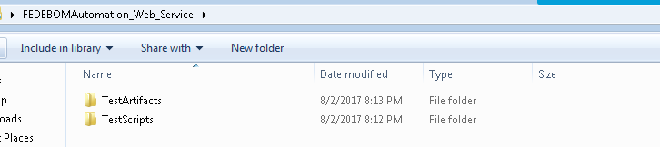
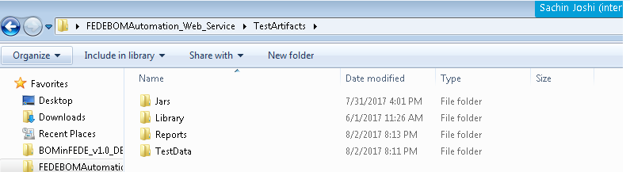
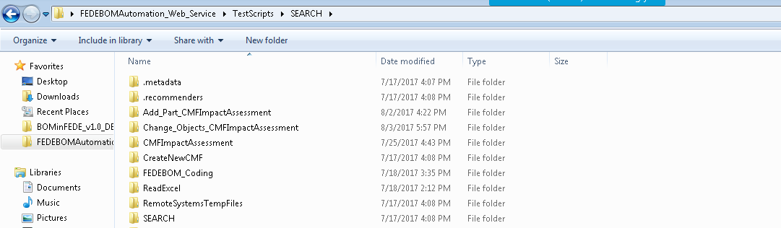
FEDE BOM – Server Side Automation Frame Work
Framework
Main folder for Web services Automation which includes 2 subfolders
TestArtifacts will contain latest application jars, Business library files (.java), Execution reports and Test data files
TestScripts folder will contain scenario based test cases/ code snippets

Slide 4
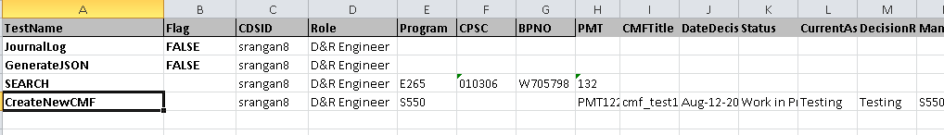
FEDE BOM – Server Side Automation Frame Work
Input Files
Input Data
Relative Paths

Slide 5
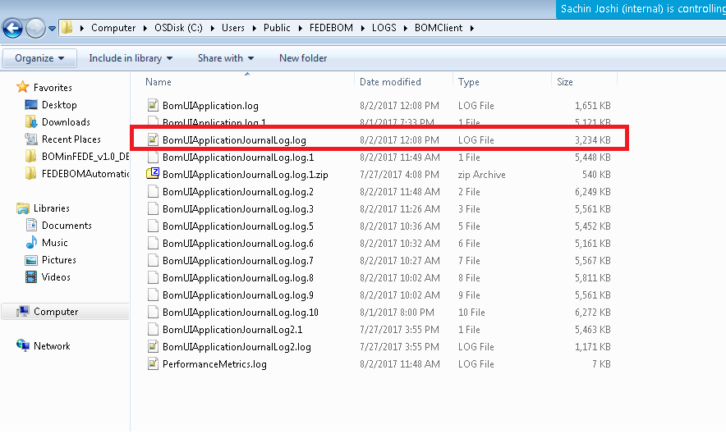
FEDE BOM – Server Side Automation Frame Work
Journal Log File
This file will contain the server request and response for each operation

Slide 6
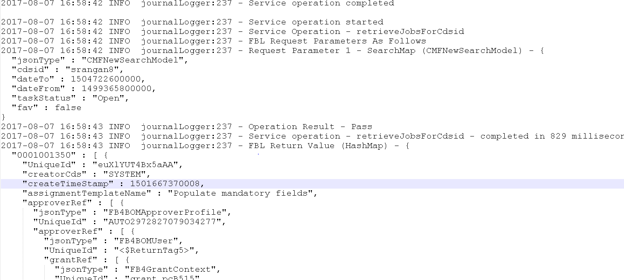
FEDE BOM – Server Side Automation Frame Work
Manual execution log file (e.g. Add Part.log)
We will execute all the manual steps to get the log file as listed below to capture all the
Web service call for request and response to create a json file.

Slide 7
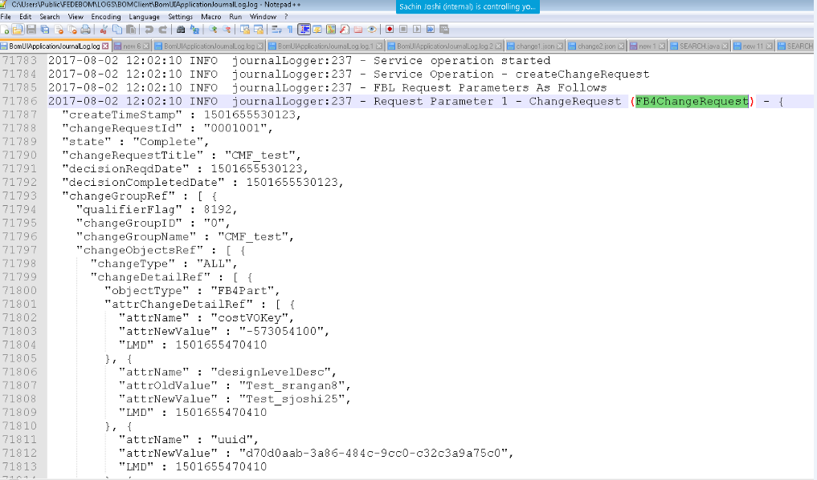
FEDE BOM – Server Side Automation Frame Work
Sample Request format(json file)
We will use this json file to create an java object which is used for web service call

Slide 8
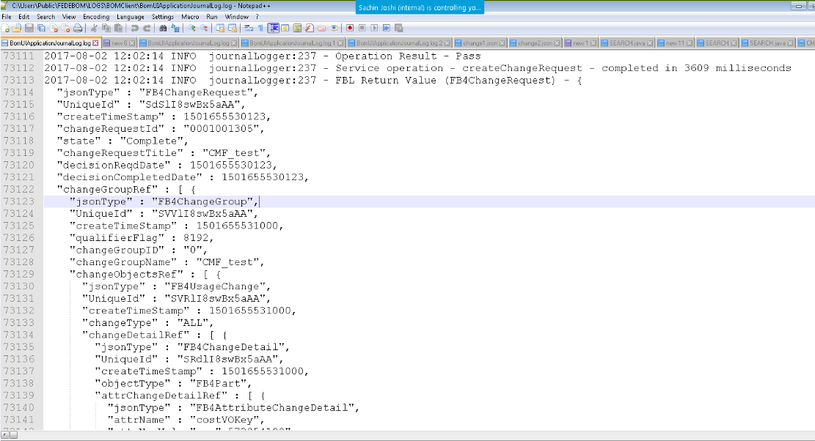
FEDE BOM – Server Side Automation Frame Work
Sample Response format
Below is the sample for create change response parameters from Journal log file.

Slide 9
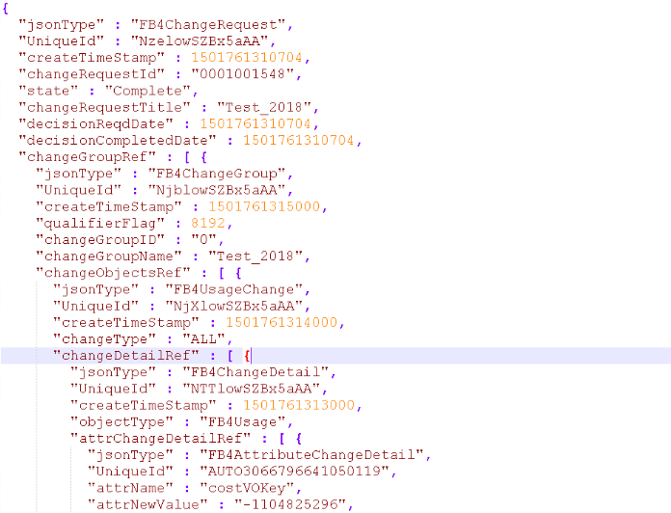
FEDE BOM – Server Side Automation Frame Work
Input Files
Sample json File
This is sample json file which we are generating from the BOMUIApplicationJournalLog.log
where we will create this json file based on which object we need to execute web service call

Slide 10
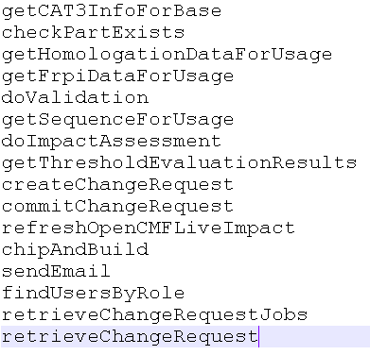
FEDE BOM – Server Side Automation Frame Work
Updates on - Add Part Creation
Web service calls:-
Below are the list of web service calls for Add Part

Slide 11
FEDE BOM – Server Side Automation Frame Work
Updates on - Add Part Creation - continued
Requirement:
We need to have 8 different json files to give as an input for above listed web service call.
We need to convert request json to corresponding java objects.
Current progress:
We have converted 2 json files out of required 8 json files.
We are working on converting 6 json files in to java objects.
We need approx 2-3 days more to convert these files.
Difficulties:
De-serialization is difficult since there are unknown field properties.
In Order to overcome this difficulty we need to change/update Class "mixin" to print
all the request parameters correctly in the log file.
JAVA JAVA/JSON
e.g. mapper.addMixIn(FB4Usage.class, FB4UsageMixin.class);
Documentation of web service calls is required for each process which needs to be automated

Slide 12
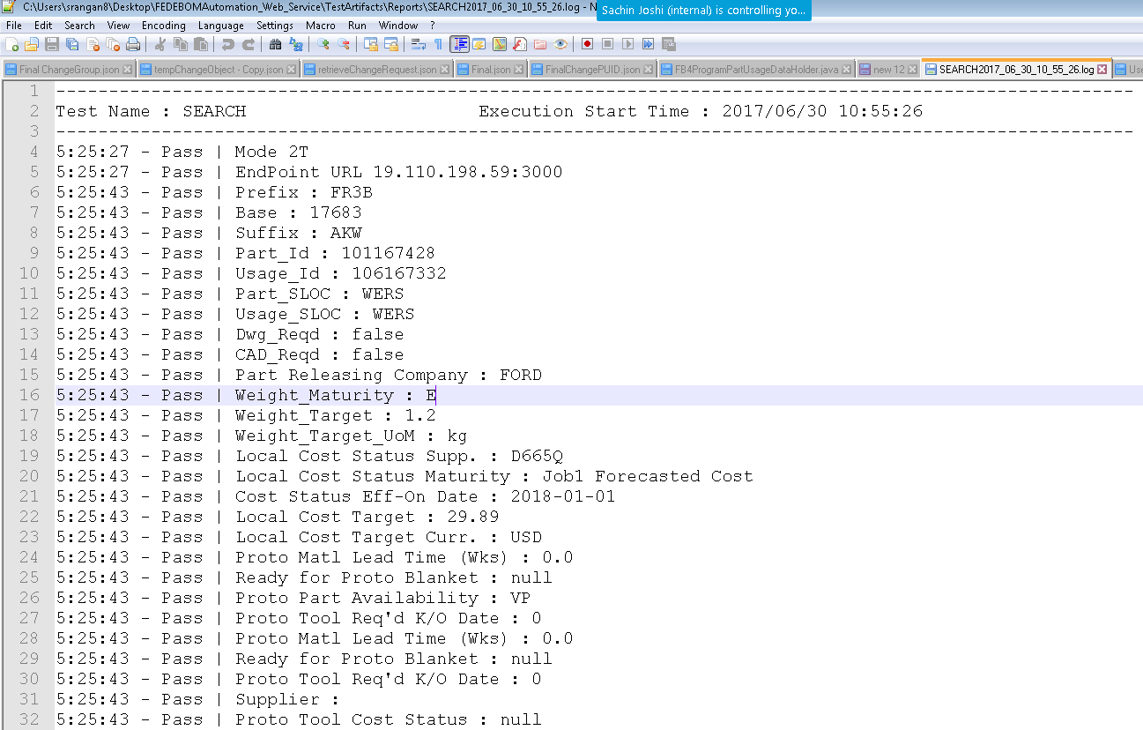
FEDE BOM – Server Side Automation Frame Work
Sample Log File
This is final output file where we will list the results of web service call which will list all the errors
Or success logs for each validation.

