Slide 1
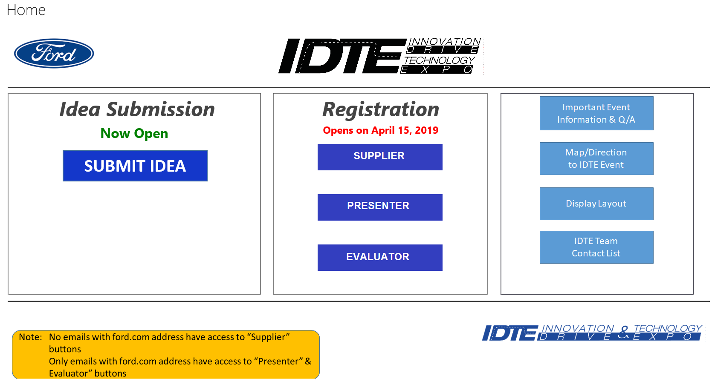
Click here if not Ford

Slide 2
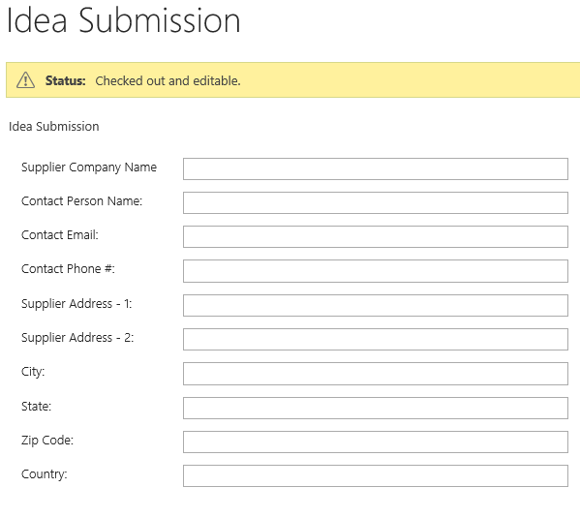



Slide 3


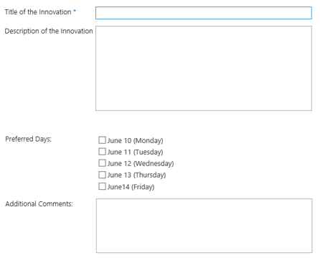
Date Selection
Name, Company Name Do not need title of innovation or description Invitee only and they will need Tech
Supplier
Presenter

Slide 4

Evaluation Team Supplier Selection
Supplier
Presenter
Evaluation Team

