Slide 1
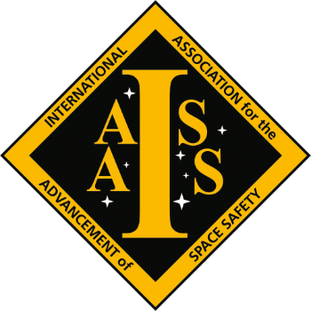
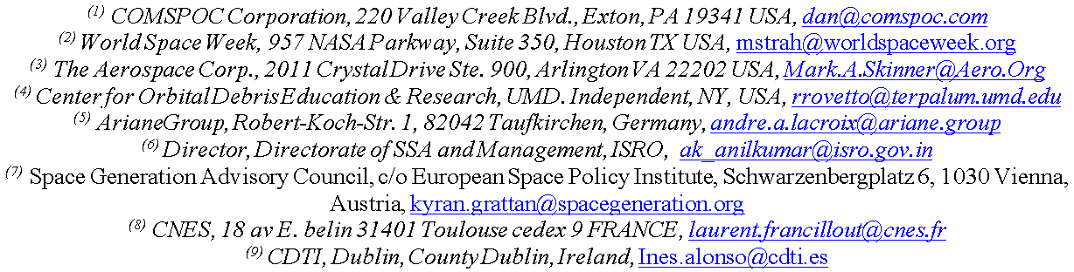



RECOMMENDATIONS OF THE IAF SPACE TRAFFIC MANAGEMENT TERMINOLOGY WORKING GROUP
Dan Oltrogge ⁽¹⁾, Maruska Strah ⁽²⁾, Mark A. Skinner ⁽³⁾, Robert J. Rovetto ⁽⁴⁾, Andre Lacroix ⁽⁵⁾,
A K Anil Kumar ⁽⁶⁾, Kyran Grattan ⁽⁷⁾, Laurent Francillout ⁽⁸⁾, Ines Alonso ⁽⁹⁾
Notes:
I’m Dan Oltrogge with COMSPOC Corporation, and I’m pleased to represent the work of the International Astronautical Federation’s STM Terminology Working Group. My coauthors are listed below on the slide, representing a diverse set of organizations from six countries.

Slide 2
Context: IAF TC26 Space Traffic Management (STM) study
Terminology - Common understanding and Definitions
Improving the knowledge
New technical means of space objects monitoring
Improve trackability and identification of small objects
Data fusion - Merging of information
Improvement of orbital data precision and accuracy
Improvement of the UN registration
Shared Catalog
Hazards associated with reentry
Operations
Space capacity management
Management of RF interferences
Improvement of the collision avoidance process
Future operations
Spacetugs, IOS, IOM, IOR
Massive constellations
Sub-orbital activities
Ground support activities such as spaceports
Transits through airspace
Impact of constellations on Astronomical observations
Preparation of future activities
Traffic from orbit to Moon (and Mars)
Technical regulations
Current references
New activities
Effective compliance to Technical Regulations
Outreach
Notes:
The International Astronautical Federation (IAF) has dedicated technical committees. Formed in 2019, the IAF’s Technical Committee #26 (TC26) deals with Space Traffic Management (STM).
This STM Technical Committee included the contributions of 117 experts (21 observers, 96 active), with a very good match to the so-called “3G” goals promoted by IAF: Geography (18 different countries), Gender (≈ 30% women), Generation (significant number of Younger experts).

Slide 3
What is Space Traffic Management (STM)? Many definitions exist!
Space Traffic Management Attribute | Aerospace | Athens Univ. | Blout | DLR | IAA COSMIC | GWU | ITU | NASA/JSC | US National Space Policy | US SPD-3
Best practices, standards, tech means | ● |  | ● |  | ● |  |  |  |  | ●
Free from physical interference | ● |  | ● |  | ● |  | ● |  |  | ●
Free from RF interference | ● |  | ● |  | ● |  | ● |  |  | ●
Information security |  |  |  |  |  |  |  | ●
Monitoring and notifications | ● |  |  | ● |  |  |  | ● |  | ●
On-orbit collision avoidance | ● | ● |  |  |  | ● |  | ● |  | ●
Plan, coordinate, synchronize activities |  |  |  | ● |  |  |  |  | ● | ●
Pre-launch risk assessments |  |  |  |  |  |  |  |  |  | ●
Safe launch |  | ● |  | ● | ● |  | ● |  | ● | ●
Safe orbit operations |  | ● |  | ● | ● |  | ● |  | ● | ●
Safe return from space |  | ● |  | ● | ● |  | ● |  | ● | ●
SSA |  | ●
Licensing and allocation |  |  |  | ●
Regulatory |  | ● | ● |  | ●
Rules of the road |  |  |  |  |  |  |  | ●
Traffic control/enforcement | ● | ● |  |  |  | ● |  | ●
Regulatory/
enforcement
Notes:
As with Space Situational Awareness, there are many definitions of Space Traffic Management. Some definitions include licensing and regulatory or control aspects, and some do not. For those that do specify traffic control and enforcement, note that at present, none specify “Turn left” or “Turn right.”

Slide 4
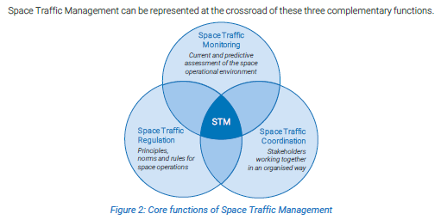
European Space Policy Institute (ESPI) STM core functions
Notes:
This Venn diagram was contained in the European Space Policy Institute’s comprehensive report from 2020, providing a European construct on the overlap of monitoring, coordination and regulation, with Space Traffic Management living in the intersection of all three core functions.

Slide 5
SDA/SSA/STM Equities
Embedded within:
Laws of Physics
Outer Space Treaty
Space Domain Awareness
Space Situational Awareness
‘Safety Culture’
Protect &
Defend
Space Medicine, nuclear space tech
National Security/Military
equities
Safety of Humans: ground,
Air, space
“any factor, passive or active, associated with the space domain”
Range Safety
Environment
contamination
“Intent”
Safety of Flight
Space Battle
Management
Characterization
Standards & compliance
Regulation/
Licensing
Command & Control
Event Analysis
Positions/“metrics”
Space Control
Authoritative
Catalog
Conjunction Assessment
Launch COLA
RFI
Blue forces
support
OADR
New foreign
Launch/reentry
ADR or JCA
Treaties/Int’l Coop
US Launch/reentry
Missile warning
Space Weather
Sub-orbital
Active Debris Removal (ADR)
Collision Avoidance (COLA)
Just-in-time Collision Avoidance (JCA)
Radio Frequency Interference (RFI)
Intelligence, Surveillance and Reconnaissance (ISR)
Open Architecture Data Repository (OADR)
Space Policy Directive-3 (SPD-3)
ISR
Space Traffic Management
Debris mitigation
Space Safety
Notes:
This Venn diagram introduces the concept of Space Domain Awareness (or SDA) and is one of many such diagrams developed by Mark Skinner and Aerospace Corporation to show the interrelationships between SDA, SSA and STM. This particular diagram is focused on the space safety perspective.

Slide 6
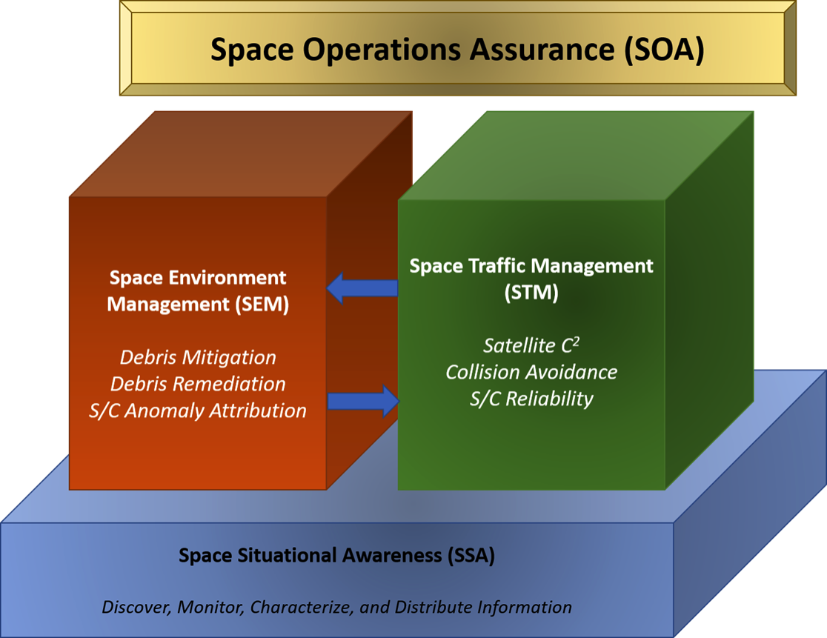
SOA = SSA+ SEM + STM
Notes:
Taken from an AMOS Conference paper authored by Darren McKnight and Tim Maclay in 2019, this depiction shows how space operations assurance is the collective objective that is enabled by STM, SSA and a new term that they developed, called Space Environment Management, or SEM.
Note that in this depiction, SSA is seen as being foundational to both SEM and STM.

Slide 7
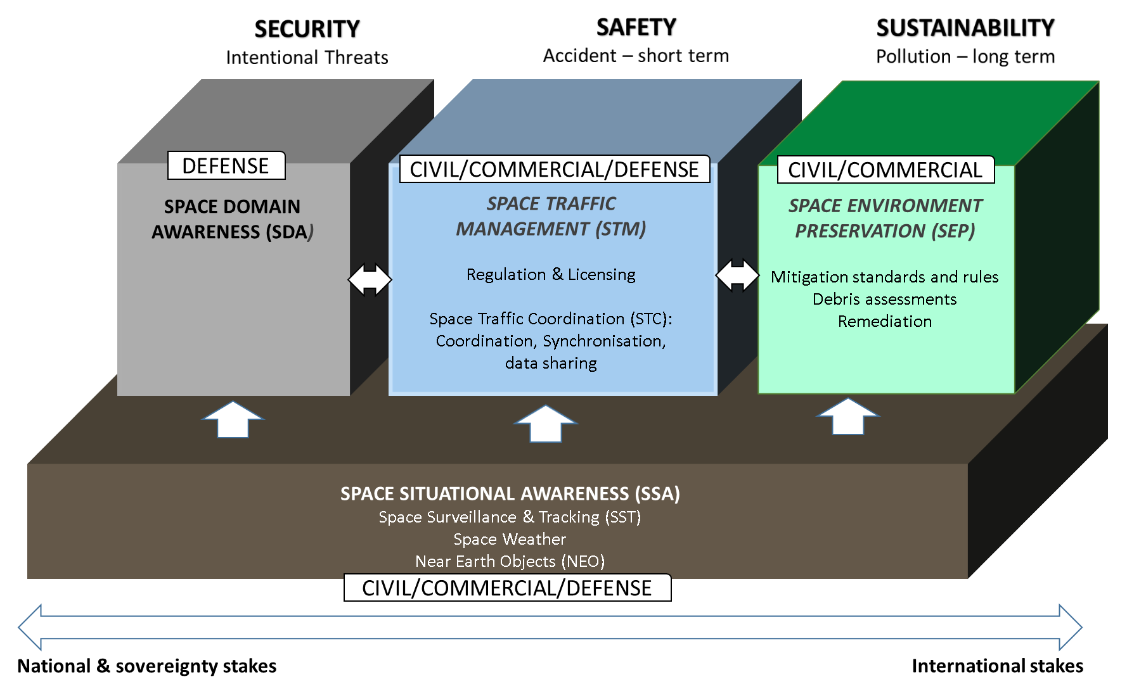
Notes:
Our STM terminology working group decided to adopt elements of each of the three previous concepts as shown in this figure. Note that SSA, consisting of Space Surveillance and Tracking (or SST), Space Weather, and for some, Near Earth Objects, is seen as the foundation of Security, Safety, and Sustainability. While it cannot be denied that each of these three core areas has some overlap and commonality with the others, our group agreed that we can generally use the three categories as shown, where:
Space Domain Awareness is focused on intentional threats to security.
Space Traffic Management addresses short-term space safety and is composed of Space Traffic Coordination (or STC), data sharing, and Regulation and Licensing.
Space Environment Preservation addresses long-term sustainability issues.
Once we had achieved this picture of the categories and their interrelationships, we were in a position to define STM and STM-related terms.

Slide 8
IAF TC26 STM Terminology WG adopted definitions
Space Domain Awareness (SDA) is the effective identification, characterization, and understanding of any factor, passive or active, associated with the space domain (the area surrounding the Earth at altitudes equal to, or greater than, 100 km) that could affect space operations and thereby impact the security, safety, economy, or environment of a nation.
Space Traffic Management (STM) is the assurance value chain that contributes to a safe and sustainable space operations environment, composed of Space Traffic Coordination (STC) and Regulation & Licensing, and dependent upon a foundation of continuous Space Situational Awareness (SSA).
Space Environment Preservation (SEP) is the activity of preserving and sustaining the space operations environment, accomplished by space debris mitigation (adherence to post-mission lifetime and disposal guidelines and rules, prevention of release of mission-related debris, and collision avoidance) and remediation (derelict object removal, relocation, and collision prevention).
Space Situational Awareness (SSA) is “the understanding, knowledge, characterization, and maintained awareness of the space environment: artificial space objects, including spacecraft, rocket bodies, mission-related objects and fragments; natural objects such as asteroids (including Near Earth Objects or NEOs), comets and meteoroids, effects from space weather, including solar activity and radiation [3]; and potential risks to persons and property in space, on the ground and in air space, due to accidental or intentional re-entries, on-orbit explosions and release events, on-orbit collisions, radio frequency interference, and occurrences that could disrupt missions and services.
Notes:
I provide on this chart the four foundational definitions for SDA, STM, SEP and SSA as adopted by the IAF’s STM Terminology Working Group. Please read our paper to get a much more comprehensive set of STM-related terms and definitions.

Slide 9
Safety, sustainability, security may overlap in STM, STC, SDA, SEP
SECURITY
Primarily falls under SDA
Threat(s) posed to operational health, stability, and capabilities of other spacecraft
Security issues may not represent immediate threats to safety (STM) or sustainability (SEP)
SAFETY
Primarily falls under STM
Safety issues exist even in imaginary world where space debris and security threats do not exist.
STC provides critical communications, info exchange and coordinated actions for STM
Regulatory + licensing helps ensure sustainability and safety
SUSTAINABILITY
Primarily falls under SEP.
STM and SEP are related.
Even in absence of new space launches or space security threats, sustainability is an issue.
Notes:
This slide reinforces the differences between the three major categories shown on the previous slide.
Security issues generally fall under the category of Space Domain Awareness. Note that such security issues may not represent immediate threats to either STM or SEP.
RETURN Safety issues are seen as short-term and fall under the category of STM. Note that such safety issues would exist in an imaginary world where our current space debris environment and space security issues were not present.
Space Traffic Coordination, or STC, is the critical synchronization, data exchange and coordination of actions that facilitates STM.
Regulations and licensing works to ensure both safety and sustainability - - so note the obvious tie to not only STM, but also to Space Environment Protection.
RETURN Space sustainability, which is the central focus of the UN COPUOS LTS Guidelines, falls under the category of SEP.

Slide 10
Conclusions
IAF TC26 Space Traffic Management (STM) study examined STM-related terminology
TC26 STM Terminology WG considered many definitions in selecting definitions for the purpose of the IAF STM study
TC26 will be continuing its work, which will be published as a report
Notes:
In conclusion, the IAF’s Technical Committee 26, consisting of 117 SMEs, studied the topic of Space Traffic Management One aspect of this study was to examine STM terminology to determine what terms and definitions that TC26 should adopt for the purposes of its study. This STM terminology WG has now completed its work, which will be incorporated into the TC26 report due out soon.
Thank you for your attention, and I look forward to your questions.

