Slide 1
Movie Recommendation System on Apache Spark
Raghad Rowaida

Slide 2
Why recommendation system
Internet is filled with data
Takes time to search for desired item
Recommendation system makes searching easier, and keep user hooked to the system
Saves a lot of time

Slide 3
Recommendation System Principles
Content based recommendation system
Collaborative Filtering based recommendation system
Hybrid recommendation system

Slide 4

Content based recommendation system
Analyze a user’s data and history to make similar type of recommendation.
User with a registered profile
Gets similar recommendation later
Searches for a type of job

Slide 5
Collaborative Filtering recommendation system
Use user’s rating to find out people of similar taste. Recommend a new item which received high rating from people of similar taste.
P
A
Q
B
R
C
S
D
T
U

Slide 6
Collaborative Filtering recommendation system
Use user’s rating to find out people of similar taste. Recommend a new item which received high rating from people of similar taste.
P
A
Q
B
R
C
S
D
T
U

Slide 7
Collaborative Filtering recommendation system
Use user’s rating to find out people of similar taste. Recommend a new item which received high rating from people of similar taste.
P
A
Q
Strategies
B
R
User based
Item based
C
S
D
T
U

Slide 8
Hybrid recommendation system
Applying a combination of both approaches for recommendation.

Slide 9
Appropriate choice for movie recommender
Content based

Slide 10
Appropriate choice for movie recommender
Content based
Collaborative filtering based
Item based
User based

Slide 11
Appropriate choice for movie recommender
Content based
Collaborative filtering based
Item based
User based

Slide 12
Collaborative Filtering: Algorithm
Represent the dataset as a Matrix of U x I dimension where U – number of user, I number of item (movies) and cell (u,i) – User u’s rating of item i.
Apply Matrix Factorization technique of Machine Learning to decompose the input matrix into user-rating, and item-rating submatrix.
Recommend item to user based on the latent rating above a threshold.

Slide 13
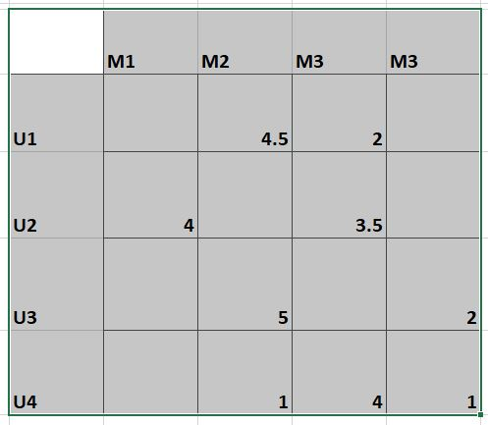
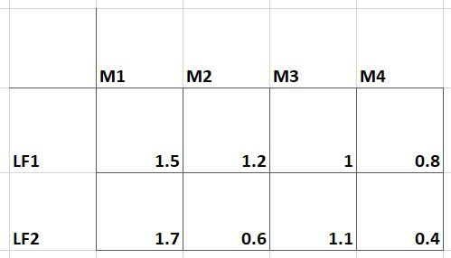
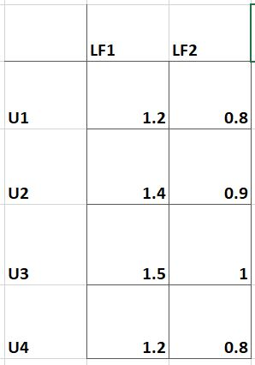
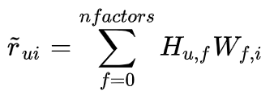
Matrix Factorization: What is it?

Slide 14
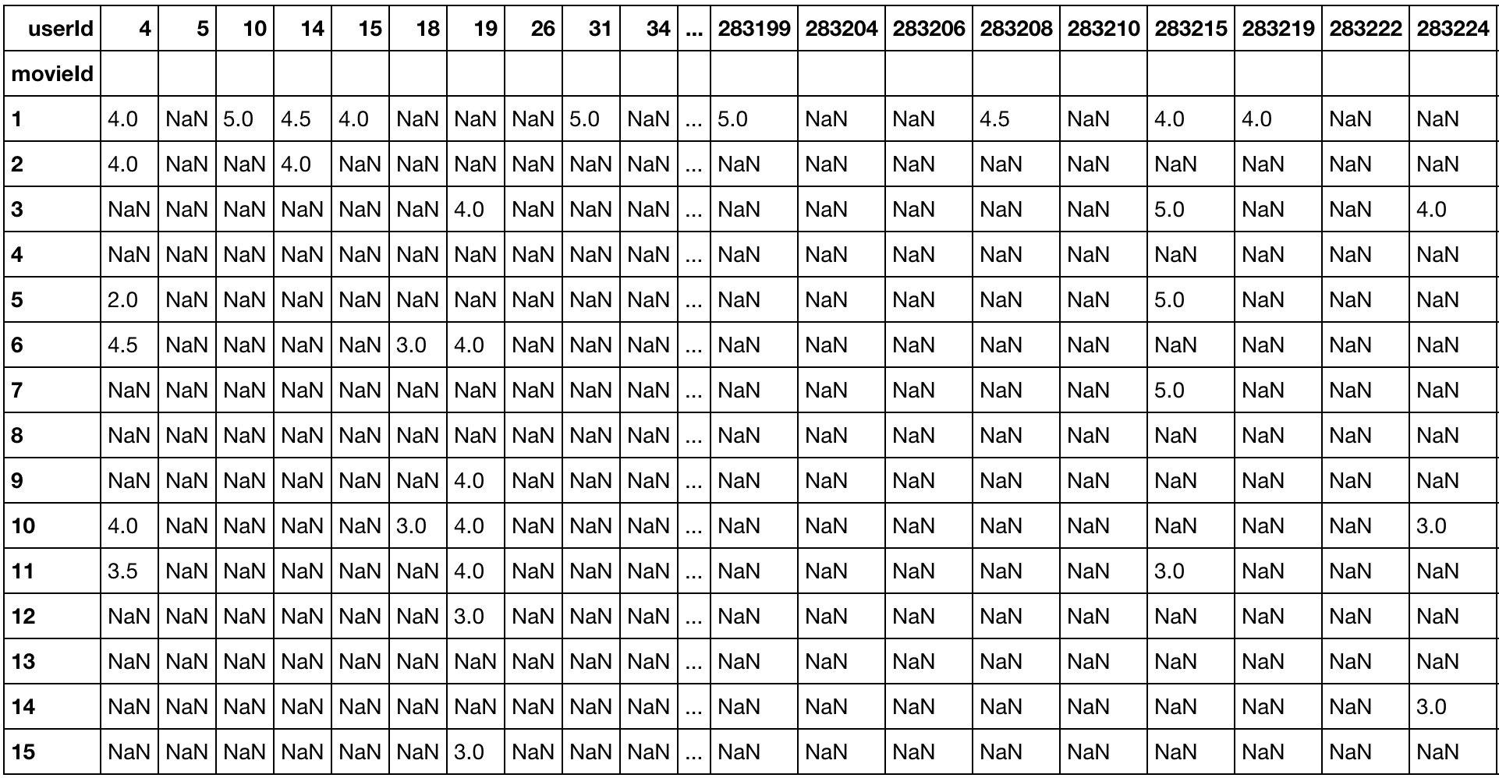
Matrix Factorization: Why?

Slide 15

Matrix Factorization: How?
Select number of latent factor
Apply gradient descent (or any other training routine) to minimize the objective function:

Slide 16
Matrix Factorization: Alternating Least Square
Implemented in Apache Spark ML
Runs in parallel

Slide 17
Alternating Least Square (ALS)
ALS minimizes two loss functions alternatively
First holds user matrix fixed and runs gradient descent with item matrix; then it holds item matrix fixed and runs gradient descent with user matrix
ALS runs its gradient descent in parallel across multiple partitions of the underlying training data from a cluster of machines

Slide 18
Dataset
MovieLens 100K Dataset
100,000 ratings (1-5) from 943 users on 1682 movies
Each user has rated at least 20 movies.

Slide 19
Implementation
OpenStack configuration with 32 GB disk space, 8 GB RAM, 4 vCPUper node
Used Apache spark 2.4.4 version
Used special libraries, such as: org.apache.spark.mllib.recommendation
Spark cluster model: single master, and single slave
Average time to run ALS for 100k rating data: 10.86 second

Slide 20
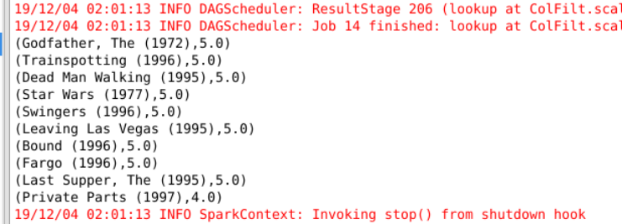
Sample output
Top 10 movie recommendation for user ID 789 from the ml-100K dataset.

Slide 21
Participation session
What type of recommendation algorithm ‘job portals’ uses, and why?
Why would we use user based CF, instead of item based CF?
How Matrix Factorization enhance CF algorithm performance?

Slide 22
Thank you

