Slide 1
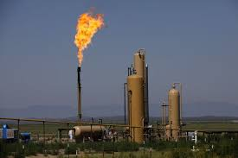
U.S Natural Gas Analysis
Rupali Roy

Slide 2
Problem Statement
Develop a dashboard showing statistics on prices, production, imports, exports, storage and consumption of Natural Gas in USA
Consider different factors affecting natural gas and the audiences for the dashboard
Notes:
I chose the first problem statement i.e. to
develop an annual Natural Gas demand analysis dashboard

Slide 3
Audiences for the Dashboard
1. Research Scientist working as Geologists
2. Students interested in Energy Sector
3. General Public
4. Oil and Gas Companies

Slide 4
Data Sources(1970-2019)
UNdata – United Nations Data
EIA – Energy Information Administration
IEA – International Energy Agency
World Bank Data
BP Statistical World
Notes:
I have referred the following sources for collecting my data - <read from slide>

Slide 5
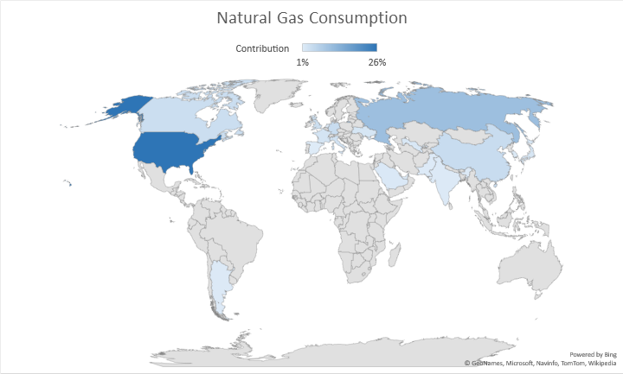
Top Natural Gas Consuming Countries
USA
Russia
Iran
China
Germany
Canada
U.K
Italy
France
Saudi Arabia
Notes:
According the United Nations database, 80% of the total Natural Gas is consumed by just 20 countries out of the 195 countries in the world. The top 10 Natural Gas consuming countries are listed here. Out of these, I chose United States of America for my analysis as it is the topmost consumer, with 24% share across the world.

Slide 6
Uses of Natural Gas
Electric Power : Generating Electricity
Industrial : Fuel for processing heat and raw material to produce chemicals
Residential : Heating and Cooking
Commercial : Heat Buildings, Operate Refrigeration
Transportation : Fuels in vehicles CNG and LNG
Notes:
There is abundant literature about the uses of Natural Gas in different sectors and how macro economic and demographic variables affect the consumption in each sector. Its consumption is divided into 5 major sectors –
Electricity generation in power plants because of the relatively lower emission and prices as compared to alternative fuels.
Industrial sector as a fuel for processing raw materials. It strongly correlates with the overall economic growth of the country.
In Residential and Commercial sector, it is majorly used for heating, ventilation, air conditioning and cooking.
and Transportation is another potential sector of demand with more energy efficient vehicles.
Now lets look at the shared division of consumption in each sector

Slide 7
Natural Gas Consumption Pattern (USA)
Notes:
This graph depicts the consumption pattern of N.G in US in each sector over the past 50 yrs. We can clearly see that Industrial and the Electric Power Sector are the highest consumers currently.
The Industrial Sector has always been the topmost consumer of N.G. Industrial sector is strongly positively correlated with the economic growth of the country.
As we can see, the share for Electric Power generation started to increase gradually after mid-80s. This can be related to the increase in population and the change in weather over past few year.
Consumption in Residential and Commercial Sector show similar pattern with higher usage.

Slide 8
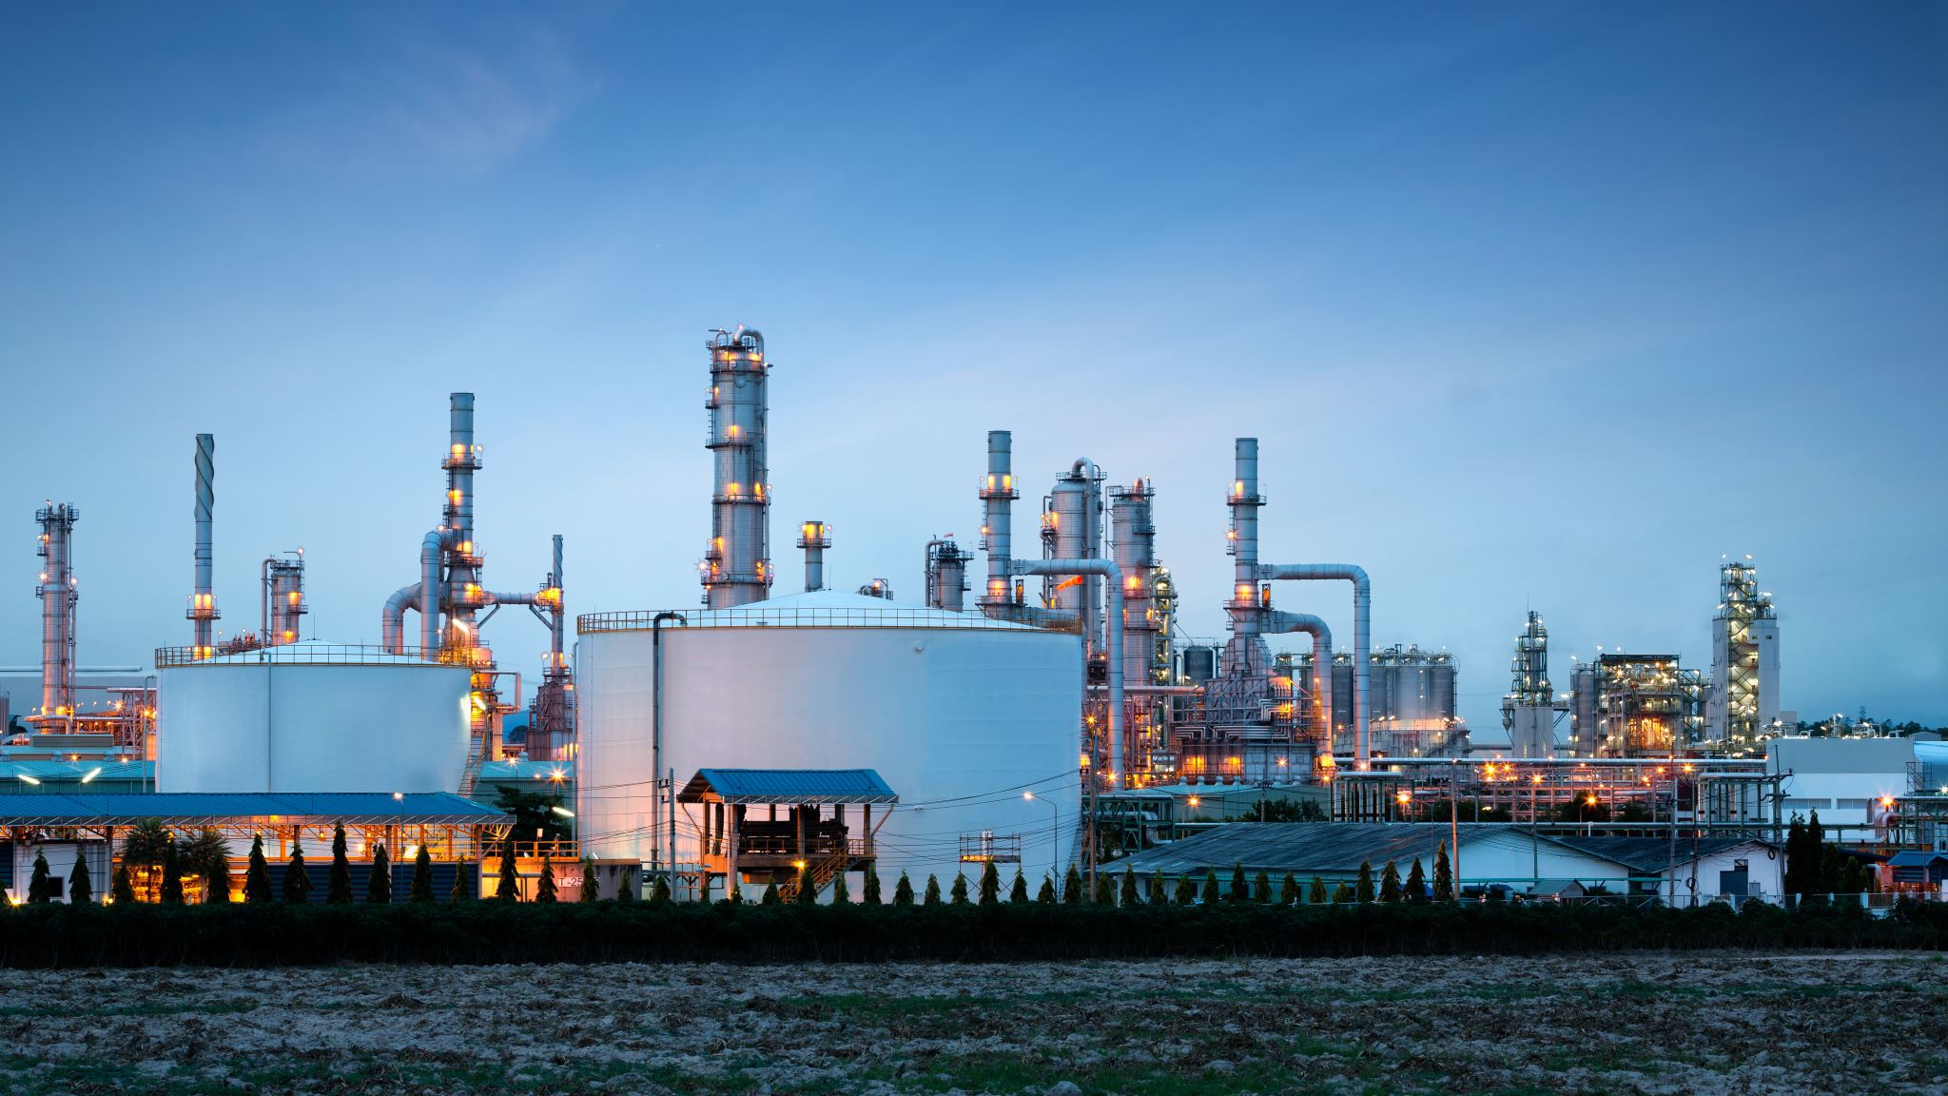
Factors affecting Demand
Government Policies
Economic Growth
Weather
Demographics
Alternate Fuels

Slide 9
Feature Selection
GDP per Capita
Natural Gas
Price
Alternative and Nuclear Energy (%use)
Natural Gas Consumption
CO2 Emissions
Sectors
Natural Gas Production
Natural Gas Underground Storage
Notes:
Here is a list of features that I have used in my model. GPD per Capita is a macro economic variable that is positively related with the demand of the natural gas. The growth in GDP of a country indicates major development in different sectors of economy for eg. Increase in Industrial sector. The demand of natural gas is majorly impacted by weather as the demand of natural gas typically peaks during the warmest months and tapers off during summer months. *** As stated earlier fuel switching is an important factor for predicting the demand. While most residential and commercial customers rely solely on natural gas to meet many of their energy requirements, some industrial and electric generation consumers have the capacity to switch between fuels. For instance, during a period of extremely high natural gas prices, many electric generators may switch from using natural gas to using cheaper coal, thus decreasing the demand for natural gas. Factors like Alternative and Nuclear Energy, Alternate Fuel Prices contribute to fuel swirching.
The Electricity capacity from Main Activity and Autoproducers indicates industries that are making the best use of the heat they produce, that is they are using alternate fuel to produce electricity.

Slide 10
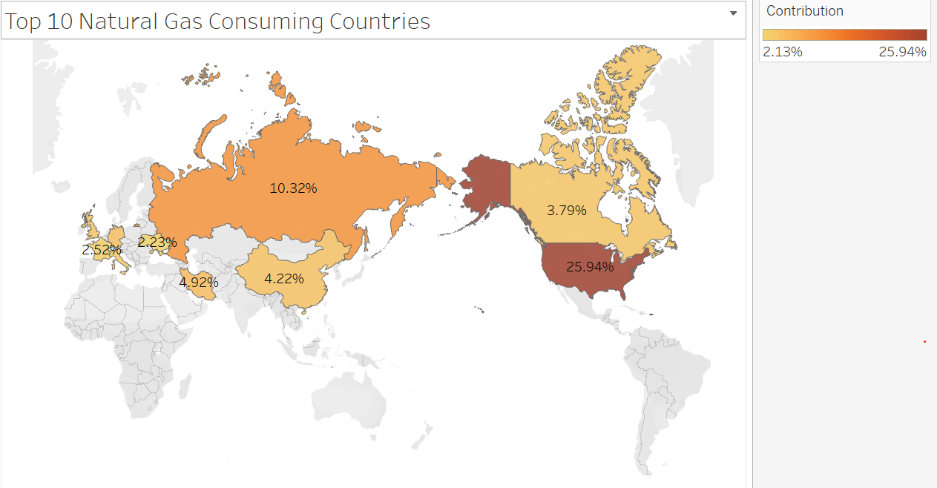
Dashboard Details

Slide 11
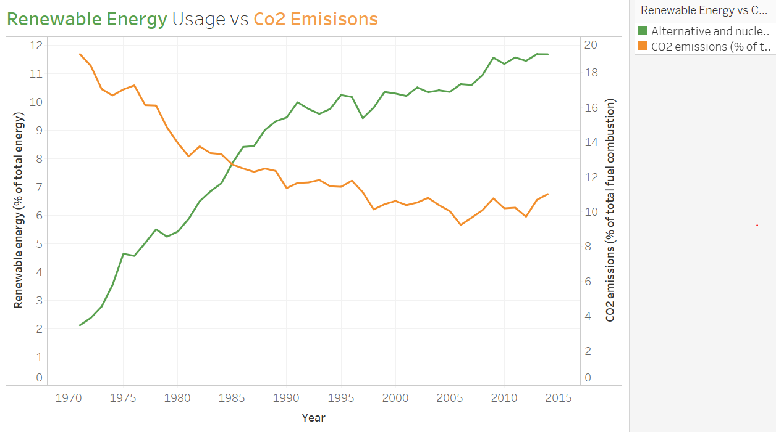
Notes:
Screenshot from Tableau Dashboard!

Slide 12
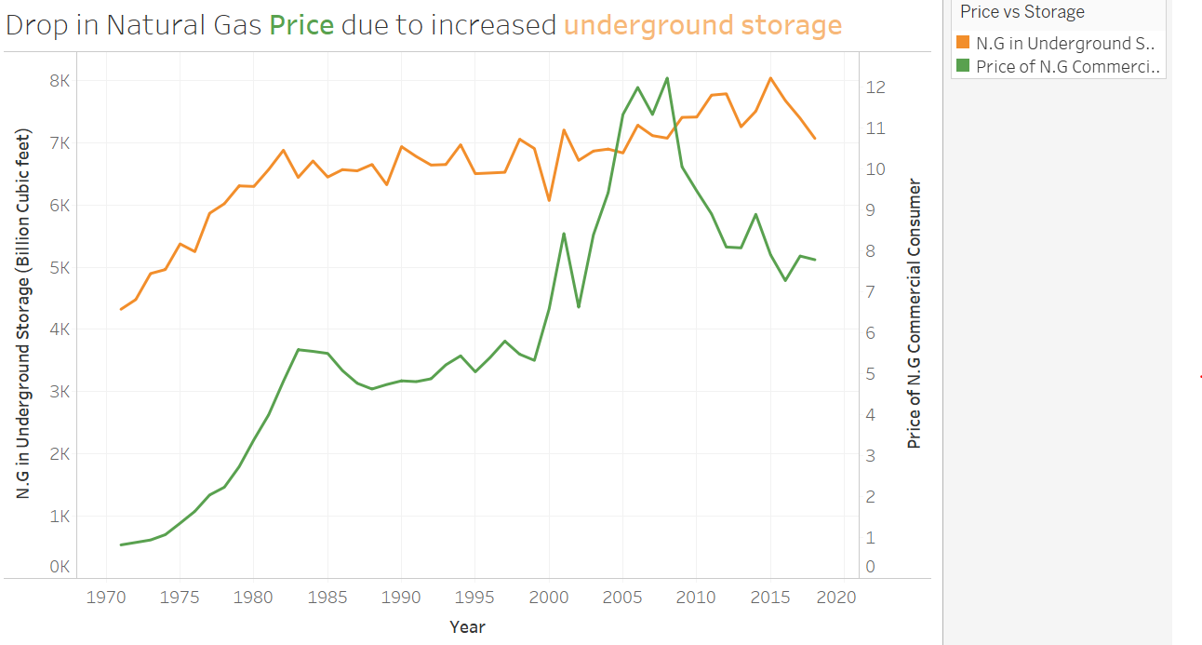

Slide 13
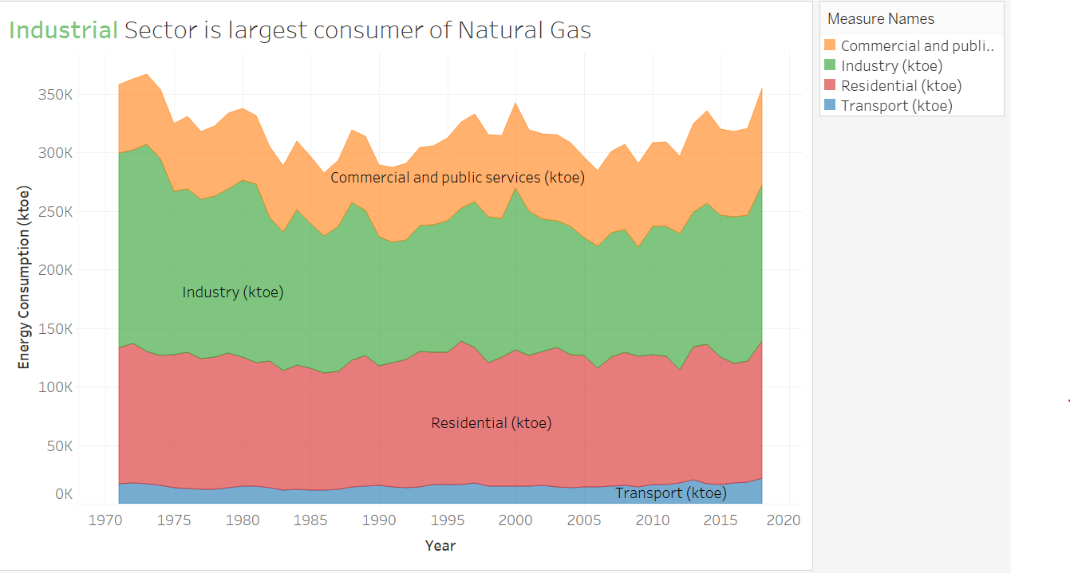

Slide 14
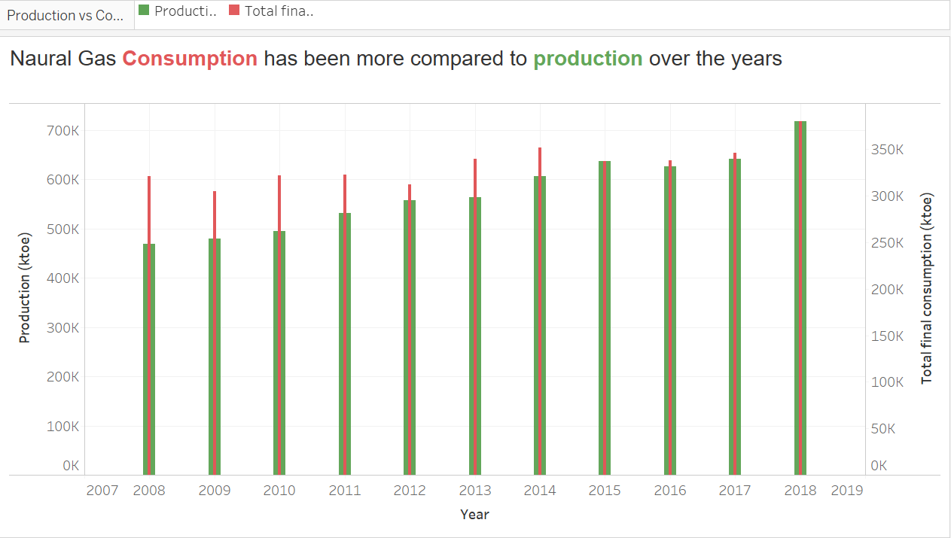

Slide 15
References
https://data.un.org/
https://www.eia.gov/
https://www.iea.org/
http://naturalgas.org/
https://data.un.org/

Slide 16
Questions?

Slide 17
Thank You!

