Slide 1

Natural Gas Demand Forecasting
Rupali Roy

Slide 2
Problem Statement
Develop an annual natural gas demand forecasting model
Local macro and demographic variables
Notes:
Develop an annual demand forecasting model
Consider local macro economic and demographic variables
Criteria of good model:
Different types of economy and demographics
Future and long term changes in consumption pattern
Factors impacting consumption in residential and commercial sector
Multiple data sources
Various regression models

Slide 3
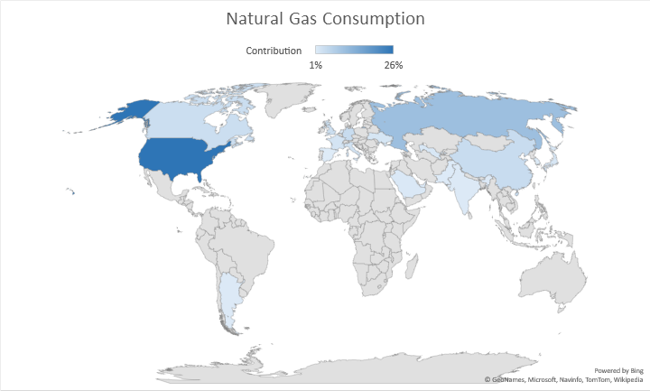
Top Natural Gas Consuming Countries
USA
Russia
Iran
China
Germany
Canada
U.K
Italy
France
Saudi Arabia
Notes:
Top natural gas consuming countries. These countries contribute to more than 80% of the total natural gas consumption in world. With USA being at the top and contributing 24% for the total

Slide 4
Region Selection for Analysis
195 countries in the world
Different types of economy
Need of various econometric regression model
Selected Region: USA
Factors influencing consumption
Notes:
There are about 195 countries in the world, all with different types of economy and demographic.

Slide 5
Uses of Natural Gas
Electric Power : Generating Electricity
Industrial : Fuel for processing heat and raw material to produce chemicals
Residential : Heating and Cooking
Commercial : Heat Buildings, Operate Refrigeration
Transportation : Fuels in vehicles CNG and LNG

Slide 6
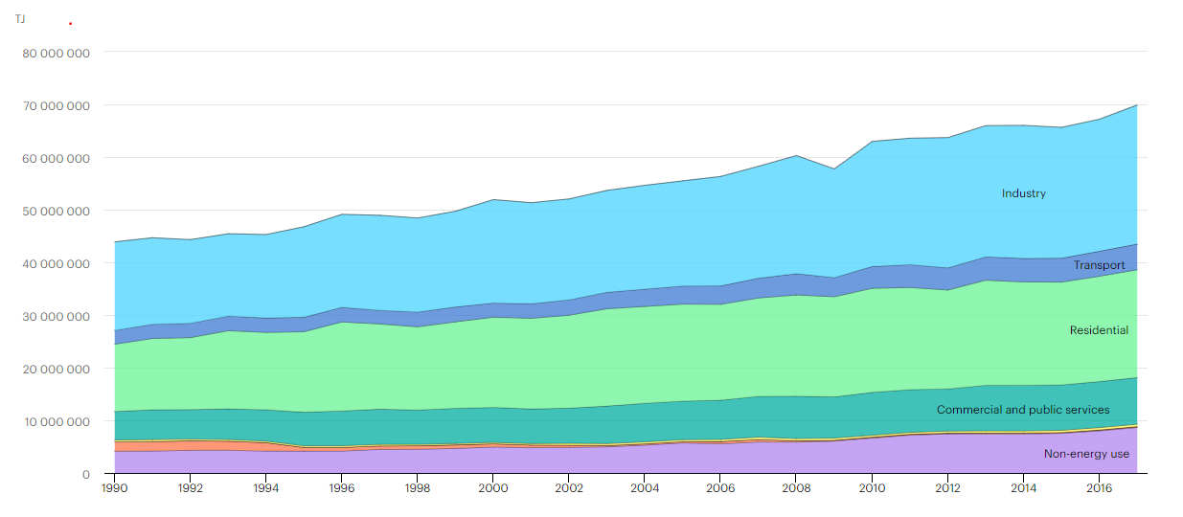
World: Natural Gas Consumption by Sector
Notes:
Talk about Current uses of natural gas

Slide 7
Natural Gas Consumption Pattern(USA)
Industrial
Electric Power
Residential
Commercial
Transportation

Slide 8


Factors affecting Consumption
Government Policies
Power Plant Retirements
Weather
Fuel Switching
Population

Slide 9
Problem Solving Approach
Data Collection
Data Cleaning
Data Visualization And Exploratory Data Analysis
Model Selection
Model Training And Tuning
Model Evaluation
Insights And Demand Forecasts

Slide 10
Data Sources
UNdata – United Nations Data
EIA – Energy Information Administration
IEA – International Energy Agency
World Bank Data
BP Statistical World Energy Review

Slide 11
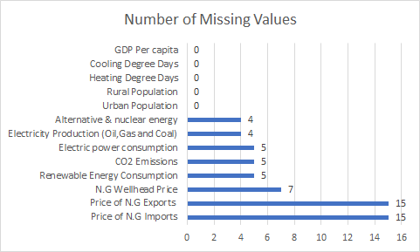
Data Cleaning
Extrapolation by growth rate
Drop ‘NAN’
Imputation by Mean
Forward Fill

Slide 12
Feature Selection
GDP per Capita
Heating and Cooling Days
Alternative and Nuclear Energy (%use)
Urban and Rural Population
CO2 Emissions
Inflation GDP deflator
Natural Gas Price Data
Natural Gas Underground Storage
Natural Gas Production
Household Consumption
Alternate Fuel Prices
Electricity capacity from Main activity & Autoproducers

Slide 13
Model Selection
ARMA – (Univariate Time Series)
Linear Regression Based Model (Considerable)
XGBoost (Machine Learning Models ) Temporal Dependency
LSTM Deep Learning Based Approach Overfitting due to Inadequate Data
Vector ARMA Multivariate Time Series

Slide 14
Model Development
Vector Autoregression
Look for trend in Time Series
Testing Causation using Granger’s Causality Test
Check for Stationarity and Make the Time Series Stationary
Train the VAR Model of Selected Order(p)
Check for Serial Correlation of Residuals (Errors) using Durbin Watson Statistic
Invert the transformation to get the real forecast
Plot of Forecast vs Actuals
Evaluate the Forecasts

Slide 15
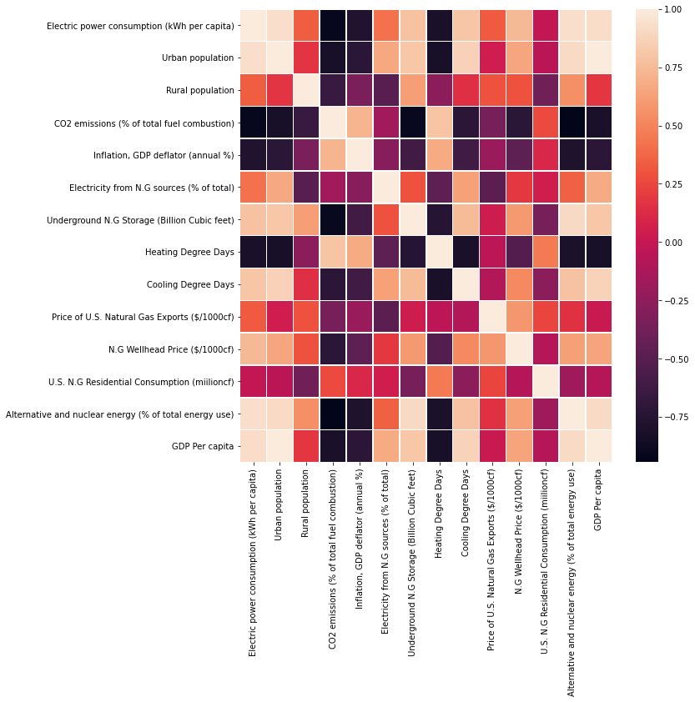

Slide 16
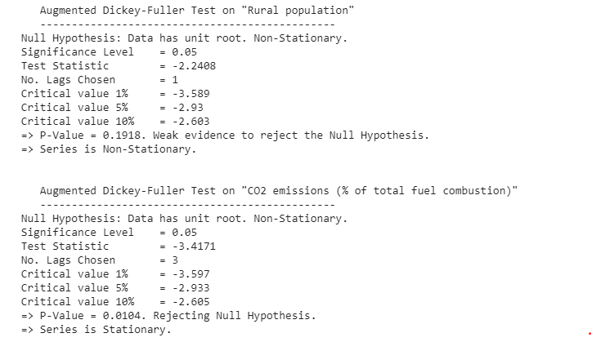
Augmented Dickey-Fuller Test (ADF Test)
Test if the time series is stationary or not?

Slide 17
Growth over the years

Slide 20
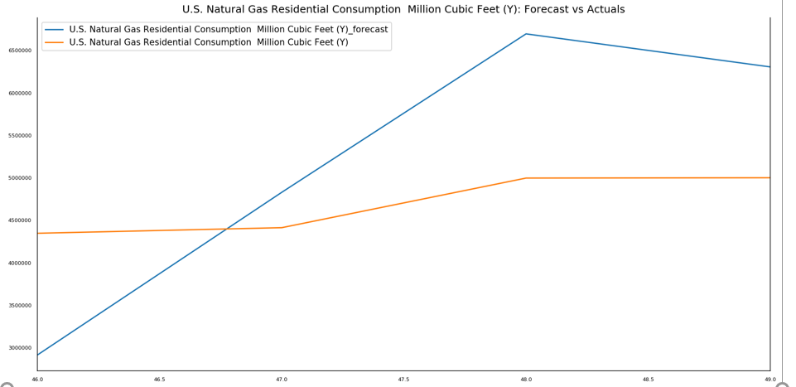
Results and Forecast
Notes:
Need to enter latest total forecast : edit

Slide 21
Challenges in Modelling
Sparse Data
Curse of Dimensionality
Complex Model Could not be used due to inadequate data

Slide 22
Possible Solutions
Explore
Explore the top 20 countries contributing 80% consumption
Apply
Apply hierarchical time series modelling
Apply
Apply econometric regression and optimization model

