Slide 1
Python Practical 1

Slide 2
Intro
Today is not assessed
Play around and get comfortable with python
Pick up some tricks to help tomorrow/Thursday
If you run out of stuff to do, we have some extension tasks

Slide 3
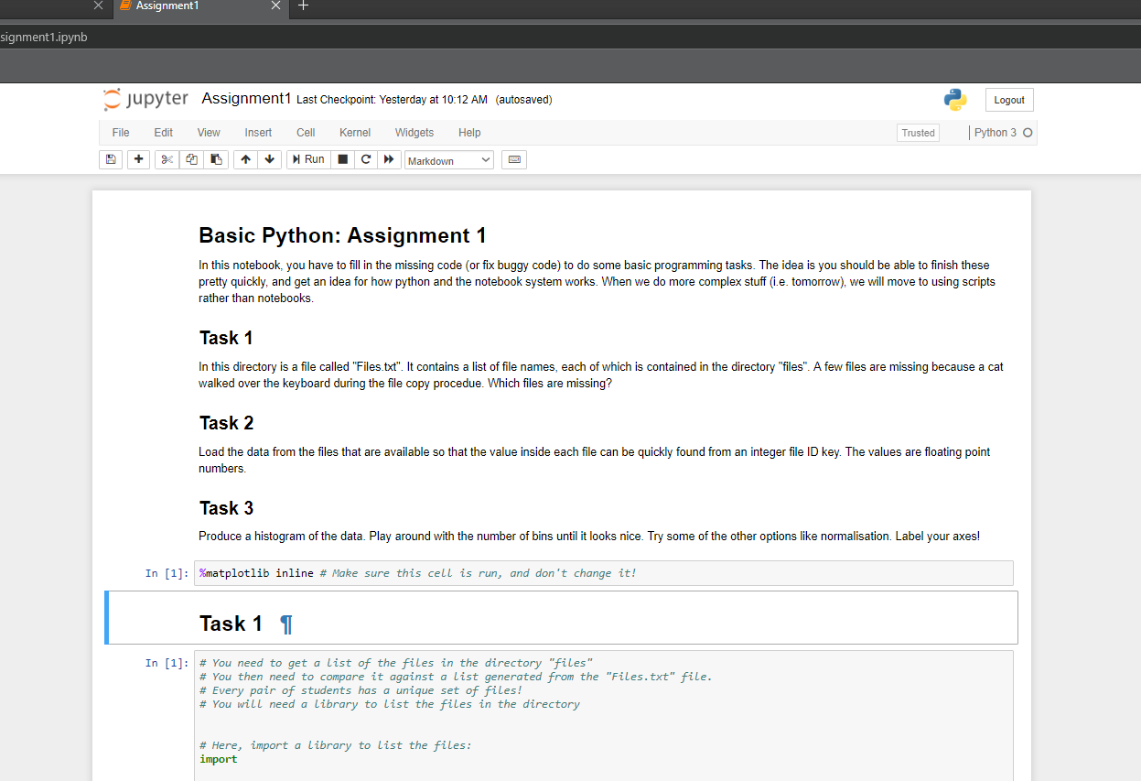
Reminders
Today we work in Jupyter notebooks
Should open in a web browser
Interactive environment
Code, instructions and notes all in one
I’ve written a (hopefully useful) reference notebook
It has some filtering functions in that you might need…

Slide 4
Reminders
To start a notebook, do the following:
Open Anaconda Prompt from start menu
Navigate to C:\PythonCourse
Type ‘jupyter-notebook’ into the prompt
Jupyter should open in the default web browser
To kill it, press Ctrl+C in the anaconda prompt
If you prefer chrome:
Open chrome and set it as default
Kill jupyter
Re-do the above
The Browser should have something like a file browser in it, navigate to Day2
If something doesn’t work, or you get asked about tokens, ask for help

Slide 5
Assignment 2
In this assignment, we do some signal processing
Using my laptop, we will record your breathing trace
Then:
Load the data
Plot the data, try some interesting plotting options
Filter the signal to remove noise
Identify peaks in the signal
Save the figure to put on your fridge

Slide 6
Bonus: give everyone a headache
We can provide a skeleton code to convert your breathing trace to audio
It sounds awful
It is also quite amusing

Slide 7
Bonus: Play games for the rest of the afternoon
You have to write it first!
We have a skeleton noughts and crosses game for you to finish off

