Slide 1
Python Practical 3

Slide 2
Intro
Today is assessed
If you run out of stuff to do, we have some extension tasks

Slide 3
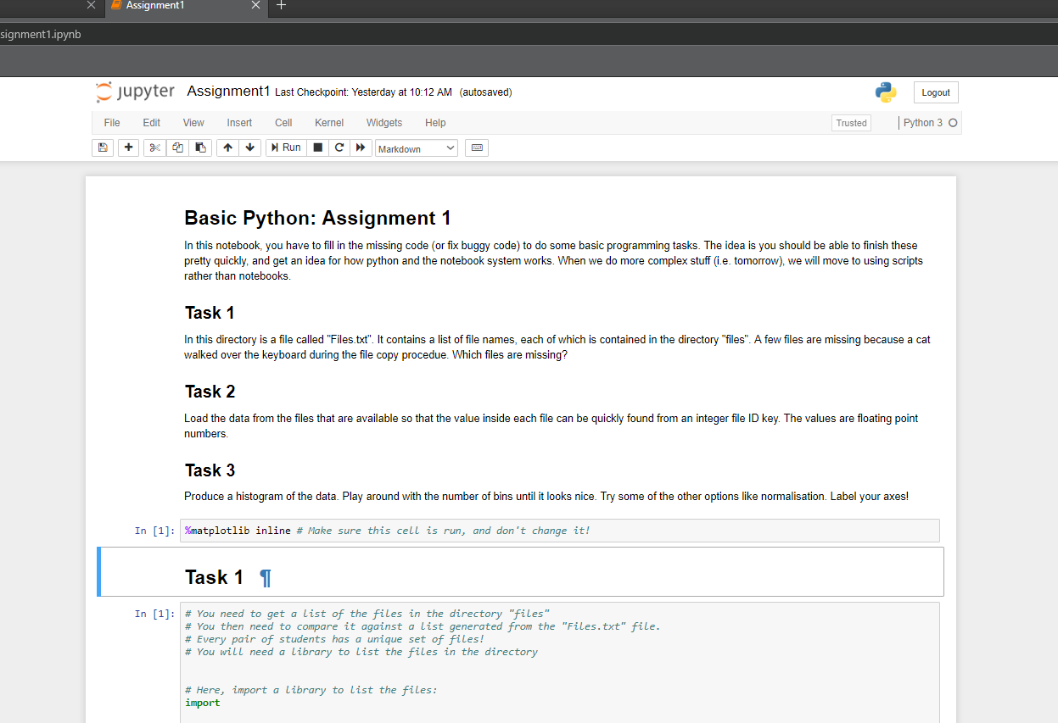
Part 1
Today we work in proper python scripts
Can still work in browser
Have to run scripts in command prompt
Remember the reference notebook
Some of it might be useful

Slide 4
Part 1
To start working, do the following:
Open Anaconda Prompt from start menu
Navigate to C:\PythonCourse
Type ‘jupyter-notebook’ into the prompt
Jupyter should open in the default web browser
To kill it, press Ctrl+C in the anaconda prompt
If you prefer chrome:
Open chrome and set it as default
Kill jupyter
Re-do the above
The Browser should have something like a file browser in it, navigate to Day4
If something doesn’t work, or you get asked about tokens, ask for help

Slide 5
Part 1
You will be editing the file called Assignment.py
Should be open in the browser in a nice text editor
To run your code:
Go to “New”
Click “Terminal”
A page should open with a command terminal in it
Type “cd Day3” and press enter
To run your code, type “python Assignment.py” and press enter

Slide 6
Part 1
You will be writing some code to manually register two images of the lungs
To do this, refer to the assignment document
Should be step-by-step
Ask for help if you need it!
You’ll be writing from scratch, so structure your code well
Comments are not optional
Remember, this is assessed

Slide 7
Bonus: Try to add mouse pick and place for the image registration
Ask for some skeleton code and tips

