Slide 1
Liver Lesion Segmentation Challenge
Write a program that outlines lesions in abdominal coronal scans

Slide 2
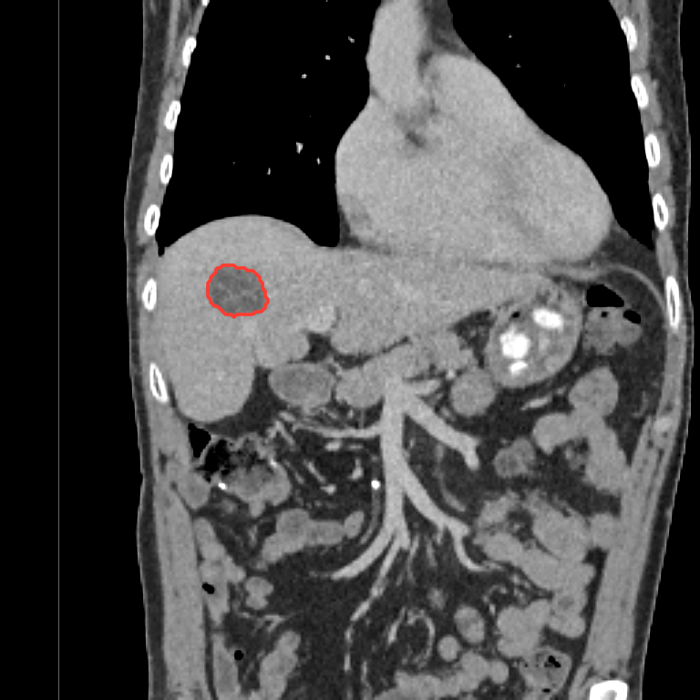
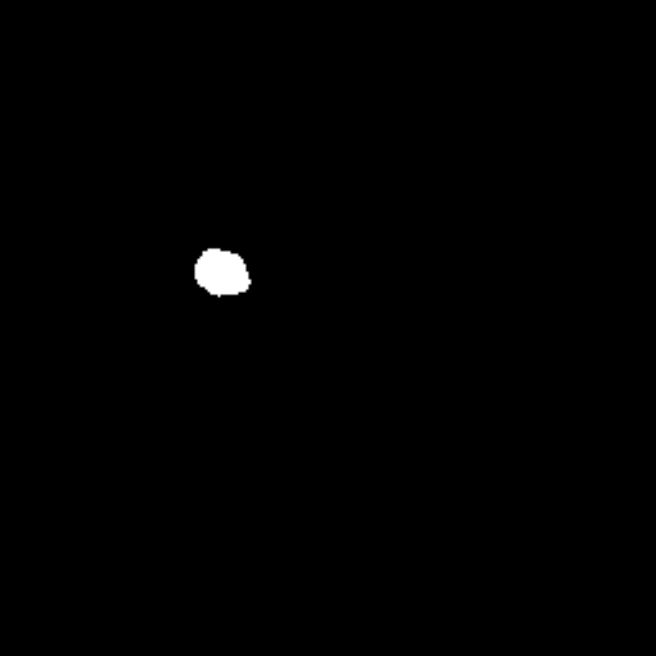
What is segmentation?
Segmentation outlines a structure in an image, pixel by pixel.
Input: a CT scan, which is a grid of numbers, one per pixel.
Output: a mask, a grid of 0s and 1s of the same size. 1 = lesion, 0 = everything else.
Clinicians use masks to measure lesions and organs at risk.
A CT scan, with the lesion outlined in red
The same lesion as a mask
(white = lesion)

Slide 3
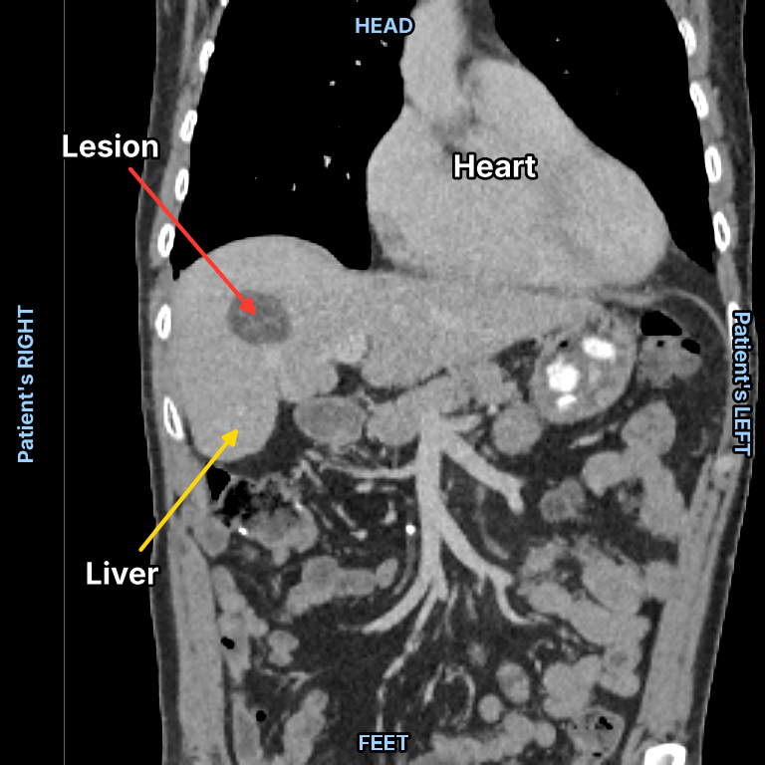
Our images: coronal CT slices of the abdomen
Coronal: a front view of the body, as if facing the patient.
Size: 256 × 256 pixels, each 1.5 × 1.5 mm
Real scans from the public TotalSegmentator CT dataset.
Exactly one (synthetic) lesion per image, always inside the liver.

Slide 4
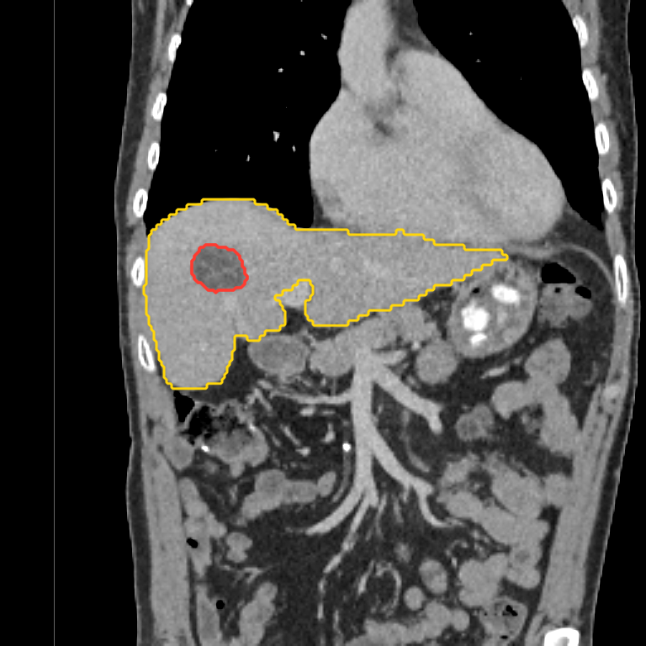
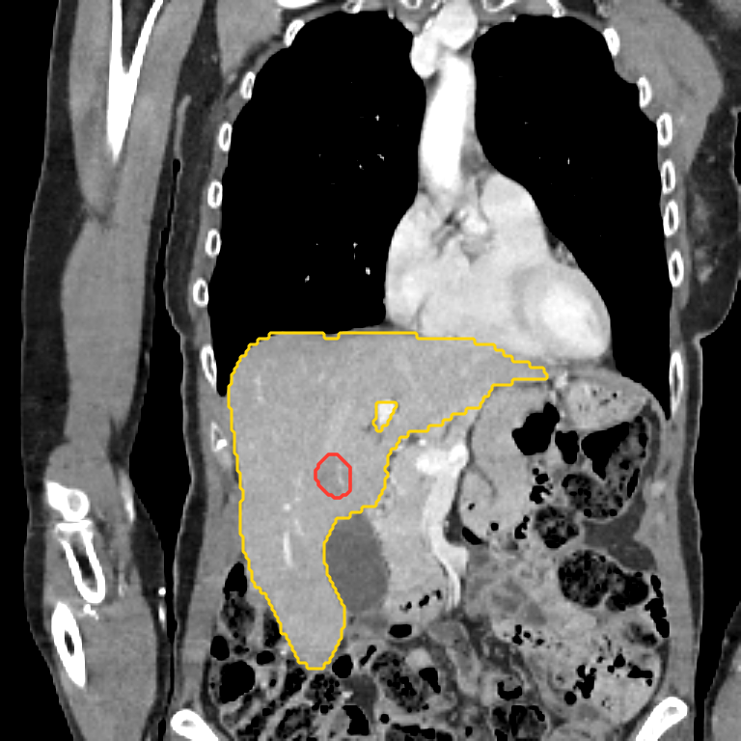
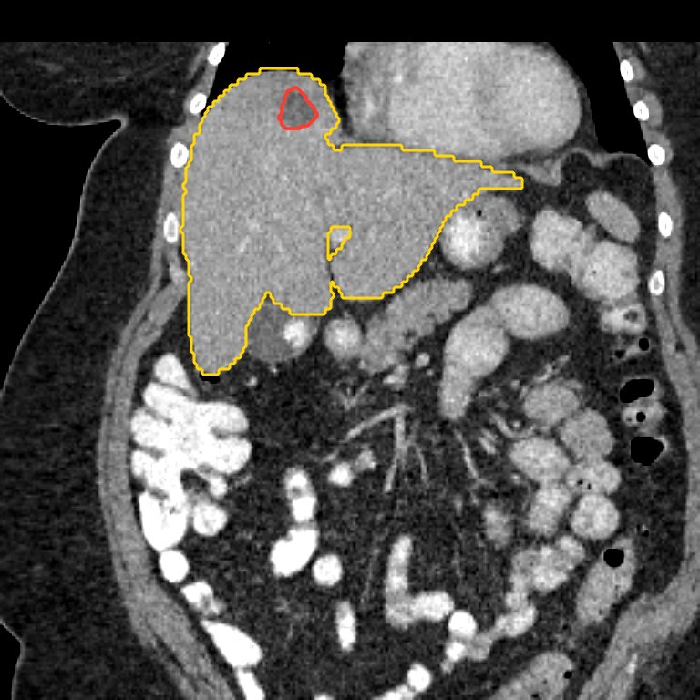
No two images look the same
dev_84
dev_83
dev_82
Yellow = liver, red = lesion. How the patient lies, the size and shape of the liver, where the lesion is and how bright the scan is all change from image to image. Your method has to work on all of them.

Slide 5
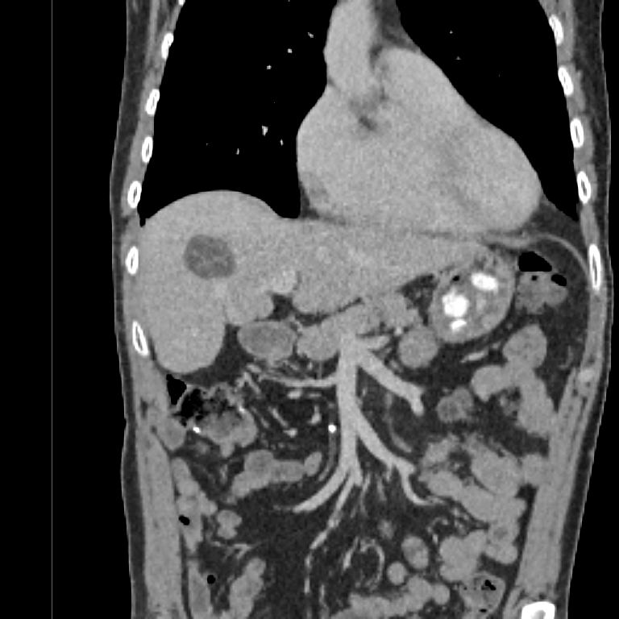
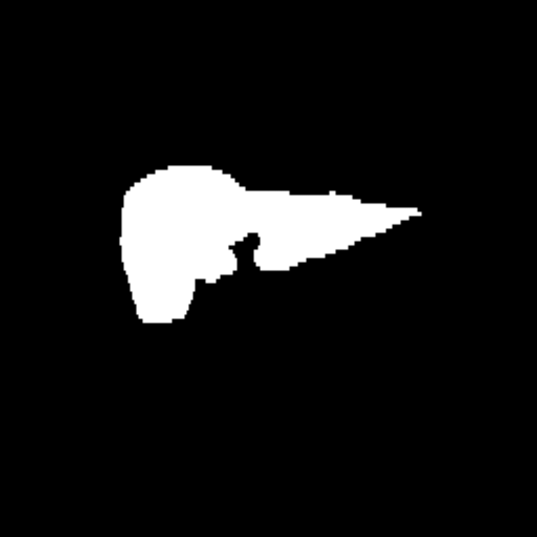
Your task: automatically segment the lesion!
YOUR TASK
+
segment()
the code you write
CT image
(optionally) Liver mask
Lesion mask
The input your code looks at
1 = liver, 0 = elsewhere
The answer: what your code must produce

Slide 6
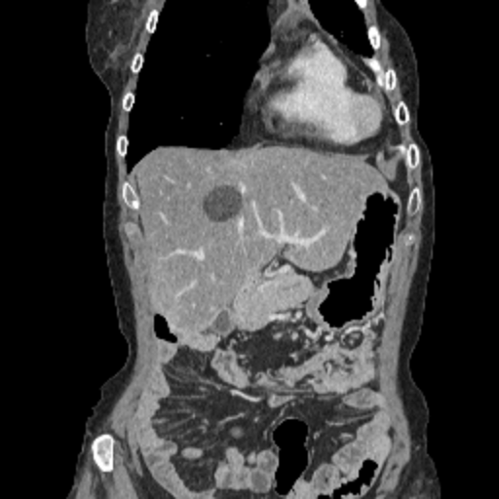
Two datasets: practise, then get scored
Development set
Test set
84 patients
10 patients
✓ CT image
✓ Liver mask
✓ Lesion mask (the answer)
✓ CT image
✓ Liver mask
✗ Lesion mask: hidden
?
Use it to: Build your method and check your score as often as you like.
Use it to: Run your finished method once. We score these masks: this is your result.
Only the test set counts towards your score.

Slide 7
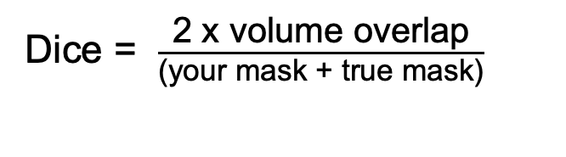
How you are scored: Dice score
Dice = $\frac{\text{2 x volume overlap}}{\text{(your mask + true mask)}}$
Example: you mark 100 pixels, the truth is 80, 60 overlap. Dice = 2 × 60 ÷ 180 = 0.67.
1.0 is perfect. 0 means no overlap.
Your score is the average Dice over the 10 test patients.
Overlap
Your mask
True mask

Slide 8
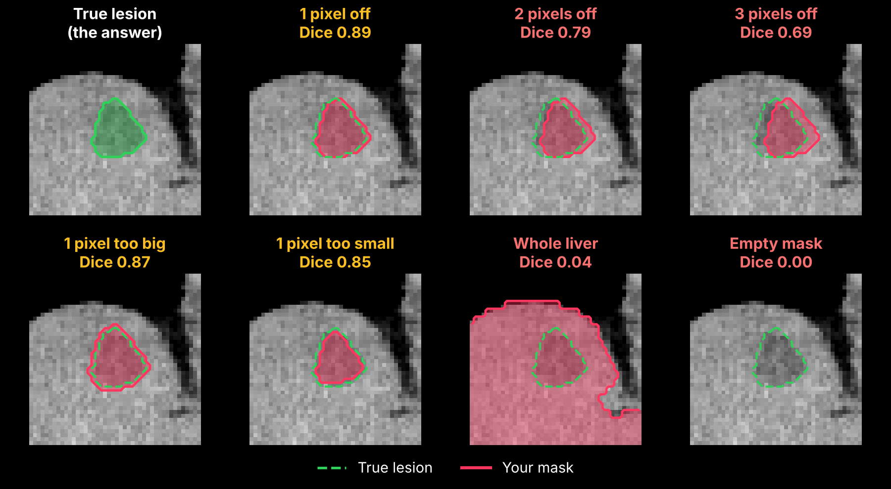
Lesions are small: every pixel counts
Marking the whole liver scores almost 0.
An empty mask scores 0: always return your best guess.

Slide 9
Getting set up on your own laptop
1
Install Python and VS Code
Plan B: Google Colab
Python 3, plus the Python and Jupyter extensions in VS Code (or use Jupyter Notebook).
Only if your laptop setup doesn't work.
2
Download the code and data
On the GitHub page, click Open in Colab.
File → Save a copy in Drive.
Run the first cell: it downloads the data for you.
Colab deletes files when it disconnects, so download your CSV straight away.
On GitHub: Code → Download ZIP and unzip it, or git clone:
github.com/rrr-uom-projects/MPiCRT-hackathon-segmentations
3
Install the packages
In a terminal:
pip install numpy pandas matplotlib scipy ipykernel
4
Open and run the notebook
Open the folder in VS Code, open starter.ipynb, choose your Python environment, then Run All. You should see:
84 development images, 10 test images

Slide 10
Submitting and scoring
What a good check looks like:
When you're happy with your method:
1 Put your team name in the last cell of the notebook.
2 Run the cell. It runs segment() on the 10 test images, saves your_team.csv and checks it.
3 Wait for OK — ready to submit. If you see FAIL, read the message and fix it.
4 Send us your CSV and your notebook.
test_01: 68 lesion pixels
test_02: 37 lesion pixels
test_03: 191 lesion pixels
test_04: 132 lesion pixels
test_05: 47 lesion pixels
test_06: 99 lesion pixels
test_07: 44 lesion pixels
test_08: 38 lesion pixels
test_09: 245 lesion pixels
test_10: 47 lesion pixels
OK — ready to submit
Scoring
Up to 3 submissions per team via email to artemis.bouzaki@postgrad.manchester.ac.uk. We reply with your mean Dice score over the 10 test images. Your best submission counts.
Main rule: fully automatic. The same code makes every mask: no hand-drawn masks, no settings chosen for particular images or file names.

Slide 11
Ideas for getting started
Load one image. Print its shape and its smallest and largest values.
Look at all images: are they equally bright? Is the lesion brighter or darker than the tissue around it?
Try to load liver segmentation to guide your solution.
Find an image where your segmentation goes wrong. What is different about that scan?

