Slide 1
Workshop 2 – Medical image segmentation with CNNs

Slide 2
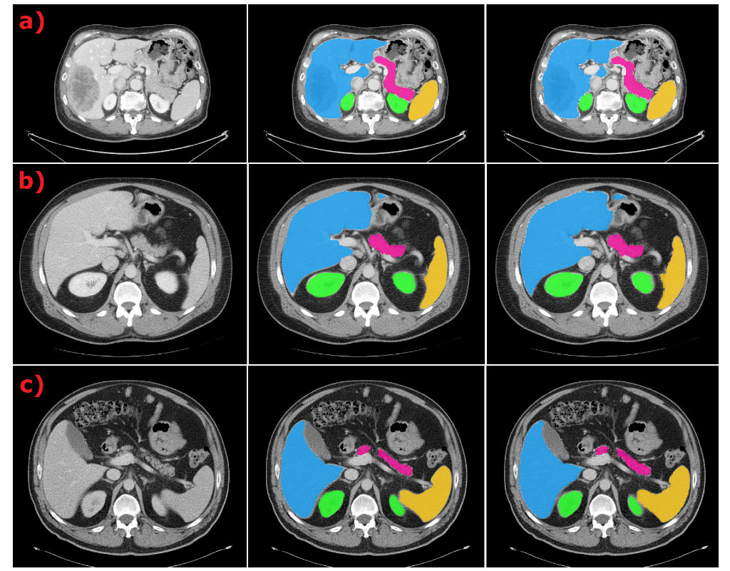
Part 1 - Abdominal organ segmentation
We will use data from the FLARE challenge from MICCAI 2021.
Train a deep-learning model to segment the liver, the kidneys, the spleen and the pancreas.
This part is a tutorial – make sure you understand what each cell is doing.
Will walk you through:
Pre-processing the data;
Loading a pre-trained segmentation model;
Set up training loops (loss function, optimizers, forward pass, backprop);
Training;
Evaluating model predictions;
Plot your results!

Slide 3
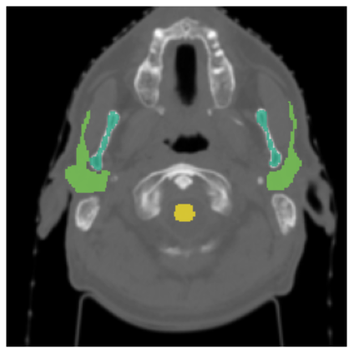
Part 2 – Head and neck organ segmentation
We will use open-access data from The Cancer Imaging Archive.
Train a deep-learning model to segment the brainstem, the mandible, the parotid glands, and the spinal cord.
Now, you are on your own!
We will load the data, but you will need to:
Pre-process the data;
Load a pre-trained segmentation model;
Set up training loops (loss function, optimizers, forward pass, backprop);
Train the model;
Evaluate model predictions;

Slide 4
Part 3 – Challenge: Image classification followed by organ segmentation
You will be given a random mix of head and neck CT scans and abdominal CT scans.
Now, you are really on your own!
We provide skeleton code (+ small hints throughout) but you will need to come up with your own solution.
Given a random image, can you train a classifier to tell you what type of image it is?
Then, use the appropriate segmentation model (from Part 1 & 2).

Slide 5
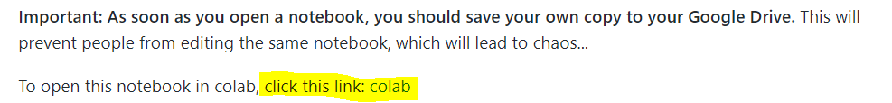
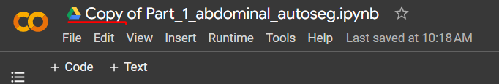
Important information:
You will need a Google account to use Google Colab
Visit the Github Repo for this workshop here: https://github.com/rrr-uom-projects/autoseg_workshop_2023
There are links to colab notebooks throughout:
!! IMPORTANT !! – SAVE YOUR OWN COPY BEFORE EDITING:
File → Save as copy in Drive
Make sure you use a GPU: Runtime → Change runtime type → Hardware accelerator = GPU

