Slide 1




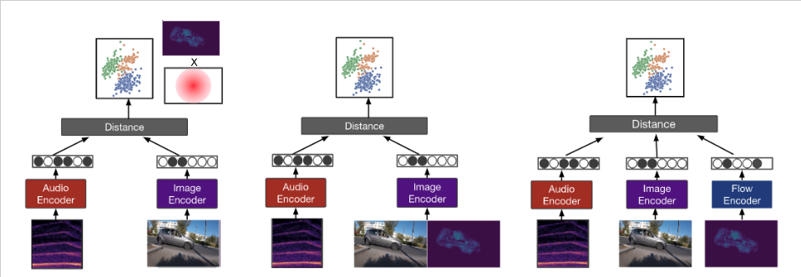
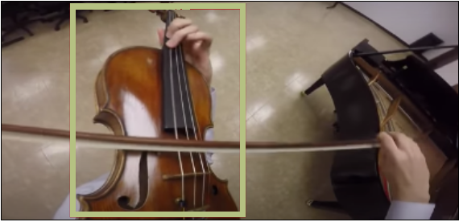
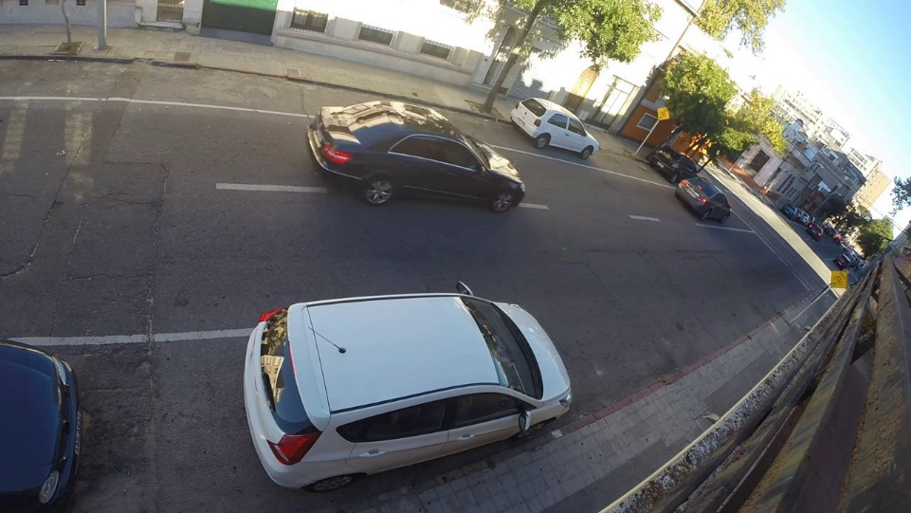


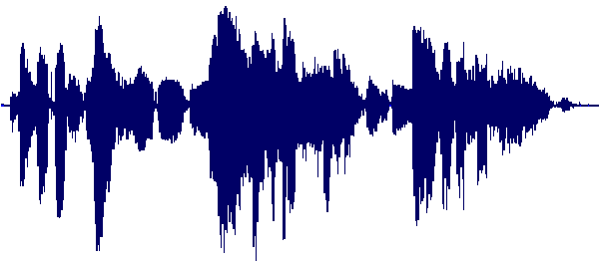
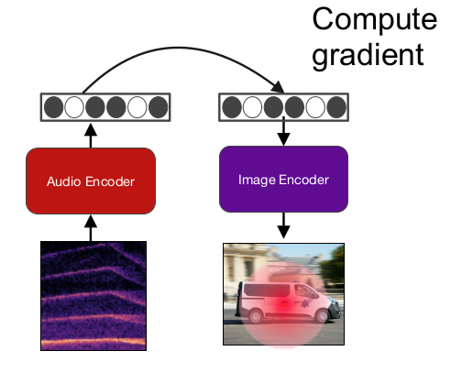
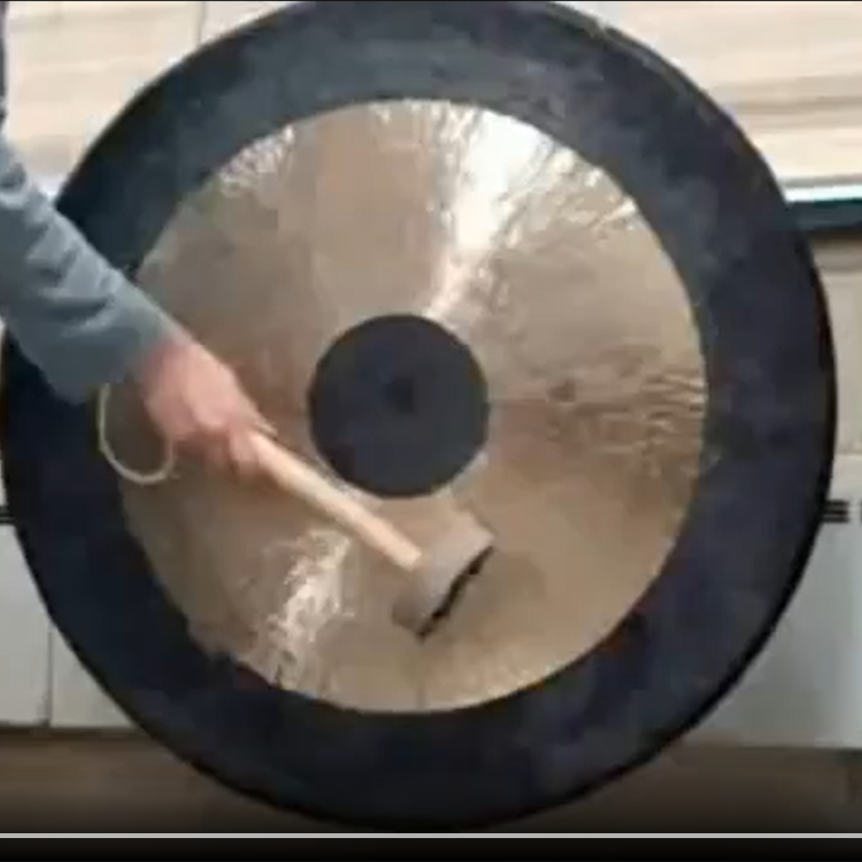
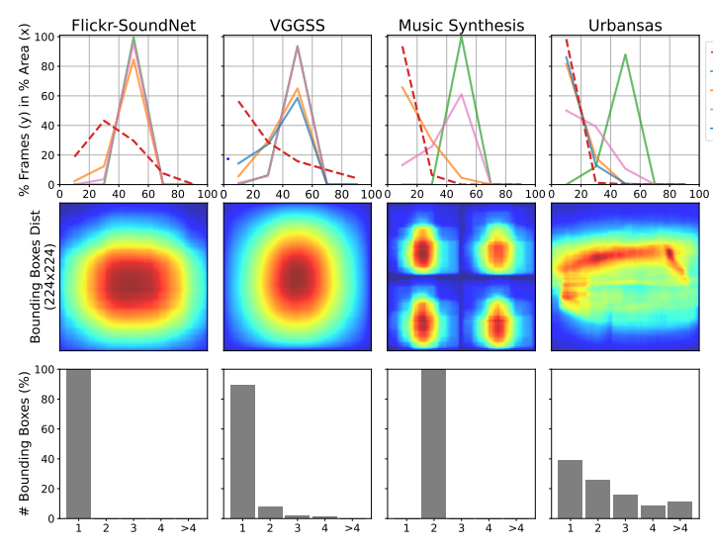
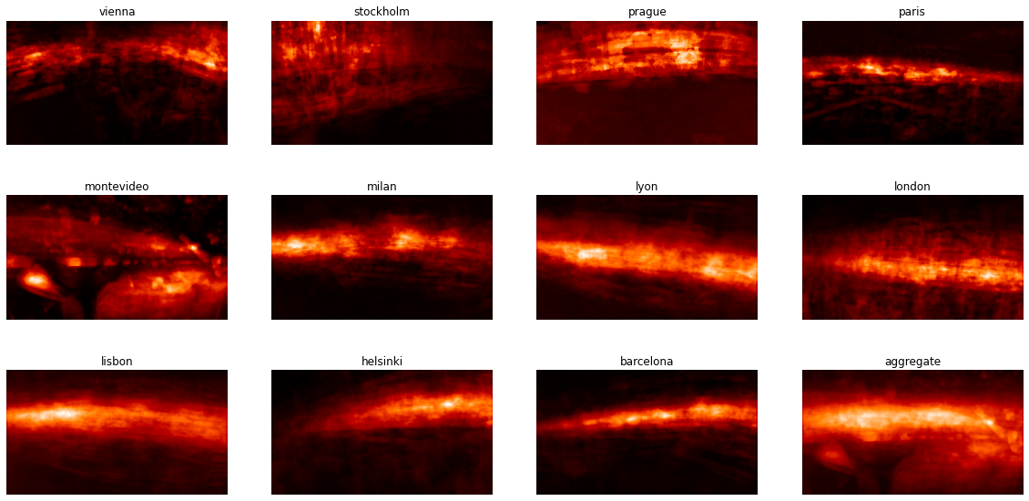
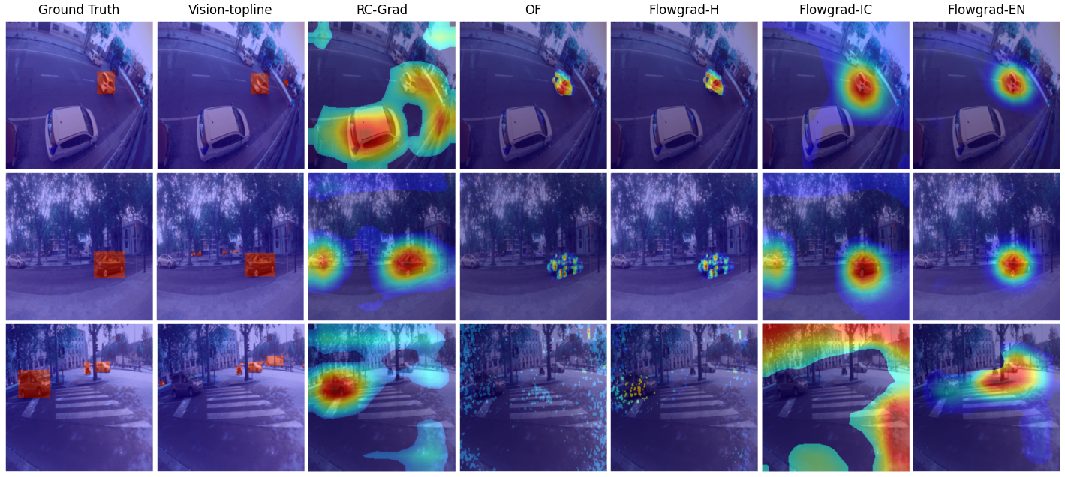
FlowGrad: Using Motion for Visual Sound Source Localization
Code Available
Rajsuryan Singh, Pablo Zinemanas, Xavier Serra, Juan Pablo Bello, Magdalena Fuentes
State-of-the-art methods are inadequate for urban scenes
Training
Purely semantic representations
Impossible to disambiguate between multiple potential sound sources
Looks like a violin
Many possible cars
Sounds like a violin
Sounds like a car
All datasets are biased, urban scenes uniquely so
Single-centered-object bias in benchmarks
Motion bias in Urbansas
a) FlowGrad-H b) FlowGrad-IC FlowGrad-EN
Localization
Grad-CAM - Backpropagate through the
vision subnetwork wrt the audio embedding
Bounding Optical
Boxes Flow
Results
Heuristics can outperform learning based methods
model | IoU | AUC
Vision-topline | 0.68 | 0.51
Optical Flow | 0.33 | 0.23
RCGrad | 0.16 | 0.13
FlowGrad-H | 0.50 | 0.30
FlowGrad-IC | 0.26 | 0.18
FlowGrad-EN | 0.37 | 0.23

