Slide 1



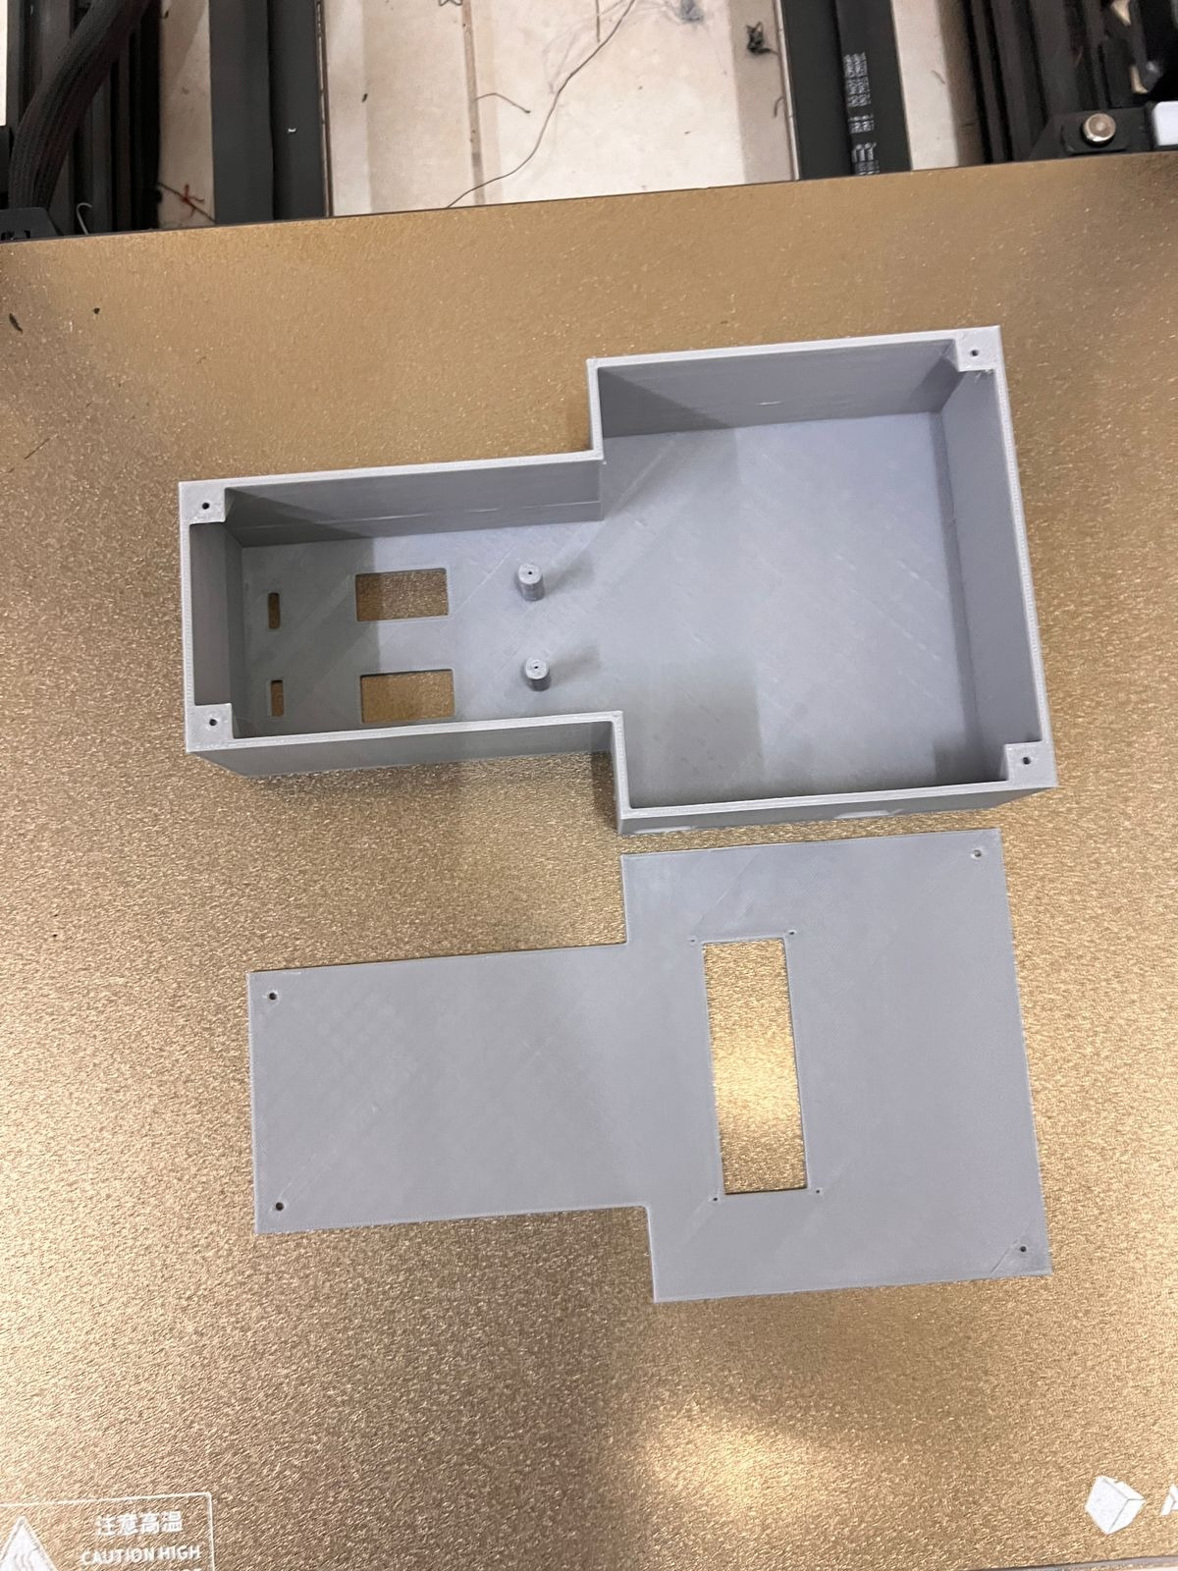
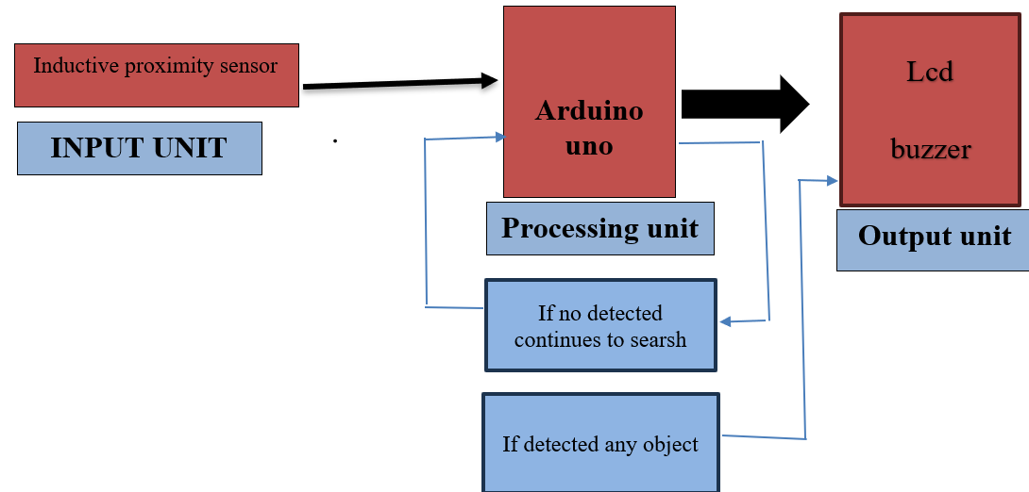
WALL SCANNER
Faisal Saud Alanezy, 391002282
Sultan Saad Albalawi, 411004798
Rayan Eid Albalawi, 411005268
Supervisor: Dr. Amer Aljaedi
Introduction
Problem Solution
USER NEED
The field of civil engineering, geological surveying, geophysical logging, archaeology, forensics, and utility infrastructure building and operation all heavily rely on the detection of buried metal objects, or BO. For example, public utility infrastructures are now frequently buried, not only to improve the aesthetics and comfort of city and rural residents, but also to shield the infrastructures from weather-related damage and mechanical effects. Underground power lines, gas lines, phone landlines, fiber-optic cables, TV cables, water pipes, sewage, etc. are examples of subsurface infrastructures. Engineering-related BOs also include a variety of metal components found inside the walls, between the flooring and the ceiling in high-rise buildings such as concrete reinforcement bars or various bearing structures. It seems that some procedures might harm BOs.
For example, in any building project where wall drilling or earthworks are involved, such artefacts might inadvertently be harmed, which could have serious repercussions. When this happens, labourers must take care not to bump into these hidden items. In other situations, such as when fixing a cable line or pipeline, installing a tie-in, or drilling a hole that has to precisely pass through reinforcing bars within a wall, workers might truly desire to strike a BO.
The primary mechanism of metal detectors is the creation of a scanning alternating magnetic field, which is then utilised to identify interruptions from metal objects. A metal detector has two antennas: a transmitter and a receiver that are arranged so that, in the absence of BOs, the instrumentation signal is nullified. If any exist, they will upset this balance, to which the recipient will react.
We aim to provide a project with electronic circuits to scan objects inside walls and give alarm if detected. The project is enhanced by web application to display data in real time about the detection that gives more accurate time to take quick decision if needed
it helps architects ,plumbing or electrical workers discover water pipes , electrical
3D PRATING
Project motvation
1-It helps detect fraud and deception in newly manufactured buildings
2-It helps the consumer to verify the agreed upon elements in the construction plan
Block daigram
conclusion
The wall scanner I've developed utilizes Arduino technology, incorporating an LCD screen, an inductive proximity sensor, a relay, and a push-button. When the sensor detects hidden objects such as metal, water pipes, or electrical wires within the walls, it sends signals to the Arduino board. The Arduino then processes these signals and activates the relay, triggering the push-button to emit a sound, alerting the user to the presence of detected objects. Additionally, the findings are displayed on the LCD screen, providing real-time feedback on the location and depth of the detected objects.

