Slide 1


Connecting outstanding arts practice
with everyday classroom planning.
Working prototype · National ambition · Staged, evidence-led development
A strategic information pack for teachers, Music Hubs, arts organisations, creative practitioners, editors, funders and development partners.
FREE CORE PLATFORM • REUSABLE PLANNING • CONNECTED PRACTICE • MEASURABLE REACH
Notes:
1

Slide 2

CCDESIGNER | PROJECT INFORMATION PACK | SEPTEMBER 2026
THE FACTS
Why this matters now
41.7%
25%
14%
fall in arts GCSE entries
fall in arts A-level entries
fewer arts teachers
The evidence behind “The Facts” shows a long-term contraction in parts of arts education alongside persistent inequalities of access. The latest picture is mixed rather than uniformly negative — which makes targeted support, strong teaching and better connection especially important.
2009/10 to 2024/25
2011/12 to 2024/25
than in 2010
54% vs 21%
~23%
2026
schools with no GCSE Music entries
expressive-arts teachers without a subject-relevant post-A-level qualification
the latest entry picture is mixed
most vs least deprived fifth of local authorities
GCSE Art & Design +2.7%; Drama -0.9%; Music -1.3%
2026 evidence synthesis
What the evidence suggests for CCDesigner
• Support the generalist as well as the specialist: reusable planning can help teachers without pretending a digital platform replaces subject expertise.
• Make progression visible from early experiences through specialist study, while allowing different routes through creative learning.
• Prioritise cold spots: free national access cannot remove structural poverty, but it can reduce avoidable gaps in information, planning support and connection.
• Keep successful practice cumulative: activities should not disappear into old folders when staff change schools or projects end.
• Measure partnership use more meaningfully than downloads alone: discovering, saving and reusing a resource tells a richer story about educational reach.
Evidence note
GCSE and A-level totals now follow the Cultural Learning Alliance Report Card 2026. The ~23% qualification figure remains from the August 2026 evidence overview. These figures describe the context, not proof that CCDesigner will change participation.

Slide 3
EXECUTIVE SUMMARY
CCDesigner in one page
The connective layer that turns resources, professional learning and teacher expertise into usable curriculum planning.
“CCDesigner starts where most resource websites finish.”
Core proposition
For teachers
For organisations & hubs
For funders
Save and reuse classroom activities; build lessons, units and curricula; select pre-written objectives or write your own; mix trusted resources with personal practice; share planning with colleagues.
Publish free, restricted or paid resources through a branded hub; connect them to CPD, events and planning; see where reach is thin, and share practice between regions.
Understand reach, identify cold spots and build a stronger evidence trail around continuing educational use of funded work.
DISCOVER
SAVE
ADAPT
PLAN
TEACH
REUSE
find
library
teacher
lesson/unit
classroom
then share
Intended result: a living national professional library where creative teaching knowledge can be found, adapted, retained, discussed and reused across music, drama, dance, art, photography, film and related curriculum areas.
ccdesigner.co.uk
2
Notes:
2

Slide 4
WHY NOW
The Facts: arts education needs practical infrastructure
The evidence picture is mixed rather than uniformly negative — which makes targeted support, connection and high-quality teaching even more important.
Long-term contraction
Unequal access
Teacher confidence
Arts GCSE entries are 41.7% below 2009/10, and A-level entries are 25% below 2011/12. Teaching hours fell 21%, with 14% fewer arts teachers than in 2010.
54% of schools in the most deprived fifth had no GCSE Music entries, against 21% in the least deprived. For Drama the gap is 59% against 17%.
About 23% of expressive-arts teachers lack a subject-relevant post-A-level qualification. Non-specialists need trustworthy planning support, not another folder of files.
• Support the generalist as well as the specialist: reusable planning can help without pretending that a digital platform replaces subject expertise.
• Make progression visible from early experiences through specialist study while allowing different routes through creative learning.
• Prioritise cold spots: free national access cannot remove structural poverty, but it can reduce avoidable gaps in information, planning support and connection.
• Keep successful practice cumulative so activities do not disappear into old folders when staff change schools or projects end.
• Measure partnership use more meaningfully than downloads alone: discovering, saving and reusing a resource tells a richer story about educational reach.
CLA Report Card 2026. Teaching-hour figures exclude Dance, which is not consistently reported. The latest exam year is mixed, so the response should stay targeted rather than become one national claim.
ccdesigner.co.uk
3
Notes:
3

Slide 5
NATIONAL CONTEXT
Fit with the national direction
Independent of government, the National Centre and the Music Hub programme — aligned with live policy, not an implied partnership.
National Plan for Music Education
Turn It Up / National Centre
Curriculum reform timing
The 2022 plan, The power of music to change lives, sets a vision to 2030: children and young people learn, create and progress through schools, Music Hubs, organisations and industry. Partnership, strong school music, Hub support, and access for every child.
July 2026’s Turn It Up plan and the new National Centre stress equitable access, high-quality teaching, partnerships, CPD and creative careers. Launch from September 2026, up to £13m over three years, a new online CPD offer, and Music Hub oversight from August 2027.
DfE procurement material anticipates a new national curriculum from September 2028 and revised GCSEs from September 2029. A modular planning system can adapt when objectives change. A fixed scheme cannot.
Potential contribution
• Hub and organisation resources move into teacher planning, not a signposting page.
• CPD activities stay in the library for later schemes of work.
• Aggregated use by region, phase or Hub area shows where support is thin.
• A shared layer lets partners combine strong provision instead of rebuilding it.
Context, not endorsement. Sources: National Plan for Music Education (2022); Turn It Up (13 July 2026); National Centre procurement (2026).
ccdesigner.co.uk
4
Notes:
4

Slide 6
THE PROBLEM
The problem is fragmentation, not a shortage of creative ideas
Excellent practice exists, but it is often difficult to find, retain, adapt and track.
Teacher practice
successful activities often live in old plans, folders or memory
Current journey
Music Hub provision
resources and CPD may be local but not easily reusable elsewhere
CPD
PDF
Link
Class
Lost
day
folder
website
maybe
later
Arts organisations
strong project work can become hard to trace after the project ends
Too often, a resource is counted when it is published or downloaded — not when it genuinely enters teaching practice.
Creators
independent resources may have limited route to schools
CCDesigner changes the journey: resource → library → lesson → unit → teaching → reuse → evidence.
Schools
non-specialists need support, but have very little planning time
The aim is not to replace existing websites or schemes. The aim is to connect them to real planning.
ccdesigner.co.uk
5
Notes:
5

Slide 7
PRODUCT MODEL
How the planning model works
Capture activities, build lessons and units, then connect curriculum, people, organisations and events.
Activity
Lesson
Unit
Curriculum
The smallest reusable block: a rhythm game, drama warm-up, composition task, photography exercise or creative-writing stimulus.
→
Activities can be selected, reordered and adapted into a teachable sequence.
→
Lessons combine into units or schemes with progression, links, objectives and resources.
→
Units sit inside terms, year groups and wider curriculum plans across phases and art forms.
Why this matters
• Teachers are not forced to choose between following somebody else’s scheme or creating everything from scratch.
• A vocal warm-up can sit beside a drama activity, a composition prompt, a gallery stimulus or a Music Hub resource.
• Resources become easier to reuse, adapt, export, share and discuss.
The same activity can travel into different lessons, year groups and art forms while still preserving creator attribution and teacher judgement.
ccdesigner.co.uk
6
Notes:
6

Slide 8
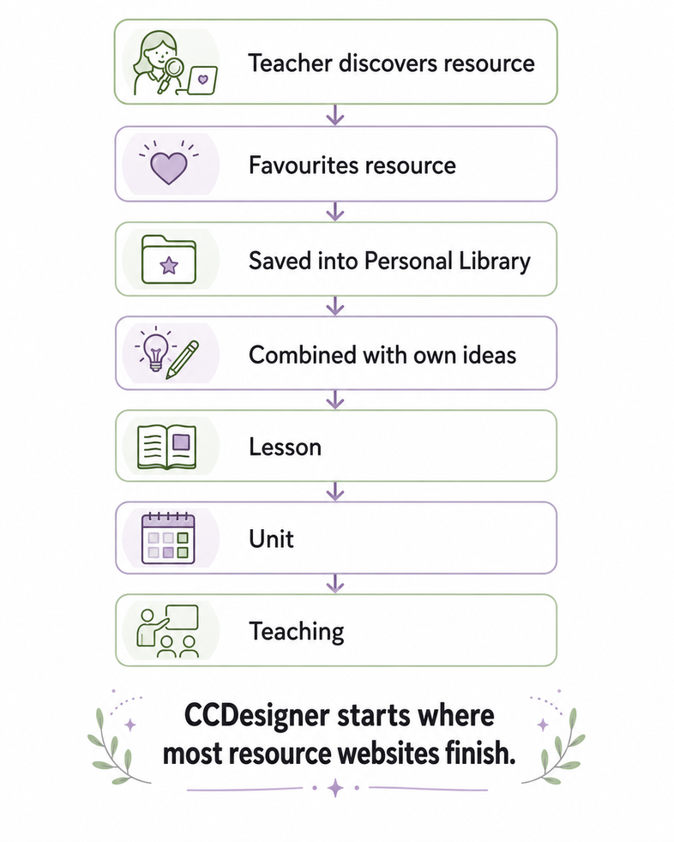
RESOURCE JOURNEY
From resource discovery to classroom use
The workflow is designed to prove that a resource has travelled beyond a web page.
Discover
Save
A teacher finds a trusted resource from a hub, organisation, creator or colleague.
The resource is added to the teacher’s personal library and retained for later use.
Adapt
Plan
The teacher combines it with their own ideas, context, class needs and objectives.
It becomes part of a lesson, unit, term or longer curriculum pathway.
Teach
Reuse
The resource is ready for classroom use with links, resources and notes intact.
Teachers and organisations learn what is useful, where, and over time.
“Planning should be a living reflection of practice — continually developing as teachers reflect, adapt and discover new ideas.”
Planning architecture principle
ccdesigner.co.uk
7
Notes:
7

Slide 9
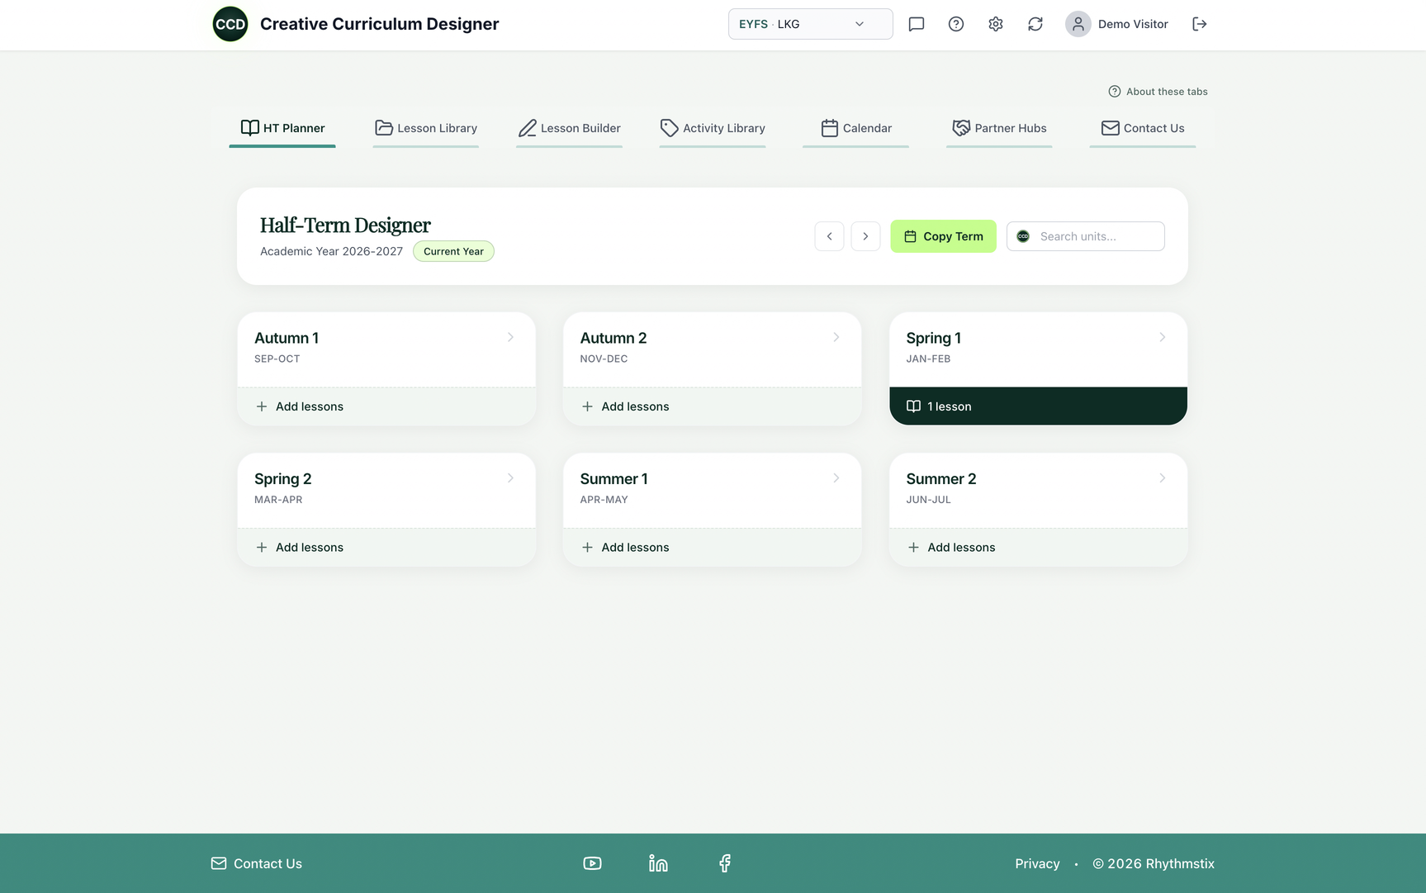
USER EXPERIENCE
Simple enough to use, deep enough to grow
Each teacher has an independent planning environment that feels closer to a professional creative workspace than a file repository.
• Activity Library: searchable bank of personal and trusted external activities.
• Lesson Builder: select, reorder and adapt activities into teachable sequences.
• Units & curriculum: combine lessons, map progression and retain the bigger picture.
• Organisation Hubs: access resources, courses, events and support from trusted providers.
• Calendar: place teaching and opportunities into terms and connect to external calendars.
• Export & share: produce professional active PDFs and share planning with colleagues.
ccdesigner.co.uk
8
Notes:
8

Slide 10
TEACHER PRACTICE
Curriculum planning without removing teacher autonomy
The platform should speed up planning without flattening professional judgement.
Premade curriculum statements
Create your own
Keep the teacher in control
A bank of pre-written objectives from EYFS to KS5, including National Curriculum and examination statements, plus editable “I can” language.
Schools, departments and specialist settings can author their own statements. A teacher’s library is meant to travel with them across schools, devices and formats.
AI may suggest or structure approved content. It must not replace teacher judgement or silently rewrite a creator’s expertise. The teacher decides.
What this enables
• Faster planning without fixed scripts.
• Better consistency across year groups and teams.
• A clearer link between activities, objectives and progression.
• Curriculum links carried into exported plans.
The curriculum statement bank is a support structure — not an imposed curriculum.
ccdesigner.co.uk
9
Notes:
9

Slide 11
PROFESSIONAL COMMUNITY
Planning becomes professional conversation
The community layer can move beyond “download and rate”.
What teachers should be able to discuss
Why this matters
• What changed for Year 2?
• How was this adapted for a non-verbal pupil?
• Which instruments or technology were substituted?
• How did this work in alternative provision?
• How could this drama idea support English?
• Expertise travels horizontally between practitioners.
• Adaptations from specialist settings can inform mainstream classrooms.
• New teachers gain more than a file: they gain a route into practice.
• Hubs and organisations learn what support teachers still need.
• AI may organise approved content, but it must not replace judgement or rewrite a creator.
“What did you change for this class — and why did it work?”
ccdesigner.co.uk
10
Notes:
10

Slide 12
CONNECTING THE SECTOR
A national creative-education ecosystem
One platform. Many voices. No single prescribed curriculum. Music Hubs are the strong first route.
Teachers
Music Hubs
Arts organisations
personal planning, classroom insight, professional exchange
Local identity stays. Resources can be public, restricted or ring-fenced. Successful practice can travel between regions, and CPD can remain after the training day.
resources, courses, projects, events, expertise
Creators
Funders
Learners
free and paid specialist material, practical resources
reach evidence, cold spots, impact beyond the original project
better access to high-quality creative experiences
CCDesigner is not trying to replace Charanga, hubs, organisation websites, schemes or specialist teachers. Its purpose is to connect them to planning and practice.
ccdesigner.co.uk
11
Notes:
11

Slide 13
CROSS-ARTS PLANNING
Designed for music, drama, art, photography and more
One architecture for music, drama, dance, art, photography, film and English — connections visible, subject identity intact.
A single lesson might combine…
Vocal warm-up
Orchestral activity
Drama Resource exercise
I Can Compose idea
Photography prompt
English stimulus
Why cross-arts matters
Why English matters
Why progression matters
Puppet project: art, story, performance and sound. Photo story: image, narrative, character and edit. Opera-making: composition, staging, design and libretto.
Drama, music and visual arts can support speaking, listening, storytelling, writing and interpretation.
Creative experiences can connect EYFS through KS5, GCSE, A-level and higher education pathways.
ccdesigner.co.uk
12
Notes:
12

Slide 14
ORGANISATION HUBS
Branded hubs with clear organisational control
Organisations and Music Hubs need reach, but they also need control, permissions and quality assurance.
• Each participating organisation or hub can have a recognisable space inside CCDesigner.
• They can share free resources, restricted materials, paid content, CPD, events and links back to their own website.
• They should retain control over what is published, who can access it and when it becomes available.
• Complete programmes can remain intact while selected activities can become adaptable building blocks.
• Editorial support can help format, tag and maintain content without creating excessive work for partners.
Organisation hub options
FREE
RESTRICTED
PAID
LINK
open
login
Stripe
external
The platform should complement partner websites, not duplicate or replace them.
Permissions, copyright, sequencing, safeguarding and accessibility are not add-ons — they are part of the product architecture.
ccdesigner.co.uk
13
Notes:
13

Slide 15
NON-SPECIALIST SUPPORT
Ready-made packs for new and non-specialist teachers
The platform can turn Hub and organisation expertise into practical classroom pathways.
Starting points
Confidence without scripts
CPD that lasts
“New Primary Music Lead”, “Starting to Teach Drama”, “KS2 Composition”, “Creative SEND Activity Bank”.
Packs provide routes into practice, but remain editable and adaptable to pupils, space, equipment and school context.
Training activities remain in the teacher’s library after the CPD session, ready to use in real planning.
Example pathway
Hub CPD
Activity Pack
Lesson
Unit
Classroom
Feedback
course
library
teacher adapts
progression
delivery
community
This is especially important where schools are struggling to sustain specialist arts provision, or where teachers are asked to deliver creative subjects outside their main specialism.
ccdesigner.co.uk
14
Notes:
14

Slide 16
REACH & ANALYTICS
From “reach” to evidence of use
A stronger account of what happens after a resource is published, a training session ends or a funded project finishes.
DISCOVER
SAVE
PLAN
RETURN
REUSE
view
library
lesson/unit
later use
new class
Why this is stronger than a page-view count
A webpage view can show awareness. A resource entering a teacher’s library, lesson or unit is evidence of a deeper educational relationship. Over time, aggregated patterns can help organisations understand which materials are useful, whether they are revisited and where additional support or CPD may be needed.
Measure without surveillance
Evidence for creators
Evidence for funders
Authenticated activity, aggregated by phase, region and Hub — not raw IPs, and not teacher surveillance.
Creators can see what teachers actually reuse and where follow-up support is needed.
Funded work can show continuing educational use, subject to appropriate governance.
ccdesigner.co.uk
15
Notes:
15

Slide 17
COLD SPOTS
Reducing cold spots and increasing reach
The aim is not only to distribute resources nationally, but to see where distribution is not working.
Cold-spot insight
Reach that can be acted on
• Which regions barely save or reuse a resource?
• Which phases need different support?
• Where is awareness low?
• Where do teachers save resources but not build them into lessons?
• Where should CPD or partnership effort be targeted next?
• A funded resource can travel beyond the original project.
• Music Hubs can share good practice between regions.
• Arts organisations can understand continuing educational use.
• Funders can review evidence of benefit across a wider range of users.
CCDesigner cannot solve structural inequality on its own. Its realistic contribution is to reduce avoidable gaps in information, planning support, professional connection and resource visibility.
ccdesigner.co.uk
16
Notes:
16

Slide 18
INCLUSION
Designed for different learners and different settings
Inclusion should be part of the architecture, not an accessibility paragraph added at the end.
PRUs & alternative provision
SEMH settings
SEND & neurodiversity
Short, flexible activities; small group formats; high-agency creative tasks; equipment-light options.
Activities that support communication, regulation, confidence, relationship-building and practical success.
Visual prompts, sensory and movement routes, non-verbal options, simplified language, and different ways to recognise progress.
Practical implication for content editors
• Every published activity should encourage practical adaptation rather than assume a single learner profile.
• Metadata should allow useful filters without labelling pupils reductively.
• Specialist contributors should shape collections, with safeguarding, licensing, accessibility and age checked first.
A conventional scheme often assumes a conventional classroom. Creative learning does not need to.
Creative subjects offer many ways to communicate, interpret, collaborate and show understanding.
ccdesigner.co.uk
17
Notes:
17

Slide 19
SUSTAINABILITY
A free core with a credible route to sustainability
The public-benefit argument depends on keeping the central planning and connection platform accessible.
Free core platform
Optional paid resources
Public benefit funding
Teacher planning, the personal library, connections to organisations and the central network stay free. No expensive subscription just to take part.
Creators and specialist providers may sell packs or courses. Working assumption: a 10% Stripe commission, still to be financially tested.
Major publicly funded organisations are expected to share mostly free material, subject to rights. Grants can build infrastructure before commercial income is proven.
Other income streams to test
• Commissioned CPD and implementation support.
• Premium organisation services where they add real value.
• Separate income from The Melting Pot products such as Assessify and PeriFeedback.
• Public, charitable or philanthropic support for specific development and access goals.
Commercial activity should sustain access rather than restrict it — with transparent payments, fair creator terms, clear licensing and a realistic cost of running the platform.
ccdesigner.co.uk
18
Notes:
18

Slide 20
CREATOR & PARTNER VALUE
A practical model for creators, hubs and arts organisations
The platform provides infrastructure without asking every partner to build their own planning technology.
For creators
For Music Hubs
For arts organisations
A route to teachers, optional paid packs, feedback on what works and the ability to release some activity free.
A place for exemplar plans, local opportunities, CPD materials, teacher support and cross-region sharing.
A way to make existing educational work easier to discover and use without abandoning their own websites.
The strongest product argument for partners
CCDesigner does not only display resources. It places trusted material inside the teacher’s real planning workflow.
This is what turns resource publication into classroom pathway, professional learning and evidence of use.
ccdesigner.co.uk
19
Notes:
19

Slide 21
SECTOR LEARNING
What sector conversations have changed
Organisations want reach and control; teachers have little spare time; rights and sequencing matter. These are product requirements.
LSO
Jazz North
Rights, sequencing, control, calendars and analytics shaped the prototype. LSO is building its own platform and is not participating; the consultation remains evidence.
Supplied prototype resources. Nigel called it “a really nice interface and a nice idea”. Helena offered funding advice and an educators’ forum invitation.
Drama Resource / David Farmer
Arts On The Move
Validated efficient planning, reviewed the Drama Resource hub and introduced further contacts. David’s written testimonial encouraged teacher connection.
provided a strong testimonial and highlighted teacher confidence and not “reinventing the drama wheel”.
WeTeachDrama
Young Voices & Essex Music
Lucy Bellingham explored how paid resources and CPD could sit in a wider ecosystem, including licensing. Interest is positive; no formal commitment.
Paul Lewis: coordination helps, but annual repertoire must be linked, time-limited or omitted. Essex: prove value against workload — do not add another login.
Status note: these entries record conversations, feedback and permissions. They do not imply formal partnership, endorsement or future participation unless explicitly stated.
ccdesigner.co.uk
20
Notes:
20

Slide 22
TESTIMONIALS & FEEDBACK
Sector voices
The strongest endorsements identify real problems the platform could help solve.
“Teachers are busy people, and anything that can make their planning and development more efficient will benefit the entire arts education sector.”
“The CCDesigner hub is a brilliant place for performing arts teachers to create lessons, store information and save useful links.”
David Farmer • Drama Resource • 3 Aug 2026
Alison Chaplin • Arts On The Move • 20 Aug 2026
“It’s a really nice interface and a nice idea.”
“I can certainly see why this level of co-ordination would make sense and have a benefit to both teachers and providers.”
Nigel • Jazz North discussion • 19 Aug 2026
Paul Lewis • Young Voices • 24 Aug 2026
Useful counterpoint
Show enthusiasm and friction. Sarah Goldsmith, Essex Music: “save everything they need in one place.” Lucy Bellingham, WeTeachDrama, was keen to continue. LSO’s platform and Young Voices’ licences remain constraints.
ccdesigner.co.uk
21
Notes:
21

Slide 23
DELIVERY BRIEF
Governance before scale
The vision is ambitious, but the next stage should be controlled. Staged growth is a strength, not a lack of ambition.
For web & product designers
For editors & partner managers
For hubs & organisations
Make activity → lesson → unit obvious. Keep search and the Library central. Cut duplicate entry and repeated logins. Design mobile, tablet and desktop together, with permissions and proportionate analytics as architecture.
Preserve creator voice and sequencing. Check copyright, licensing, age suitability and accessibility. Make free, restricted or paid status unambiguous, and route each resource toward CPD and planning.
Decide what travels nationally and what stays local. Start with small exemplar collections. Define which engagement evidence is useful, and how resources will be maintained after funding ends.
A national platform requires editorial review, safeguarding, copyright and licensing processes, accessibility standards, moderation, data protection, support responsibilities and a clear route for keeping partner material current.
CONNECT RATHER THAN DUPLICATE • SUPPORT RATHER THAN PRESCRIBE • MEASURE WITHOUT SURVEILLANCE
ccdesigner.co.uk
22
Notes:
22

Slide 24
FUNDED PILOT
A sensible route from prototype to national potential
The pilot should prove a narrow but complete journey before attempting scale.
1. Discovery & specification
2. Prototype refinement
3. Teacher-led beta
Partner interviews, editor workflow, permissions model, technical audit, accessibility brief.
Activity Library, lesson builder, hub admin, calendar, PDF export and analytics tested with real content.
Small group of teachers across phases and contexts, including non-specialists and specialist settings.
4. Evaluation & funding evidence
5. Scale decision
Track discovery, saving, planning, reuse, barriers and cold spots; produce funder-ready evidence.
Costed specification, governance model, partner onboarding process and technical roadmap.
Pilot requirements
Small number of partners and teachers • Real resources with permissions • Teacher-led usability testing • SEND / alternative-provision testing • Clear evaluation framework • Costed specification for national scale
ccdesigner.co.uk
23
Notes:
23

Slide 25
RISK & EVALUATION
Risks, assumptions and how to reduce them
The project should be inspirational and practical — ambitious, but not naïve.
Adoption risk
Content risk
Licensing risk
Teachers have limited time. Reduce friction, avoid repeated logins and provide ready-made routes into use.
Too much material can become noise. Curate exemplar collections before uploading large archives.
Copyright, performer rights, images, music and project permissions must be reviewed before publication.
Data risk
Quality risk
Sustainability risk
Analytics must be proportionate, transparent and UK GDPR compliant.
Editorial review, safeguarding, accessibility and age suitability must be built into the process.
Funding should test the route to sustainability before assumptions about paid content are locked in.
Evaluation should ask whether teachers can find, save, adapt, plan, teach and reuse resources — and whether partners gain useful, ethical evidence of reach.
ccdesigner.co.uk
24
Notes:
24

Slide 26
THE VISION
CCDesigner is designed to make exceptional arts education easier to find, easier to use, easier to share — and much harder to lose.
Turn disconnected arts resources into connected classroom practice.
ccdesigner.co.uk
25
Notes:
25

Slide 27
EARLY YEARS
Creative learning starts before Key Stage 1
Child-shaped and exploratory. Expressive Arts and Design sits at the heart of the EYFS framework.
Play first
The gap starts here
Arts and culture
Children help shape what they explore. Music, movement, role-play and materials come before a secondary classroom model.
When early arts are thin, or only adult-directed, the entitlement gap starts before Key Stage 1. Later enrichment depends on those early habits.
One of five enrichment areas: music, dance, theatre, museums and galleries. Special-school participation already lags mainstream.
• Reusable blocks for early years, without forcing Reception into a secondary model.
• Partner resources can sit beside child-led play, not instead of it.
• Early confidence in music, drama and dance feeds later participation.
• The Enrichment Framework starts at age 5. The habits of access start earlier.
• Inclusive early practice matters, because special-school participation already lags.
Sources: EYFS statutory framework; DfE Enrichment Framework, June 2026; DfE evidence on enrichment.
ccdesigner.co.uk
26

Slide 28
PRIMARY
Arts time is already unequal in primary
Teacher Tapp / CLA 2026 is a survey, not a census. Independent schools report far more arts hours.
47% against 6%
Under an hour
Who leads it
Independent versus state primary teachers reporting more than 2.5 hours of arts a week. The gap is there before secondary.
About one in four primary teachers report less than an hour of arts a week. Highest-FSM schools are more likely to have cut hours: 31% against 22%.
Subject leads: Art 89%, Music 84%, Drama 9%, Dance 5%. 43% of primary teachers report no external partners for the arts.
• Generalists carry most of the arts, especially where specialist capacity is thin.
• Reusable activity blocks put strong practice within reach of a non-specialist.
• Partner hubs matter most where a school has no external arts partner.
• Higher-FSM schools are more likely to have reduced weekly arts hours.
• Treat these as a teacher survey, not a census of every primary school.
Source: Teacher Tapp / Cultural Learning Alliance Report Card 2026.
ccdesigner.co.uk
27

Slide 29
GCSE
No exam entries is not the same as not taught
Pathways are thinner where disadvantage is higher. Arts GCSE entries were 41.7% lower in 2024/25 than in 2009/10.
Music: 36%
Drama: 36%
Dance: 83%
of schools had no GCSE Music entries in 2024/25. In 2022/23 that figure was 42%. No entries does not mean the subject is not taught.
of schools had no GCSE Drama entries in 2024/25, down from 41% in 2022/23. In the most deprived fifth the gap is 59% against 17%.
of schools had no GCSE Dance entries in 2024/25, compared with 84% in 2022/23. The exam route is missing in most schools.
• Ofqual provisional summer 2026: Art +2.7%, Drama -0.9%, Music -1.3%.
• Performing and Expressive Arts entries were up 1.2% in that same release.
• No GCSE Music: 54% of schools in the most deprived fifth, 21% in the least.
• Planning still matters in a school that no longer enters the exam.
• Partner resources can keep a route open where the exam pathway has thinned.
Sources: CLA Report Card 2026; Ofqual provisional entries, 11 June 2026. “No entries” does not mean “not taught”.
ccdesigner.co.uk
28

Slide 30
A-LEVEL
After GCSE, the arts pathway thins again
Arts A-level entries are 25% lower than in 2011/12. In the most deprived areas they are a smaller share.
Drama: -9.5%
Music: -4.9%
3.8% against 5.9%
Provisional summer 2026 against 2025. All A-level entries rose 2.9% in the same Ofqual release.
Provisional summer 2026 against 2025. This is the school-exam picture, not the small rise in undergraduate music.
Arts subjects are 3.8% of A-levels in the most deprived fifth, and 5.9% in the least. Art and Design entries were -1.0%.
• The long fall is 2011/12 to 2024/25, from the CLA Report Card 2026.
• Place still shapes who stays on for an arts A-level.
• Shared planning keeps a specialist route where the exam cohort is small.
• Undergraduate music and drama can rise in a year when school entries fall.
• One Ofqual year is not a reversal of the longer decline.
Sources: CLA Report Card 2026; Ofqual provisional A-level entries, summer 2026 against 2025.
ccdesigner.co.uk
29

Slide 31
UNIVERSITY
Creative degrees are narrowing too
Creative arts undergraduates edged down while the wider cohort rose. Nine of the ten largest falls are at modern universities.
Not the school fall
Provider falls
Courses closing
Undergraduate Drama rose 1.6% and Music 1.1%. In the same year A-level Drama fell 9.5% and Music 4.9%.
University College Birmingham -85%, Wolverhampton -58%, and St Mary’s -51%, from 2020/21 to 2024/25.
Kent, Northumbria and Oxford Brookes have closed courses or stopped new intake. Nottingham paused 2026/27 recruitment.
Staff losses
OfS funding cut
What continues
Roehampton, Kent and Cumbria are among providers that lost about two-thirds of creative arts academic staff.
High-cost funding for creative and performing arts falls from £12.9 million to £0 in 2026/27.
The Performing Arts Specialist Initiative remains at £9.6 million. Specialist-provider funding continues.
The school pipeline feeds this. Lower GCSE and A-level take-up thins later demand. Sources: HESA via CLA 2026; OfS 2026/27.
ccdesigner.co.uk
30

Slide 32
PLACE AND INCOME
Where you live still shapes the arts you get
The gap starts early and travels upward. Free access cannot, on its own, remove structural poverty.
Music and drama
Two regions
After 18
No GCSE Music: 54% against 21%. No GCSE Drama: 59% against 17%. Most versus least deprived fifth of local authorities.
The West Midlands and the North East have the highest free-school-meal rates, and are among the lowest regional shares of arts GCSE and A-level entries.
FSM-eligible pupils are under-represented in arts GCSEs and in Music, Dance and Drama A-levels. Disadvantaged students are more likely to live at home while studying.
• Arts are 3.8% of A-levels in the most deprived fifth, and 5.9% in the least.
• Nine of the ten largest creative-arts degree falls are at modern universities.
• The realistic contribution is information, planning and connection.
• Hub and organisation resources need a route into those schools’ planning.
• Aggregated use can show where materials are not travelling.
Sources: DfE Curriculum and Assessment Review annex, Tables 18–19, 2024/25; CLA Report Card 2026.
ccdesigner.co.uk
31

Slide 33
ENRICHMENT
After the bell is part of a good education
The Enrichment Framework, June 2026, is non-statutory guidance for schools, colleges and partners.
Five areas
Who takes part
Benchmark 6
Civic engagement; arts and culture; nature and adventure; sport; life and future skills. Schools judge themselves from identifying through to sustaining.
75% of schools offered musical performance in 2024–25. Reported participation was 72% at KS1–3, 60% at KS4, and 45% in special schools.
Work with partners beyond the school staff, locally or online. Hubs, resources, CPD, events and add-to-planning are that infrastructure.
• Also close: curriculum intent, communication, access, outcomes and review.
• An optional framework layer can tag activities. It should not be a second system.
• Evidence for leaders has to stay lighter than a compliance exercise.
• £22.5m over three years is aimed at up to 400 schools, not every school.
• This does not replace safeguarding checks or due diligence on providers.
Sources: DfE Enrichment Framework, June 2026; DfE evidence on enrichment in schools and colleges.
ccdesigner.co.uk
32

Slide 34
MUSIC HUBS
Three funding lines, not one uplift
Hub revenue, capital and the National Centre do different jobs. They are not added together as one increase.
£76m a year
£25m capital
£13m centre
Music Hub revenue has been held near £76m in cash since 2019. Music Mark notes £76m in 2019 is about £100m in today’s money.
A separate line for instruments and technology. It is not a like-for-like rise in the annual revenue grant to hubs.
Up to £13m over three years for the National Centre. A further £22.5m enrichment programme targets up to 400 schools.
• The Centre is due in September 2026. Hub oversight follows from August 2027.
• Real-terms pressure is why shared resources need to travel further.
• Funders can see use without analytics becoming surveillance.
• Local hub identity stays. What travels is practice, not a takeover.
• CCDesigner is independent of the Centre and of the Hub programme.
Sources: Turn It Up, 13 July 2026; Music Mark comparison cited in the facts briefing. Not an endorsement.
ccdesigner.co.uk
33

Slide 35
NATIONAL PLANS
Policy is writing the arts back in
The years entries fell are also the years music was written back into national plans and free resources.
EBacc measures
Curriculum, 2028
Free resources
Headline and additional KS4 EBacc measures go from 2025/26. The Review found they constrained arts and vocational choice.
A reformed National Curriculum, with music as an entitlement, is to be taught from September 2028. Revised GCSEs are expected from 2029.
Oak, BBC Teach, Ten Pieces, Arts Council Music Hub guidance and Youth Music already publish material schools can use at no charge.
• National Centre: September 2026, online CPD, Hub oversight from August 2027.
• SEND and disadvantage pilot: £2m from government, plus £3.85m from ACE and Youth Music.
• That pilot offers free lessons for up to 1,000 pupils.
• Discover Creative Careers is refreshed with £9m over three years.
• CCDesigner sits alongside these, and keeps what teachers actually use.
Sources: Curriculum and Assessment Review; Turn It Up, 13 July 2026. Context, not endorsement.
ccdesigner.co.uk
34

Slide 36
FURTHER VOICES
Two conversations, in their words
These sit with the testimonials already in the deck. Interest is not a partnership.
“It would be great if there was a place where teachers could save everything they need in one place.”
“I would like to continue this conversation and explore how WeTeachDrama resources could sit within a wider ecosystem.”
Sarah Goldsmith · Essex Music Hub
Lucy Bellingham · WeTeachDrama
“Do not change the original. Teachers adapt a copy. The creator’s version stays intact.”
“Record the conversation. Do not imply a partnership, endorsement or funding commitment.”
Editorial principle · for partners
How these notes should be read
Not a partnership
LSO shaped early thinking and is not participating. Young Voices needs time-limited repertoire. None of these notes is a formal commitment.
ccdesigner.co.uk
35

Slide 37
KEEP THIS
What should not be lost
The ambition is national. These are the lines a later build should not trade away.
Free core
Teacher control
Creator’s original
Planning, the personal library and connections to organisations stay free. No subscription just to take part.
AI may suggest approved content. It must not replace judgement or silently rewrite a creator’s expertise.
Rights, sequencing and the original activity stay intact. A teacher adapts a copy, not the source.
Hub identity
No surveillance
Prove, then scale
A hub can stay local. Resources can be public, restricted or ring-fenced, and still be reusable.
Use is authenticated and aggregated by phase, region and hub. Not raw IP addresses. Not a watch on teachers.
One complete journey first: find, save, adapt, plan, teach, reuse. Governance before a national launch.
Free at the core. The teacher decides. The creator’s original stays intact. Measure use without surveillance.
ccdesigner.co.uk
36

Slide 38
SOURCES
Where the figures come from
Official publications, plus the project’s own conversation record. Context, not a result for CCDesigner.
Entry totals
2026 exams
School access
Cultural Learning Alliance Report Card 2026. GCSE -41.7% from 2009/10. A-level -25% from 2011/12. Hours -21%. Teachers -14% versus 2010.
Ofqual provisional entries for summer 2026, published 11 June 2026. GCSE and A-level movements are on the new slides.
DfE music GCSE statistics, and the Curriculum and Assessment Review annex, Tables 18 and 19, for 2024/25.
Primary years
Funding lines
This project
Teacher Tapp / CLA primary survey 2026. EYFS statutory framework. DfE evidence on enrichment, including special schools.
Turn It Up, 13 July 2026. Enrichment Framework, June 2026. OfS grant funding for 2026/27, including the move to £0.
Sector conversations, August 2026. Quotes record interest and advice. They are not partnerships unless a later agreement says so.
These figures describe the context. They are not evidence that CCDesigner itself changes national participation.
ccdesigner.co.uk
37

