Slide 1
Intro to AI development
Project
December 2, 2021
Oscar Alan Lozada Villa
Ram Raghu Sankar
Shrijit Rajesh Pendse
Varun Kadian
Vrushabh Shah

Slide 2
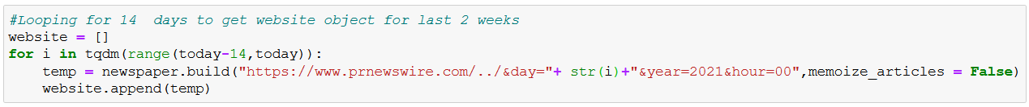
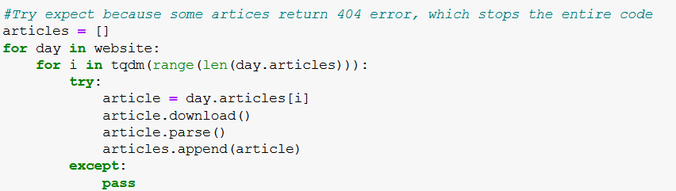
Scan / Parse
Newspaper library is used to parse the data.
temp
website
Download and parse
articles

Slide 3
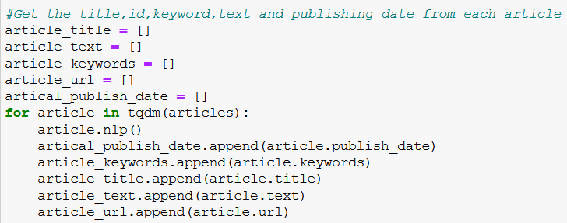
Scan / Parse
Articles’ title are stored in a list named ‘article_title’.
All the news content is stored in a list ‘article_text’.
Other contents are then stored in their respective variables.

Slide 4

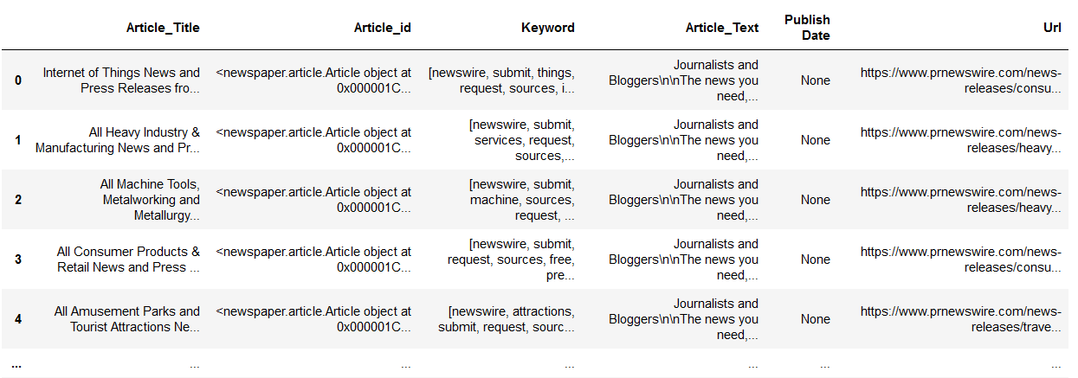
Track / Store
Website data is stored into a dataframe.

Slide 5
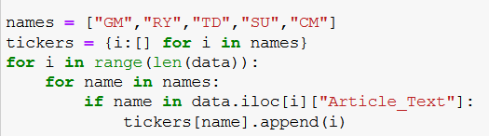
Search

Slide 6
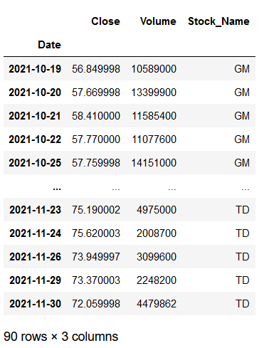
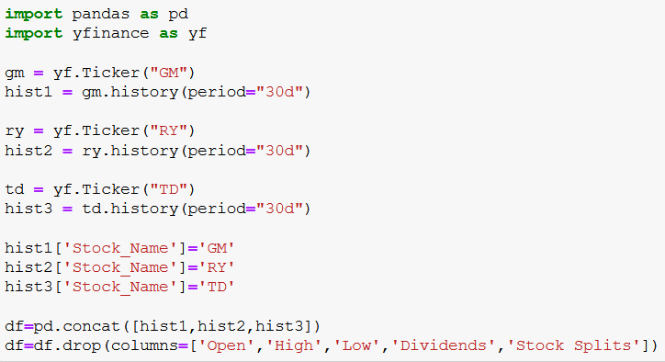
Retrieve Stock Price
yfinance library is used to retrieve stock data.
history function is used to retrieve the data for a certain period of time (30 days).
Stock’s price and volume are then retrieved and stored into a dataframe.

Slide 7
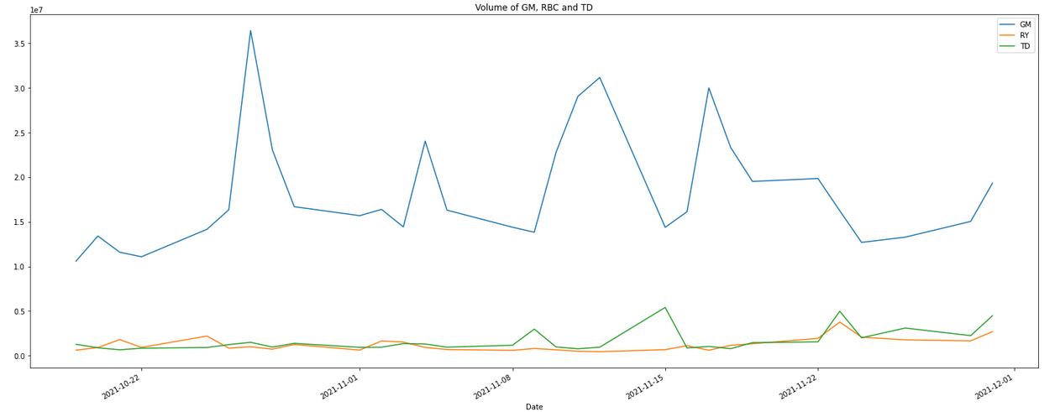
Visualization
Volume vs Time
Volume of the stocks for the last 30 days.
Scale: 1:1 million

Slide 8
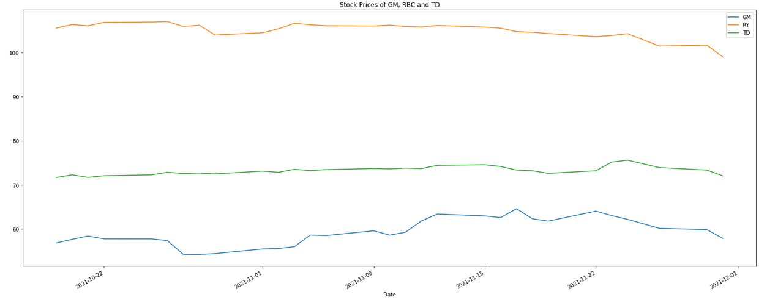
Visualization
Price vs Time
Price of the stocks for the last 30 days.
Scale: 1:1

Slide 9
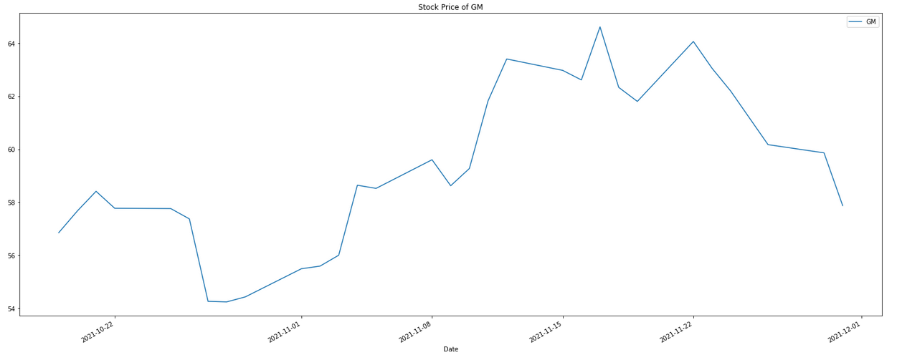
Stock Recommendation
Price vs Time
Price trend of General Motors stock (GM) is inconsistent over the past month.
It is recommended to wait before buying the stock.

Slide 10
THANK YOU

