Slide 1

Creating a SaaS AI Platform with Next.js 13, React, Tailwind, Prisma, and Stripe
The aim of this project is to develop a cutting-edge SaaS AI platform using Next.js 13, React, Tailwind, Prisma, and Stripe. The platform will revolutionize the integration of AI by enabling image, video, conversation, music, and code generation within a unified and user-friendly environment.

Slide 2

Identifying the Gap in the Market
Existing Gap
The current market lacks a comprehensive SaaS AI platform that seamlessly integrates various AI functionalities. There is a need for a solution that bridges the limitations of existing AI platforms to provide a holistic and efficient service.

Slide 3
Survey of Existing AI Systems
Features and Limitations
Popular AI platforms have inherent limitations in integrating multiple AI functionalities. By comparing the features and functionalities of existing systems, we can highlight the unique selling points of the proposed SaaS AI platform.

Slide 4
Project Objectives: A Comprehensive Approach
1
2
3
Develop a Robust Platform
Integrate AI Functionalities
Implement User-Friendly Subscription Plans

Slide 5
Essential Requirements and Technologies
Next.js 13
React and Tailwind
Prisma and Stripe
For dynamic and speedy frontend development, ensuring an exceptional user experience.
Combining React for interactive UIs with Tailwind for streamlined and responsive styling.
Prisma for efficient database operations and Stripe for secure and user-friendly subscription plans.

Slide 6
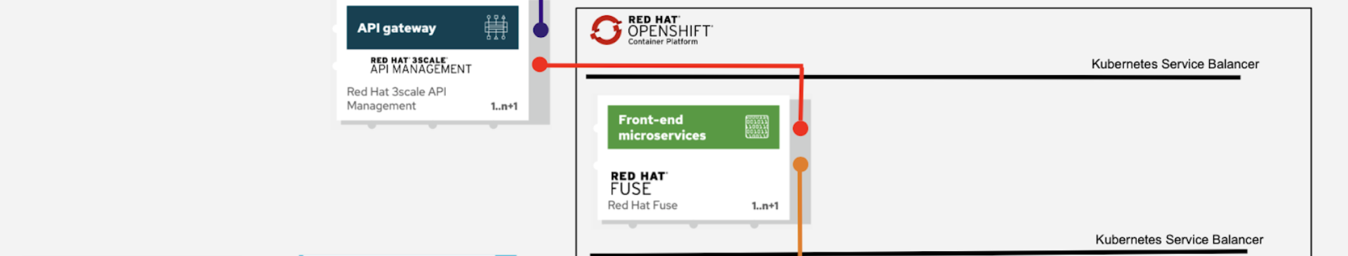
Proposed Solution Overview
Next.js, React, Tailwind
Prisma and Stripe Integration
For a comprehensive and efficient user interface and frontend development.
Efficient database operations and secure subscription plans implementation.

Slide 7
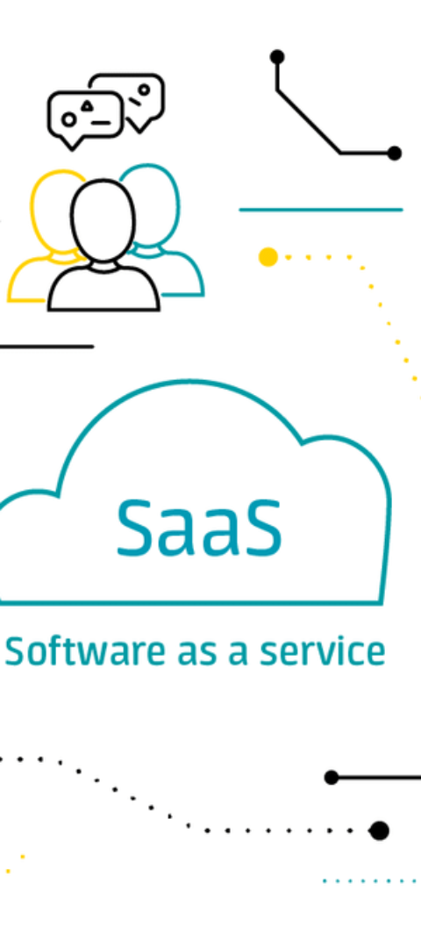
Key Features of the SaaS AI Platform
1
Image and Video Generation
Powerful tools for creating and manipulating visual content.
2
Conversational AI Capabilities
Natural language processing for seamless interactions.
3
Music and Code Generation
Innovative functionalities to enable music and code creation.

Slide 8
Architectural Framework
Interaction between Next.js, React, and Tailwind
Efficient frontend development with responsive styling
Integration with Prisma
Streamlined database operations for high performance
Secure Subscription Plans through Stripe
User-friendly payment solutions for seamless customer experience

Slide 9

User Interface Design
Customization with React
Styling with TailwindCSS
Intuitive Layouts and Components
Developing personalized and interactive user interfaces.
Efficient and responsive styling for an enhanced user experience.
Creating a user-friendly interface to ensure seamless interactions.

Slide 10
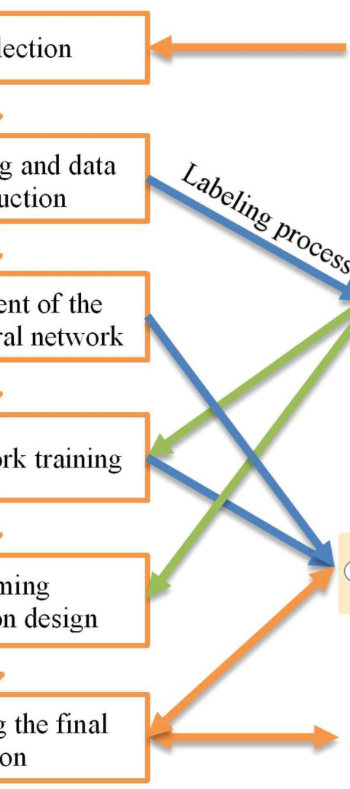
Testing Strategy for Quality Assurance
1
Unit Testing for Components
Ensuring the functionality and reliability of individual elements.
2
Integration Testing for Interaction
Validating the seamless interaction between different components.
3
User Acceptance Testing
Verifying the overall functionality through user-centric testing.

Slide 11
The Outcome Discussion:
The Outcome Discussion:
User Adoption:
Evaluate the platform's initial user adoption and user feedback.
Performance Metrics:
Share key performance metrics: response time, uptime, and reliability.
Lessons Learned:
Share lessons learned during development and post-launch.
Future Roadmap:
Present plans for future enhancements and updates.

Slide 12
Conclusions:
Summarize the project, highlighting achievements and meeting project objectives.
Discuss potential future enhancements or features.

