Slide 1
PRISM
FINAL REVIEW · PROJECT PRESENTATION
Predictive, explainable system-health monitoring on a personal computer
Sahil Dhanuka
Reg. No. 24BDS0456
Shambhav Ghosh
Reg. No. 24BCB0013
Naresh Kumar Bishnoi
Reg. No. 24BDS0336
October 2026
Notes:
Introduce the team. PRISM forecasts CPU and memory, predicts contention, explains the cause and recommends an action, all on the device.

Slide 2





Monitoring tools react; PRISM predicts and explains
PROBLEM AND OBJECTIVES
Activity Monitor / Task Manager today
PRISM answers four questions every 5 s
Shows usage only after the slowdown is felt
Raw numbers, no cause
No advice on what to do
Where will CPU and memory be in 45 s and 210 s?
How likely is a slowdown (resource contention)?
What is causing it?
What should the user do?
How PRISM works, on the laptop itself
Collect
Forecast
Score risk
Explain
Advise
CPU, memory, disk, network and processes
CPU and memory 45 s and 210 s ahead
probability of a slowdown
the most likely cause
three concrete actions

Slide 3
How PRISM compares with existing work
EXISTING WORK
 | Activity Monitor / Task Manager built into macOS / Windows | PRESS Gong et al., CNSM 2010 | ARIMA workload prediction Roy et al. 2011; Calheiros et al. 2015 | PRISM (ours) this project
Where it runs | Personal computer | Cloud servers | Cloud servers | Personal computer
Predicts future load | ✗ current only | ✓ | ✓ | ✓ 45 s and 210 s ahead
Method | — | FFT + Markov chain | ARIMA time-series model | LightGBM (beat RF, Ridge)
Explains the cause | ✗ | ✗ | ✗ | ✓ SHAP
Advice to the user | ✗ | auto-scales servers | auto-scales servers | ✓ 3 concrete actions
Flags unusual behaviour | ✗ | ✗ | ✗ | ✓ Isolation Forest
Trains on the user's machine | — (no model) | ✗ | ✗ | ✓ with a 5 % deployment gate
Different setting
Cloud work sees smooth, aggregated demand. A laptop is mostly idle with short, user-driven bursts.
Beyond forecasting
PRISM adds the cause and the action, not just a number.
Private and local
Data, training and models never leave the machine.
Notes:
Existing tools like Activity Monitor show what is happening now but never predict, explain or advise. Research on resource prediction (PRESS; ARIMA-based work by Roy et al. and Calheiros et al.) targets cloud servers, where the forecast drives automatic scaling, not advice to a person. PRISM brings prediction to a single personal computer and adds an explanation (SHAP), concrete advice, anomaly awareness, and on-device training behind a quality gate. References: Z. Gong, X. Gu, J. Wilkes, PRESS, CNSM 2010; N. Roy, A. Dubey, A. Gokhale, IEEE CLOUD 2011; R. N. Calheiros et al., IEEE Trans. Cloud Computing 2015.

Slide 4














From one OS sample to a forecast on screen
ARCHITECTURE
Follow the numbers 1 → 7
01 COLLECT
02 STORE
03 FEATURES
04 PREDICT + EXPLAIN
05 SERVE
Collectors
Feature engine
Forecaster
Contention
Live loop
collectors.py
SQLite
aiperfopt.db
3
features/engine.py
4
forecasting/
5
contention/
drives 3–6
live_state.py
psutil reads the system every 1.5 s, top processes every 3 s
254 features: lags, rates of change, rolling statistics, process activity
LightGBM: CPU and memory, 45 s and 210 s ahead
Logistic regression: probability of a slowdown
Runs steps 3–6 every 5 s on its own thread
1
writes
6
if risk is high
Ingestion
Storage
Preprocessing
Anomaly
Diagnosis
Dashboard
ingestion.py
2
storage/
preprocessing.py
anomaly/
insight/
7
api/ + web/
Bounded queue; one writer thread saves rows in batches
Samples, features, forecasts, diagnoses, model versions
Log-modulus transform, variance + correlation filters (training only)
Isolation Forest: how unusual is now? (0 to 1)
Cause via SHAP, then 3 suggested actions
FastAPI pushes results to the browser over a WebSocket
LEGEND
Comparison evaluation/
Model lifecycle lifecycle/
CLI cli.py
main path of one sample
LightGBM vs Random Forest vs Ridge
Retrain offline → beat best baseline by 5 % → operator confirms → versioned deploy, rollback
run · train · compare · replay
result going to the user
helpers: orchestrate, train, compare
Notes:
Follow one sample. (1) psutil collectors read the machine and (2) hand rows to a bounded queue; one writer thread saves them to SQLite. (3) The feature engine reads the recent window and builds 254 features. (4) LightGBM forecasts CPU and memory; Isolation Forest scores how unusual the moment is. (5) Both feed a logistic-regression contention classifier. (6) If risk is high, SHAP finds the cause and the catalogue suggests three actions. (7) FastAPI pushes the result to the browser over a WebSocket. The live loop thread runs steps 3 to 6 every 5 s. Dashed: preprocessing and model comparison run when training; the lifecycle deploys a model only after the gate and a human confirm.

Slide 5
Standard time-series features, built without look-ahead
FEATURE ENGINEERING
Table 1 254 features per sample, by technique
TARGET: PREDICT THE CHANGE
Feature group | Technique | Count | Example
Current value | raw observation | 1 | CPU % at time t
Lag features | lagged observations | 16 | value 30 s and 120 s ago
Rate of change | first difference ÷ Δt | 8 | slope per second
Rolling statistics | sliding-window mean, std, min, max | 64 | over 30 s and 120 s
Process activity | per-process aggregation | 165 | launches, top-1 / top-5 CPU share
Total |  | 254
Δ = y(t + h) − y(t)
Differencing, as in the "I" of ARIMA. Forecast = current value + predicted change, so "no change" is the model's natural zero.
No look-ahead
Every feature uses only data at or before t. One function builds features for training and for live use; a test checks both give the same vector.

Slide 6
Eight steps, each a standard method, fitted without leakage
PREPROCESSING
Stage | Step | Established method | What it does in PRISM | Effect
Per sample | Clean timestamps | Sort + de-duplicate | later sample wins on a repeated timestamp | —
Per sample | Counters → rates | First differencing | cumulative bytes → bytes / s; counter reset or gap → missing | —
Rows | Validity filter | Domain range check | drop non-finite values or values outside 0–100 % | 0 rows
Rows | Warm-up removal | Gap segmentation + burn-in removal | new segment after a gap > 30 s; drop its first 120 s | 988 rows
Columns ¹ | Skewed byte rates | Log-modulus transform (John & Draper, 1980) | sign(x) · log(1 + |x|) | 44 columns
Columns ¹ | Constant features | Zero-variance filter | drop columns with a single value | 1 dropped
Columns ¹ | Redundant features | Pearson correlation filter | if |r| > 0.99, drop the later column | 29 dropped
Per model | Missing values, scale | Trees: native missing-value splits · Ridge: median imputation + z-score (StandardScaler) | LightGBM / RF route gaps themselves; Ridge needs complete, scaled input | —
¹ Fitted on training rows only, then applied unchanged to test rows (and refitted inside every cross-validation fold), so no test data influences which columns are kept. Overall: 254 → 224 features. Effects shown for the 45 s target.
Notes:
Per-sample steps live in the feature engine; row and column steps in features/preprocessing.py; imputation and scaling for Ridge are scikit-learn's SimpleImputer(strategy='median') and StandardScaler inside a Pipeline. The log-modulus transform keeps the sign and compresses huge byte rates so a linear model can use them.

Slide 7
Three ML families, one fair test, a rule fixed in advance
ALGORITHMS COMPARED
LightGBM
Random Forest
Ridge
Persistence
Gradient-boosted trees
Bagged trees
Regularised linear
Reference, not a candidate
Each small tree fixes the errors of the previous ones
Averages many deep, independent trees
Weighted sum of features, L2-penalised
Predicts "no change": ŷ(t+h) = y(t)
80 rounds · 15 leaves · lr 0.1
100 trees · depth 12
α = 1 · imputed + scaled
the bar every model must beat
How they are tested
SELECTION RULE · written before the first run
1
Chronological hold-out: oldest 80 % train, newest 20 % test
Skill = 1 − MAE(model) / MAE(persistence)
2
Walk-forward cross-validation (TimeSeriesSplit, 4 folds)
Highest average skill over 4 targets (CPU, memory × 45 s, 210 s) wins. Skill above 0 means it beats "no change".
3
Same preprocessed features and same Δ target for all
4
47.7 h of real usage from one Mac; nothing simulated
Notes:
Why these three: tree ensembles are the strongest family on medium tabular data; Ridge is the standard linear baseline. Deep sequence models were excluded because PRISM retrains on the user's own laptop. MAE = mean absolute error in percentage points.

Slide 8
Where each model lives in the code
IMPLEMENTATION
All paths under src/aiperfopt/
Forecasters compared
Baselines to beat
LightGBM
lgb.train, 80 rounds · 15 leaves
forecasting/model.py
Persistence
"no change": ŷ = current value
forecasting/baselines.py
Random Forest
RandomForestRegressor, 100 trees
evaluation/model_comparison.py
Moving average
trailing rolling mean
forecasting/baselines.py
Ridge
median impute → scale → Ridge
evaluation/model_comparison.py
Holt smoothing
statsmodels Holt, linear trend
forecasting/baselines.py
Live risk and explanation
Training and deployment
Isolation Forest
how unusual is now (0 to 1)
anomaly/detector.py
Train forecasters
4 LightGBM models
forecasting/training_pipeline.py
Train classifier
logistic regression
contention/training_pipeline.py
Logistic regression
probability of a slowdown
contention/model.py
Gate
beat best baseline by 5 %
lifecycle/gate.py
SHAP
TreeExplainer on LightGBM → cause
insight/explainer.py
Deploy / roll back
versioned models
lifecycle/deployment.py
Notes:
LightGBM is the only forecaster that is deployed; Random Forest and Ridge exist only in the comparison harness (run with 'aiperfopt compare'). Line numbers: LightGBM params forecasting/model.py:42, training :105; Random Forest model_comparison.py:146; Ridge :152; baselines.py persistence :58, moving average :68, Holt :85; IsolationForest anomaly/detector.py:140; LogisticRegression contention/model.py:90.

Slide 9
PRISM's forecasts are about 98 % accurate
ACCURACY
OVERALL FORECAST ACCURACY
CPU 45 s ahead
CPU 210 s ahead
97.9 %
97.0 %
96.3 %
LightGBM, average of the 4 forecasts
Average error ±3.0 points
Direction right 54 %
Average error ±3.7 points
Direction right 54 %
HOW IT IS CALCULATED
Accuracy = 100 % − MAE
Memory 45 s ahead
Memory 210 s ahead
MAE = (1/n) · Σ | forecast − actual |
99.4 %
99.1 %
The average miss in percentage points, over n ≈ 22,000 test samples the model never saw.
CPU 45 s: 100 − 2.95 = 97.0 %
Overall: 100 − 2.06 (mean MAE of 4) = 97.9 %
Average error ±0.6 points
Direction right 86 %
Average error ±0.9 points
Direction right 82 %
Direction right = share of samples where the forecast got up, down or steady right (steady = within 2 % of the current value). Memory is steadier than CPU, so it is easier to forecast.
Notes:
Say: PRISM's forecasts are about 98 % accurate overall, 97 % for CPU and 99 % for memory, on the newest 20 % of the data the model never saw. Accuracy = 1 minus the normalised mean absolute error. Be ready: because the laptop was mostly idle, simply repeating the current value scores about the same on average; the models' advantage shows when load changes, where they are about 30 % more accurate (next slides). The contention classifier has no accuracy figure: the test period had no real contention events.

Slide 10
LightGBM: smallest error, on average and at worst
RESULTS
Fig. 1 Extra forecast error compared with "no change" (lower is better)
LightGBM
11 % more error than "no change" on average, never more than 23 %
Random Forest, Ridge
each wins one CPU target, but miss badly on memory (up to +85 % and +179 %)
Why all are above 0
the laptop was idle 97 % of the time, so "no change" is usually right; next slide shows where the models help
Notes:
Read the chart as: how much worse than simply repeating the current value. Lower is better. Measured on the newest 20 % of data, never seen in training. Targets: CPU and memory, 45 s and 210 s ahead.

Slide 11
When load changes, the models cut error by ~30 %
RESULTS
Fig. 2 Average CPU forecast error, 45 s ahead, split by how much the load changed
−30 %
Load changing: LightGBM error 6.1 vs 8.7 points for "no change". This is when a warning is useful.
+69 %
Load steady: models predict small moves that don't happen (1.9 vs 1.1 points). 3 in 4 samples are steady, so the average looks worse.
Notes:
'Changing' means the CPU moved by more than 3.8 points over the next 45 s (the largest 25 % of moves). This split uses the real outcome, so it explains the results; it is not something the live system can use directly.

Slide 12
Why PRISM uses LightGBM
ALGORITHM CHOSEN
1
Most accurate overall
Best average skill under the rule fixed in advance.
Table 2 Running cost on the laptop (lower is better)
 | LightGBM | Rand. Forest | Ridge
Time per prediction | 1.7 ms | 15.8 ms | 2.1 ms
Training time per target | ≈ 6 s | ≈ 88 s | ≈ 6 s
Model file size | 138 kB | 4.5–10 MB | 17 kB
2
Never badly wrong
At most 23 % worse than "no change"; a monitor that is sometimes far off loses trust.
3
Cheap on a laptop
Fast to predict and 15× faster to train than Random Forest, so retraining on the device is practical.
Worth testing next: Ridge was best on short-term CPU. A per-target mix (Ridge for CPU, LightGBM for memory) may do better and needs confirming on new data.
4
Fits the system
Handles missing values after gaps, and SHAP explains each prediction exactly.

Slide 13
A model is served only if it beats the simple baselines
DEPLOYMENT GATE
1
Retrain
2
Gate
3
Confirm
4
Deploy
on the user's own accumulated data, offline
must beat the best simple baseline (no change, moving average, Holt) by ≥ 5 %
an operator approves in the CLI, API or Model view; never automatic
versioned, stored with its evidence; one click rolls back
If the gate fails, the best baseline keeps serving.
Served today: moving average
On the current data LightGBM does not yet clear the 5 % gate, so the gate correctly keeps it out until it earns its place on new data.

Slide 14
CONCLUSION
1
A complete on-device monitor
Predicts, explains and advises, with a gated, human-confirmed model lifecycle.
2
A fair, leakage-free comparison
LightGBM chosen by a rule fixed in advance: smallest error on average and in the worst case.
3
Value where it matters
When CPU load changes, the models cut forecast error by about 30 % versus "no change".
Thank you
Sahil Dhanuka · Shambhav Ghosh · Naresh Kumar Bishnoi

Slide 15
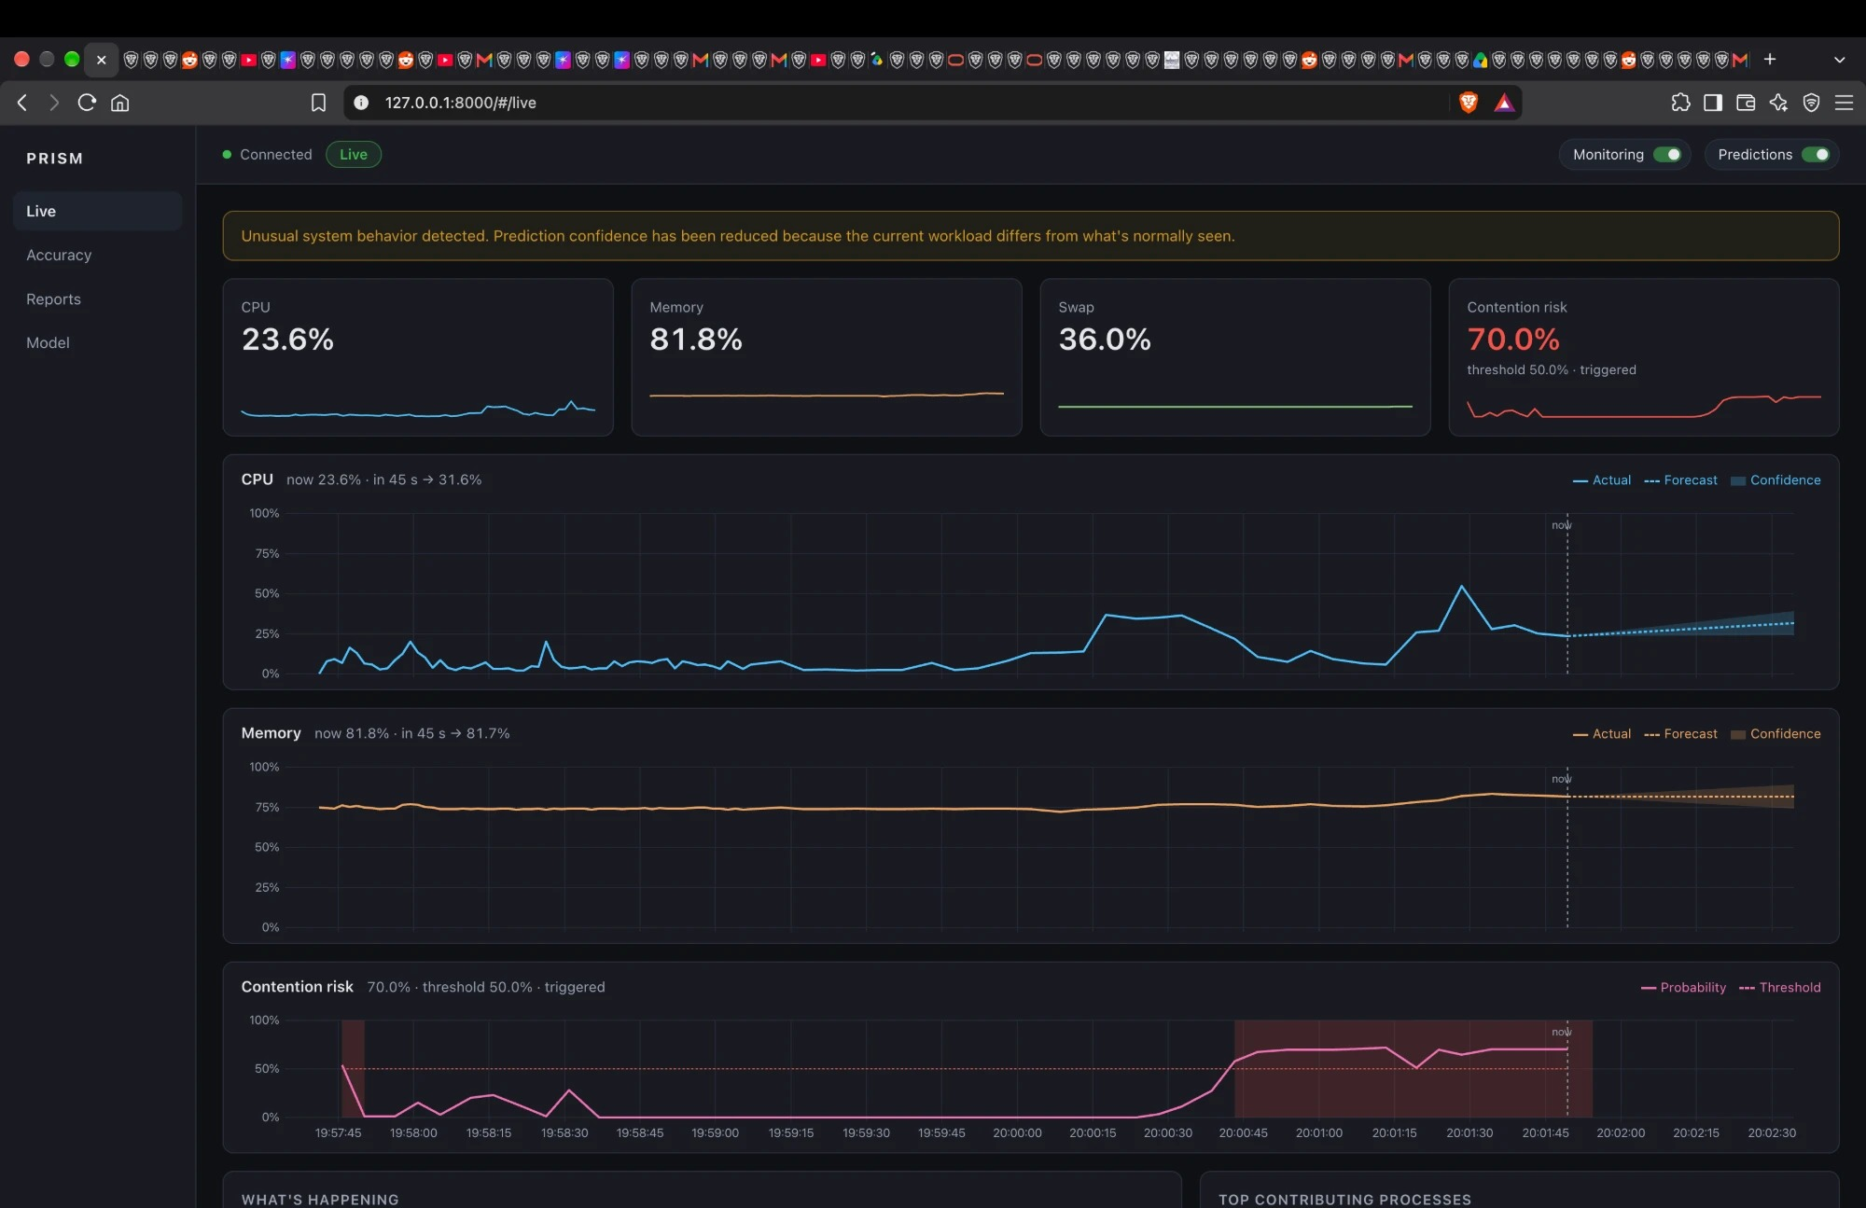
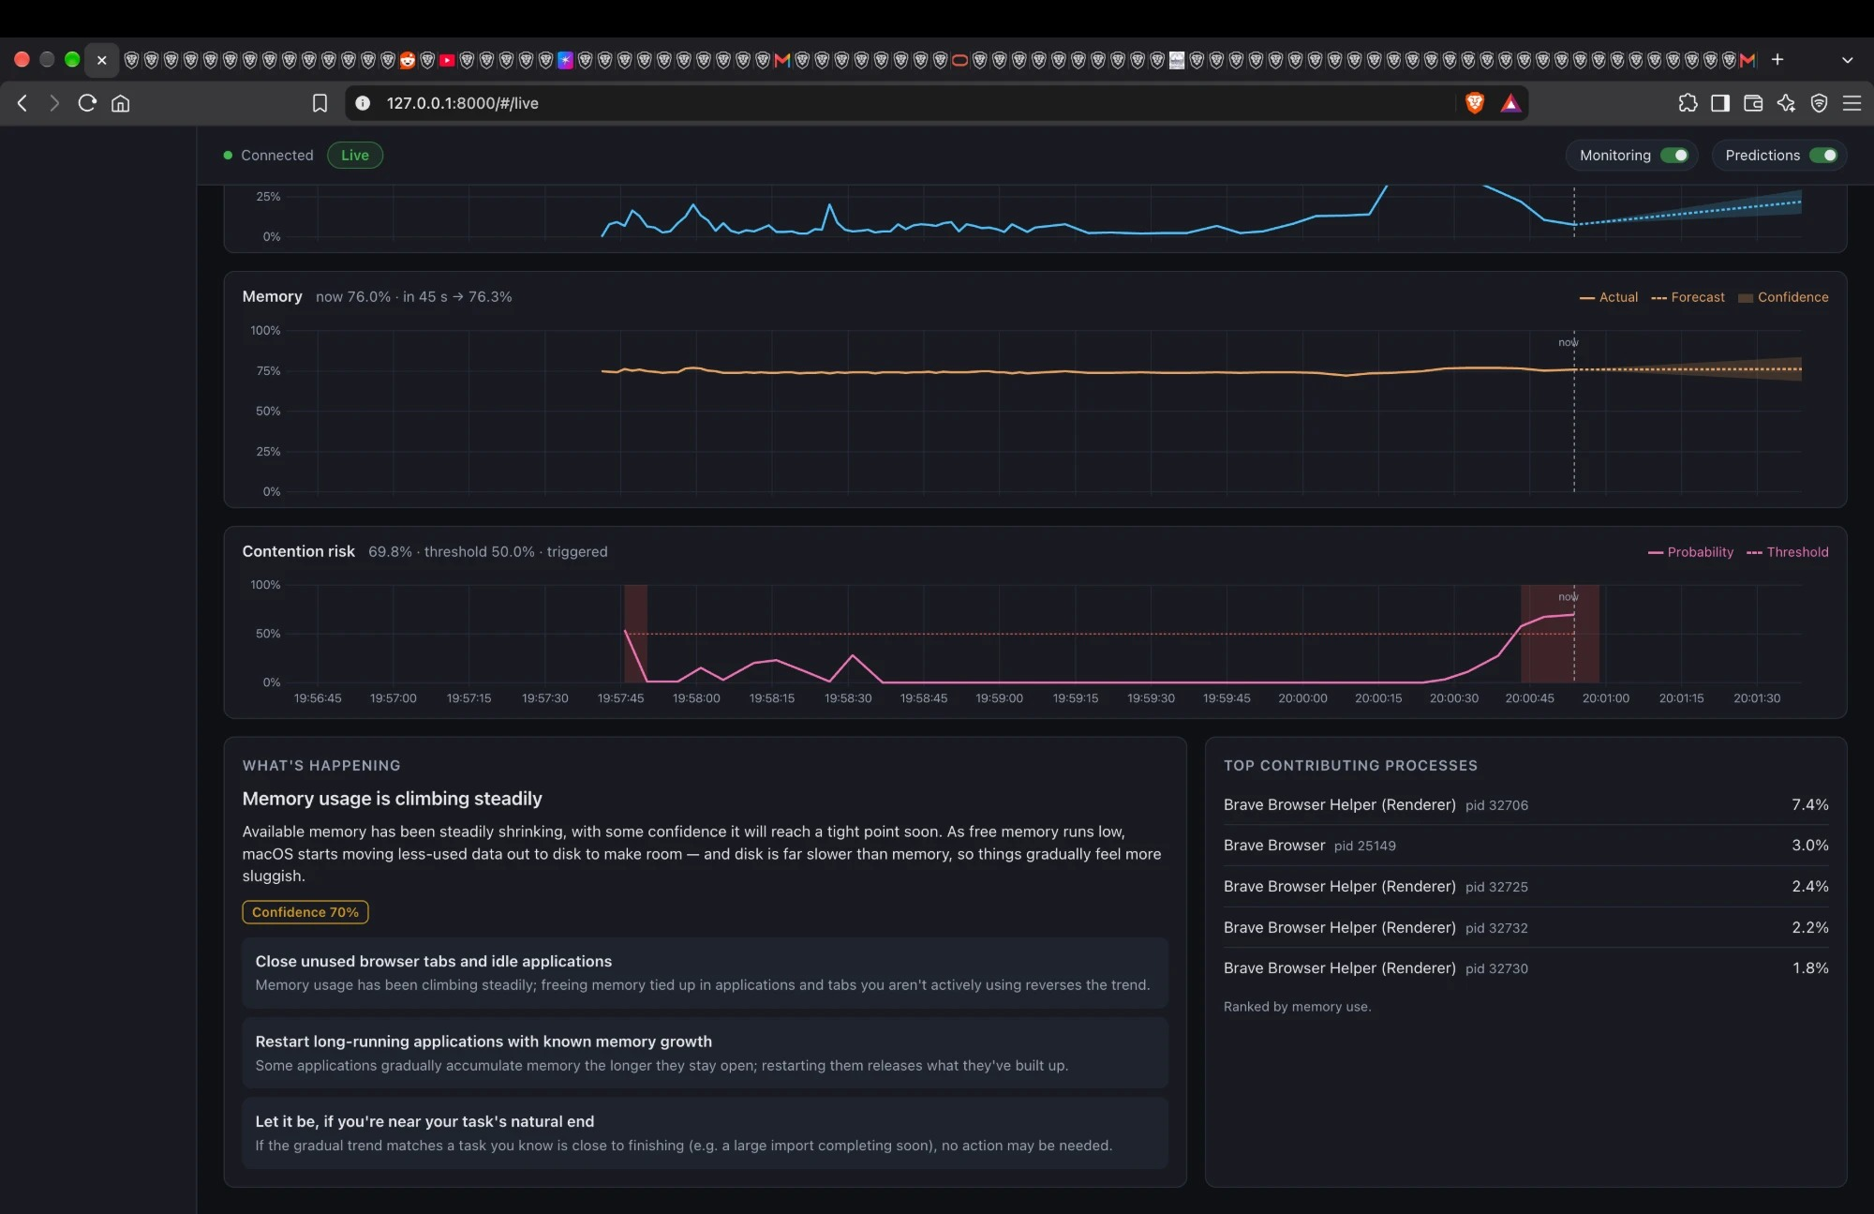
PRISM sees a slowdown coming and says why
LIVE DEMO · 1 OF 2
1
Risk crosses the threshold
Contention risk jumps to 70 % (threshold 50 %) with memory at 82 %. The anomaly detector also flags the workload as unusual and lowers confidence.
2
Cause and advice
"Memory usage is climbing steadily". Top advice: close unused browser tabs. The browser's renderer processes lead the memory list.
Notes:
Recorded live on this Mac on 20 Oct 2026, with dozens of browser tabs open. Nothing was simulated.

Slide 16
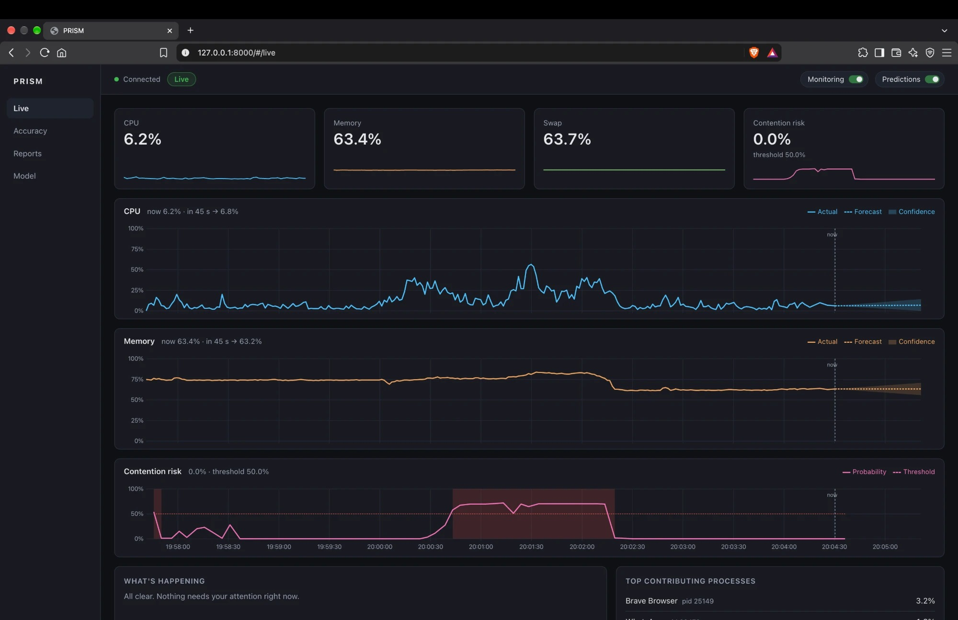
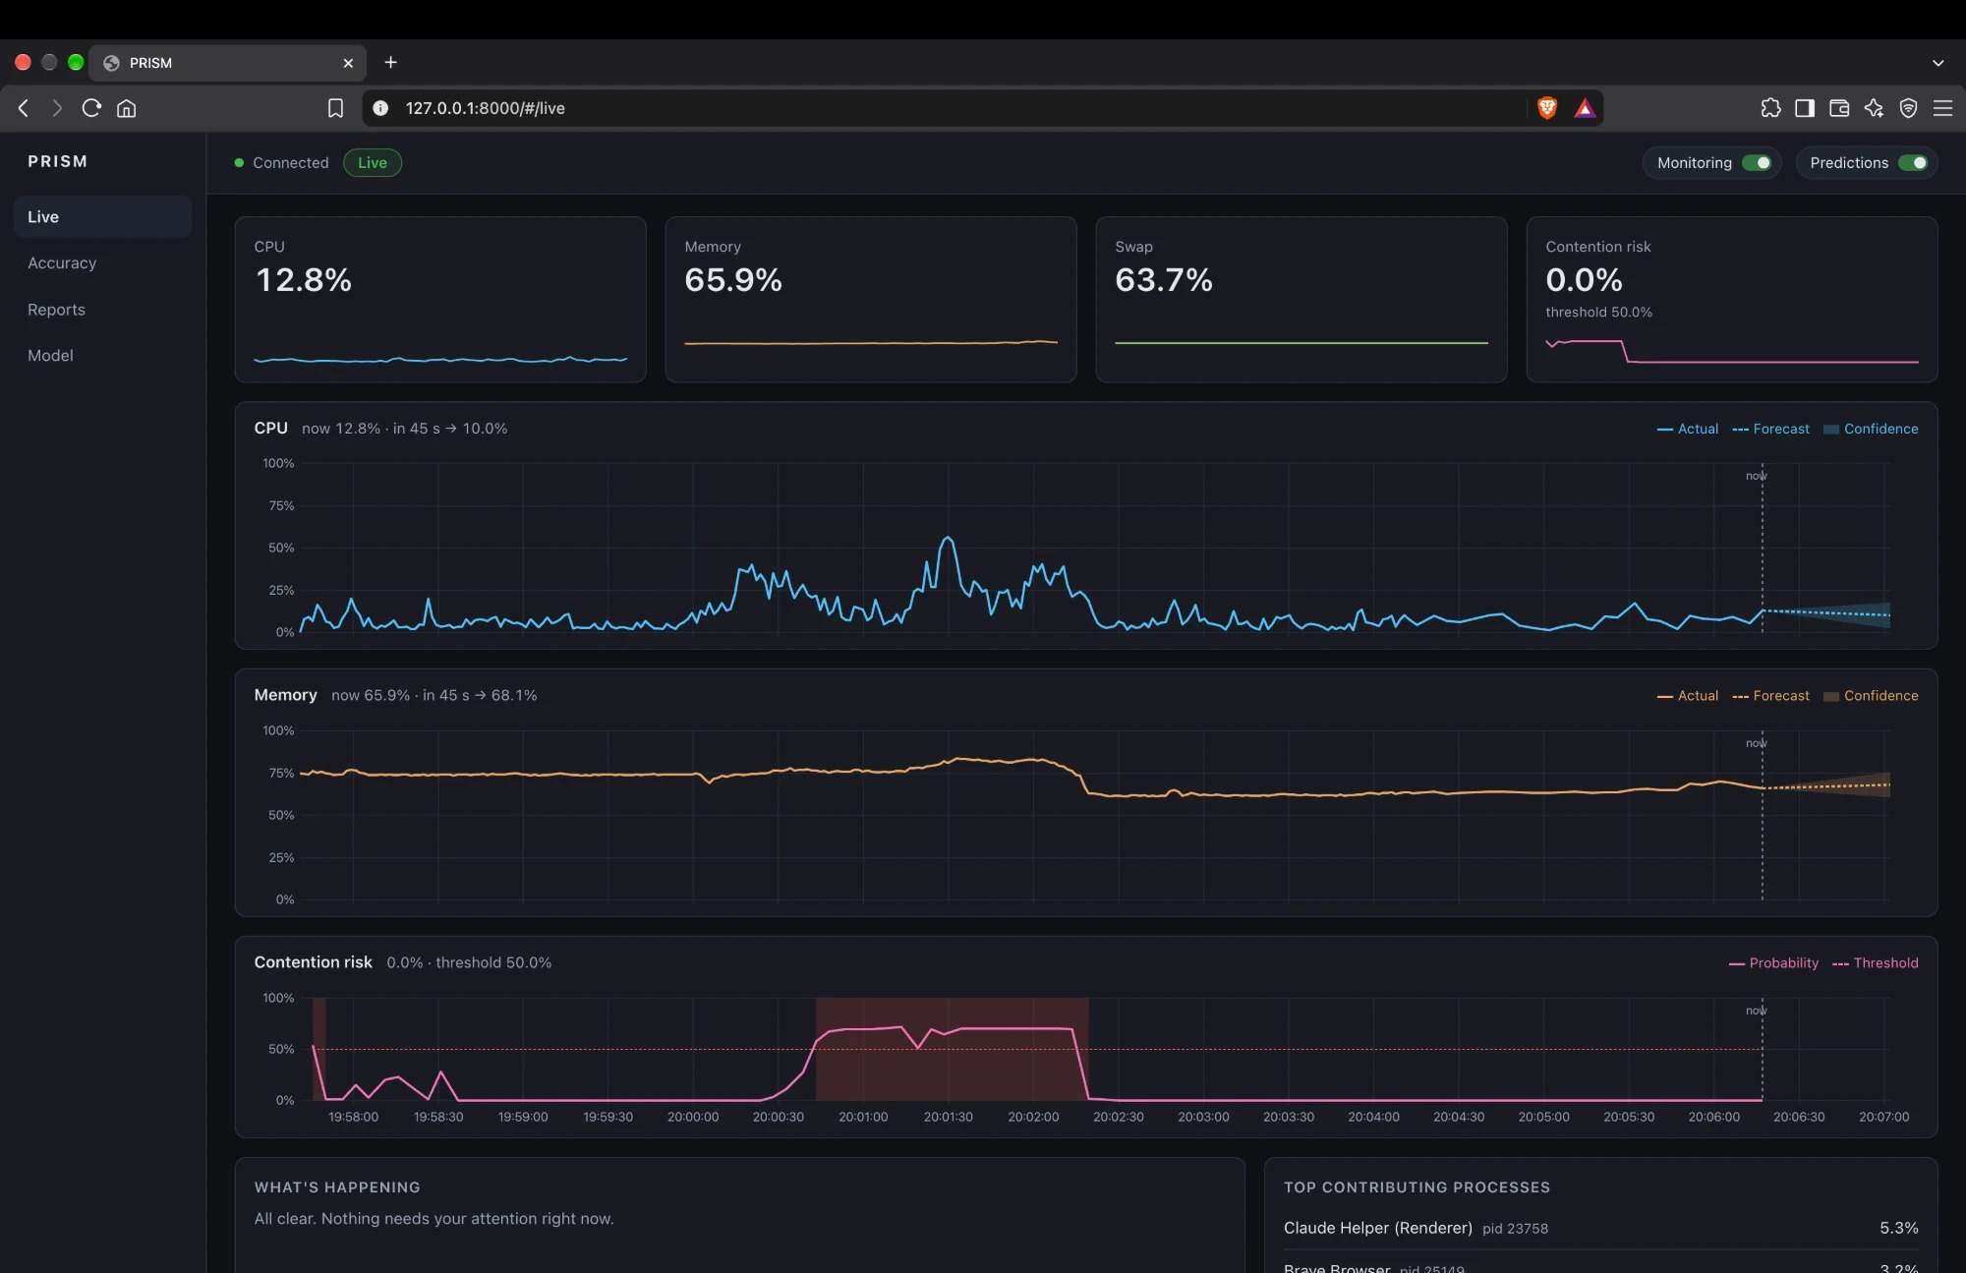
The advice is followed and the risk goes away
LIVE DEMO · 2 OF 2
3
Tabs closed, memory drops
Memory falls from about 82 % to 63 % at 20:02:20; contention risk drops to 0 % within seconds.
4
All clear
"Nothing needs your attention right now." The forecasts keep running every 5 s.
Notes:
Between the two slides the browser went from dozens of tabs to one. The red band on the contention chart marks the period the risk was above the threshold.

