Slide 1



Shutter
Motor
DPDT
Relay
Open/Close
(Outside)
Open/Close
(Inside)
SPDT
Switch
DPDT
Switch
Keyed
Switch
MaxDome II
Controller
(Shutter)
Open/Closed
Motor Control
“Solar” Power
Voltage
Regulator
Solar
Panel
12V Power
Gel Cell
Battery
Wipers
Bluetooth
Battery
Monitor
Observatory Power Supply
Emergency
Power
Receptacle
Dome Exterior

Slide 2
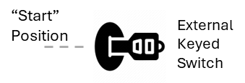
External
Keyed
Switch
Door
Motor
4PST
Relay
DPDT
Relay
MaxDome II
Controller
DPDT
Switch
SPDT
Switch

