Slide 1
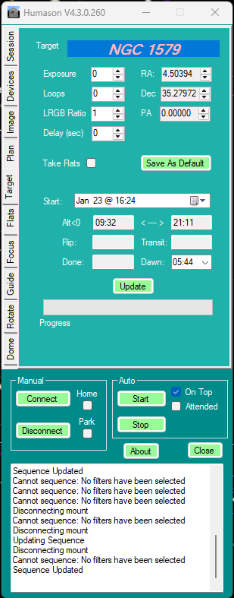
Humason Hardware Interface (V4.x)
TSX Wrapper
ScriptTheSkyX
Mount
Dome
Chart
Image
Camera
TheSky Pro
Planetarium
SExtractor
Image Reduction
Precision Slew
AutoGuide**
@Focus
Rotation
Filter Control**
X2 & ASCOM drivers
Paramount
Dome
Other
MaximDL ASCOM Wrapper
MDL LT
* ASCOM does not support AO and configuration is currently very unstable.
** X2 DL camera driver does not support filter wheel, guider or AO.
MDL Drivers
Camera
Filter
Wheel
Guider
AO

Slide 2
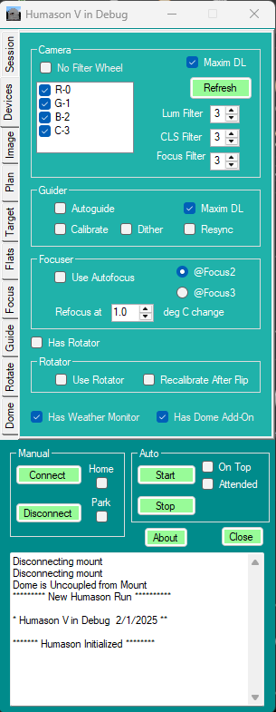
* Active only when MDL is enabled. Guider and Filter functions switch to TSX Wrapper otherwise.
Humason Hardware Interface (V5.x)
TSX Wrapper
Guider Image Transfer*
TSX to MDL Wrapper*
Single shot for guide star selection & exposure
Guide Commands
Filter Commands
Guide Images
ScriptTheSkyX
MDL Pro Scripting
Direct
Guide
Mount
Dome
Chart
Camera
Wizard
Application
Document
Camera (Guider)
ASCOM2X
Adapter
(7.0 LS)
TheSky Pro
MaximDL Pro
Planetarium
SExtractor
AutoGuide
Image Reduction
Precision Slew
Filter Control
@Focus
Rotation
Pulse
Guide
X2 & ASCOM drivers
MDL & ASCOM Drivers
Paramount
Dome
Other
MDL Imaging
Main
Camera
Filter
Wheel
Guider
Camera
AO
Imaging

Slide 3
Voyager Configuration
Voyager
AutoFocus
Sequencing
Dome Control
AutoFlat
ASCOM Client
Image
Guide
Filter
Mount
Image Link
Direct
Guide
MDL Pro Scripting
ScriptTheSkyX
MaximDL
ASCOM2X
Adapter
(7.0 LS)
Imaging
Calibration
TheSky Pro
Planetarium
AutoGuide
Image Link
MDL Driver
ASCOM Client
BCS Driver
Pulse
Guide
Main
Camera
Filter
Wheel
Guider
Camera
AO
Paramount
Dome
Focuser
Rotator
Weather
Flat Panel

Slide 4
PHD2
ASCOM Telescope Server
Pulse
Guide
AP Mount
ASCOM2X
Adapter
TheSky
Direct
Guide

Slide 5
TheSky T-Point Configuration
TheSky Pro
T-Point
Mount
Dome
Chart
Image
Camera
X2 & ASCOM drivers
Paramount
Dome
MDL LT
MDL Drivers
Camera

Slide 6
Ascom PulseGuide
(direction, duration)
Command
PulseGuide Handler
Log: Can Pulse Guide
Use Direct Guide?
No
Log: DirectGuide
Yes
Convert To Direct Guide
Direct Guide command
IsSlewComplete
Is Slew Complete ?

