Slide 1
Reduction Library
Bias Image Set
Match Binning
Match Temp
Darks Image Set
Match Exposure
Darks For Flats Image Set
Match Filter
Flats Image Set

Slide 2
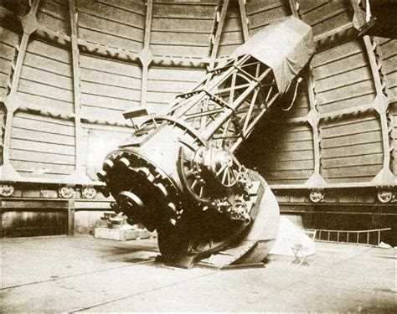
Process Structure
AAVSO VSX
Import CSV
Target List (CSV)
Generate Variable List
Session Manager
Target List (XML)
TheSkyX
Image Reduction Libraries
Image Bank
Imaging
Light Source Inventory
Plate Solving
Catalog Inventory
Catalog Searching
Photometry
Calibrated Magnitudes
Reports

Slide 3
<date>.log
Configuration.xml
Log
Starchive
Starchive.xml
CalLib
VariScan
<target name>
Image <filter> <date>.fit
<Collection>
Image Bank
<Collection>
VariableList.xml
Image <filter> <date>.fit
<target name>

Slide 4
Starchive.xml
T<temp>.E<sec>.fit
Bias
T<temp>.fit
<Exposure>
CalLib
Darks
<Exposure>
Image <filter> <date>.fit
<Exposure>
Flats

Slide 5
TheSkyX
Image Bank
Image Bank
Fits Image
Light Source Qualities
Light Source Qualities
Plate Solution
Light Source Coordinates
Light Source Coordinates
Light Source Qualification
Catalog Search
Catalog Calibration
Catalog Calibration
Photometry
Reports

