Slide 1
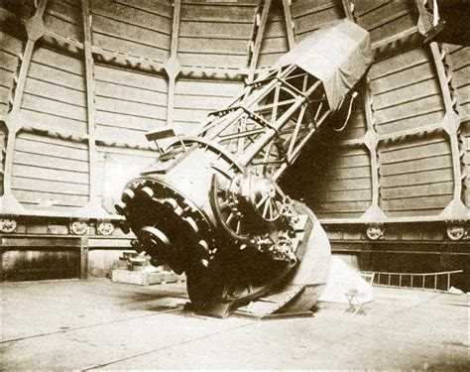
Process Structure
AAVSO VSX
Reduction Library Generator
Import CSV
Target List (CSV)
Variable List
Image Reduction Libraries
Session Manager
Target List (XML)
TheSkyX
Image Bank
Imaging
Light Source Inventory
Plate Solving
Catalog Inventory
Catalog Searching
Photometry
Calibrated Magnitudes
Reports

Slide 2
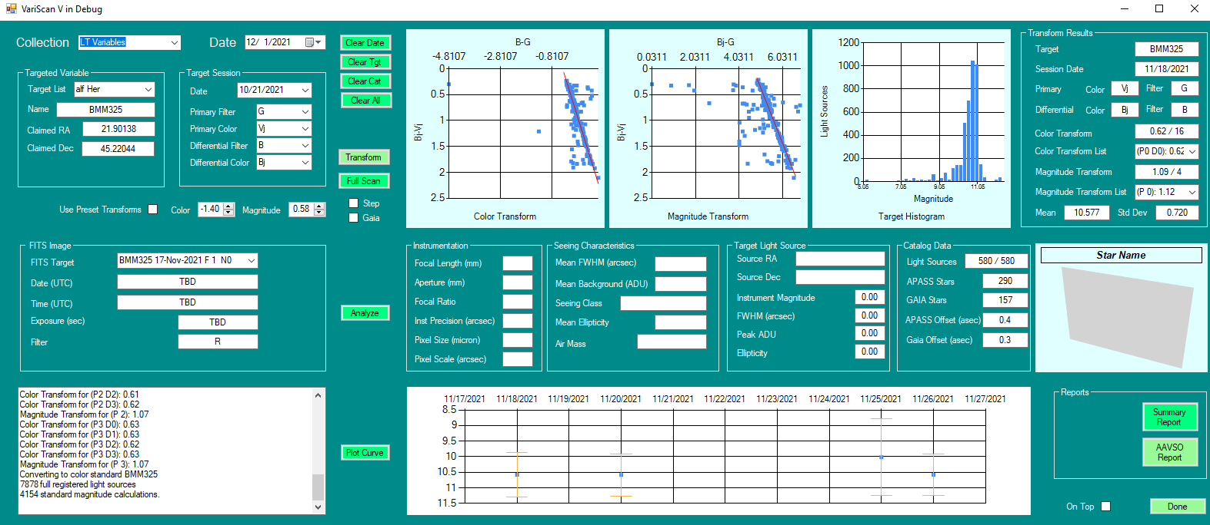

Slide 3
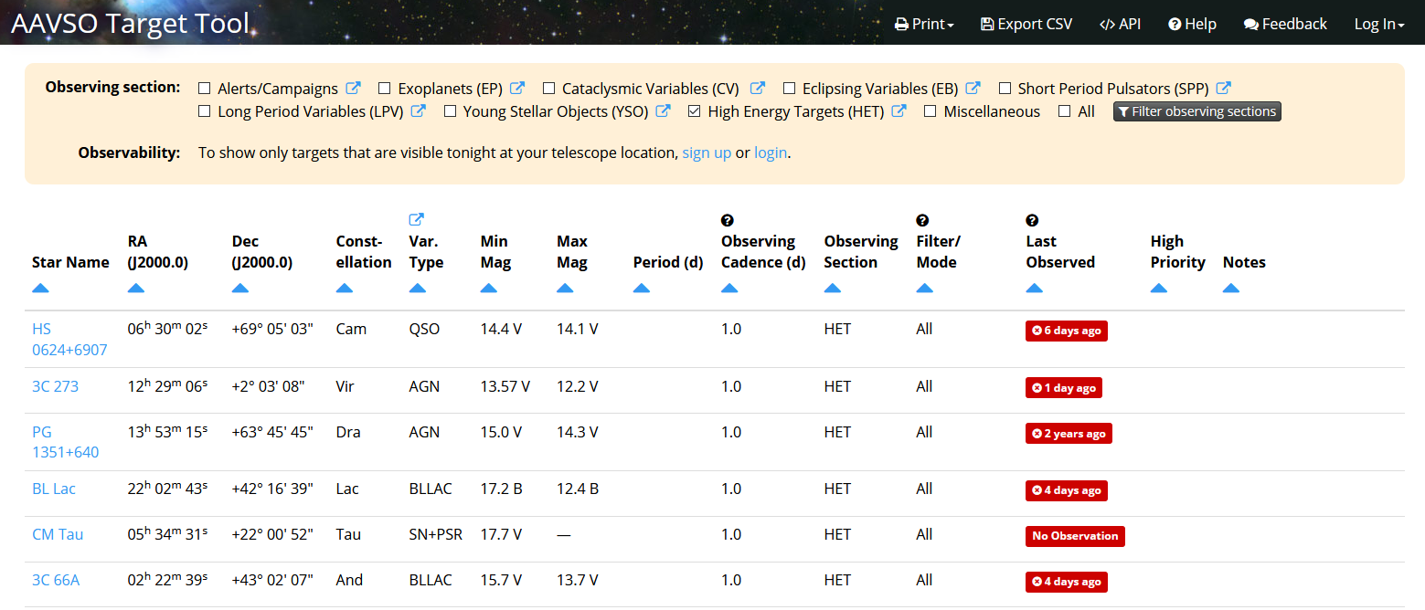
Target List CSV Generation via AAVSO
(https://filtergraph.com/aavso)

Slide 4
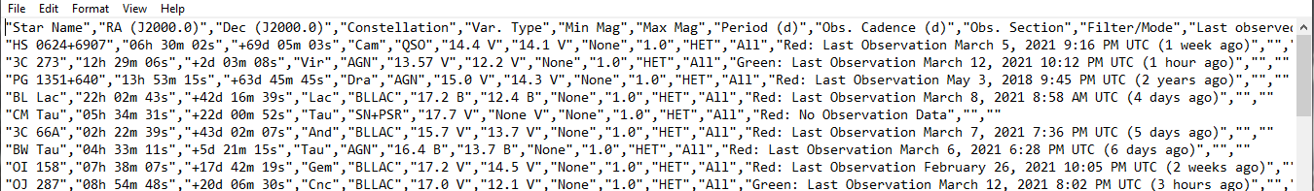
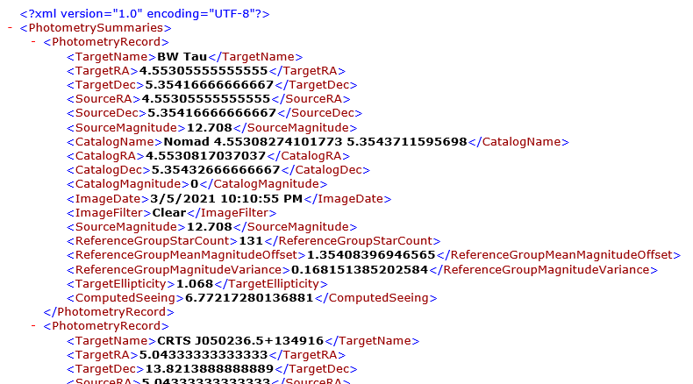
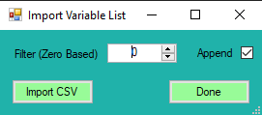
AAVSO Exported CSV File
Variable Survey Import CSV File
VariableList.xml

Slide 5
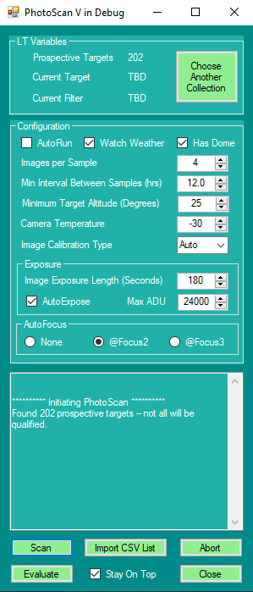
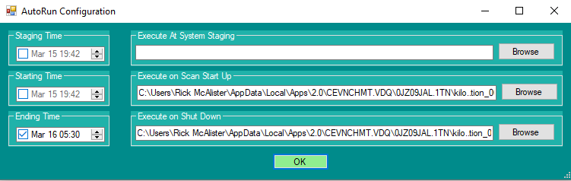
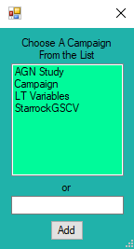

Slide 6
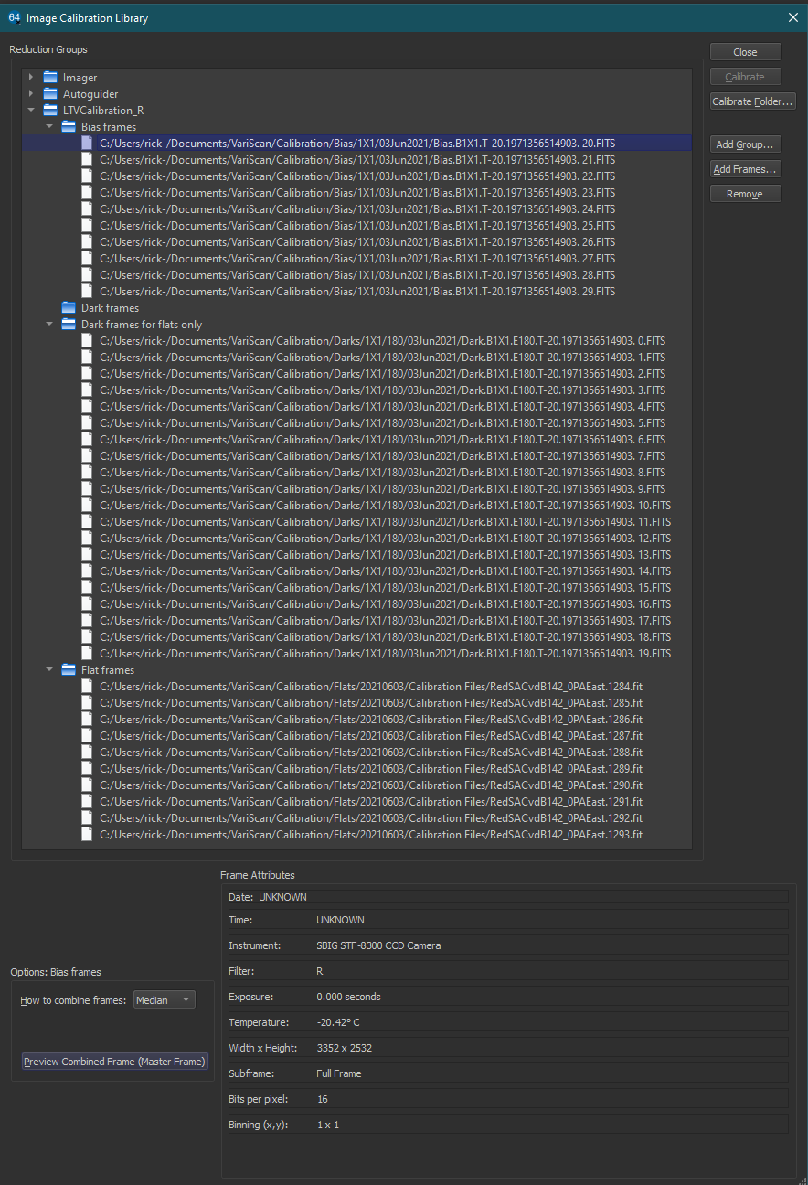

Slide 7
<date>.log
Log
Configuration.xml
Starchive.xml
Image Bank
VariScan
<target name>
Image <filter> <date>.fit
<Collection>
ColorIndex.xml
<Collection>
Image <filter> <date>.fit
<target name>
VariableList.xml

Slide 8
Starchive.xml
T<temp>.E<sec>.fit
Bias
T<temp>.fit
<Exposure>
Calibration Library
Darks
<Exposure>
Image <filter> <date>.fit
<Exposure>
Flats

Slide 9
Scan
Auto
Run?
No
Staging Exe (Staging
user defined)
Staging Time?
Yes
Now
None
No
Staging Exe (Staging
user defined)
Start Up?
Watch Weather?
Weather Change?
Has Dome
Close or Open Dome
Now
Yes
Yes
Yes
None
No
No
Staging Exe (Staging
user defined)
Shut Down?
Auto
Focus?
> 1 degree increase
@Focus2
Or
@Focus3
Now
Yes
Yes
None
No
No
More Targets?
Auto Expose
Adjust Exposure
Yes
Yes
No
Repeat?
Image Target
No
No
Done
Yes

Slide 10
TheSkyX
Image Bank
Image Bank
Fits Image
Light Source Qualities
Light Source Qualities
Plate Solution
Light Source Coordinates
Light Source Coordinates
Light Source Qualification
Catalog Search
Catalog Calibration
Catalog Calibration
Photometry
Reports

Slide 12
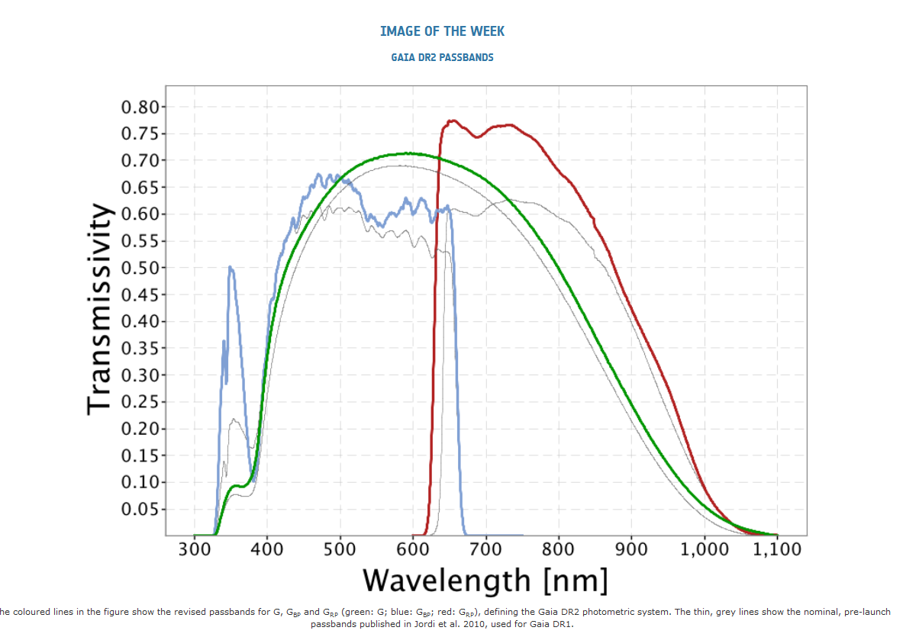

Slide 13
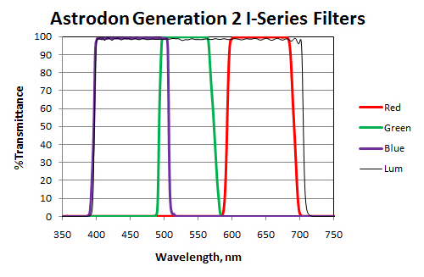

Slide 14
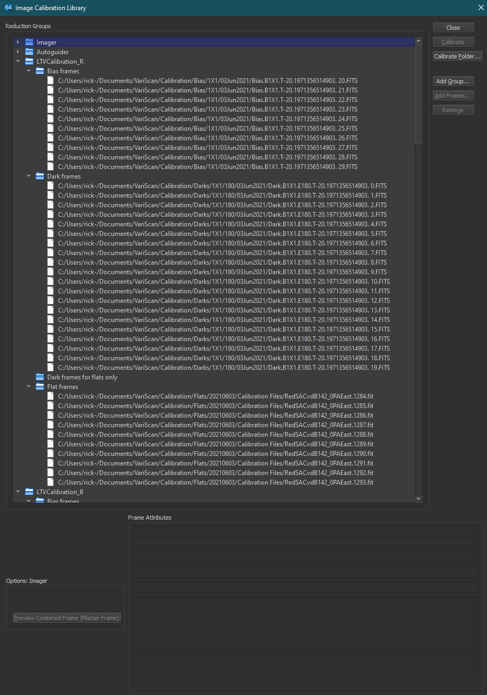

Slide 15
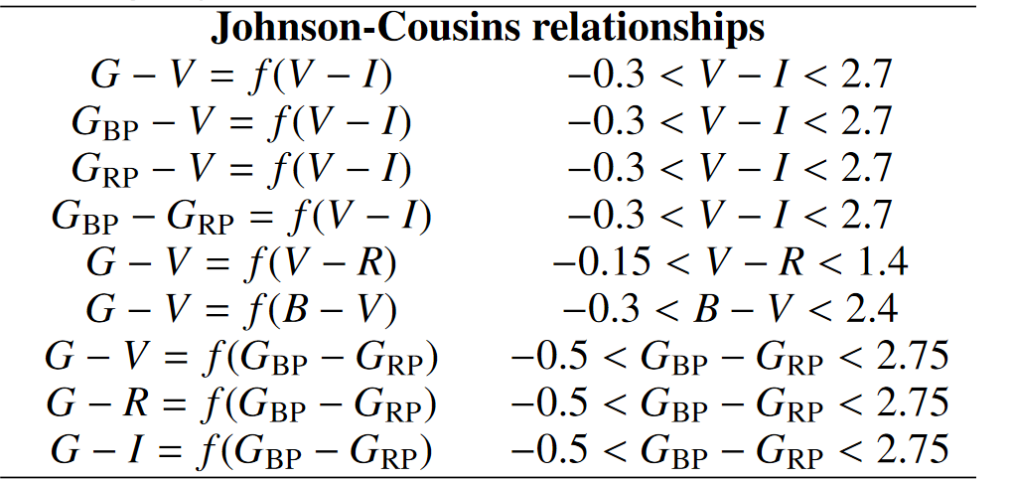
Astronomy&Astrophysicsmanuscript no. GAIA-CS-CP-IOA-DWE-052Finalc©ESO 2018June 22, 2018Gaia Data Release 2Photometric content and validation

Slide 16
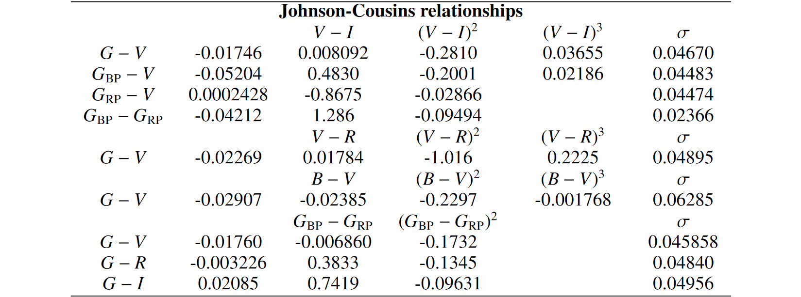
https://arxiv.org/abs/1804.09368

Slide 17
B
V
Rc

