Slide 1
CUS1166 – Software Engineering Technology Presentation
Flask-S3
Seamlessly serve your static files of your Flask app from Amazon S3
Raeven Small
April 10, 2019

Slide 2
Overview
Flask-S3 allows you to easily serve all your Flask application’s static assets from Amazon S3, without having to modify your templates.
Notes:
Provide any information need to orient the audience what topic you are about to present.

Slide 3
Purpose/Goal of Technology
Flask-S3 has two main functions:
Walk through your application’s static folders, gather all your static assets together, and upload them to a bucket of your choice on S3
2. Replace the URLs that Flask’s flask.url_for() function would insert into your templates, with URLs that point to the static assets in your S3 bucket.
(Every time url_for is called in one of your application, flask_s3.url_for is instead invoked. )
Notes:
Motivate. what problem does this technology tries to solve; What is its purpose

Slide 4
Purpose/Goal of Technology
Gathering and uploading your static assets to S3 need to be done once and your application doesn’t have to be running for the process to work.
The location of your S3 bucket is specified in your Flask application, therefore there doesn’t need to be communication set up between your Flask application and Amazon S3.
Notes:
Motivate. what problem does this technology tries to solve; What is its purpose

Slide 5
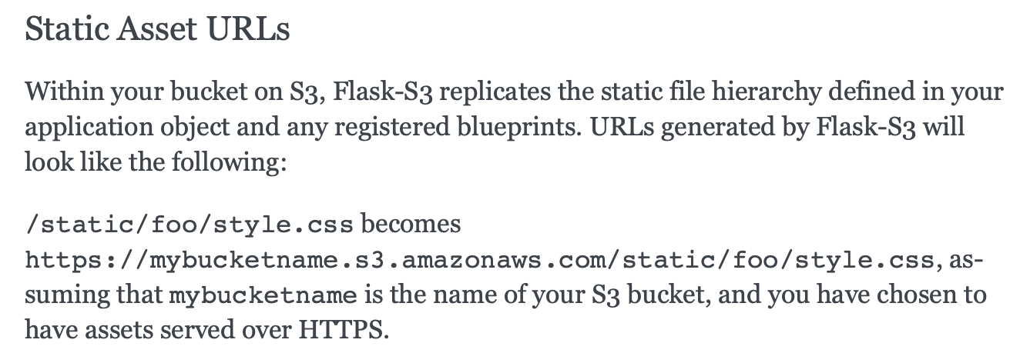

Slide 6
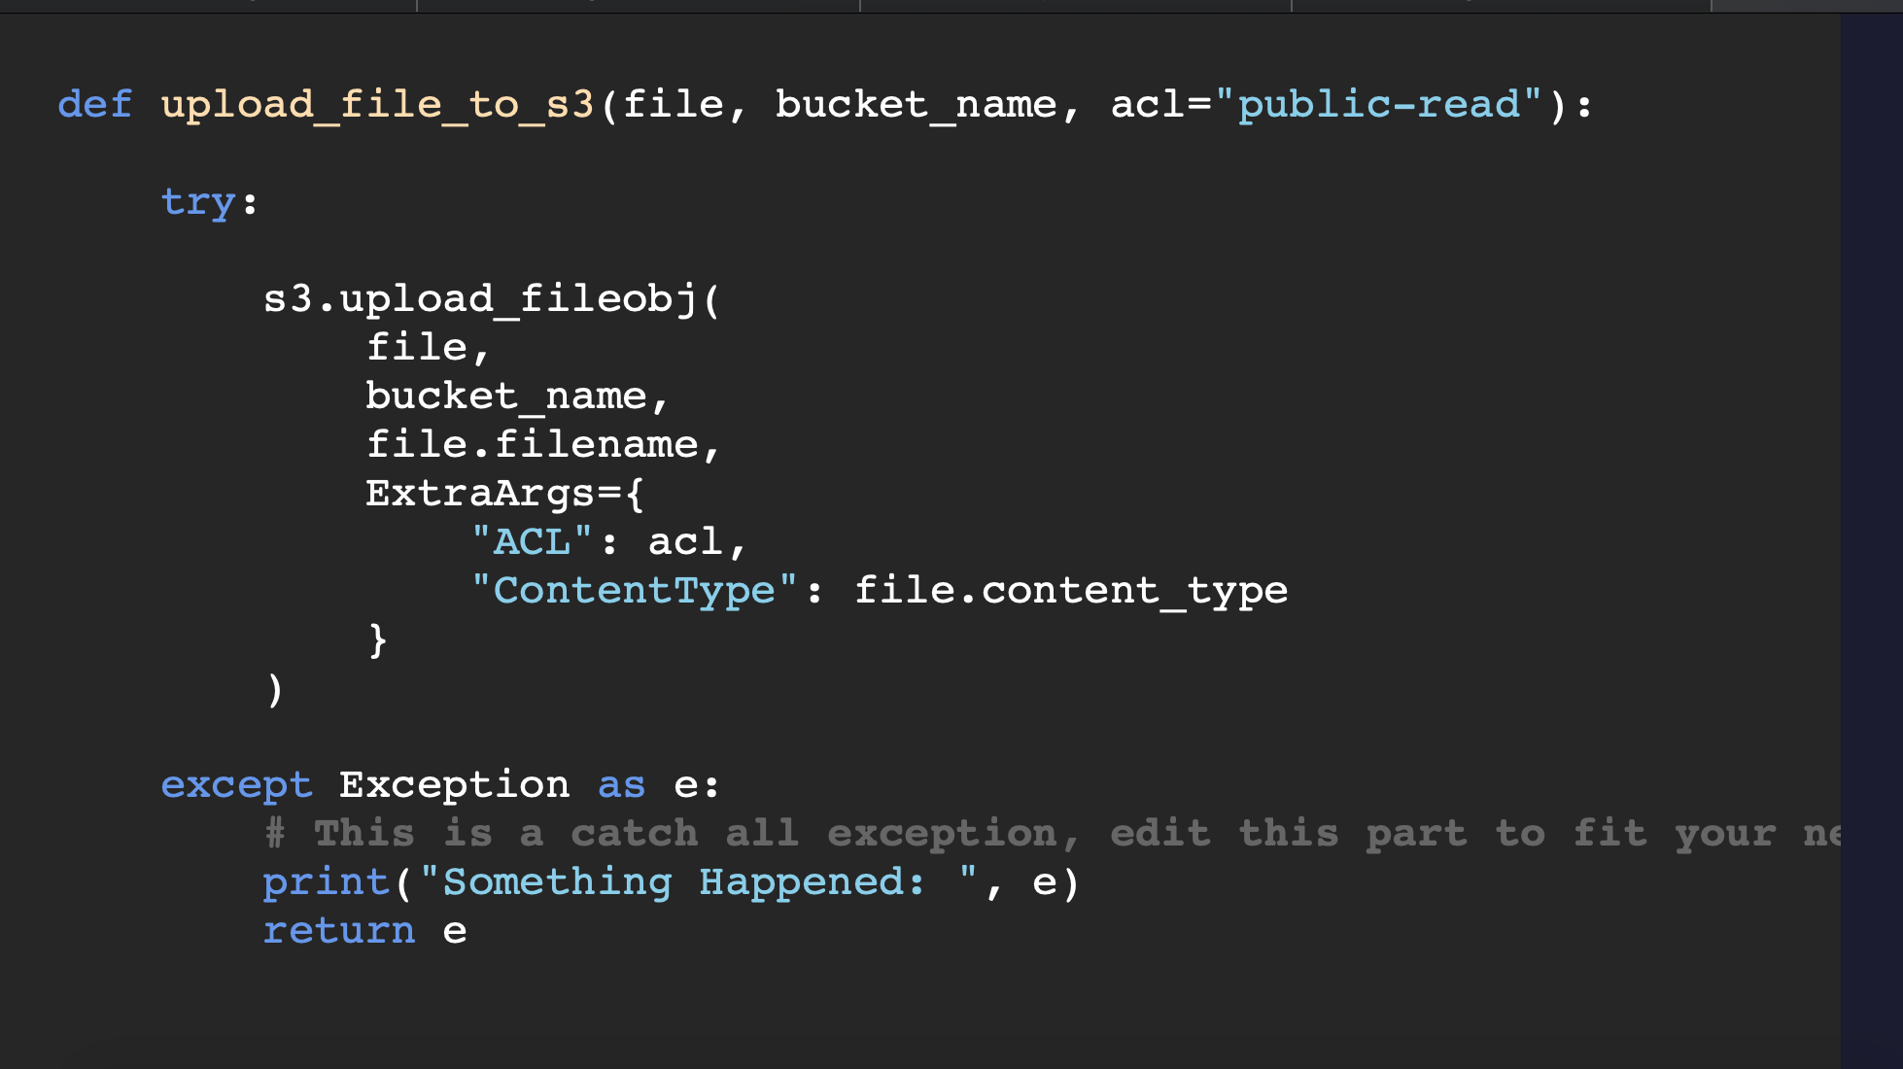
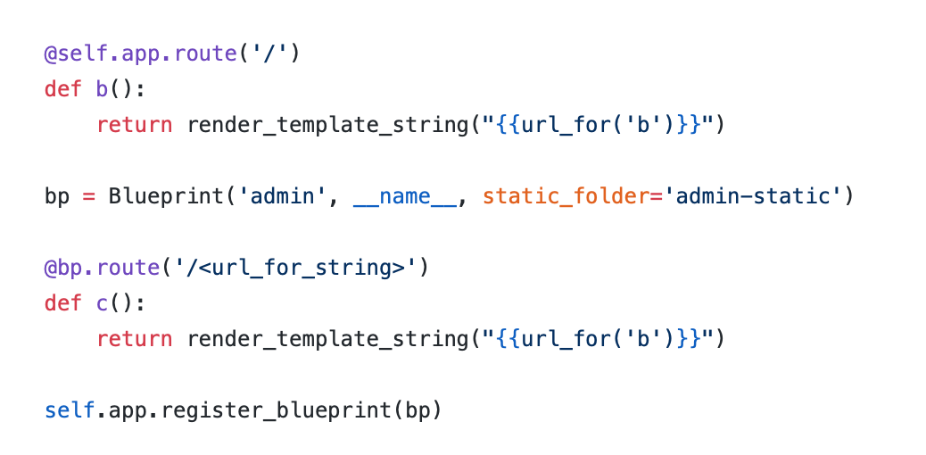
Use Cases/Examples/ Applications
“Flask uses a concept of blueprints (record operations to execute when registered on an application) for making components and supporting common patterns within an application or across applications. “
Generally used with larger applications – its how you ”extend” or “construct” an application. Once you register a blueprint you can’t delete it, you would have to delete the whole application
Notes:
Identify possible use cases, examples, problems someone could consider using this technology.

Slide 7
Background – Key Concepts
Flask
Flask-s3
Flask Blueprints
Boto
awscli
AWS
Notes:
Introduce any background, key concepts and terminology needed for the audience to understand the technology your are presenting.

Slide 8
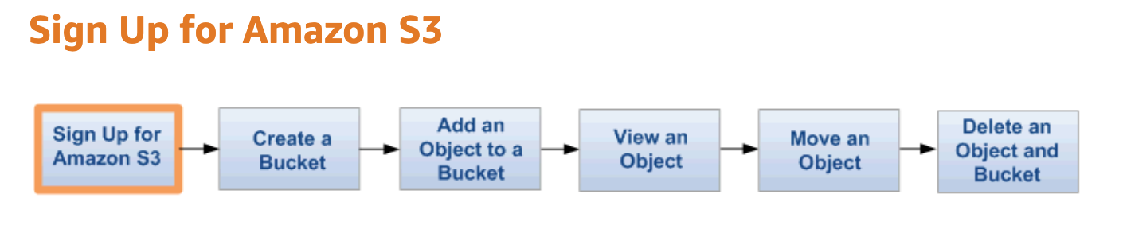
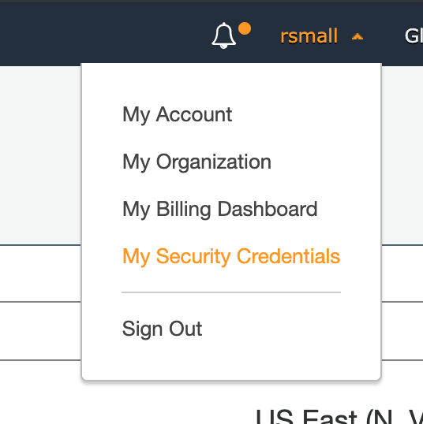
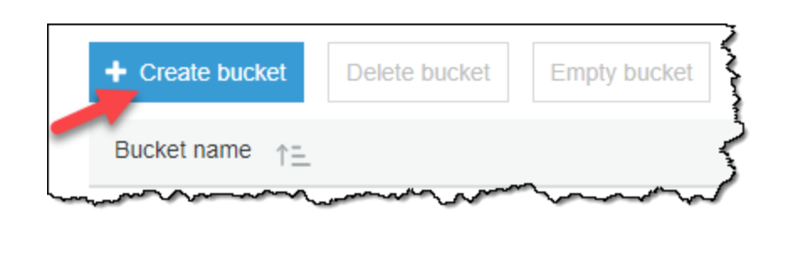
Getting Started Tutorial

Slide 9
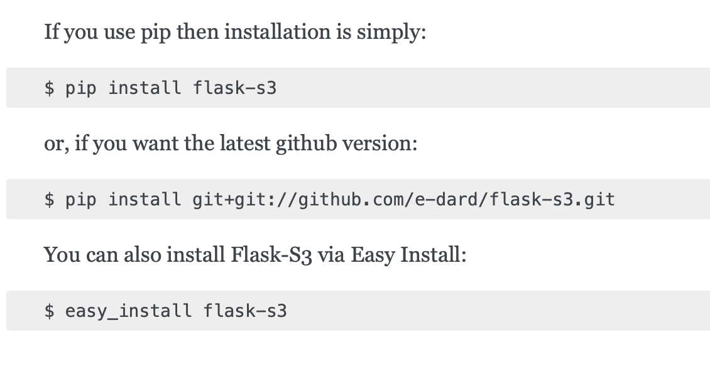
Getting Started Tutorial
Notes:
Present a getting tutorial; this should cover the basic activities for someone to start using the technology and solving a basic problem using this technology (This might need more that one slides)

Slide 10
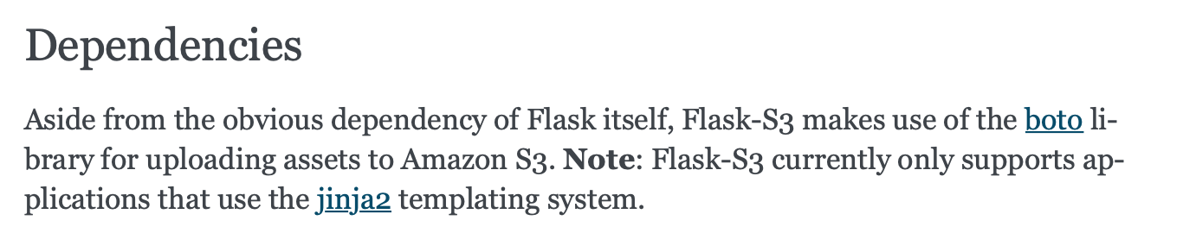

Slide 11
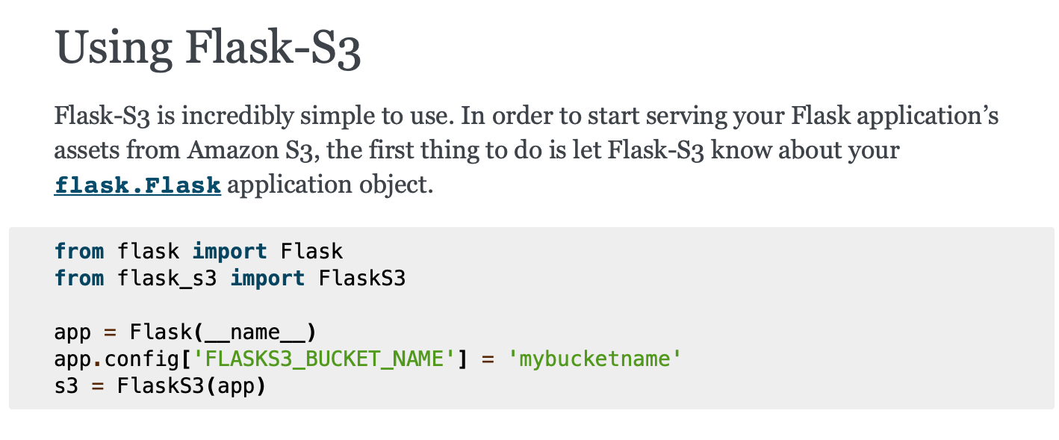
Getting Started Tutorial

Slide 12
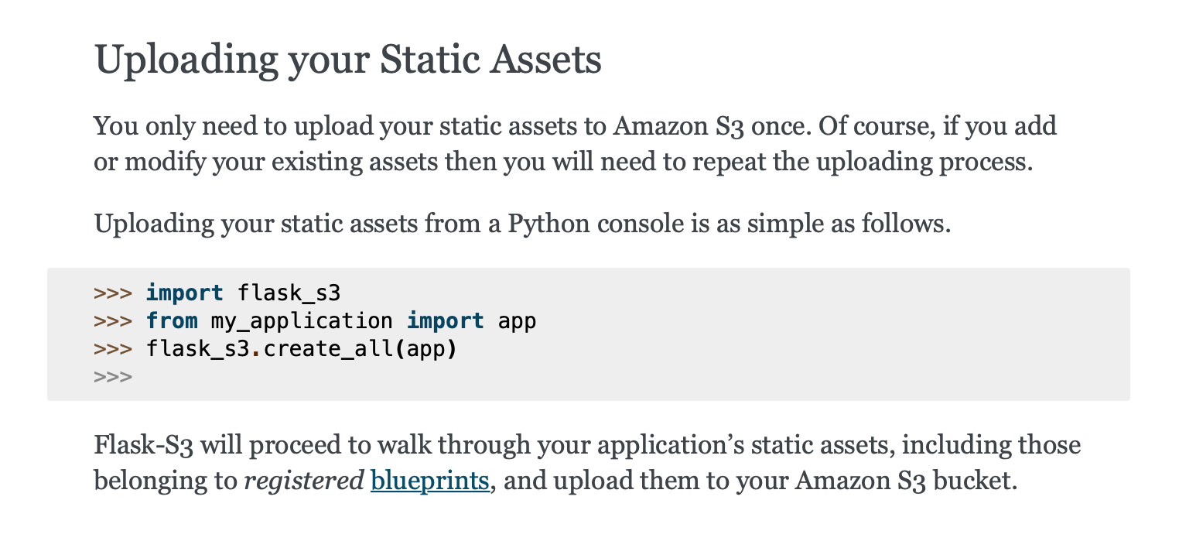

Slide 13
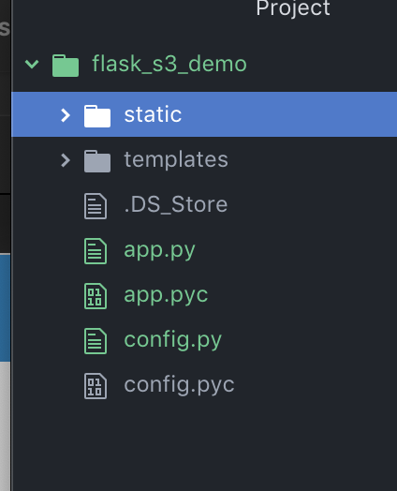
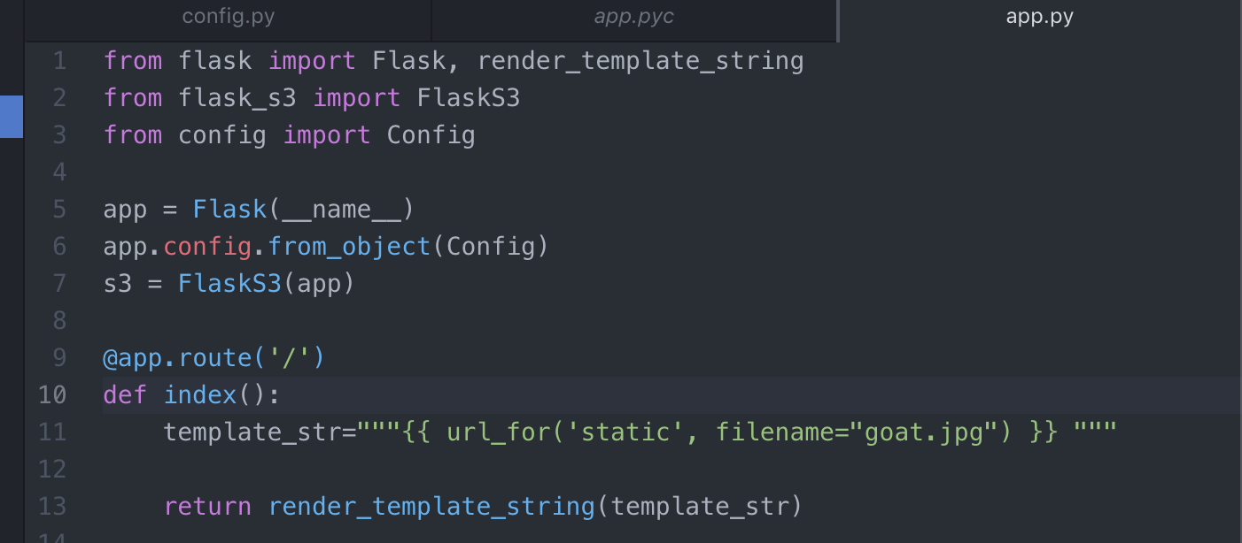

Non-Trivial Application
Notes:
Demonstrate a non-trivial use case/application of the technology that you coded/prepared. This should be a custom example you coded yourself. Possibly this can be an example demonstrating how you could use this technology in your team’s project. You might need more that one slide for this section.

Slide 14
Resources
https://flask-s3.readthedocs.io/en/latest/
http://flask.pocoo.org/docs/1.0/blueprints/
https://aws.amazon.com
https://github.com/e-dard/flask-s3
Notes:
Resources for further reading. Provide a list of resources to help your classmates to learn more about this technolgy.

Slide 15
Q&A
Questions???
Notes:
Open the floor for your classmates and the instructor to ask question about your presentaiton.

Slide 16
Thank you!!!

