Slide 1
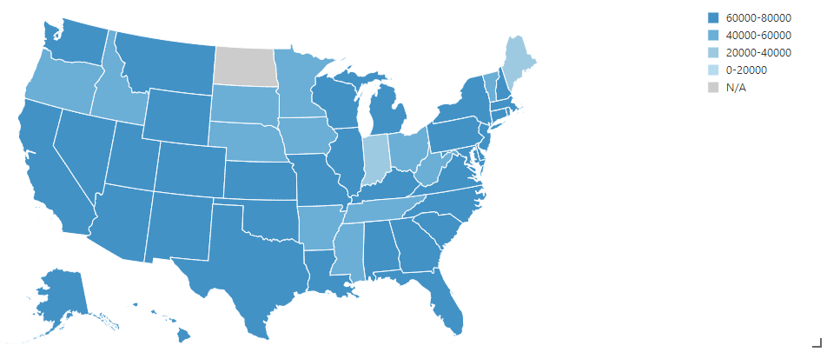
Data Science
Evaluating Risk for Loan Approvals on LendingClub

Slide 2
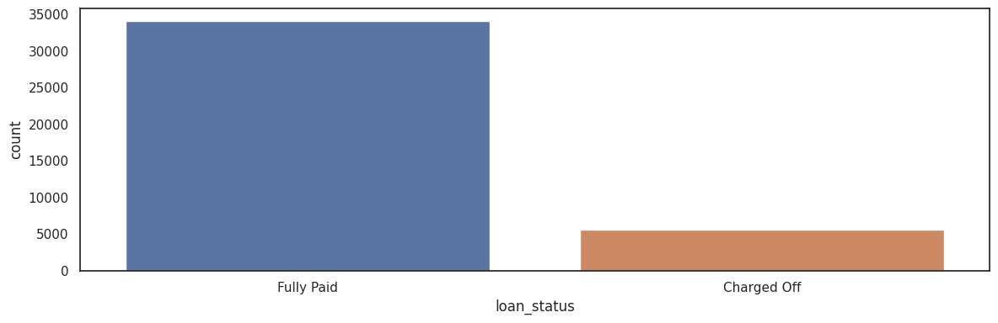
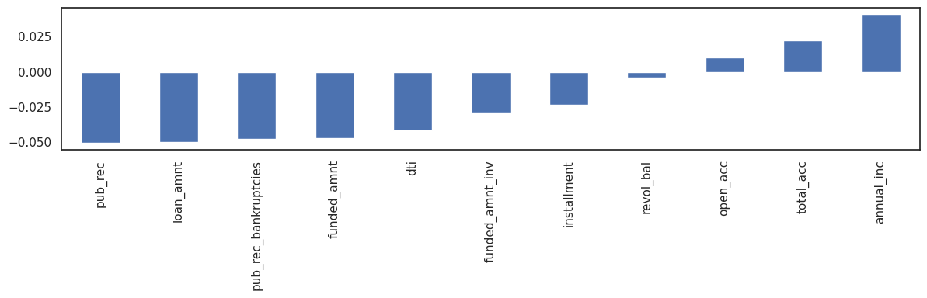
The self-reported annual income provided by the borrower during registration.
The number of open credit lines in the borrower's credit file.
The total number of credit lines currently in the borrower's credit file
Total credit revolving balance
Debt-to-income ratio
Loan amount granted
Number of derogatory public records
Loan status correlation plot

Slide 3
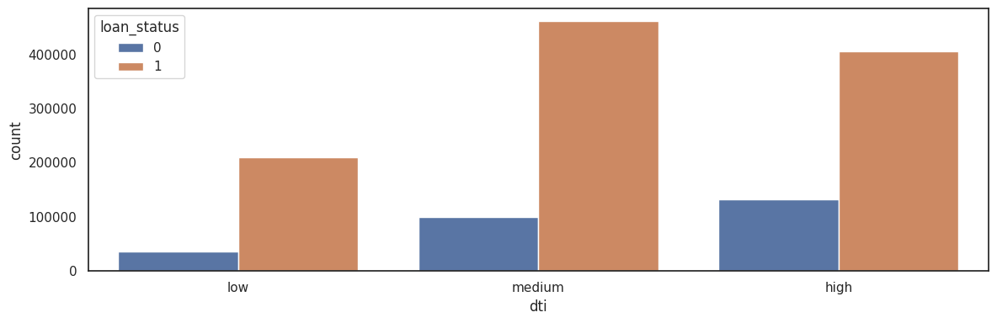
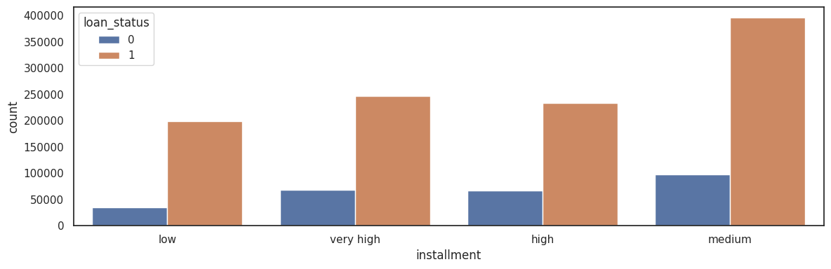
High DTI translates into higher default rates
A ratio calculated using the borrower’s total monthly debt payments
Higher the installment amount, higher the
default rate
The monthly payment owed by the borrower if the loan originates.

Slide 4
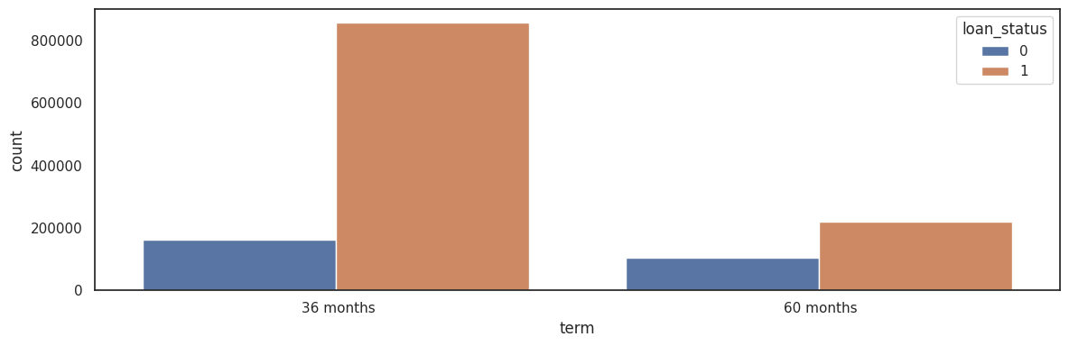
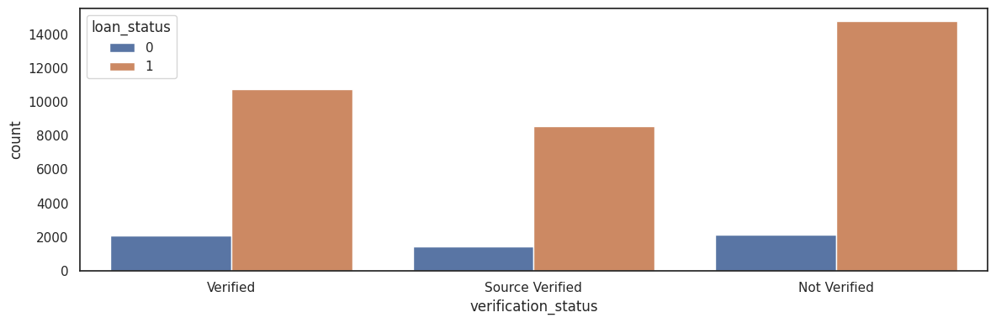
60 months term loan are defaulted more often
The number of payments on the loan. Values are in months and can be either 36 or 60.
Verified accounts defaulted in large number
Indicates if income was verified by LC, not verified, or if the income source was verified

Slide 5
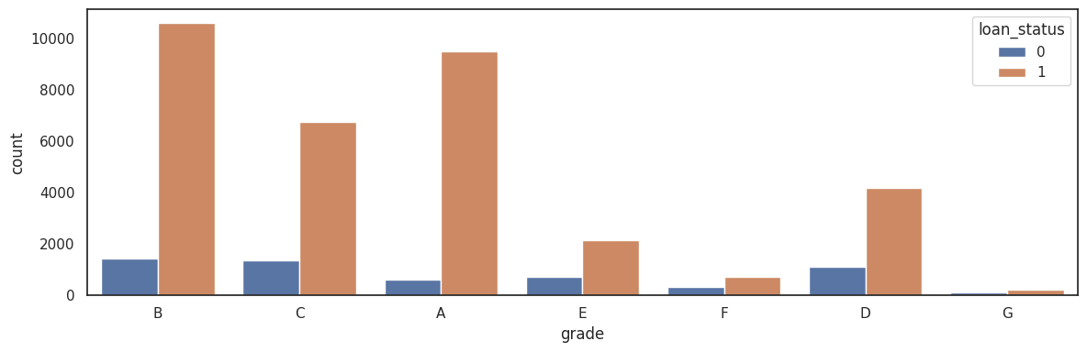
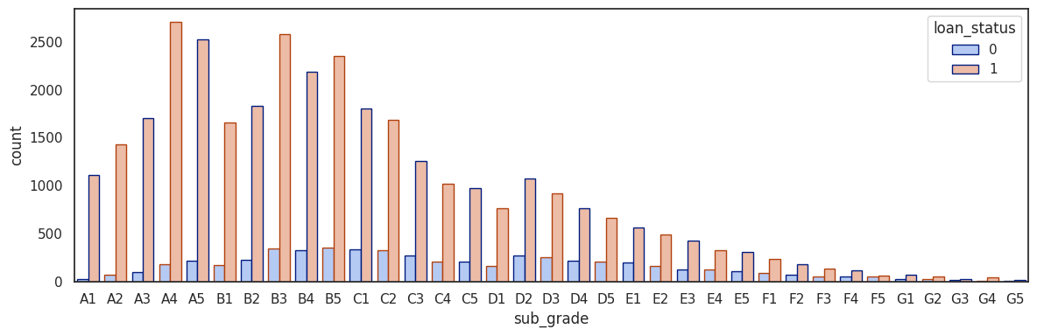
LC assigned loan grade
The 'E' and 'F' grade loans are defaulted more often.
LC assigned loan subgrade
'F' and 'G' sub-grades
don't get paid back that often

Slide 6
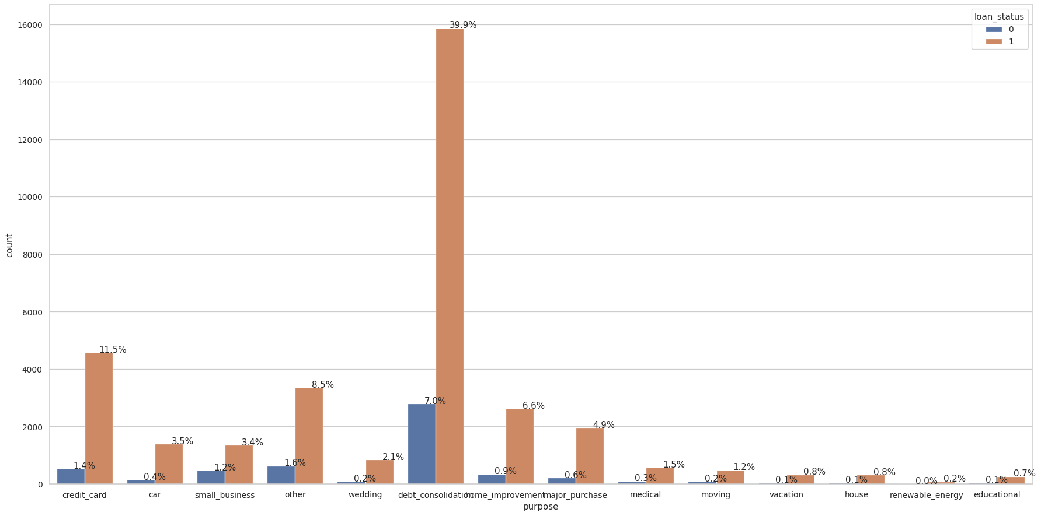
Better to avoid small business loans followed by educational loans

Slide 7
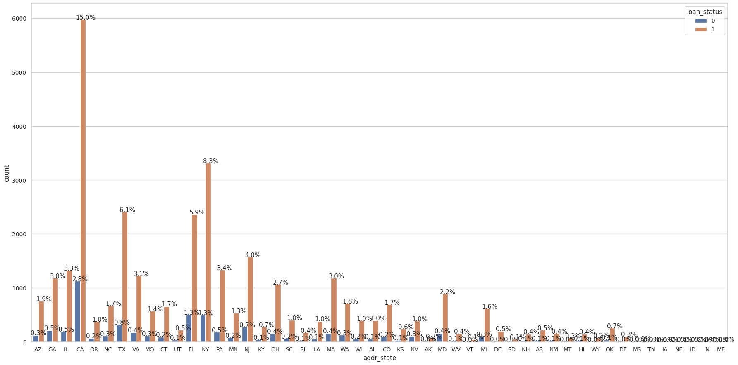
The CA, NY, TX states had high number of applications and high default rate

Slide 8
Machine Learning based Loan
Default Predictions
Modeling Binary Classifiers

Slide 9
Five binary classifiers have been modeled namely, Linear SVC, Logistic Regression, Gaussian NB, Random Forest Classier, Gradient Boosting Classifier and XGBClassifier
Chosen Recall, Precision, and F1-score as evaluation metrics.
The precision is the measure of how accurate the classifier's prediction of a specific class.
The Recall is the measure of the classifier's ability to identify a class.
Resampling (Oversampling)
This technique is used to upsample the minority class of an imbalanced dataset using
replacement. This technique is called oversampling.
Synthetic Minority Oversampling Technique (SMOTE)
SMOTE is another technique to oversample the minority class. It looks into minority class instances and uses k nearest neighbor to pick a random nearest neighbor, and a synthetic instance is created randomly in feature space.

Slide 10
Classification Metrics without application of Data Imbalance handling Techniques
precision recall f1-score support
0.0 0.33 0.00 0.00 534
1.0 0.87 1.00 0.93 3440
accuracy 0.87 3974
macro avg 0.60 0.50 0.47 3974
weighted avg 0.79 0.87 0.80 3974
precision recall f1-score support
0.0 0.25 0.00 0.01 534
1.0 0.87 1.00 0.93 3440
accuracy 0.86 3974
macro avg 0.56 0.50 0.47 3974
weighted avg 0.78 0.86 0.80 3974
precision recall f1-score support
0.0 0.25 0.32 0.28 534
1.0 0.89 0.85 0.87 3440
accuracy 0.78 3974
macro avg 0.57 0.59 0.58 3974
weighted avg 0.80 0.78 0.79 3974
precision recall f1-score support
0.0 0.33 0.10 0.16 534
1.0 0.87 0.97 0.92 3440
accuracy 0.85 3974
macro avg 0.60 0.54 0.54 3974
weighted avg 0.80 0.85 0.82 3974
precision recall f1-score support
0.0 0.00 0.00 0.00 534
1.0 0.87 1.00 0.93 3440
accuracy 0.87 3974
macro avg 0.43 0.50 0.46 3974
weighted avg 0.75 0.87 0.80 3974
precision recall f1-score support
0.0 0.38 0.06 0.11 534
1.0 0.87 0.98 0.92 3440
accuracy 0.86 3974
macro avg 0.62 0.52 0.52 3974
weighted avg 0.80 0.86 0.81 3974
Linear
SVC
RandomForest
Classifier
Logistic
Regression
GradientBoosting
Classifier
Gaussian
NB
XGBClassifier

Slide 11
Classification Metrics with application of Data Imbalance handling Techniques-Resampling (Oversampling)
precision recall f1-score support
0.0 0.56 0.68 0.62 3367
1.0 0.61 0.48 0.54 3450
accuracy 0.58 6817
macro avg 0.59 0.58 0.58 6817
weighted avg 0.59 0.58 0.58 6817
precision recall f1-score support
0.0 0.63 0.57 0.60 3367
1.0 0.61 0.67 0.64 3450
accuracy 0.62 6817
macro avg 0.62 0.62 0.62 6817
weighted avg 0.62 0.62 0.62 6817
precision recall f1-score support
0.0 0.62 0.59 0.60 3367
1.0 0.61 0.64 0.63 3450
accuracy 0.61 6817
macro avg 0.61 0.61 0.61 6817
weighted avg 0.61 0.61 0.61 6817
precision recall f1-score support
0.0 0.80 0.94 0.86 3367
1.0 0.93 0.76 0.84 3450
accuracy 0.85 6817
macro avg 0.86 0.85 0.85 6817
weighted avg 0.87 0.85 0.85 6817
precision recall f1-score support
0.0 0.62 0.66 0.64 3367
1.0 0.65 0.61 0.63 3450
accuracy 0.63 6817
macro avg 0.63 0.63 0.63 6817
weighted avg 0.63 0.63 0.63 6817
precision recall f1-score support
0.0 0.74 0.82 0.78 3367
1.0 0.80 0.72 0.76 3450
accuracy 0.77 6817
macro avg 0.77 0.77 0.77 6817
weighted avg 0.77 0.77 0.77 6817
Linear
SVC
RandomForest
Classifier
Logistic
Regression
GradientBoosting
Classifier
Gaussian
NB
XGBClassifier

Slide 12
Classification Metrics with application of Data Imbalance handling Techniques-SMOTE
precision recall f1-score support
0.0 0.51 1.00 0.68 3479
1.0 0.22 0.00 0.00 3338
accuracy 0.51 6817
macro avg 0.37 0.50 0.34 6817
weighted avg 0.37 0.51 0.35 6817
precision recall f1-score support
0.0 0.64 0.57 0.60 3479
1.0 0.59 0.66 0.63 3338
accuracy 0.61 6817
macro avg 0.62 0.61 0.61 6817
weighted avg 0.62 0.61 0.61 6817
precision recall f1-score support
0.0 0.61 0.74 0.67 3479
1.0 0.65 0.50 0.57 3338
accuracy 0.62 6817
macro avg 0.63 0.62 0.62 6817
weighted avg 0.63 0.62 0.62 6817
precision recall f1-score support
0.0 0.94 0.85 0.89 3479
1.0 0.85 0.94 0.90 3338
accuracy 0.89 6817
macro avg 0.90 0.89 0.89 6817
weighted avg 0.90 0.89 0.89 6817
precision recall f1-score support
0.0 0.85 0.79 0.82 3479
1.0 0.80 0.86 0.83 3338
accuracy 0.82 6817
macro avg 0.83 0.82 0.82 6817
weighted avg 0.83 0.82 0.82 6817
precision recall f1-score support
0.0 0.98 0.84 0.90 3479
1.0 0.85 0.98 0.91 3338
accuracy 0.91 6817
macro avg 0.92 0.91 0.91 6817
weighted avg 0.92 0.91 0.91 6817
Linear
SVC
RandomForest
Classifier
Logistic
Regression
GradientBoosting
Classifier
Gaussian
NB
XGBClassifier

Slide 13
Machine Learning based Loan
Default Predictions
Modeling Binary Classifiers after
Data Augmentation

Slide 14
New Dataset-Classification Metrics without application of Data Imbalance handling Techniques
precision recall f1-score support
0 0.84 0.87 0.86 9674
1 0.96 0.95 0.96 32378
accuracy 0.93 42052
macro avg 0.90 0.91 0.91 42052
weighted avg 0.93 0.93 0.93 42052
precision recall f1-score support
0 0.84 0.88 0.86 9674
1 0.96 0.95 0.96 32378
accuracy 0.94 42052
macro avg 0.90 0.92 0.91 42052
weighted avg 0.94 0.94 0.94 42052
precision recall f1-score support
0 0.86 0.87 0.86 9674
1 0.96 0.96 0.96 32378
accuracy 0.94 42052
macro avg 0.91 0.92 0.91 42052
weighted avg 0.94 0.94 0.94 42052
precision recall f1-score support
0 0.82 0.86 0.84 9674
1 0.96 0.94 0.95 32378
accuracy 0.93 42052
macro avg 0.89 0.90 0.90 42052
weighted avg 0.93 0.93 0.93 42052
precision recall f1-score support
0 0.87 0.83 0.85 9674
1 0.95 0.96 0.96 32378
accuracy 0.93 42052
macro avg 0.91 0.90 0.91 42052
weighted avg 0.93 0.93 0.93 42052
precision recall f1-score support
0 0.58 0.74 0.65 9674
1 0.91 0.84 0.87 32378
accuracy 0.81 42052
macro avg 0.74 0.79 0.76 42052
weighted avg 0.84 0.81 0.82 42052
Linear
SVC
RandomForest
Classifier
Logistic
Regression
GradientBoosting
Classifier
Gaussian
NB
XGBClassifier

Slide 15
New Dataset-Classification Metrics with application of Data Imbalance handling Techniques-Resampling (Oversampling)
precision recall f1-score support
0 0.90 0.89 0.90 32315
1 0.89 0.90 0.90 32462
accuracy 0.90 64777
macro avg 0.90 0.90 0.90 64777
weighted avg 0.90 0.90 0.90 64777
precision recall f1-score support
0 0.93 0.92 0.92 32315
1 0.92 0.93 0.93 32462
accuracy 0.92 64777
macro avg 0.92 0.92 0.92 64777
weighted avg 0.92 0.92 0.92 64777
precision recall f1-score support
0 0.79 0.92 0.85 32315
1 0.91 0.75 0.82 32462
accuracy 0.84 64777
macro avg 0.85 0.84 0.84 64777
weighted avg 0.85 0.84 0.84 64777
precision recall f1-score support
0 0.93 0.98 0.95 32315
1 0.98 0.93 0.95 32462
accuracy 0.95 64777
macro avg 0.95 0.95 0.95 64777
weighted avg 0.95 0.95 0.95 64777
precision recall f1-score support
0 0.92 0.93 0.92 32315
1 0.93 0.92 0.92 32462
accuracy 0.92 64777
macro avg 0.92 0.92 0.92 64777
weighted avg 0.92 0.92 0.92 64777
precision recall f1-score support
0 0.93 0.94 0.93 32315
1 0.94 0.93 0.93 32462
accuracy 0.93 64777
macro avg 0.93 0.93 0.93 64777
weighted avg 0.93 0.93 0.93 64777
Linear
SVC
RandomForest
Classifier
Logistic
Regression
GradientBoosting
Classifier
Gaussian
NB
XGBClassifier

Slide 16
New Dataset-Classification Metrics with application of Data Imbalance handling Techniques-SMOTE
precision recall f1-score support
0 0.94 0.97 0.95 32432
1 0.97 0.94 0.95 32345
accuracy 0.95 64777
macro avg 0.95 0.95 0.95 64777
weighted avg 0.95 0.95 0.95 64777
precision recall f1-score support
0 0.94 0.95 0.94 32432
1 0.95 0.93 0.94 32345
accuracy 0.94 64777
macro avg 0.94 0.94 0.94 64777
weighted avg 0.94 0.94 0.94 64777
precision recall f1-score support
0 0.96 0.96 0.96 32432
1 0.96 0.95 0.96 32345
accuracy 0.96 64777
macro avg 0.96 0.96 0.96 64777
weighted avg 0.96 0.96 0.96 64777
precision recall f1-score support
0 0.88 0.96 0.92 32432
1 0.96 0.86 0.91 32345
accuracy 0.91 64777
macro avg 0.92 0.91 0.91 64777
weighted avg 0.92 0.91 0.91 64777
precision recall f1-score support
0 0.94 0.94 0.94 32432
1 0.94 0.94 0.94 32345
accuracy 0.94 64777
macro avg 0.94 0.94 0.94 64777
weighted avg 0.94 0.94 0.94 64777
precision recall f1-score support
0 0.87 0.91 0.89 32432
1 0.91 0.86 0.88 32345
accuracy 0.89 64777
macro avg 0.89 0.89 0.89 64777
weighted avg 0.89 0.89 0.89 64777
Linear
SVC
RandomForest
Classifier
Logistic
Regression
GradientBoosting
Classifier
Gaussian
NB
XGBClassifier

Slide 17
ANN Classification Metrics ATT LC Dataset Vs. Augmented Dataset
precision recall f1-score support
0.0 0.25 0.00 0.01 534
1.0 0.87 1.00 0.93 3440
accuracy 0.86 3974
macro avg 0.56 0.50 0.47 3974
weighted avg 0.78 0.86 0.80 3974
precision recall f1-score support
0 0.86 0.85 0.85 9674
1 0.96 0.96 0.96 32378
accuracy 0.93 42052
macro avg 0.91 0.90 0.91 42052
weighted avg 0.93 0.93 0.93 42052

Slide 18
Conclusions
Driving Factors (or driver variables) (1) Grade: Default Rate is high in high risk loan applicants. It is important to thoroughly check high risk loan applications. (2) Installment Amount: Defaulter rate increases as the requested loan installment amount increases. (4) Annual Income: Applicants from Low income group have a greater share of defaulted loans.
(5) States: The CA, NY, TX states had high number of applications and high default rate. The plot
is represented in Figure 16.
(6) Purpose: Better to avoid small business loans followed by educational loans
(7) DTI: Higher DTI translates to higher default rates
(8) Income source verification: Should be checked thoroughly.
(9) Binary Classification: Random Forest and XGBoost provided the best F-Scores and produces good accuracy as well.
(10) ANN: ANN F-score improved on Augmented data.

Slide 19
Thank you

Slide 20
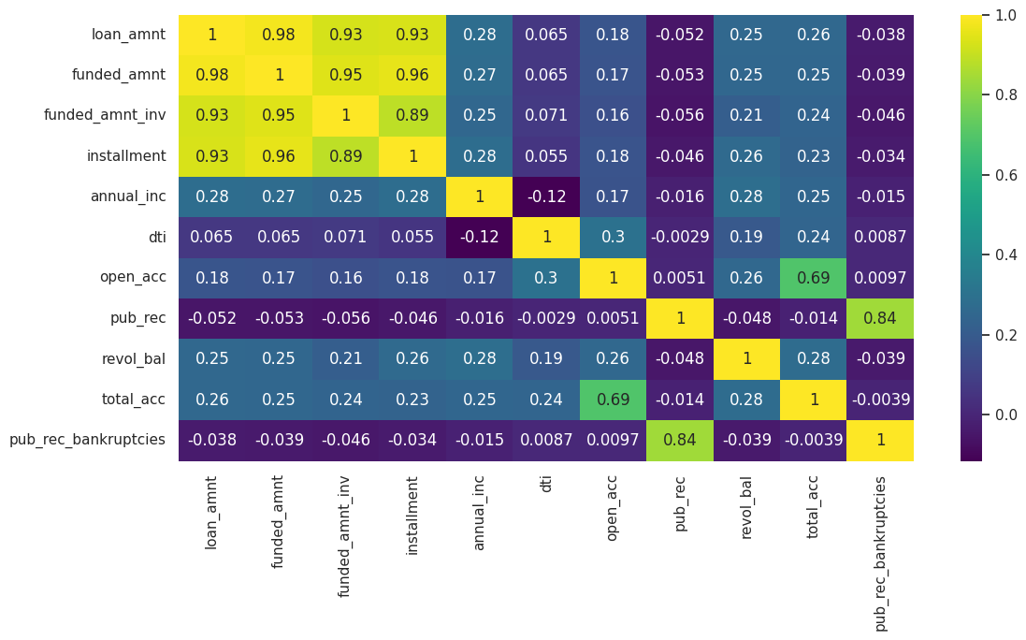
LC Loan Stats

Slide 21
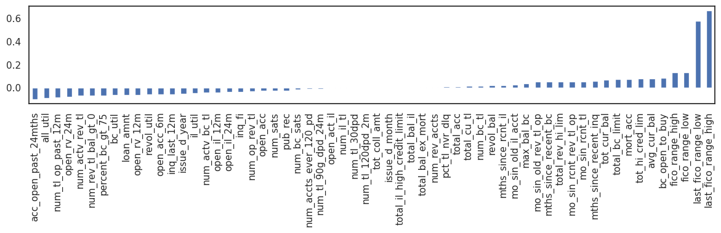

Slide 22
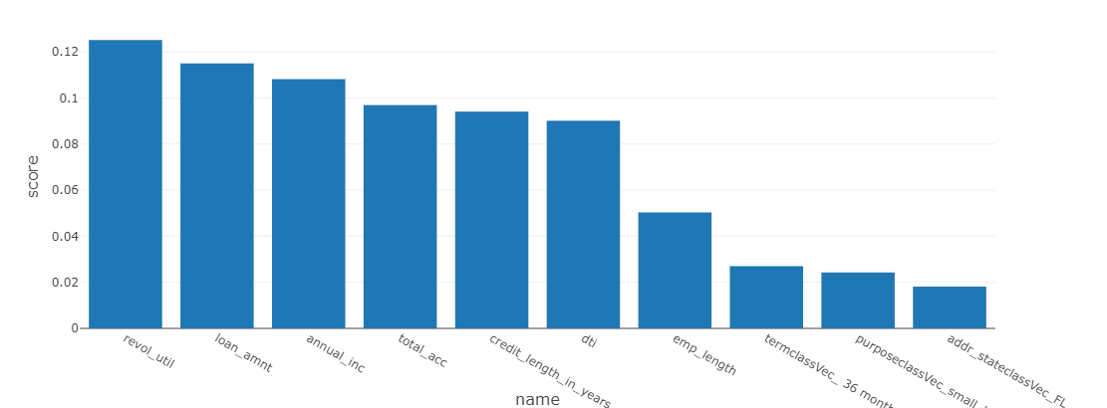
Identify Important Features from Model

Slide 23
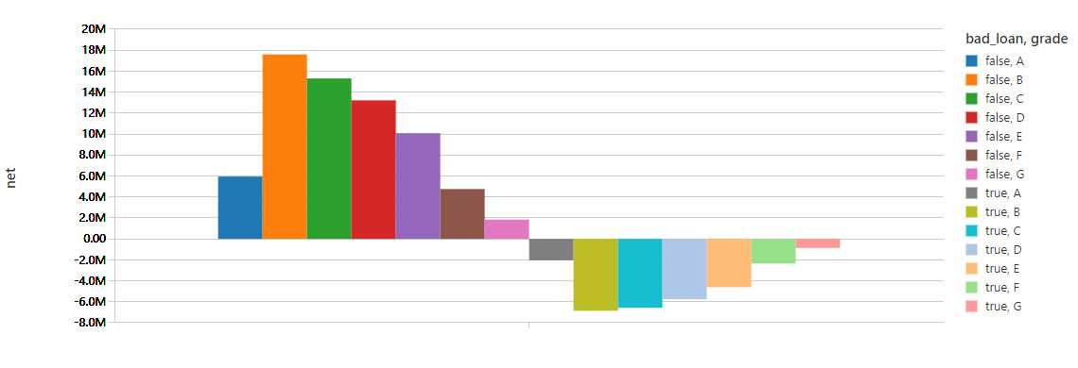
Net Profits by Asset Class and Default Status

Slide 24
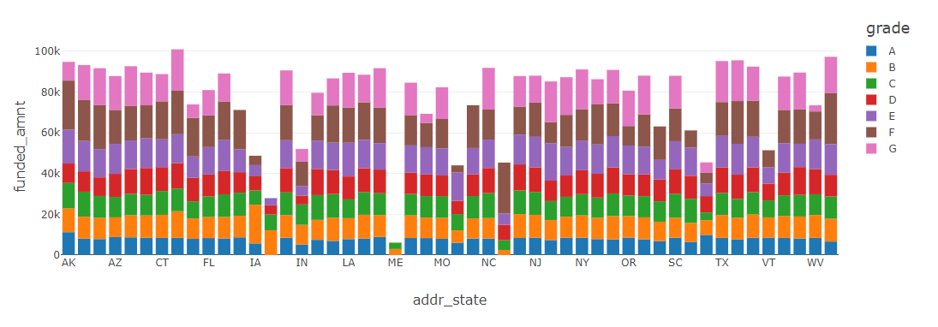
LC Asset Allocation by Grade

Slide 25
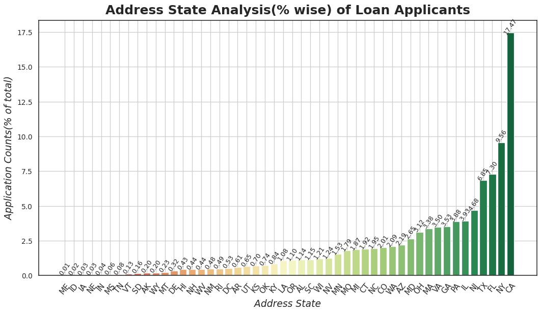

Slide 26
