Slide 1


Startup Business Model, Private investment, and how to clearly communicate why you?
Gary Jinks President/Owner GLJ Group Founder and Managing Director South Valley Angels
Product Development, Realization and Commercialization
gary@gljgroup.com 408/420-3650

Slide 2
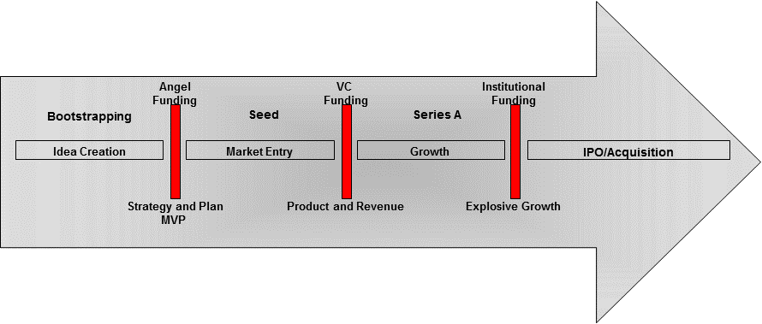
Life Cycle - Where are You and What is Important
Bootstrapping
FFF

Slide 3
“Startup” Business Model
Based on
Fast, explosive growth through private investment, not “long term growth through debt”
Short term returns (3-8 years) generally through acquisition or IPO (investor exit)
Owner/CEO/Founder Challenges
Loss of control, dilution, getting funded
Advantages
Fully funded budgets to acheive explosive growth

Slide 4
Types of Equity Funding
Angel
Seed and early stage
$25,000 - $1,000,000
Venture Capital – VC
Later Stage; A, B, C Round
$5M and up
More doing seed, $500k up
Super Angel
Early – Mid Stage
$500,000 - $2M
Corporate Venture
Intel
Google Ventures
GM Ventures
Crowd Funding
Kickstarter; Non Equity
EquityNet, Angel List; Equity
Incubators/Accelerators; Equity

Slide 5
Ok – So you Have An idea
Understand where you belong
Better, Faster, Lower Cost
Game Changing
Understand the intent of the model
10x Investor return
Explosive growth
Have a Plan

Slide 6
Key Walk Away Points
There is an opportunity and you have a solution to solve a problem necessary to capture large share
You have an executable plan and understand the cost
You have the right team to execute
You have an Investor Exit Plan

Slide 7
What Do you Need
Documents
Executive Summary
Pitch Deck/Presentation
Plan with Financials
Right Team
Technical, Business, Start-up, Specialty; Leader
Passion
A Compelling Opportunity
Large, high demand, growing and now
Angels – MVP
VC - Revenue

Slide 8
Investment Decision Flow
Intro - Send Your Executive Summary
Directly or through their Website
Screening Process
Internal; could include in-person
Pitch
Generally 10- 15 minutes plus Q&A
Deep Dive
Hours to days; come prepared
Due Diligence
Can be lengthy and trying; primarily term sheet negotiations

Slide 9
Pitching
&
Pitch Deck

Slide 10
General Guidelines
Sell your product to customers and your business case to investors
Opportunity Based
Simplicity and Clarity
Know your audience
Formal, public, 1on1, group
Presentation; communicate the facts your way
Story ; compelling, passionate, engaging

Slide 11
Slide Deck
Opportunity (why)
Problem (capture opportunity)
Solution; (why you)
Market (who, where do you fit, dynamics)
The Plan (get to the finish line)
Team (what don’t you have)
Financials (monetize; customer acquisition)

Slide 12
Title Page Logo Tag Line We believe the Future of _______ is ________
Notes:
Internet based online sales has reached $1.7 Trillion world wide and USA reaching $350 Billion in the year 2014. It is pulling brands into new territories.
Last year, U.S. Cyber Monday sales were $2.3 billion—up 29 percent from the year before. Nothing to sniff at, but China’s big buyer day, November 11, dwarfs it: This year, Alibaba only took two hours to reach $2 billion in sales on Singles Day, and by day’s end reported sales surpassed $9 billion.
Refer http://internet.com/ecommerce/ecommerce-trends/

Slide 13
Opportunity (why is this an opportunity)
$B ______________ Market
_______ is going to grow to $37 Trillion by 2019
Everybody wants it now and is wiling to pay big $
Trends
There is
Demand
83M
Millennials in US
Market Dynamics
Use Cases
There is
Growth

Slide 14
The Problem (pick the right problem)
One single strategic problem (_______is broken);
→ it’s obvious if you fix this you can capture the Opportunity
What problem do you solve best
Support it with qualifying statements and examples
Cost
Time
Technology
Use Case
Tightly choreographed with Solution and Opportunity
Notes:
After spending 29 Billion to buy news FCC AWS-3 spectrum, AT&T and Verizon increased their capacity by just 2% to reach 38% ownership.
Current Millimeter wave technologies can reach up to 2 Gbps outdoors for 5 miles max, and quite expensive. Ubiquity millimeter solutions are at
$3000 per pair, plus installation cost on top of towers.
It costs on a average anywhere from $100,000 to $500,00 per mile to lay down fiber, after all the time spent on permits to dig the roads.

Slide 15
The Solution (fix the problem and why you)
We Fix the Problem like this
How you solve the problem
In the same order as Problem page
Quantified
What you do and Why your better
Product
Business
Benefits
What's cool
Competitor Landscape axis
Notes:
Imagine WiGig like capacity outdoors for each end user.

Slide 16
Market
Competitive Landscape
Market information
Compelling facts
Key measuring point
Trending statistic
More detail and insight than Opportunity page
You
TAM $350B (Define – if everyone did it)
SAM $50B (Define – we will focus on)

Slide 17
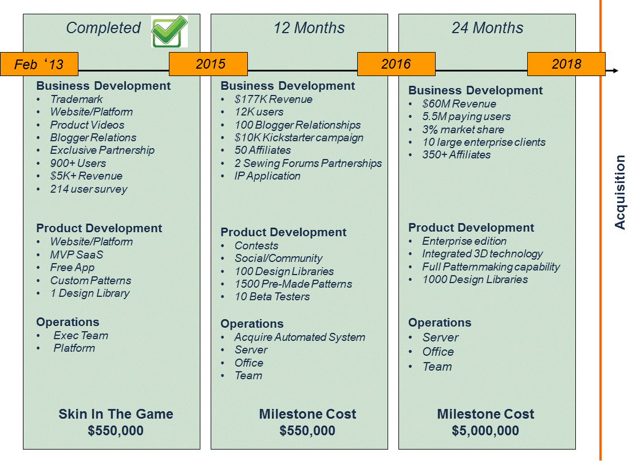
Plan
Acquisition

Slide 18
Team
Success and Skills based
Why the staff will be successful
What are you missing
CEO – Moses Factor

Slide 19
Financials
How do you Make Money
Subscriptions
Sell product
Advertising
 | 2015 | 2016 | 2017 | 2018 | 2019
Customer
Customer
Revenue
Expenses
Gross Margin

Slide 20
Funding
$XM to execute XX Month Plan
10%
30%
60%
What This Buys
$XX Revenue
XX Customer
15 Patents
Positioned for Acquisition
Exit Plan/Terms

Slide 21
Executive Summary – One Page
Summary Box (why?)
Opportunity and how you fit
Why is it important
Key milestone or successes; Wow
What do you need, what do they get
Team Skills (optional)
Point of Contact
What and How (why you?)
Problem and your solution –
Differentiators, Benefits
Roadmap – how do you get there
Market, Financials (business case)
Who, where do you fit, dynamics
How do you make money
How much money and how much does it cost

Slide 22
Logo
Vision Statement
Summary Box
Why You
Market and Financials

Slide 23
1 on 1 Acceleration Process Overview
Business Planning
Identify gaps and alternatives
Review Go to market and funding strategy
Detailed road map and plan
Articulate your value proposition
Identifying and defining your “Wow”
Investor preparation and documents
Investor Presentation (Pitch Deck)
Executive Summary
How it works
First session will last around 3 hours and result in a draft Pitch Deck
Update and make necessary changes fill holes and address actions items; .
Review and update; detailed refinements, adjustments and modifications.
When we complete the pitch deck we create the executive summary,

Slide 24
gary@gljgroup.com

