Slide 1
Project Title: Walmart Superstore Sales Analysis Technologies: Data collection, Data visualisation , Power BI Domain: Data visualization

Slide 2
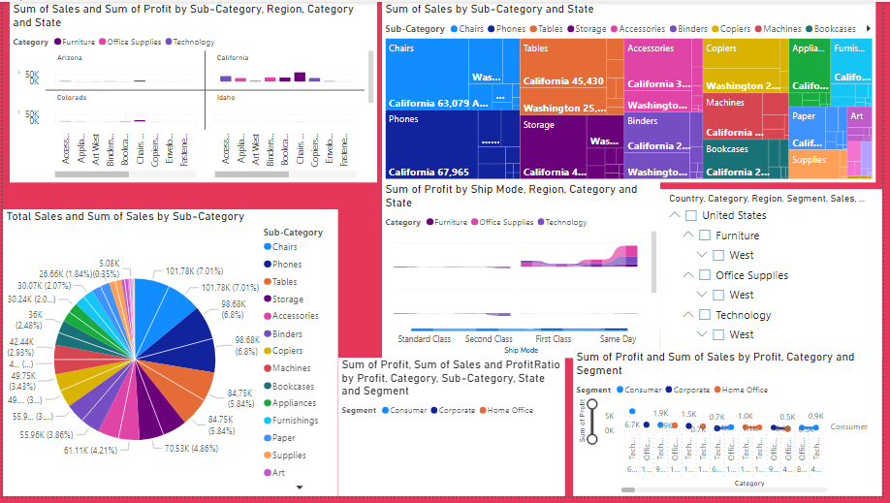
Problem Statement: The Walmart Superstore wants to analyze its sales data to gain insights into its performance and identify opportunities for growth. The company has a vast amount of sales data, including information on products, customers, stores, and transactions. The main objective is to extract meaningful insights from this data to analyze the overall sales of Walmart superstore.

Slide 3
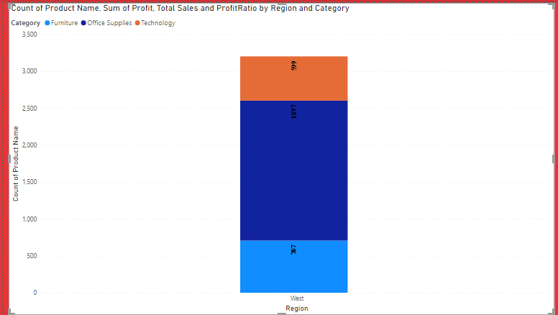
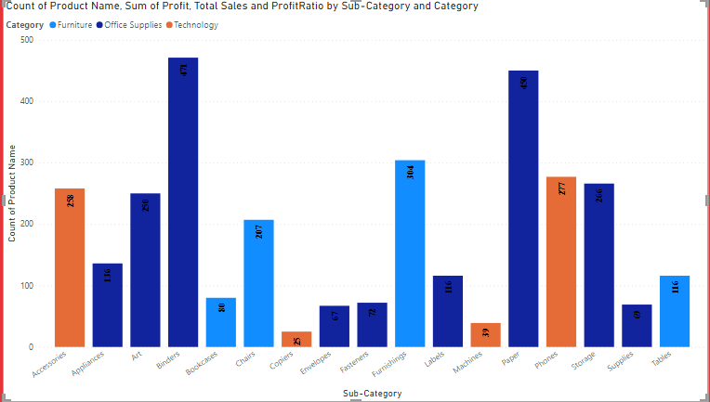
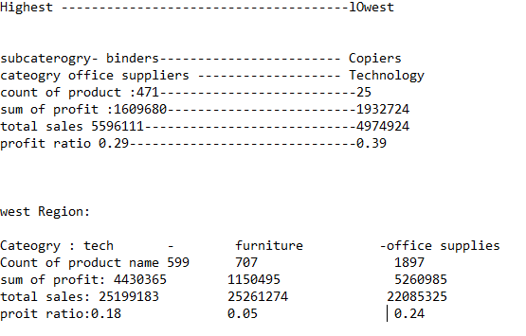
Sales and Revenue: You can track the store's sales and revenue over time, by category, region, and product

Slide 4
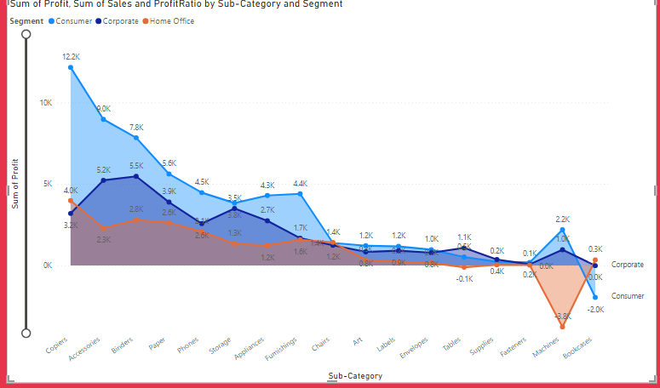
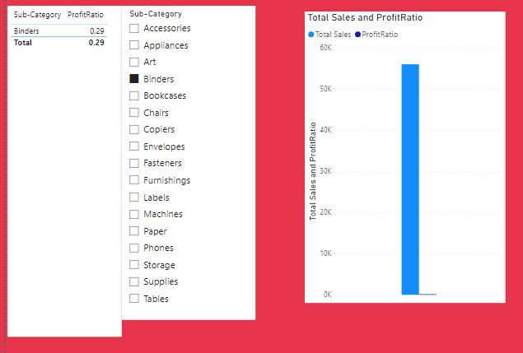
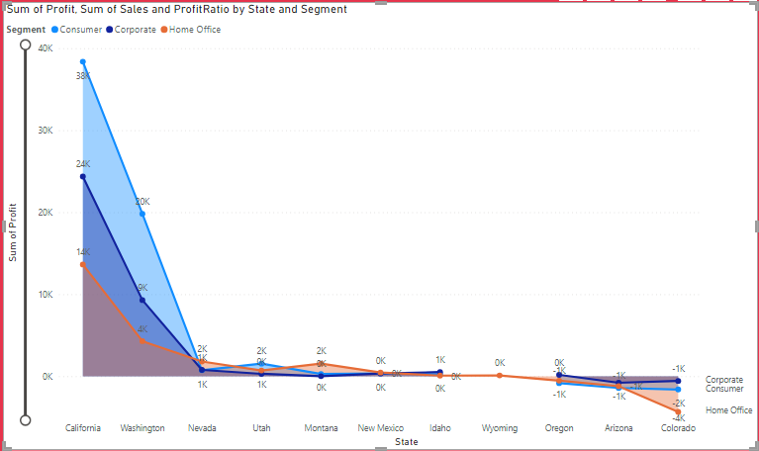
Inventory Management: You can monitor the store's inventory levels and turnover rates to optimize stock levels and ensure adequate supply of popular products.

Slide 5
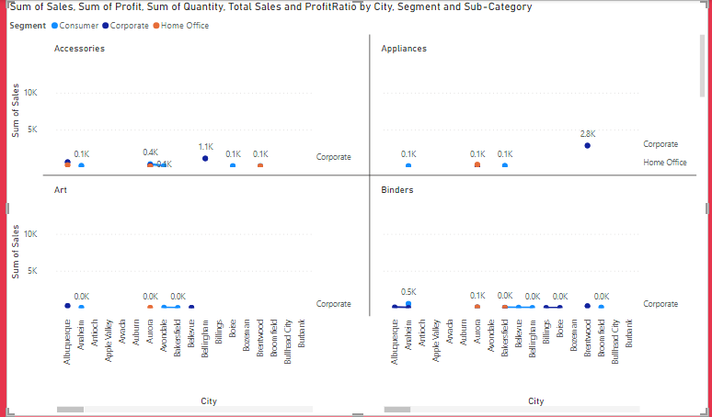
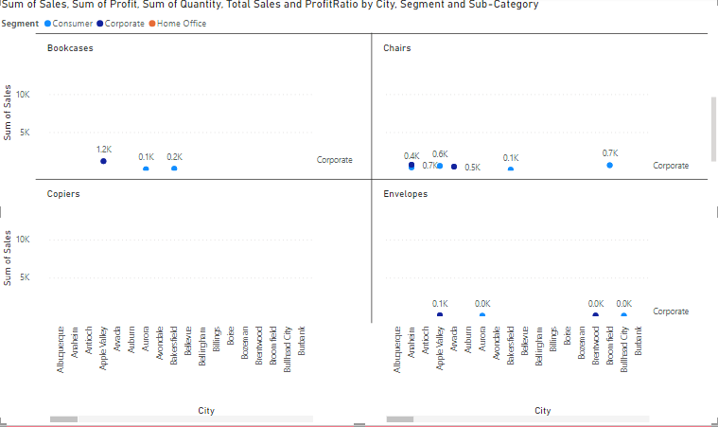
Customer Insights: You can analyze customer data, such as demographics, purchase history, and customer feedback, to gain insights into their behavior and preferences. Store Performance: You can measure store performance metrics, such as sales per square foot, customer traffic, and employee productivity, to identify areas of improvement and optimize store operations

Slide 6
