Slide 1

Health
Apple Health Application (iOS 8/9 app on iPhone and iPod Touch)
Dashboard for personal health and fitness data
Provides a common data store available to third-party applications via the HealthKit API.
Official website: https://www.apple.com/ios/health/

Slide 2
HealthKit
Core iOS 8/9 Framework. Overview at https://developer.apple.com/healthkit/
API for central health data store available to all health apps with user permission
Fine grained access permissions; every type of data has its own permissions.
Represents data including units.
The data store is encrypted

Slide 3
HealthKit Framework Ref
https://developer.apple.com/library/ios/documentation/HealthKit/Reference/HealthKit_Framework/index.html#//apple_ref/doc/uid/TP40014707
Swift
if HKHealthStore.isHealthDataAvailable() {
// add code to use HealthKit here...
let healthStore = HKHealthStore()
// get permission to read/write data...
}

Slide 4
ResearchKit
http://researchkit.org/
https://github.com/ResearchKit
Getting Started with ResearchKit by Edward Cessna and Dhanush Balachandran, Packt Publishing, 2016
an open source software framework for medical research

Slide 5
ResearchKit Modules
Three customizable modules
Consent – customizable templates to explain details of study and obtain participant’s consent
Surveys – predefined UI for building surveys by specifying questions and types of answers
Active Tasks – can create custom tasks or use the predefined tasks available in six categories: motor activities, fitness, cognition, voice, audio, and hole peg. Iphone sensors actively collect data using HealthKit and CoreMotion APIs.

Slide 6
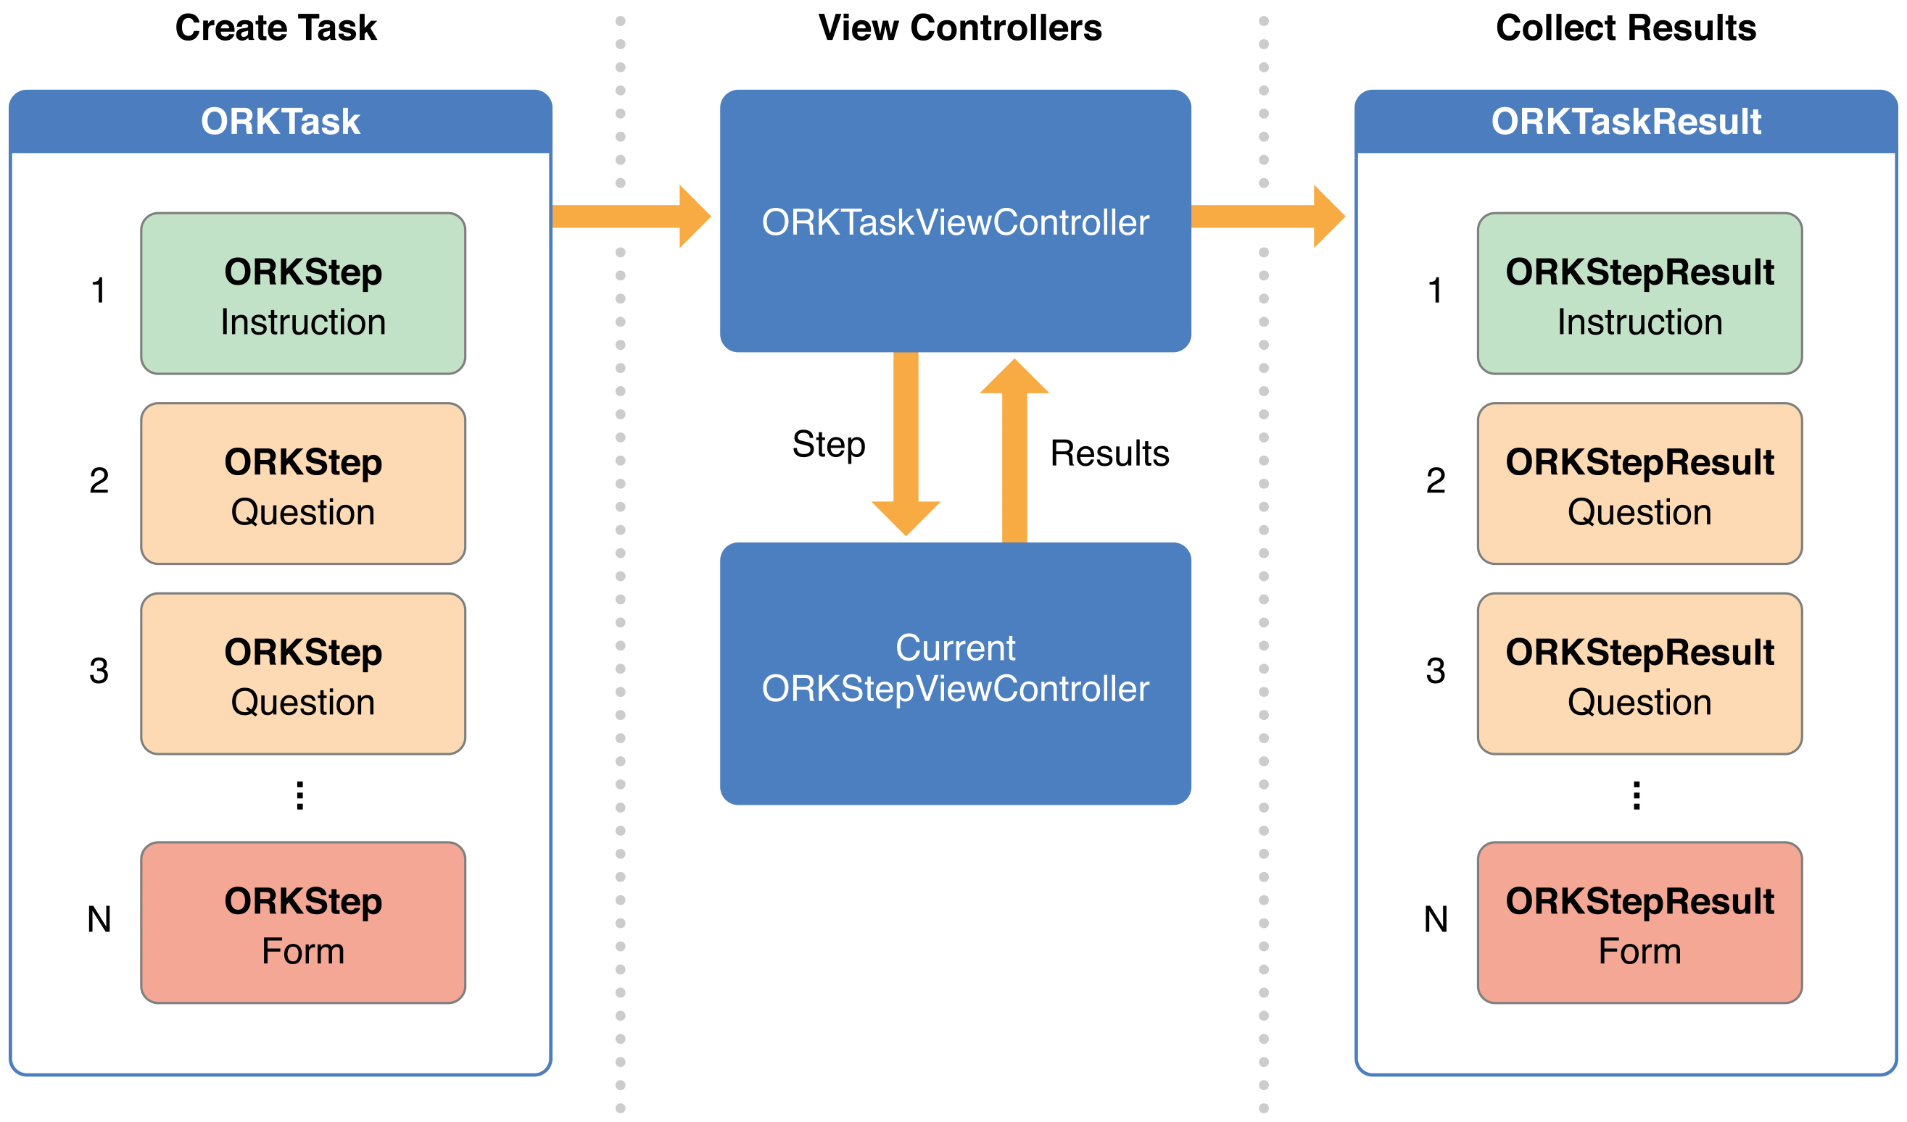
Tasks, TaskViewController and Results
Notes:
Whether giving instructions, presenting a form or survey, obtaining consent, or running an active task, everything in the ResearchKit framework is a collection of steps (ORKStep objects), which together form a task (an ORKTask object). To present a task, attach the task to a task view controller object (ORKTaskViewController). When the user completes a step in a task, the task view controller generates a step result object (ORKStepResult) that records the start and end time for that step, and any results from the step.

Slide 7
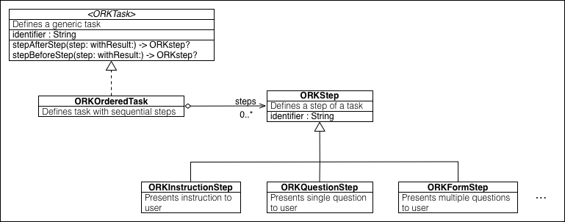
Steps and Tasks

Slide 8
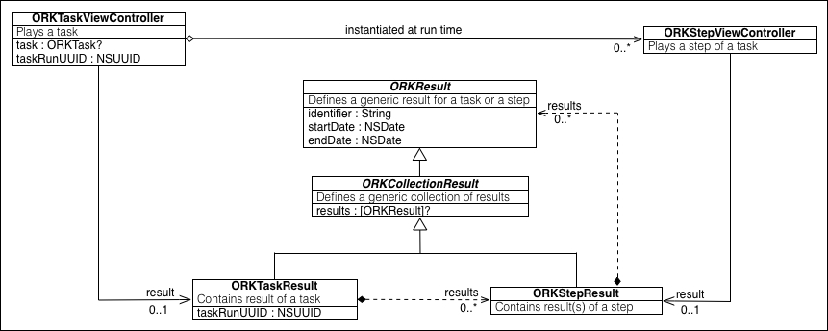
TaskViewController and Results

Slide 9
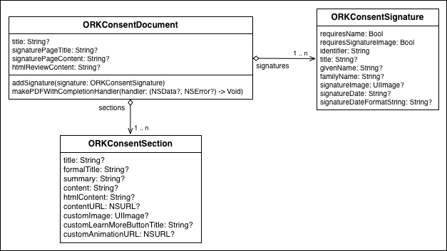
Consent Module

Slide 10
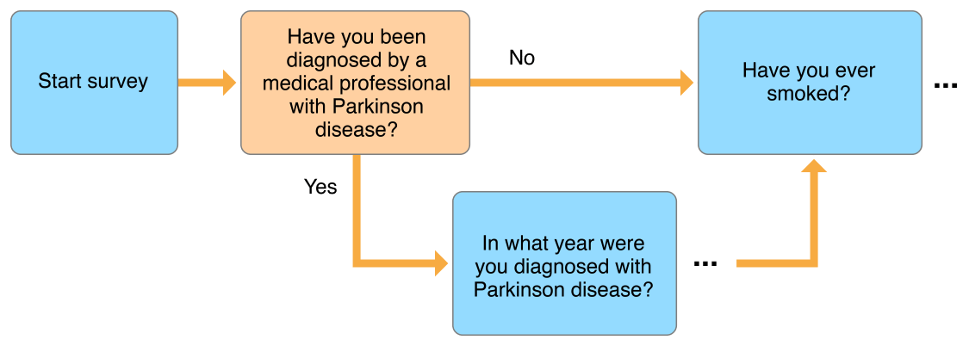
Surveys (ORKOrderedTask / ORKNavigableOrderedTask)

Slide 11
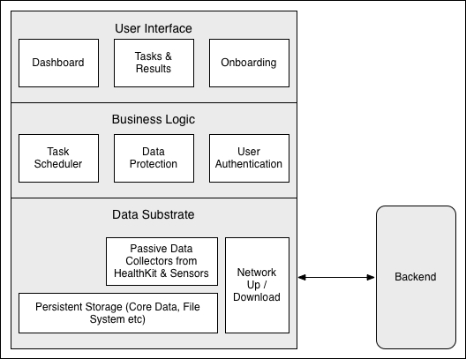
Typical Architecture

