Slide 1

CareKit http://github.com/carekit-apple/carekit

Slide 2
Overview https://developer.apple.com/videos/play/wwdc2016/237/
Open source framework
Providers build apps that empower patients
Engage patient to take active role in their care
Encrypted data storage

Slide 3
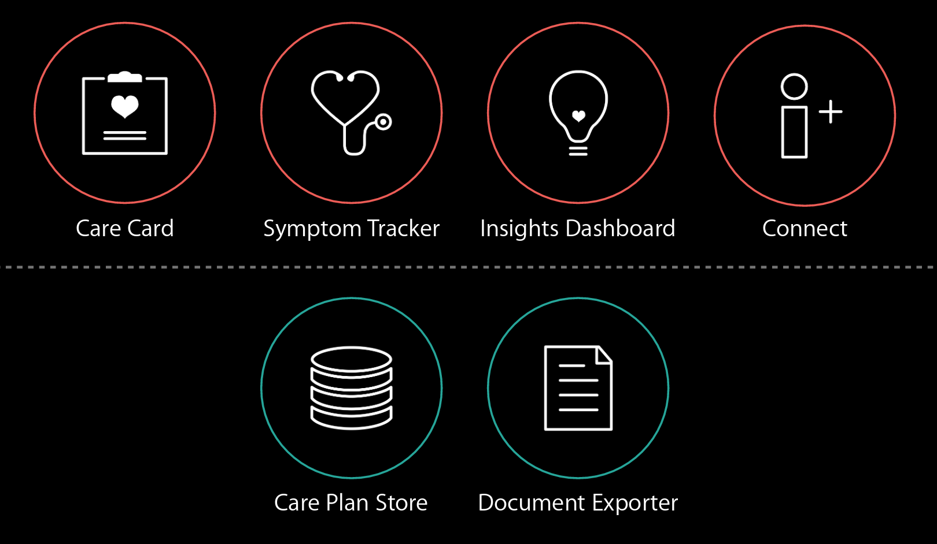
CareKit Modules

Slide 4
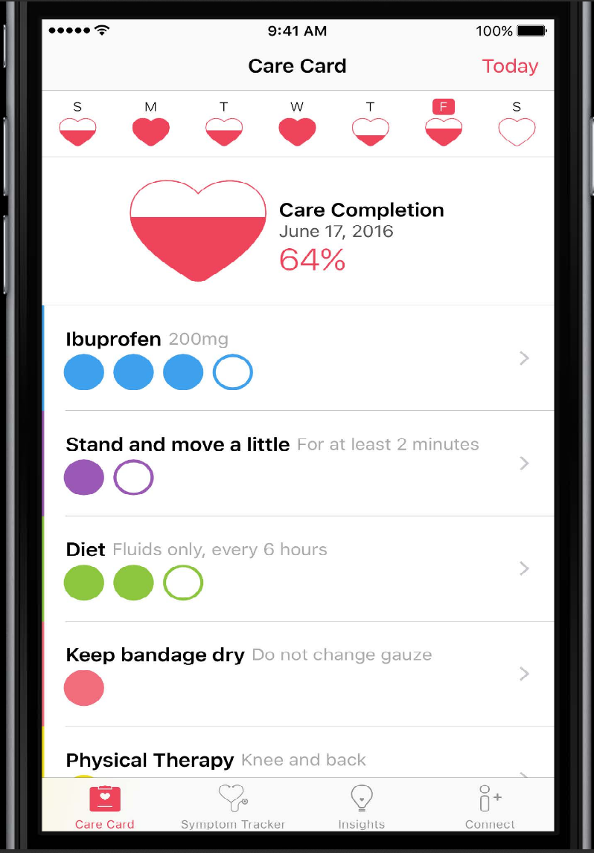
Care Card
Interactive treatment plan

Slide 5
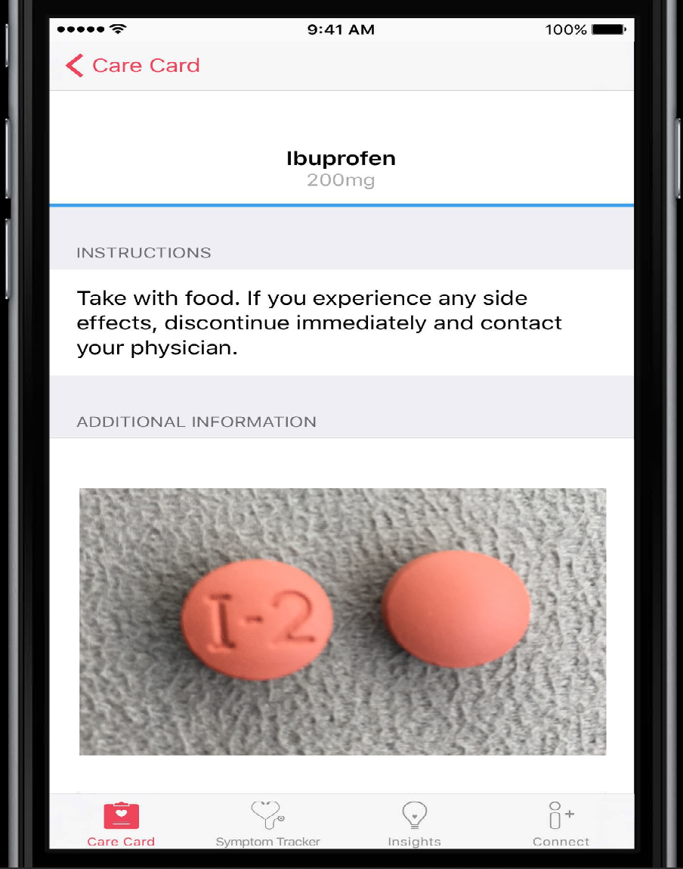
Care Card Instructions

Slide 6
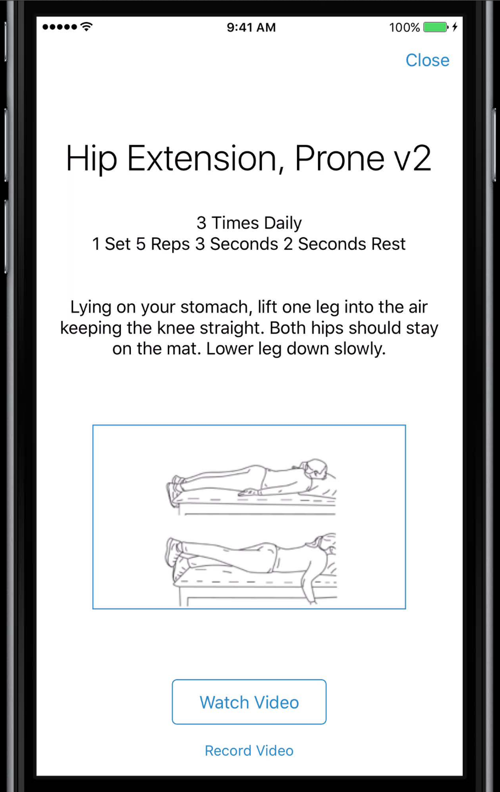
Care Card Instructions

Slide 7
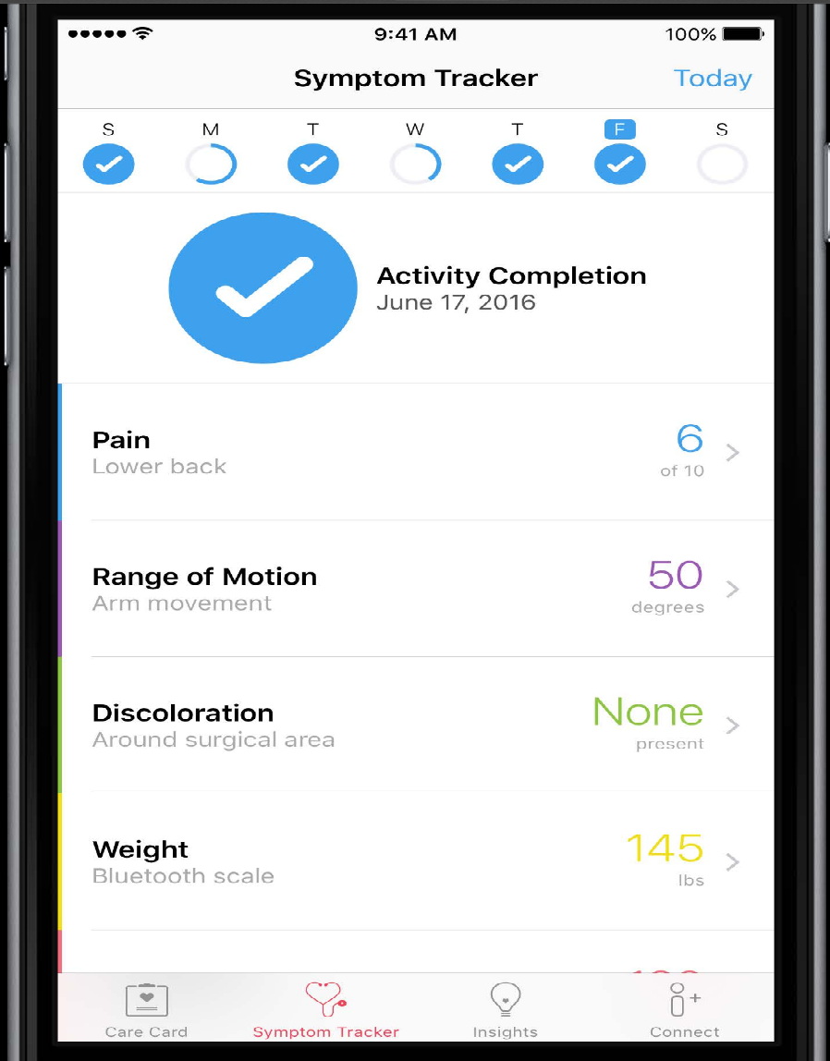
Symptom and Measurement Tracker
Subjective and objective data

Slide 8
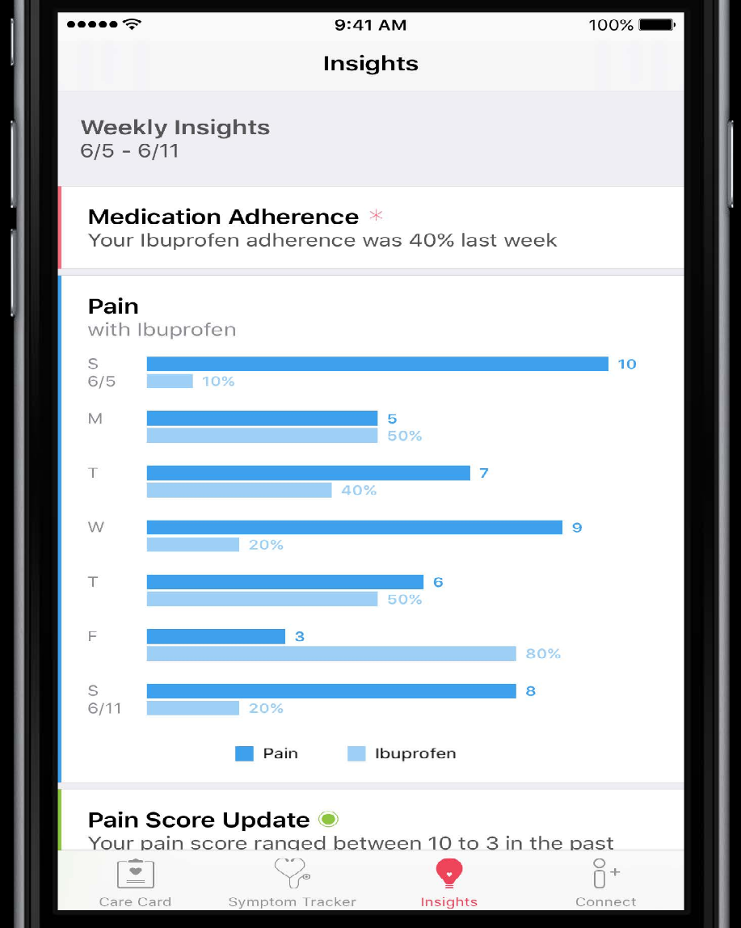
Insights
Understanding your data

Slide 9
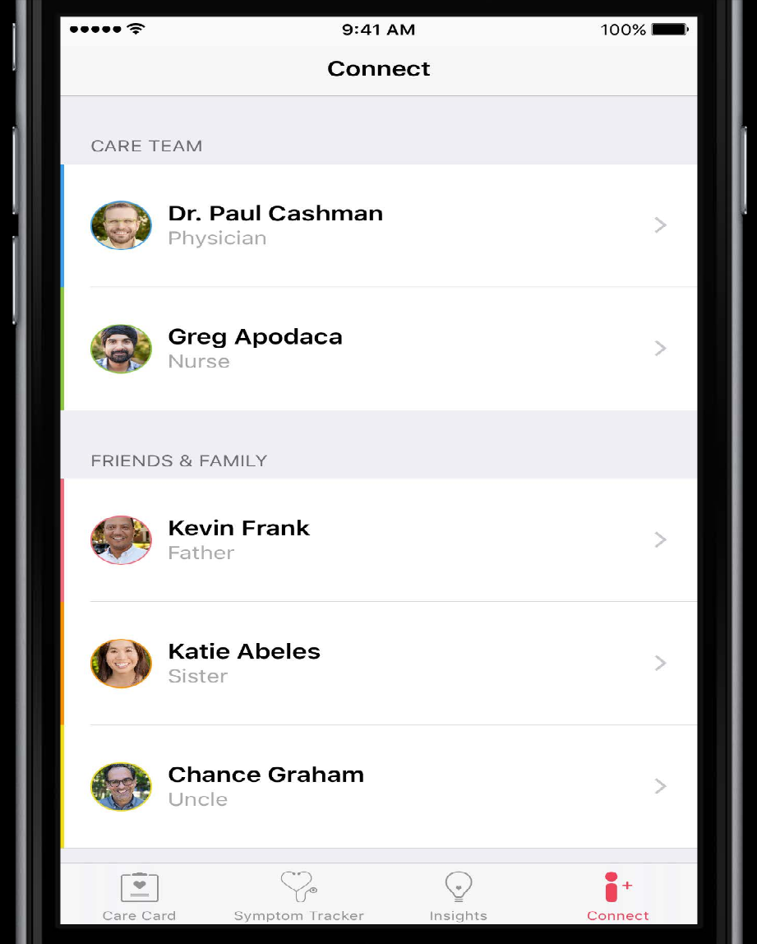
Connect
Communicate and share

Slide 10
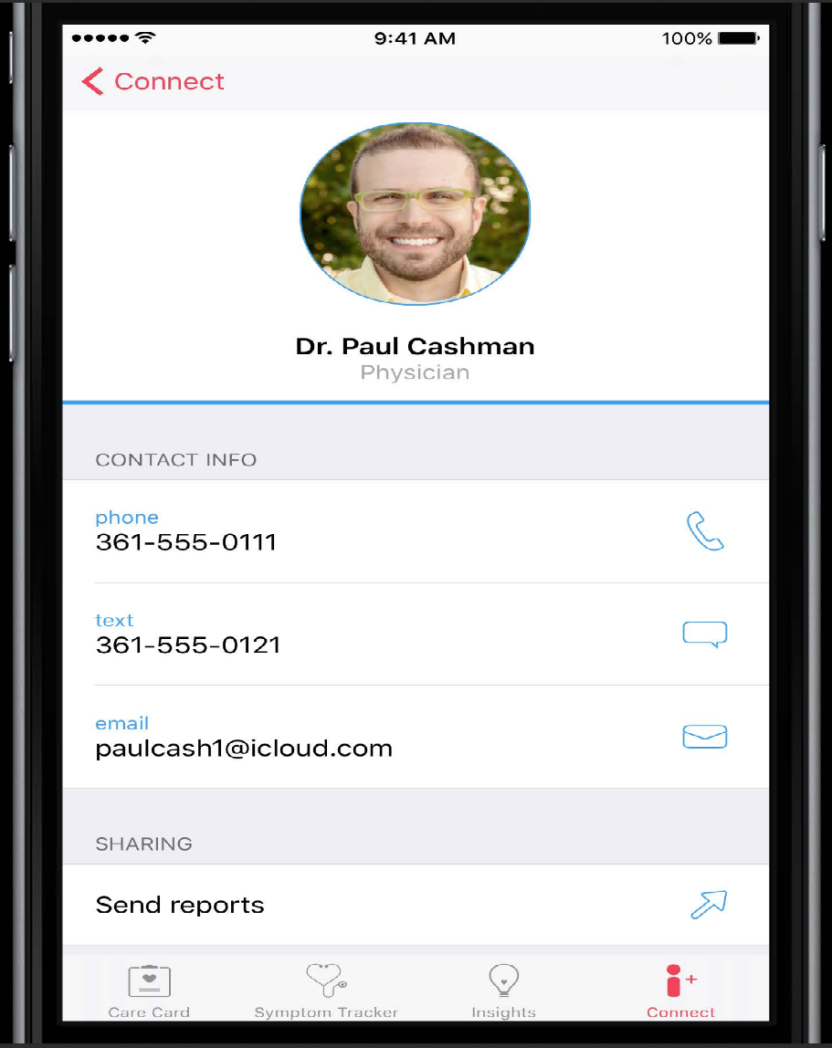
Connect Information

Slide 11
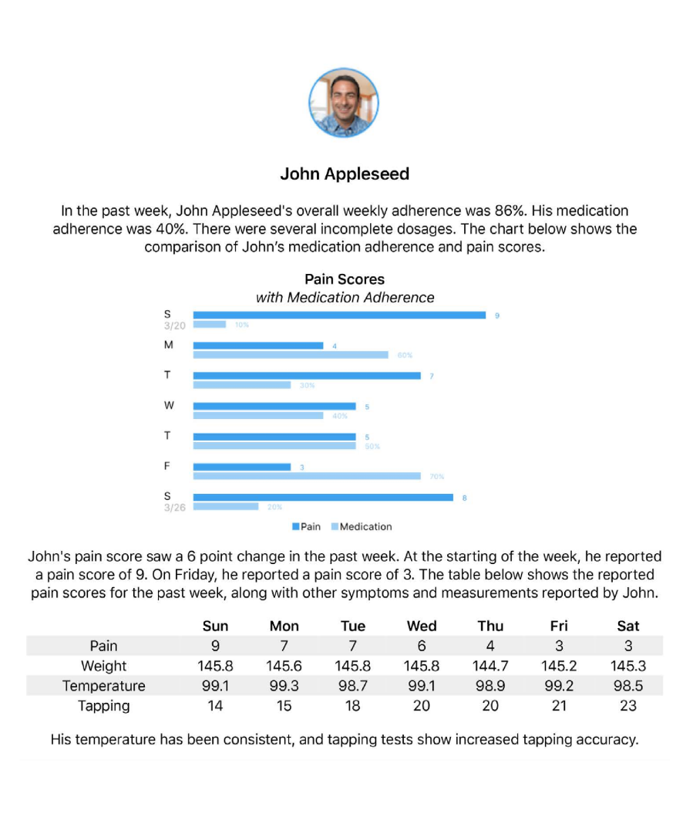
Document Exporter
Elements
Headers and footers
Texts and paragraphs
Images
Charts
Tables

Slide 12
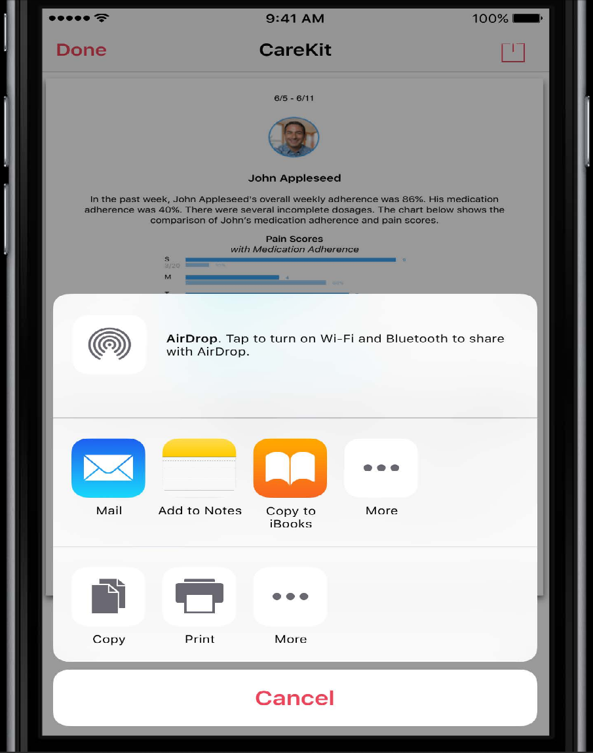

Slide 13
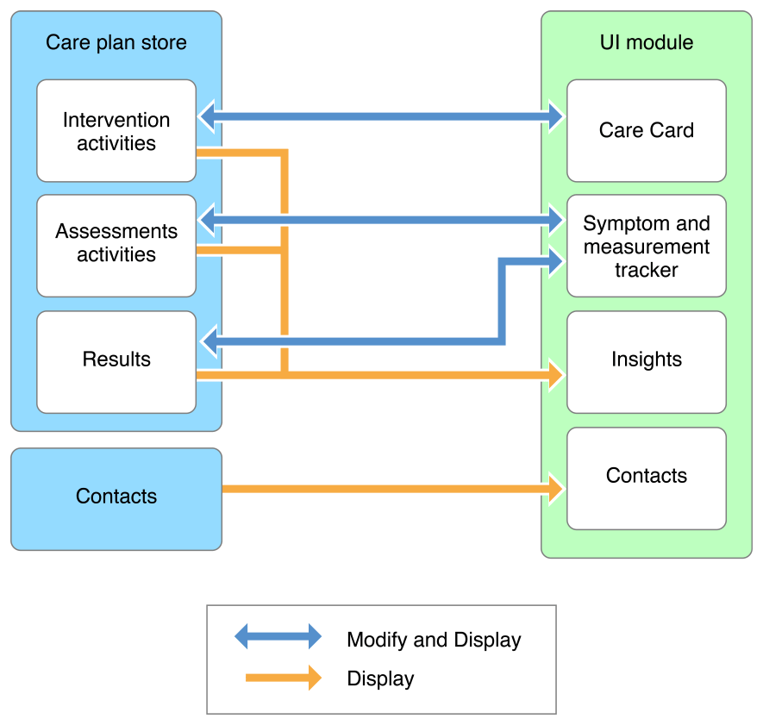
CareKit Framework
http://carekit.org/docs/docs/Overview/Overview.html

Slide 14
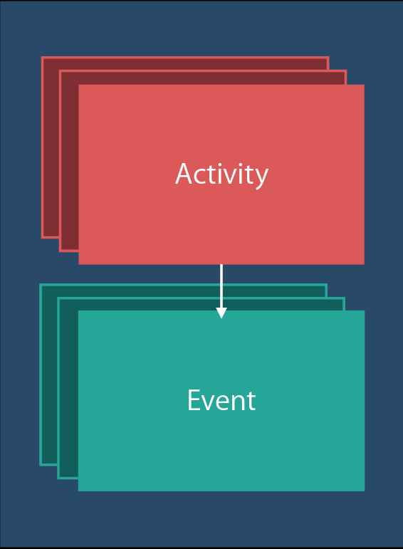
Care Plan Store
Encrypted data storage

Slide 15
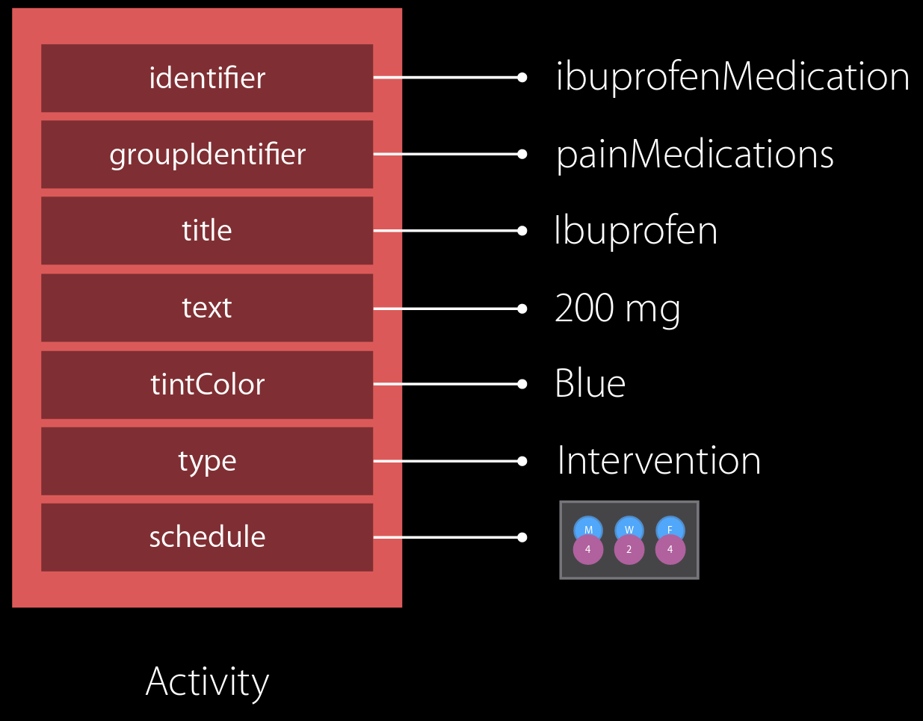
Care Plan Store

Slide 16
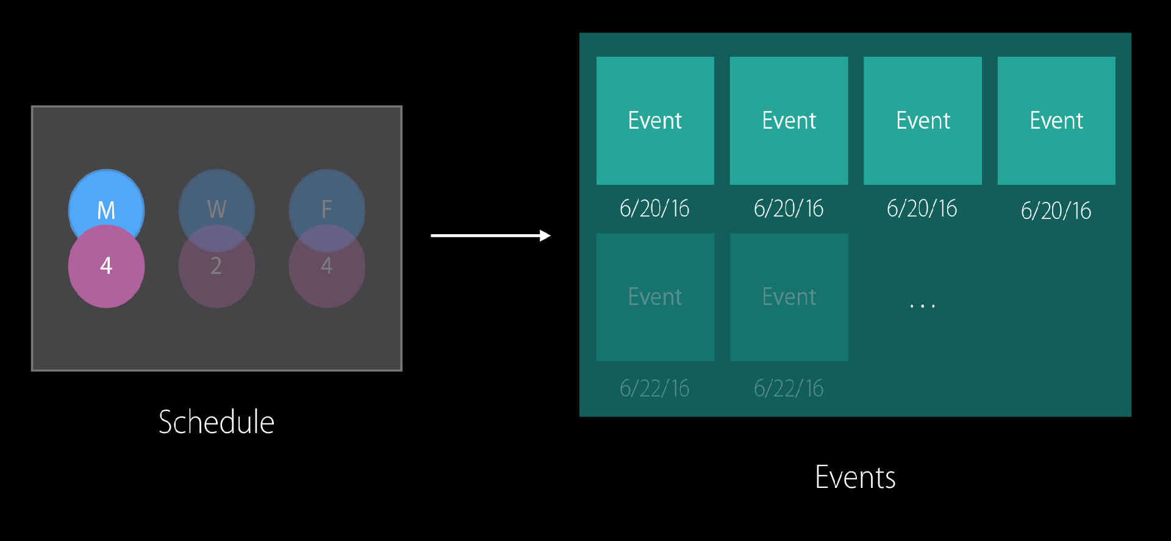
Schedule Events

Slide 17
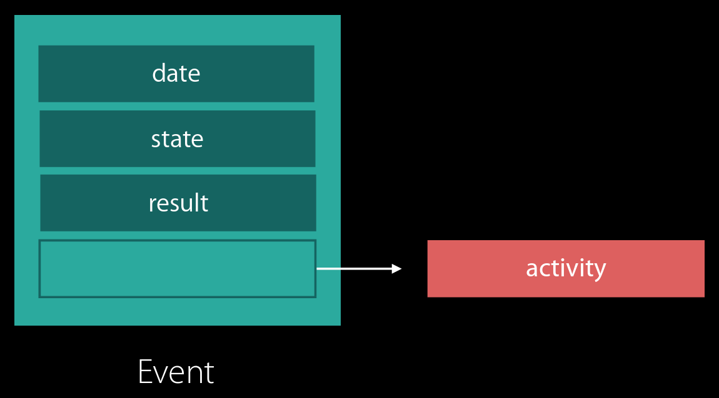
Event

Slide 18
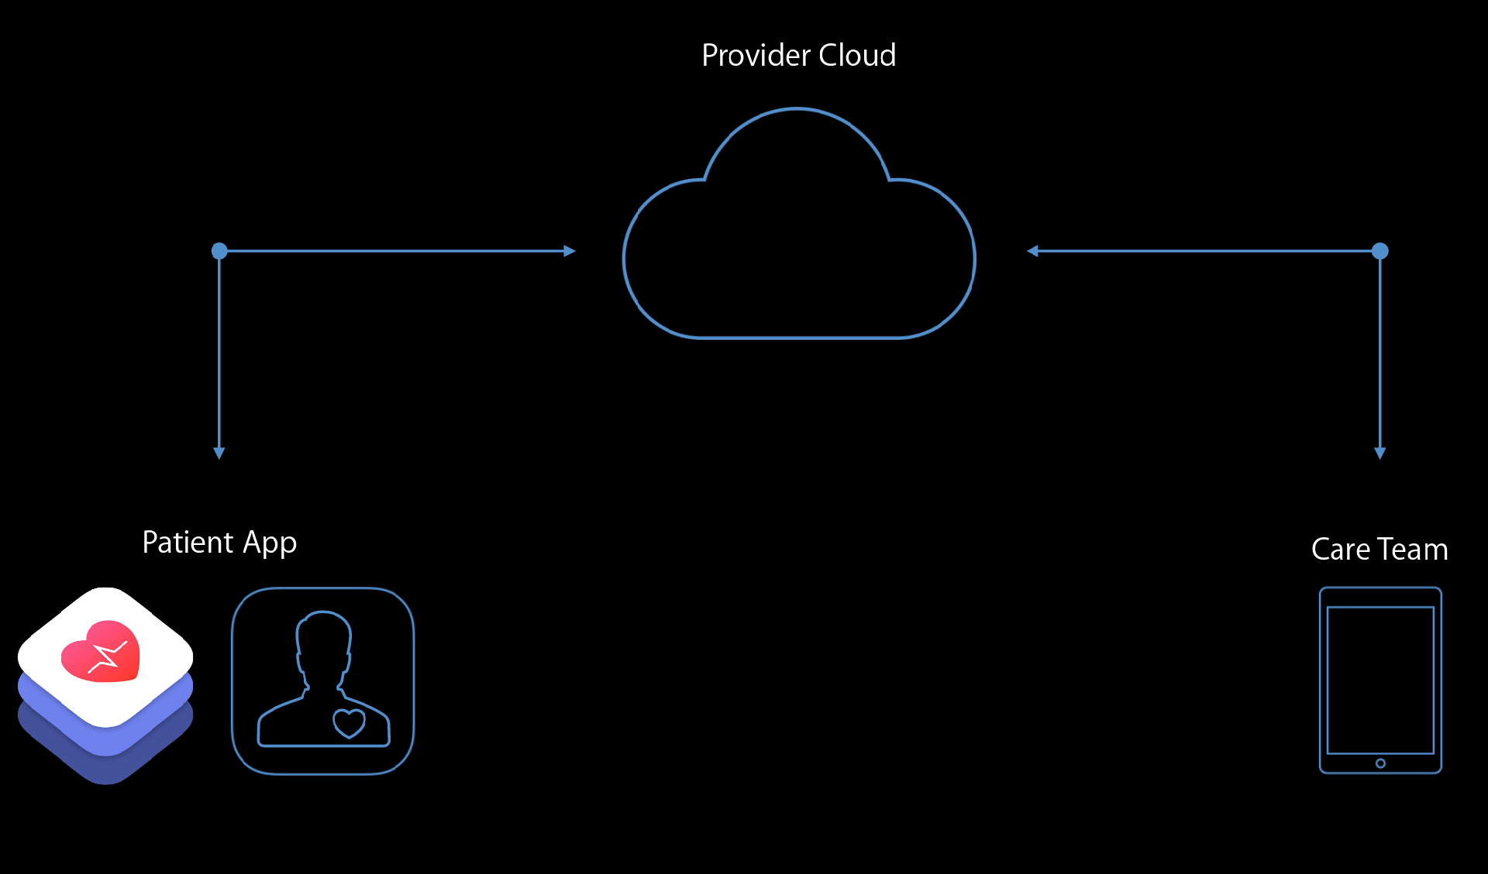
CareKit App

Slide 19
CareKit Development Process http://github.com/carekit-apple/carekit
External Developer
* Report issues, request features on Github
* Fix issues, develop feature
* Participate in review process
Core Developers
* Accessibility
* Localization
* QA testing
* Merge into framework

