Slide 1
Developing and Optimizing WebAssembly Progressive Web Applications
Name of Event
Intel

Slide 2
Agenda
Setting up the environment
Outline of files to create

Slide 3
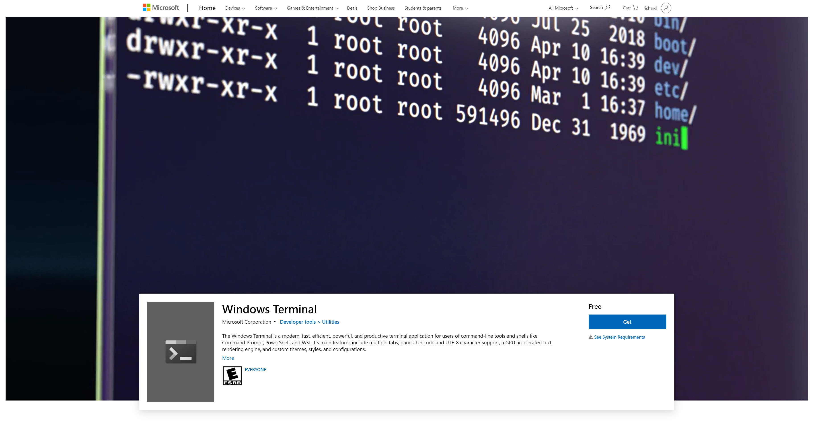
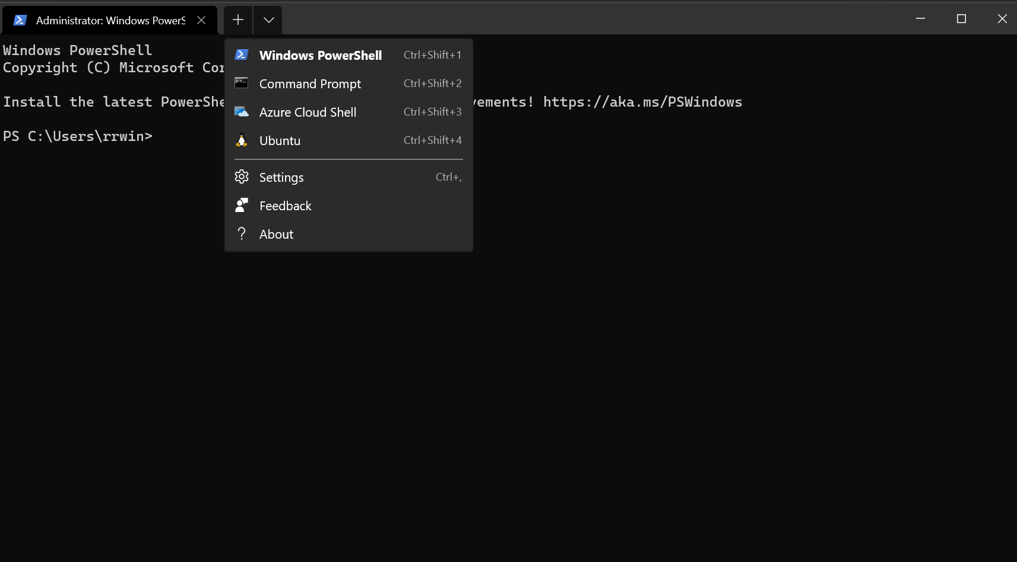
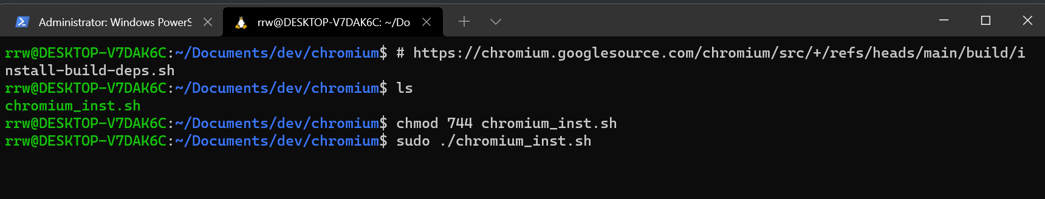
Windows, Chromebooks, Linux
Windows
Install Windows Terminal
Install WSL2
Install Ubuntu
Chromebooks
Put Chromebooks into Developer mode
Install Linux
Windows, Chromebooks, Linux
Chrome Developer Environment Chromium Linux Environment (more than you need)
Editor (I use Microsoft Visual Code)

Slide 4
WebAssembly Compiler Environment
Setup EMSCRIPTEN Environment
Emscripten SDK
./emsdk install tot
./emsdk update
./emsdk install latest
./emsdk activate latest
Source emsdk_env.sh

Slide 5
Get the files for the project

