Slide 1

Customer Churn
- Prediction and Recommendation

Slide 2


Business Problem Understanding
Customer Churn occurs when a customer decides to end
his or her relationship with a business.
DTH industry is one of the most competitive industries in the world with high acquisition costs and changing tariff plans. Industry also has to face severe competition from market through the attractive offers and discounts from competitors to retain & switch customers.
The challenge in front of this service provider was the potential churn of subscribers. The business objective was to identify the subscribers who have a high propensity to churn and thereby focus the marketing campaigns on a select segments of subscribers and therefore optimize the marketing spend.

Slide 3
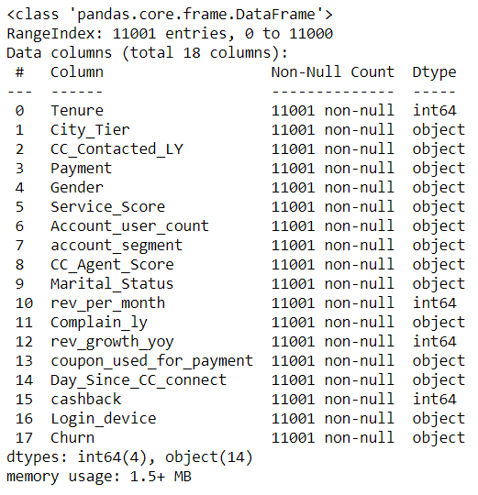

About Dataset
Data Report
The given dataset is provided by the great learning for the Capstone project- Customer Churn.
After performing different data cleaning techniques , we have got information about 11001 customers.
There are ‘four’ variables of data type-int and ‘fourteen’ variables of data type - string.
This dataset has one dependent variable ‘Churn’ and 17 independent variables excluding variable ‘AccountID’.
The given data is imbalanced based on variable ‘Churn’ as it has lesser data points in True Churn category (16.8% of total dataset)

Slide 4
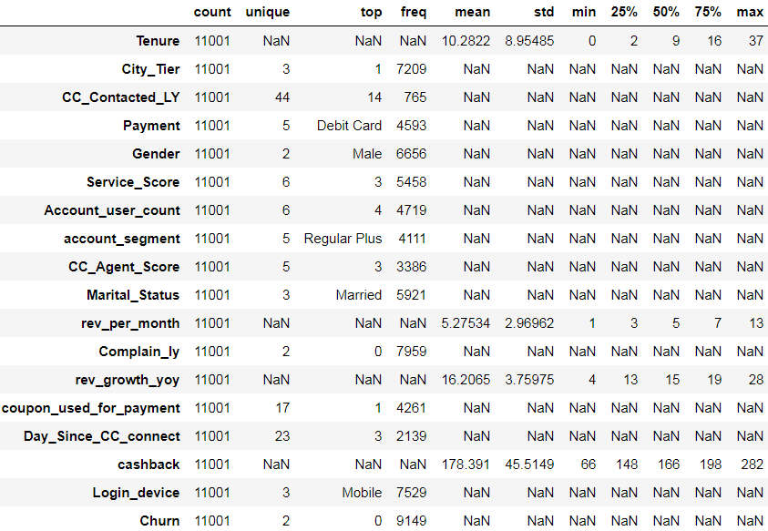
About Dataset
Descriptive stats:
Majority of the customers are ‘Male’ and belongs to City_Tier-01.
Mobile is the most preferred login device of the customers in the account and most of the customers gave Satisfaction score of 3 about the service provided by company.
Majority of the customers made payment through ‘Debit Card’ and are coming under account_segment –‘Regular Plus’
Majority of the customers are ‘Married’ and Most of accounts have 4 no of customers tagged with the account
Most of the customers have used coupons to do the payment in last 12 months for single time only

Slide 5
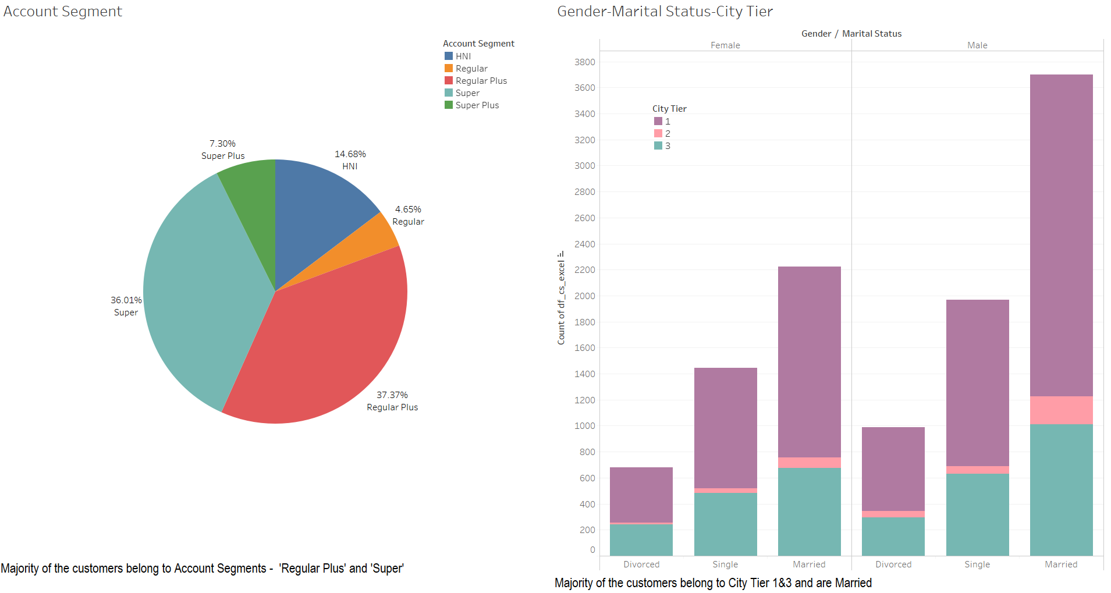
EDA - Inferences

Slide 6
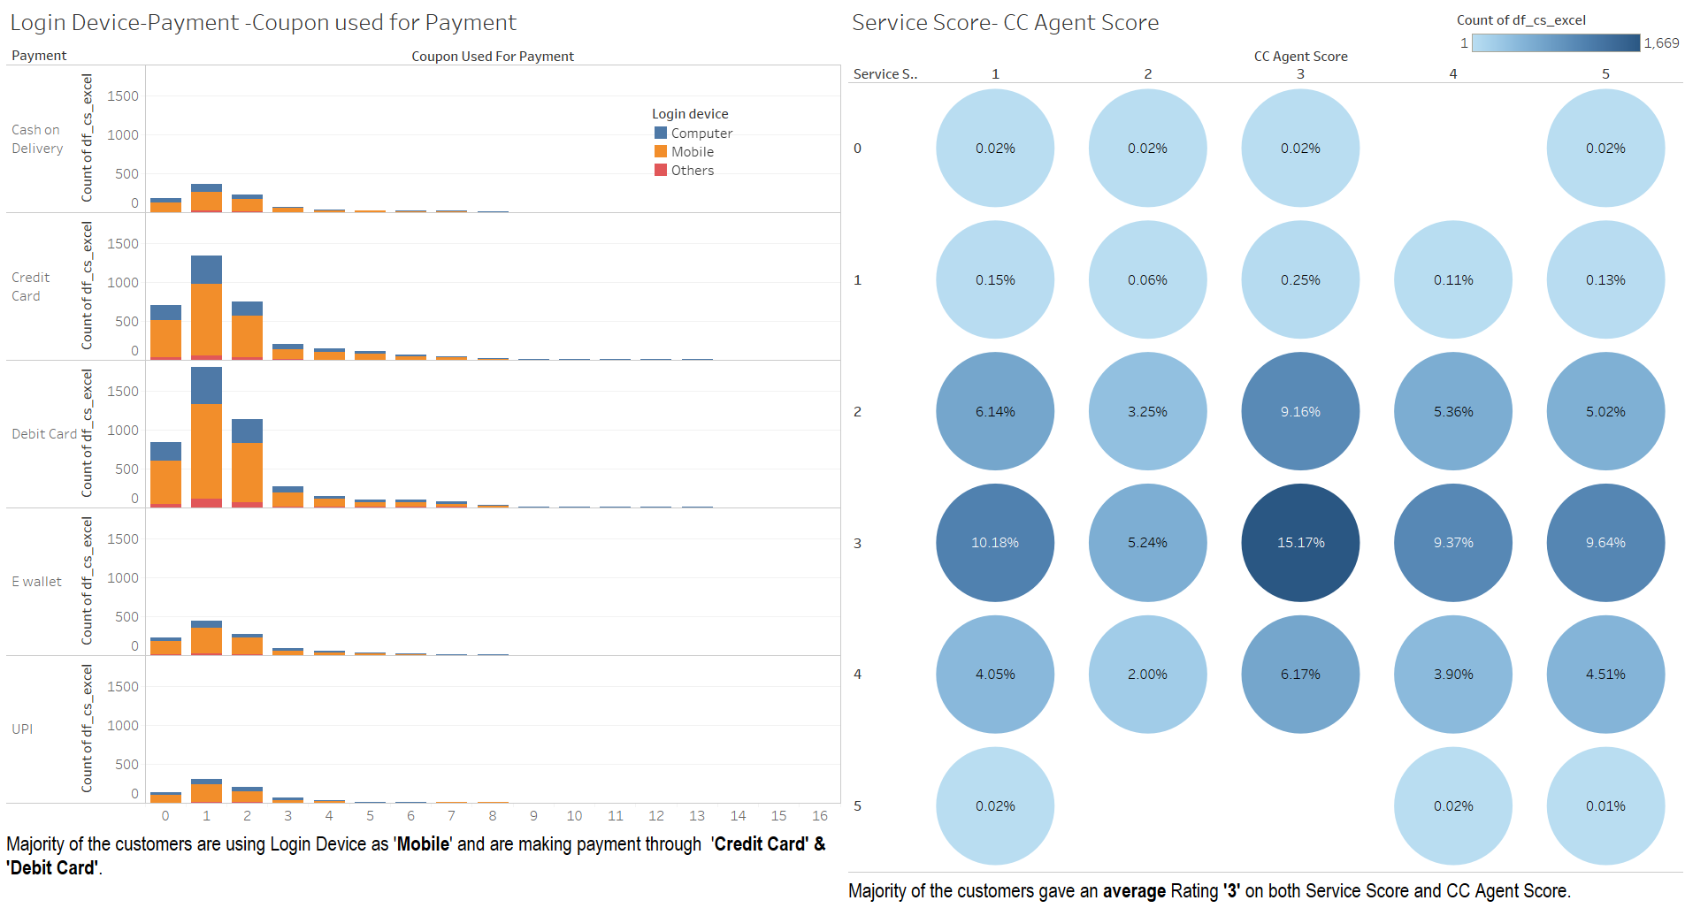
EDA - Inferences

Slide 7
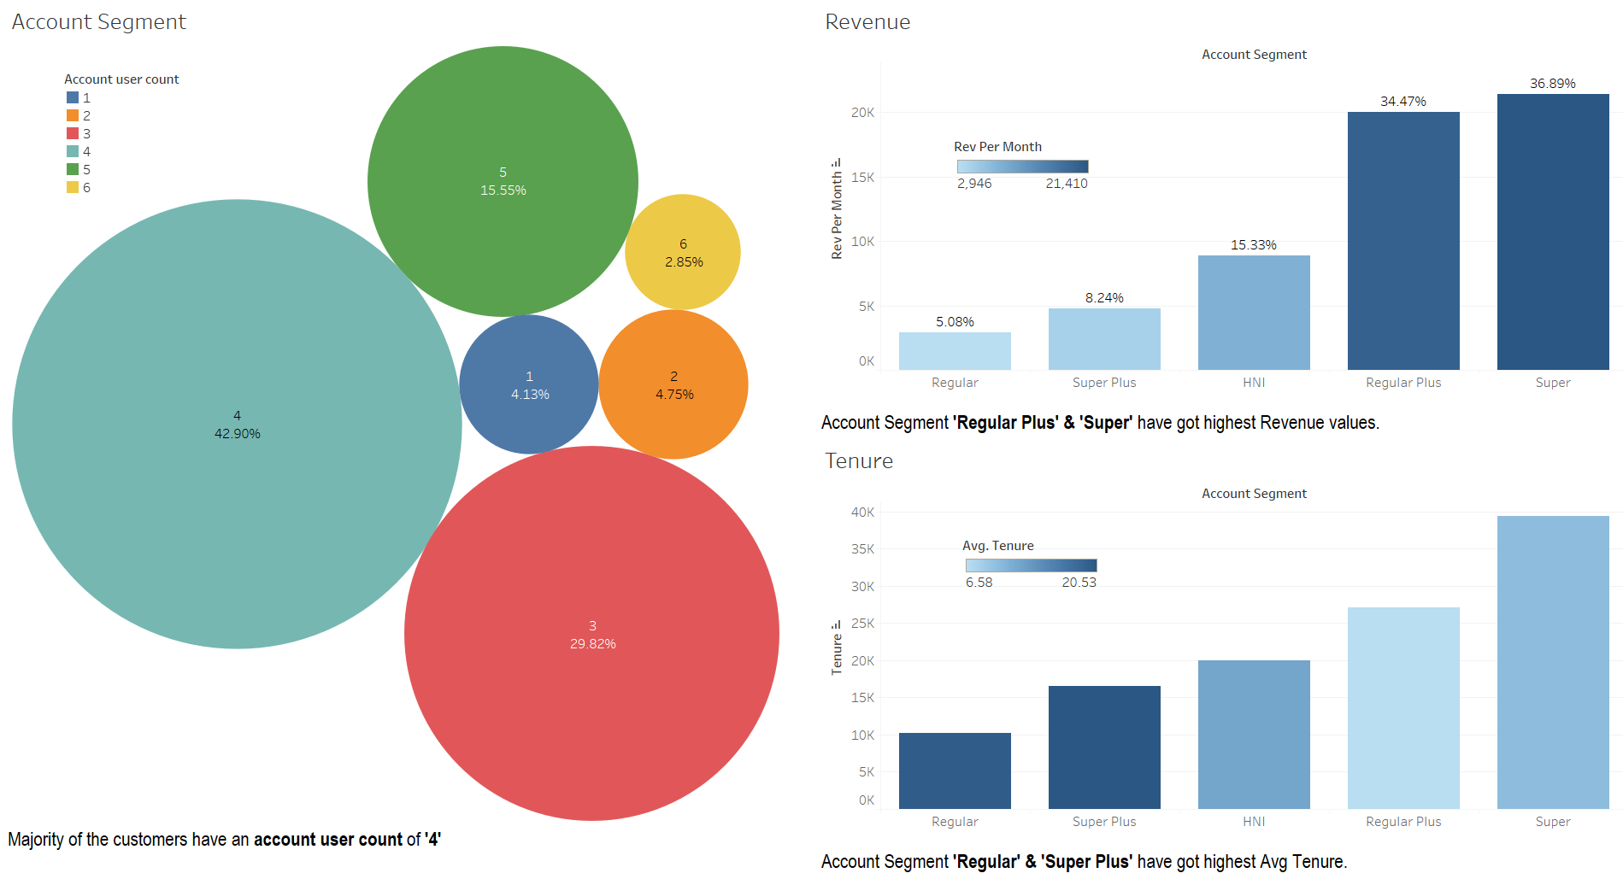
EDA - Inferences

Slide 8

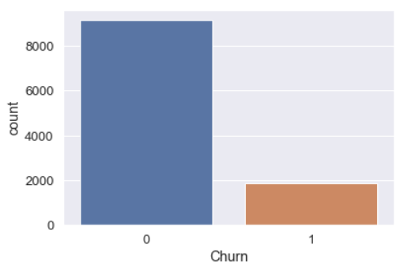
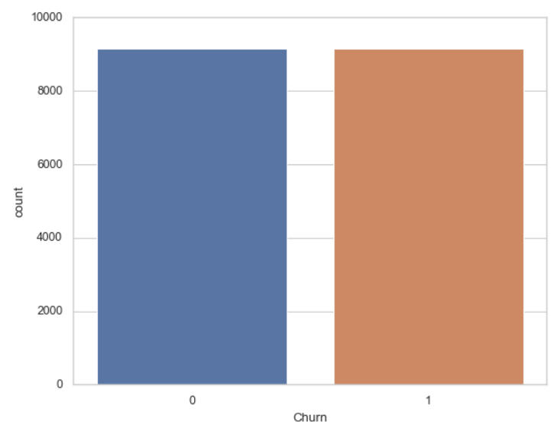
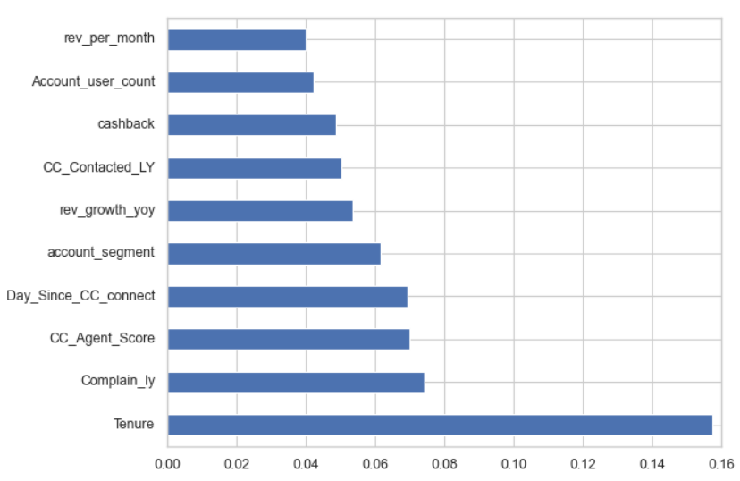
Modelling Approach Used & Why
The given data is imbalanced based on variable ‘Churn’ as it has lesser datapoints in True Churn category (16.8% of total dataset). We try to increase the frequency of the customers of churn class to obtain approximately the same number of instances for both the classes.
These are the most important variables which contribute much to our target variable and are helpful in order to achieve better accuracy of the model.

Slide 9
Modelling Approach Used & Why
Predicting churn is important only to the extent that effective action can be taken to retain the customer before it is too late. Once those customers at risk of churning have been identified, certain measures can be taken for each individual customer to maximize the chances that the customer will remain a customer
As per our project, we have to predict whether a customer is going to churn or not. We have target variable of qualitative data type. So, we are going to build classification models for prediction.
We have used variety of models such as Logistic Regression, KNN Classifier, Decision Tree etc., for prediction on test data and summarized overall results.
The overall measures are high in KNN Classifier model. Therefore, KNN Classifier model has best performance among all the models and can used for predictions.

Slide 10
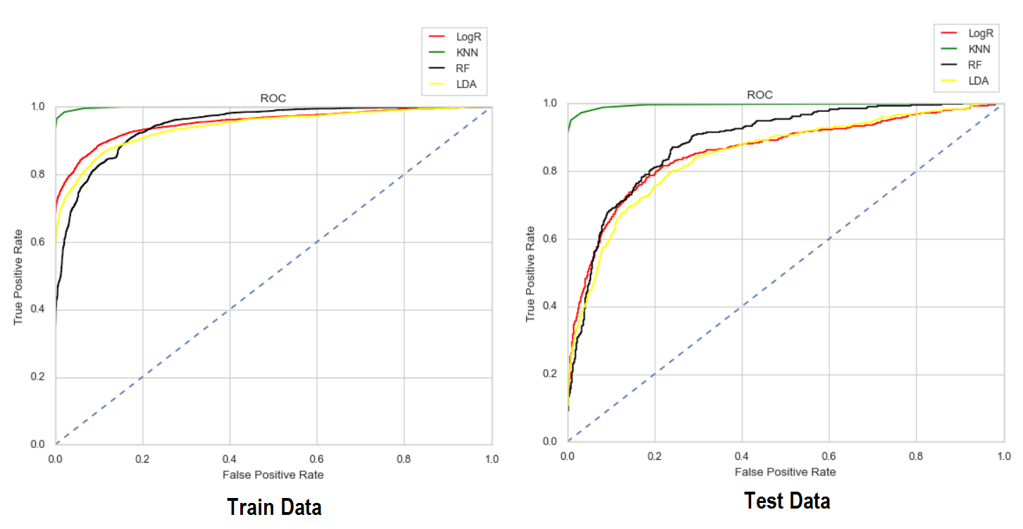
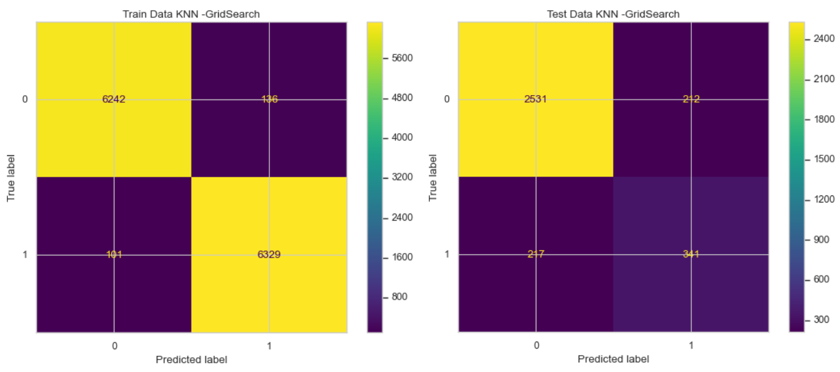
Modelling Approach Used & Why
KNN gives a probability of a particular customer churning. The threshold is usually set to .5 by default. This means that anyone with a probability of more than .5 is predicted to churn. If you reduce the probability threshold, more people will be predicted to churn, this gives you a higher number of “at risk customers” to target. However, this increases the likelihood that customers who are not at risk will pass the threshold and be predicted to churn. This can be checked by looking at the Recall score (TP/TP+FN) . The results from models show that KNN Classifier algorithm is a promising opportunity in predicting customer churn status

Slide 11

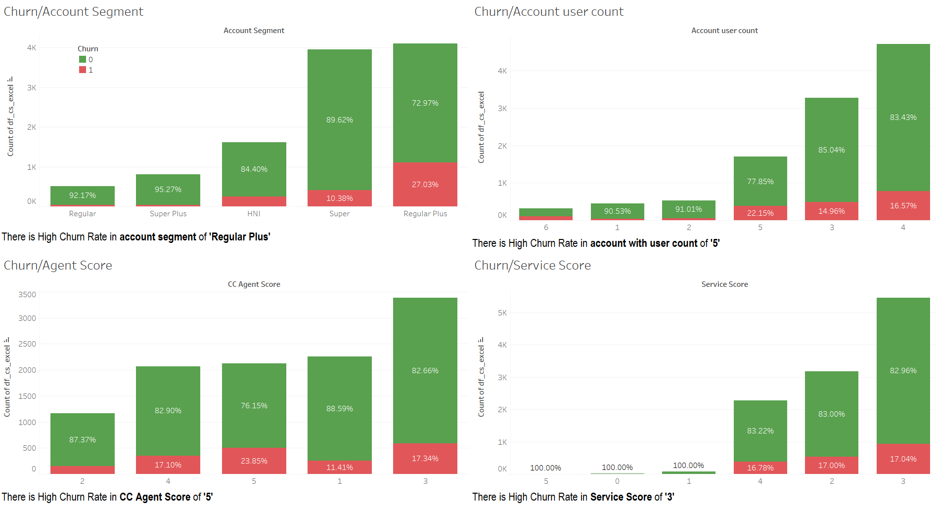
Insights from Analysis
On observing different independent variables with respect to output variable ‘Churn’. We have got following info :

Slide 12
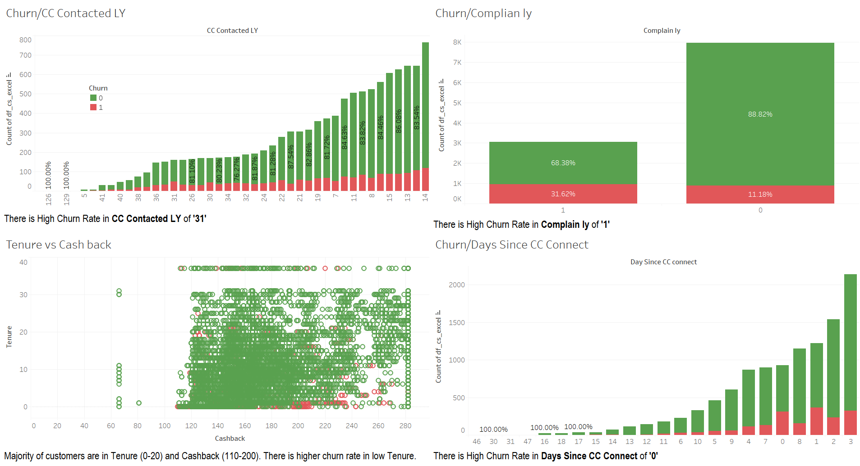
Insights from Analysis
On observing different independent variables with respect to output variable ‘Churn’. We have got following info :

Slide 13
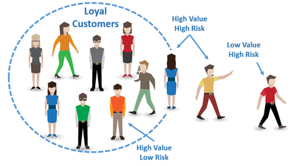
Insights from Analysis
Segregating customers based on probability of churn, Revenue and Tenure . We have got the following Matrix
Risk-Value-Tenure Matrix
Risk (Prob) | Revenue Value | Account Tenure
 |  | VeryOld | Old | Latest
VeryHigh (>0.8) | VeryHigh | 49 | 16 | 64
 | High | 56 | 15 | 83
 | Medium | 93 | 31 | 104
 | Low | 190 | 38 | 174
High (0.8-0.6) | VeryHigh | 111 | 126 | 191
 | High | 112 | 80 | 165
 | Medium | 149 | 119 | 210
 | Low | 361 | 192 | 430
Moderate(0.5-0.6) | VeryHigh | 20 | 33 | 13
 | High | 11 | 25 | 24
 | Medium | 25 | 60 | 74
 | Low | 54 | 108 | 156
We can never afford to lose the customers who are providing Very High Revenue and Very Old Tenure account. They are the most loyal and high monetary value customers.
Different strategies can be applied to retain the customers based on value of the customer.
Red color Marked customers are most important , followed by Blue and Brown. As majority of the business happens through these customers we have to make customer specific retention efforts.
Budget preference should be based on High Value-High Risk

Slide 14

Recommendations
Majority of the customers belongs to segment – ‘Regular Plus’ & ‘Super’ and also associated with 3-4 persons per account. So, we can include more channels in these segments to cover wide range of audience.
Most of the customers are using mobile as Login device. So, we can allow multiple login for single account through discounted pricing. This would help in retaining customers.
Most of the Payment is done through Credit and Debit Cards. We can attract customers for higher recharge values through reward points and high cash back for payments.
Majority of the customers gave an average score on both Service score and Customer service score. Its preferable to get customer feedback through text by providing certain questionnaire. This would be helpful in understanding the exact problem and then we can act accordingly.
Customer complaints must be solved in minimal time. Customer service should be very effective to make it easy for the customer as per his requirements.
There is high churn rate in low tenure or recent accounts. We can provide offers such as Welcome bundle etc., for first 3-6 months. So that customer will get to know about various options available for him.
Retention Marketing: The at risk customers can be specially added to retention marketing lists so that sufficient measures can be used for them specifically.
Discounts or other incentives can be offered to at risk customers to try to retain them.
Offering Special deals such OTT Subscriptions could be given to retain customers.
Proactively emailing or calling at-risk customers to understand their requirements
Customers with a low probability of churning can be removed from re-targeting lists, this could lead to cost saving in marketing.

