Slide 1
Session 3 – Automation & Testing Data Skills for Research Kellogg Research Support
August 15, 2023
Notes:
Welcome. We are so happy you’re here.
What you are about to hear next is about the closest you will get to a lecture in this workshop series. Most of the rest of this will be pretty interactive.
There will be discussions and you follow along with a demonstration, and maybe try to solve a few problems yourself.
But before we get into demonstrations of tools and how to apply them to your research work, I want to talk a bit about the reproducibility of that work you are about to start.
It is a very important topic, and I believe there are a few general principles that, if kept in mind, can help you quite a lot when you go to reproduce your work in the future.

Slide 2
Aside: Jupyter Notebooks
First Method: Quest Analytic Nodes
Second Method:
First time:
module load python-miniconda3/4.12.0
conda create -n jup-env python jupyterlab
conda activate jup-env
jupyter lab --browser=firefox
Subsequently:
module load python-miniconda3/4.12.0
conda activate jup-env
jupyter lab --browser=firefox
Third Method: VSCode

Slide 3
Automation
Declarative > Procedural
Modular > Monolithic
Automatic > Manual
Notes:
All these things turn procedural unspoken knowledge into explicit, declarative and executable specifications

Slide 4
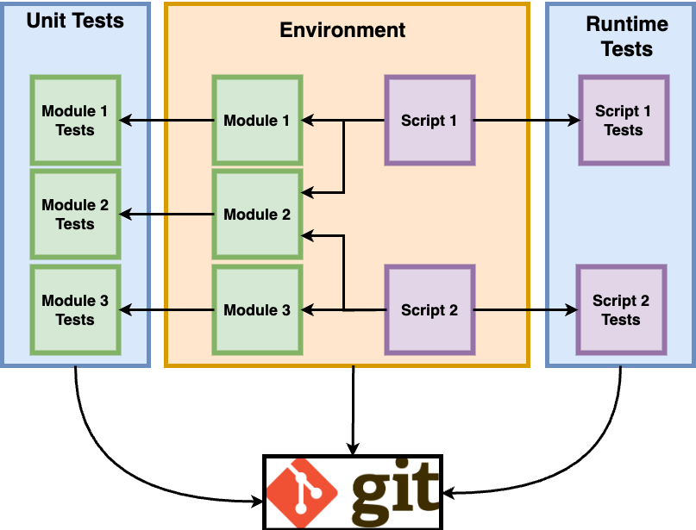
Yesterday’s Big Picture
Version Control

Slide 5
Roadmap
Shell scripts
Launching code from command line
Scripting multiple commands
Schedule jobs
Parallel processing (revisit later)
Runtime Testing
Handle exceptions
Generate logs
Validate output
Notes:
All these things turn procedural unspoken knowledge into explicit, declarative and executable specifications

Slide 6
Launching Code from Command Line

Slide 7
Command Line
To launch an R file:
Rscript <file_name.R>
To launch a python file:
python <file_name.py>
To launch a stata do file:
stata-mp -b do <file_name.do>
Shell scripts:
nano <file_name.sh>
chmod u+x <file_name.sh>
./<file_name.sh>
How to divide up application logic is up to you
Notes:
You can add any bash shell command to a shell script. Executing it is like having the machine sit there and enter the commands one by one

Slide 8
Creating a Shell Script
If you’d like to run multiple programs in sequence, you can create a shell script on KLC using the nano editor.
nano <file_name.sh>
chmod u+x <file_name.sh>
./<file_name.sh>
Here is a simple example file:
#!/bin/bash
# load modules
module load python-miniconda3/4.12.0
# run script
python test.py

Slide 9
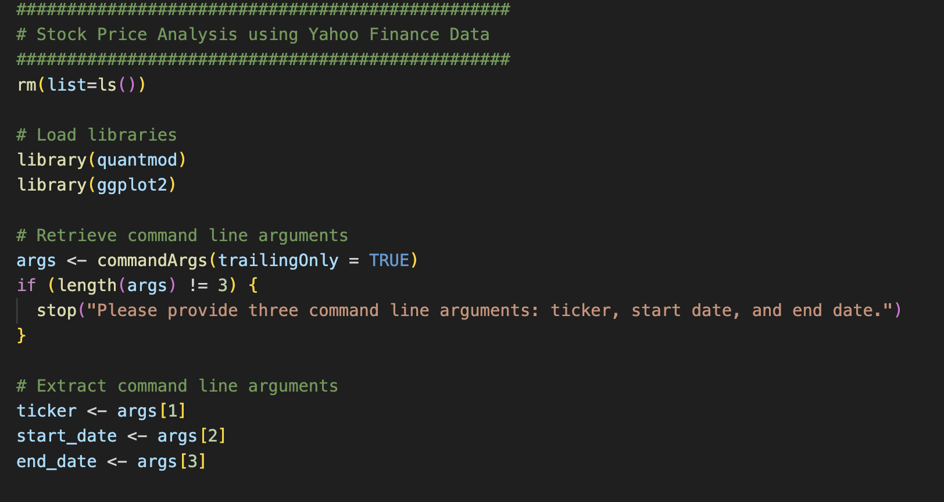
Passing Arguments: R

Slide 10
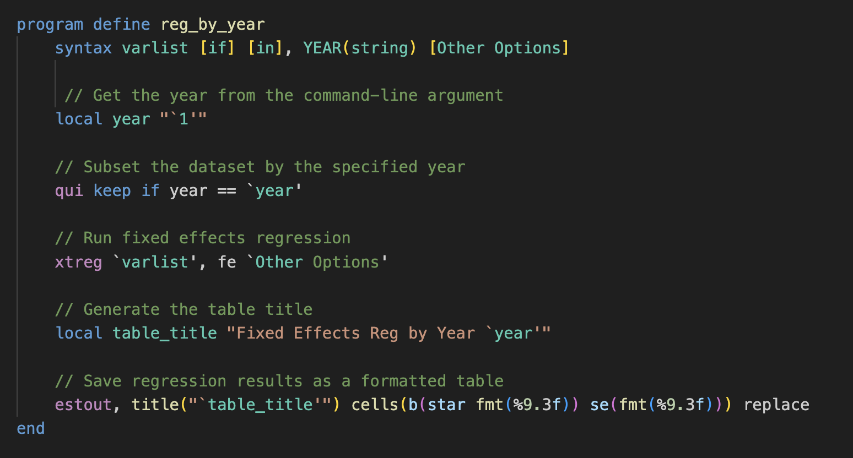
Passing Arguments: Stata

Slide 11
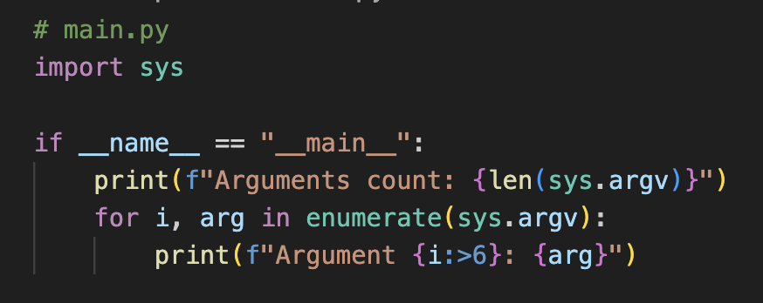
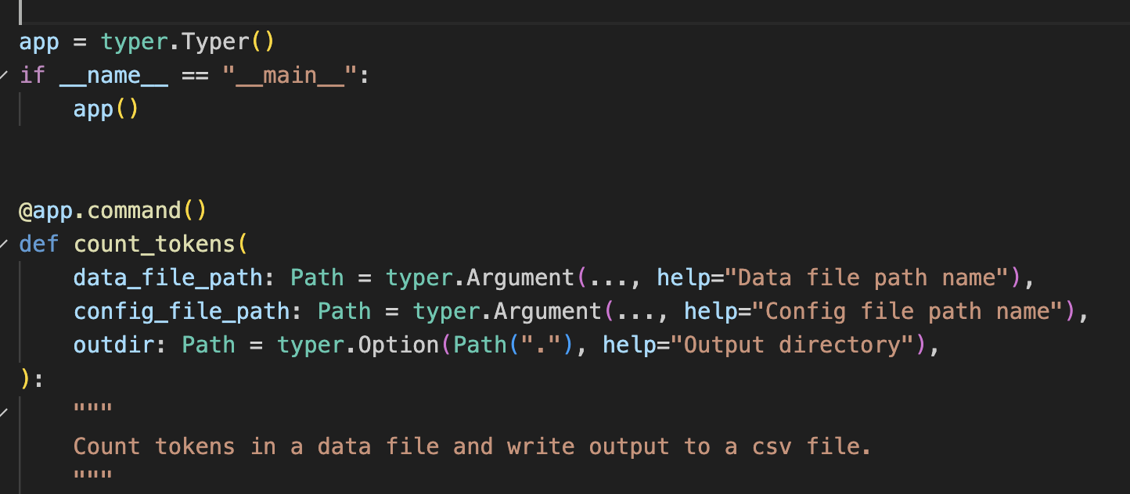
Passing Arguments: Python
command line arguments

Slide 12
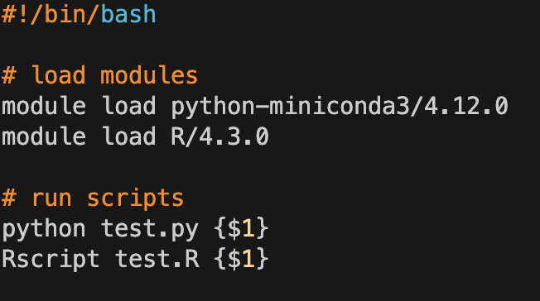
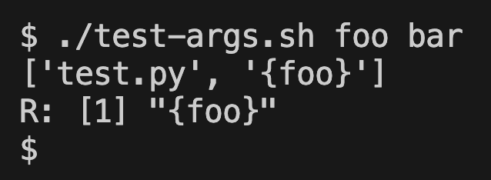
Passing Arguments: Shell Scripts
Shell Script Arguments
Notes:
Show examples of how to control execution of a script.
Maybe one flavor where you use bash, and another where you use a Python wrapper to control it?

Slide 13
Scripting Multiple Tasks at Once

Slide 14
Complex Workflows
raw data
raw data
model-ready data
results
transformations
analysis
raw data
raw data
update inclusion,
model specs
obtain more data
Notes:
JOHN
Your research project will go through many steps from its start to its final output.
Yesterday we urged you to break your steps down into discrete pieces so that you have a clean record of each step.
Scripting the overall pipeline is important for documenting which pieces were run and when.

Slide 15
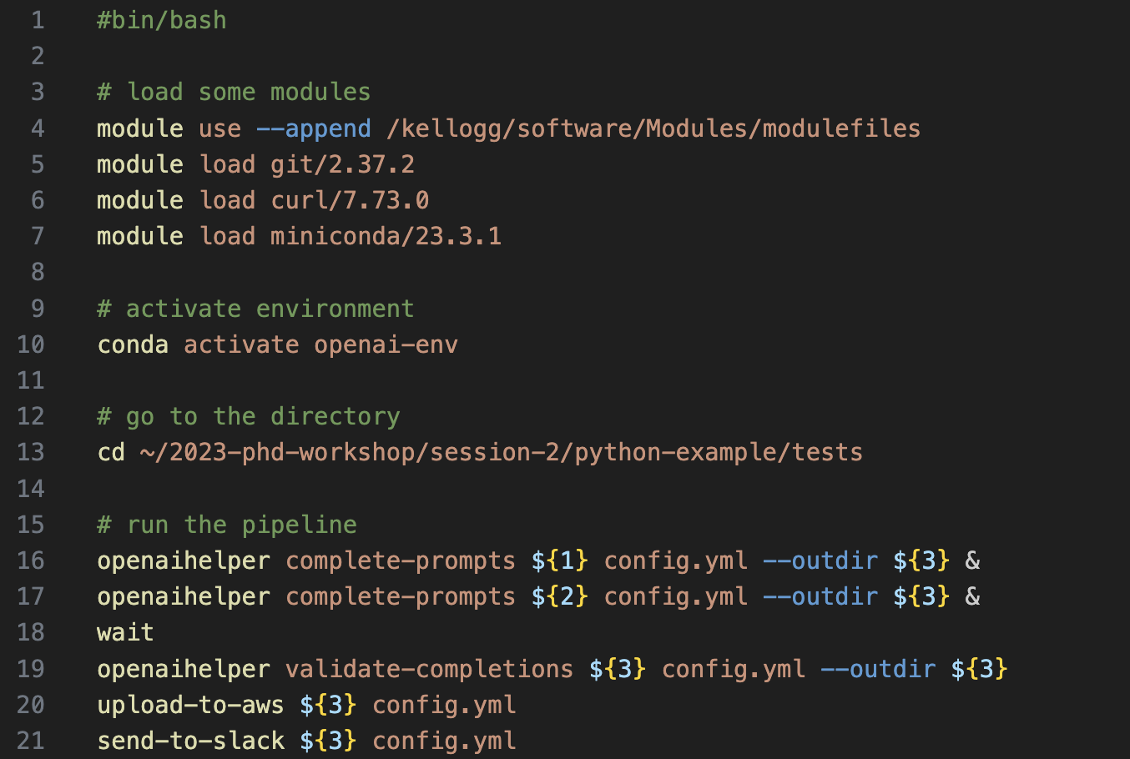
Scripting Complex Workflows

Slide 16
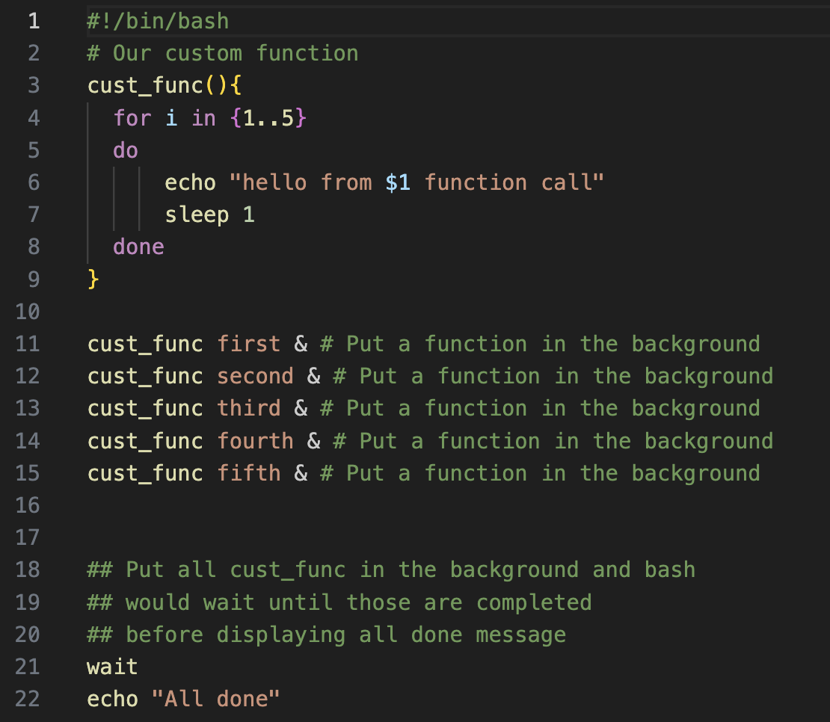
Simple Parallelization Example

Slide 17
Scheduling Jobs

Slide 18
Creating a Cron Job
To create a cron job type the following from any node:
crontab -e
Note that you will need to enter your job in a vi editor.
To insert text type “i”
To exit text type “esc”
To save changes type “:wq”
To exit the file without saving changes type “:q!
To enter a cron job for the cron_example.sh shell script and print the results to a file:
15 12 * * * sh ~/cron_example.sh > ~/cron_output.txt
45 12 * * * sh ~/fellows_workshop_2022/
Session2_Automation/FEC/fec_cron.sh > ~/fellows_workshop_2022/Session2_Automation/
FEC/fec_cron_output.txt

Slide 19
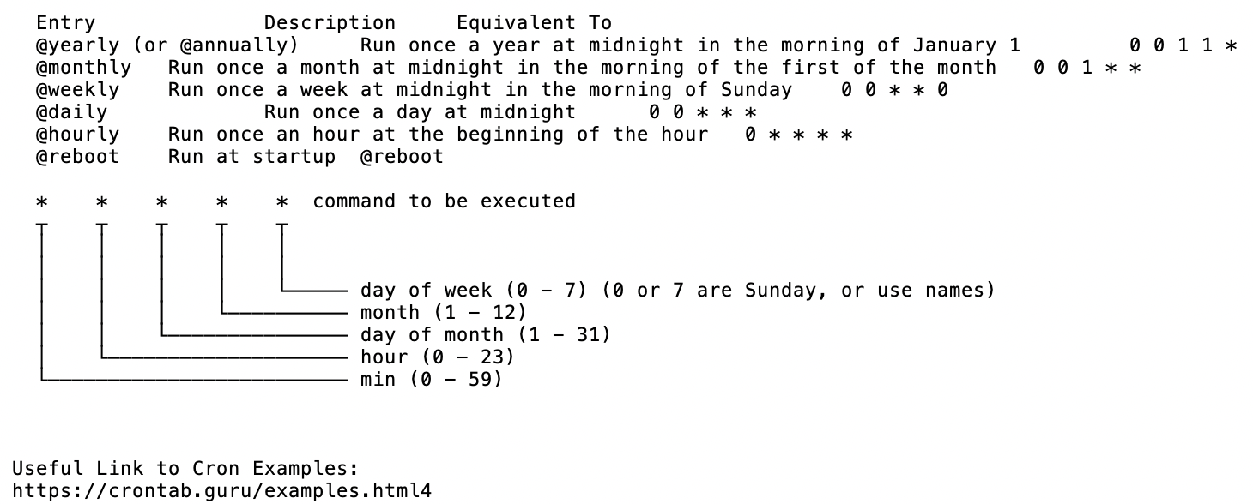
Crontab Guide
https://crontab.guru/

Slide 20
Crontab Examples
The following example will run every 10 minutes
*/10 * * * * /usr/bin/somedirectory/somecommand
The following example will run every 3 hours and 30 minutes
*/30 */3 * * * /usr/bin/somedirectory/somecommand
The following example will run every day at 8am
0 8 * * * /usr/bin/somedirectory/somecommand
The following example will run every Friday at 2pm
0 14 * * FRI /usr/bin/somedirectory/somecommand
0 14 * * 6 /usr/bin/somedirectory/somecommand
The following example will run every month
0 0 1 * * /usr/bin/somedirectory/somecommand
The following example will run every quarter (4 times a year)
0 0 1 */3 * /usr/bin/somedirectory/somecommand
The following example will run the specified months only.
0 0 10 Jan,Apr,Jul,Oct * /usr/bin/somedirectory/somecommand

Slide 21
Handle Exceptions

Slide 22
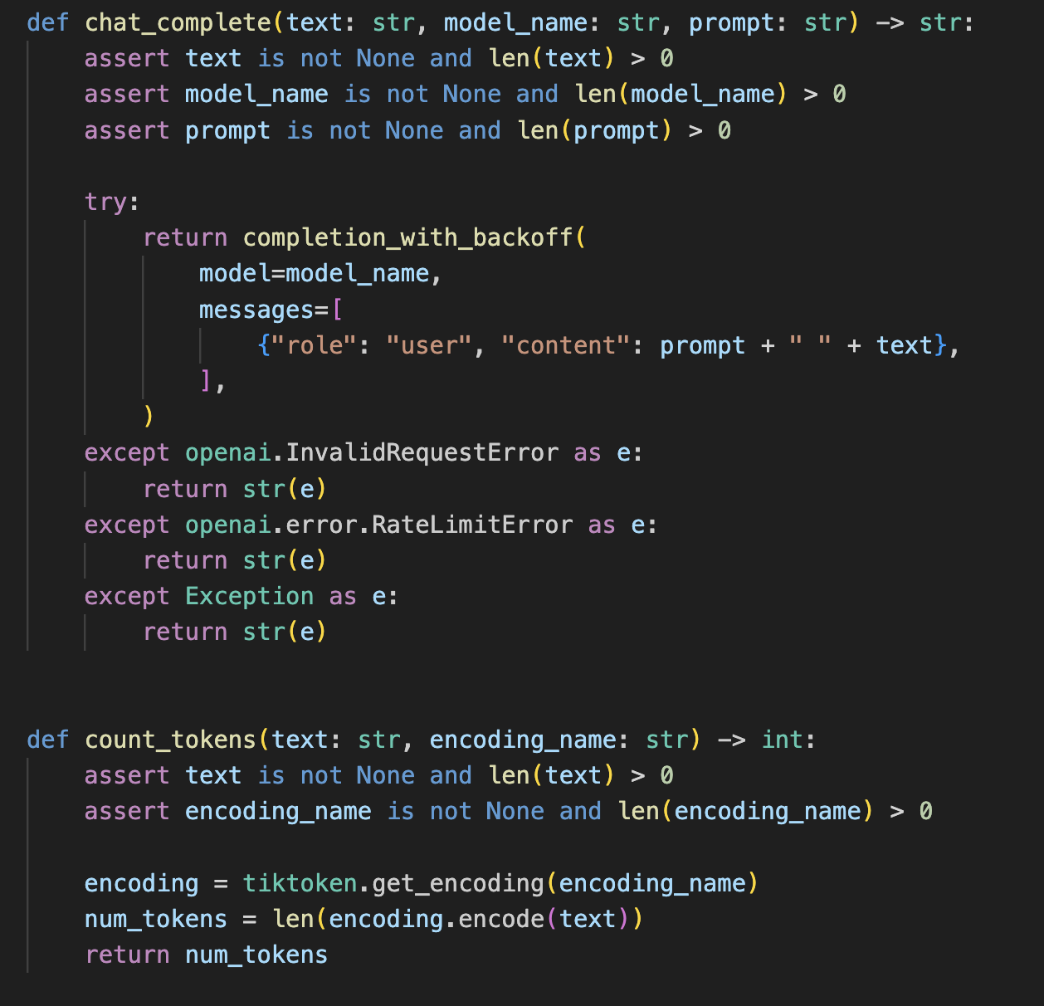
Handle Exceptions
Notes:
Show examples of how to control execution of a script.
Maybe one flavor where you use bash, and another where you use a Python wrapper to control it?

Slide 23
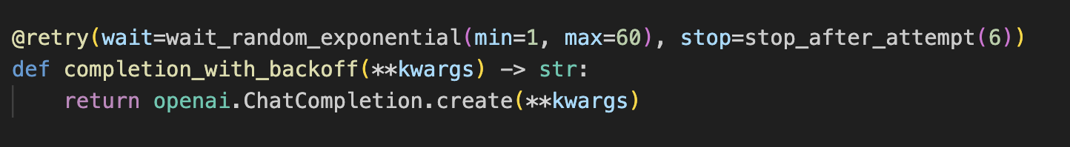
What To Do When Runtime Tests Fail?
Keep going, just log results
Stop program execution
Pause and retry
Examine error code and decide what to do
Exception handling in R
Exception handling in Python
Exception handling in Stata (?)
Notes:
Introduce "exception handling" as a term.
Consider 3 different scenarios where you have to decide whether to...
Continue with the rest of the steps, then go back and rerun just the ones that failed?
Wait and then restart where the job failed
Abort the process, and fix your code before starting again

Slide 24
Generate Logs

Slide 25
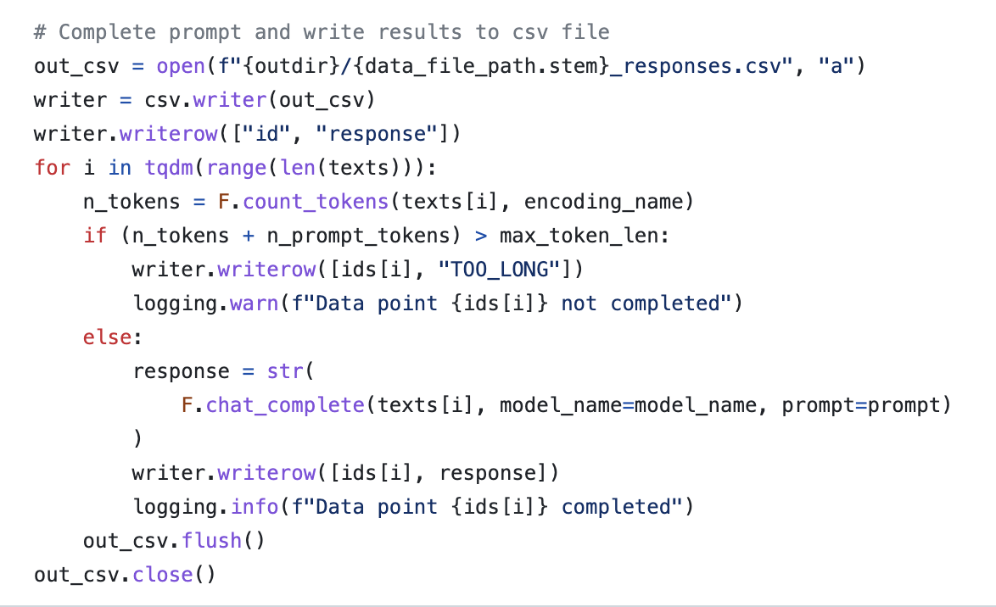
Generate Logs
GitHub Repository
Notes:
Print statements, printing to file.
Discussion: What should you print to file? In what format?

Slide 26
Validate Output

Slide 27
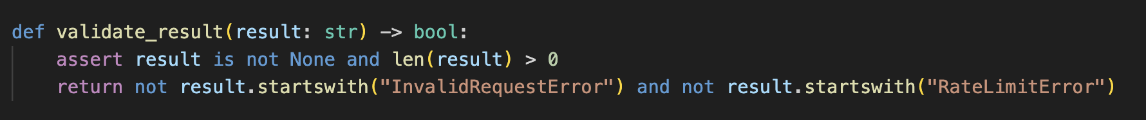
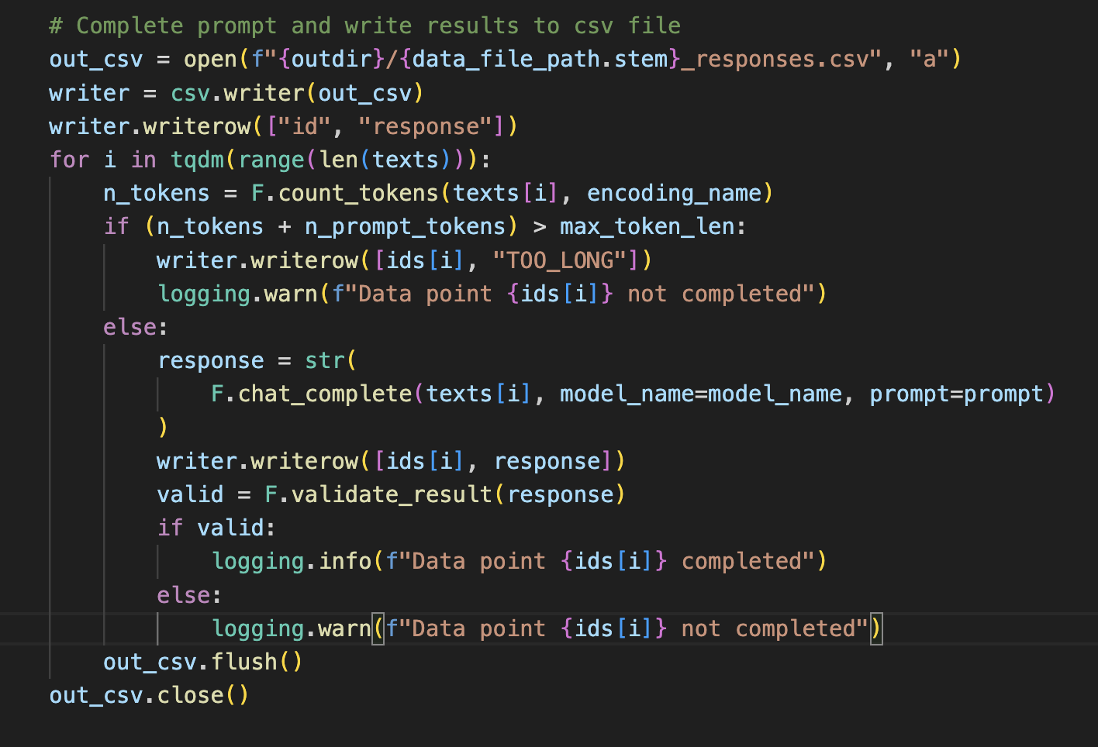
Validate Output
Notes:
Show examples of how to control execution of a script.
Maybe one flavor where you use bash, and another where you use a Python wrapper to control it?

Slide 28
Conclusion

Slide 29
Take Aways
Create automated scripts for all your workflows
Scripts can be in any programming language(s)
Shell scripts are ways to combine shell commands into a single file
Scripts can accept arguments
Runtime tests and logging are crucial for long running jobs
Jobs can be scheduled
Version Control

