Slide 1
Session 3 – Automation & Testing Data Skills for Research Kellogg Research Support
August 15, 2023
Notes:
Welcome. We are so happy you’re here.
What you are about to hear next is about the closest you will get to a lecture in this workshop series. Most of the rest of this will be pretty interactive.
There will be discussions and you follow along with a demonstration, and maybe try to solve a few problems yourself.
But before we get into demonstrations of tools and how to apply them to your research work, I want to talk a bit about the reproducibility of that work you are about to start.
It is a very important topic, and I believe there are a few general principles that, if kept in mind, can help you quite a lot when you go to reproduce your work in the future.

Slide 2
Aside: Jupyter Notebooks
First Method: Quest Analytic Nodes
Second Method:
First time:
module load python-miniconda3/4.12.0
conda create -n jup-env python jupyterlab
conda activate jup-env
jupyter lab --browser=firefox
Subsequently:
module load python-miniconda3/4.12.0
conda activate jup-env
jupyter lab --browser=firefox
Third Method: VSCode

Slide 3
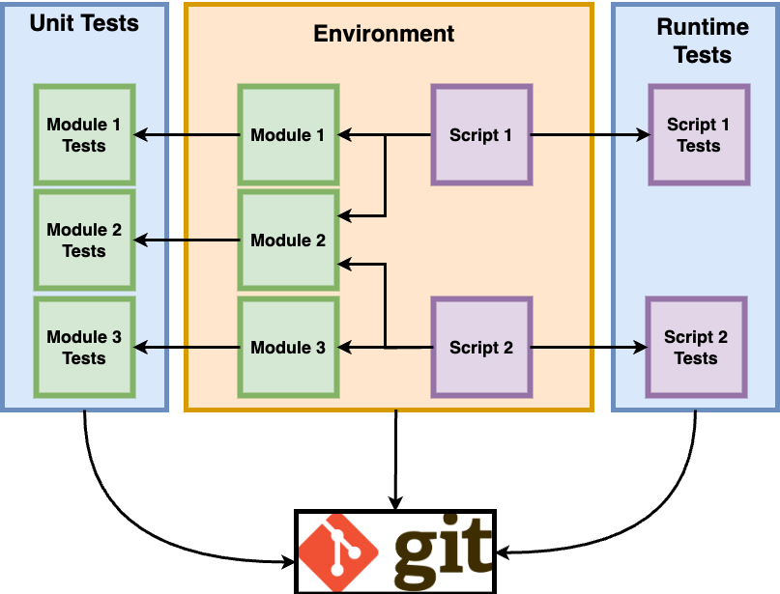
Yesterday’s Big Picture
Version Control

Slide 4
Automation
Declarative > Procedural
Modular > Monolithic
Automatic > Manual
Notes:
All these things turn procedural unspoken knowledge into explicit, declarative and executable specifications

Slide 5
Roadmap
Shell scripts
Launching code from command line
Scripting multiple commands
Schedule jobs
Parallel processing
Runtime Testing
Handle exceptions
Generate logs
Validate output
Notes:
All these things turn procedural unspoken knowledge into explicit, declarative and executable specifications

Slide 6
Launching Code from Command Line

Slide 7
Launching Code from Terminal
To launch an R file:
Rscript <file_name.R>
To launch a python file:
python <file_name.py>
To launch a stata do file:
stata-mp -b do <file_name.do>
With arguments:
python 1_fec_extract.py --start=2018 --end=2020

Slide 8
Scripting Multiple Tasks at Once

Slide 9
Creating a Shell Script
If you’d like to run multiple programs in sequence, you can create a shell script on KLC using the nano editor.
nano <file_name.sh>
chmod u+x <file_name.sh>
./<file_name.sh>
Here is a simple example file:
#!/bin/bash
# load modules
module load python-miniconda3/4.12.0
module load R/4.3.0
# run scripts
python test.py
Rscript test.R

Slide 10
Complex Workflows
raw data
raw data
model-ready data
results
transformations
analysis
raw data
raw data
update inclusion,
model specs
obtain more data
Notes:
JOHN
Your research project will go through many steps from its start to its final output.
Yesterday we urged you to break your steps down into discrete pieces so that you have a clean record of each step.
Scripting the overall pipeline is important for documenting which pieces were run and when.

Slide 11
Script Parameters
Executing steps in a pipeline, test output
Passing in arguments
Notes:
Show examples of how to control execution of a script.
Maybe one flavor where you use bash, and another where you use a Python wrapper to control it?

Slide 12
Scheduling Jobs

Slide 13
Creating a Cron Job
To create a cron job type the following from any node:
crontab -e
Note that you will need to enter your job in a vi editor.
To insert text type “i”
To exit text type “esc”
To save changes type “:wq”
To exit the file without saving changes type “:q!
To enter a cron job for the cron_example.sh shell script and print the results to a file:
15 12 * * * sh ~/cron_example.sh > ~/cron_output.txt
45 12 * * * sh ~/fellows_workshop_2022/
Session2_Automation/FEC/fec_cron.sh > ~/fellows_workshop_2022/Session2_Automation/
FEC/fec_cron_output.txt

Slide 14
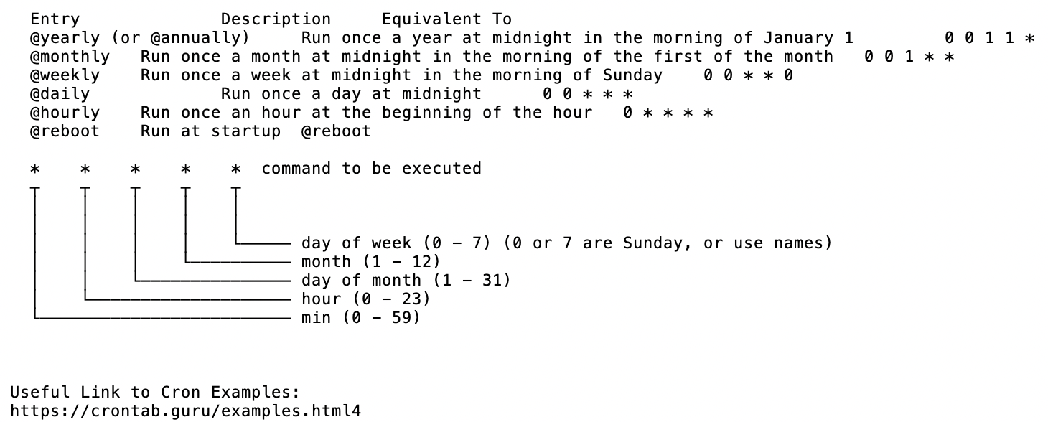
Crontab Guide

Slide 15
Crontab Examples
The following example will run every 10 minutes
*/10 * * * * /usr/bin/somedirectory/somecommand
The following example will run every 3 hours and 30 minutes
*/30 */3 * * * /usr/bin/somedirectory/somecommand
The following example will run every day at 8am
0 8 * * * /usr/bin/somedirectory/somecommand
The following example will run every Friday at 2pm
0 14 * * FRI /usr/bin/somedirectory/somecommand
0 14 * * 6 /usr/bin/somedirectory/somecommand
The following example will run every month
0 0 1 * * /usr/bin/somedirectory/somecommand
The following example will run every quarter (4 times a year)
0 0 1 */3 * /usr/bin/somedirectory/somecommand
The following example will run the specified months only.
0 0 10 Jan,Apr,Jul,Oct * /usr/bin/somedirectory/somecommand

Slide 16
Creating a Shell Script for Cron
Create a sample shell script for a cron job in the nano editor and follow the previous steps to make it executable:
nano cron_example.sh
In the nano editor, enter the following:
#!/bin/bash -l
source ~/.bash_profile
# load modules
module load python/anaconda3.6
# run scripts
python file.py
# print message
echo “Cron Job is Running on KLC Node 5”

Slide 17
Parallel Processing

Slide 18
Parallel Processing
Notes:
Show examples of how to control execution of a script.
Maybe one flavor where you use bash, and another where you use a Python wrapper to control it?

Slide 19
Handle Exceptions

Slide 20
Handle Exceptions
Notes:
Show examples of how to control execution of a script.
Maybe one flavor where you use bash, and another where you use a Python wrapper to control it?

Slide 21
What To Do When Run Time Tests Fail?
Keep going, just log results
Stop program execution
Pause and retry
Examine error code and decide what to do
Notes:
Introduce "exception handling" as a term.
Consider 3 different scenarios where you have to decide whether to...
Continue with the rest of the steps, then go back and rerun just the ones that failed?
Wait and then restart where the job failed
Abort the process, and fix your code before starting again

Slide 22
Generate Logs

Slide 23
Generate Logs
Log output to output file – if the program crashes we don't want to lose work (costs time and money)
Log errors and exceptions when they occur
For long running processes (like cron jobs), send some kind of alert
Notes:
Print statements, printing to file.
Discussion: What should you print to file? In what format?

Slide 24
Validate Output

Slide 25
Validate Output
Notes:
Show examples of how to control execution of a script.
Maybe one flavor where you use bash, and another where you use a Python wrapper to control it?

Slide 26
Conclusion

Slide 27
Big Picture

