Slide 1
Week 3: SQL and KDC Data Data Skills for Empiricists
January 25, 2019
Notes:
Welcome. We are so happy you’re here.

Slide 2
Goals for Today
Learning Objectives
Navigating KDC as a data repository
Primer on SQL Syntax
Accessing KDC Data
With DBeaver
Where to Find Data Tables, Field Names, Attributes
PSA: Senior Academic Editor and Translation Manager, Maja Kos
Kellogg Insight
Accessing KDC Data from Programs on KLC:
R
Python

Slide 3
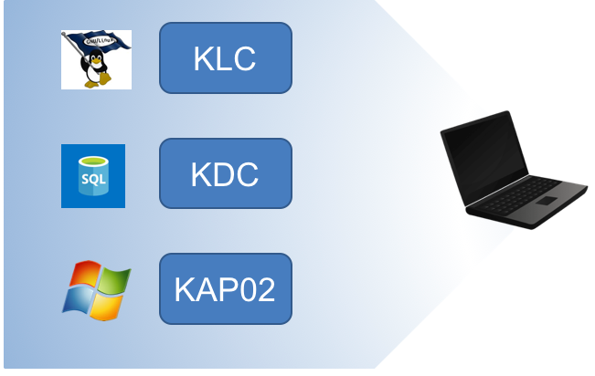
Differences Between Kellogg’s Servers

