Slide 1
SQL Primer Data Skills for Empiricists
January 10, 2020
Notes:
Welcome. We are so happy you’re here.

Slide 2
Goals for Today
Learning Objectives
Primer on SQL Syntax
What is a table?
Anatomy of a select statement
Generating new variables
Types of table joins
Accessing KDC Data from Programs on KLC:
R
Python
Stata

Slide 3
Preparation for Coding Lab
Login to a terminal window in KLC and
run this:
source /kellogg/bin/freetds_config

Slide 4
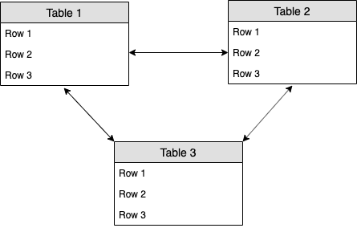
Relational Data

Slide 5
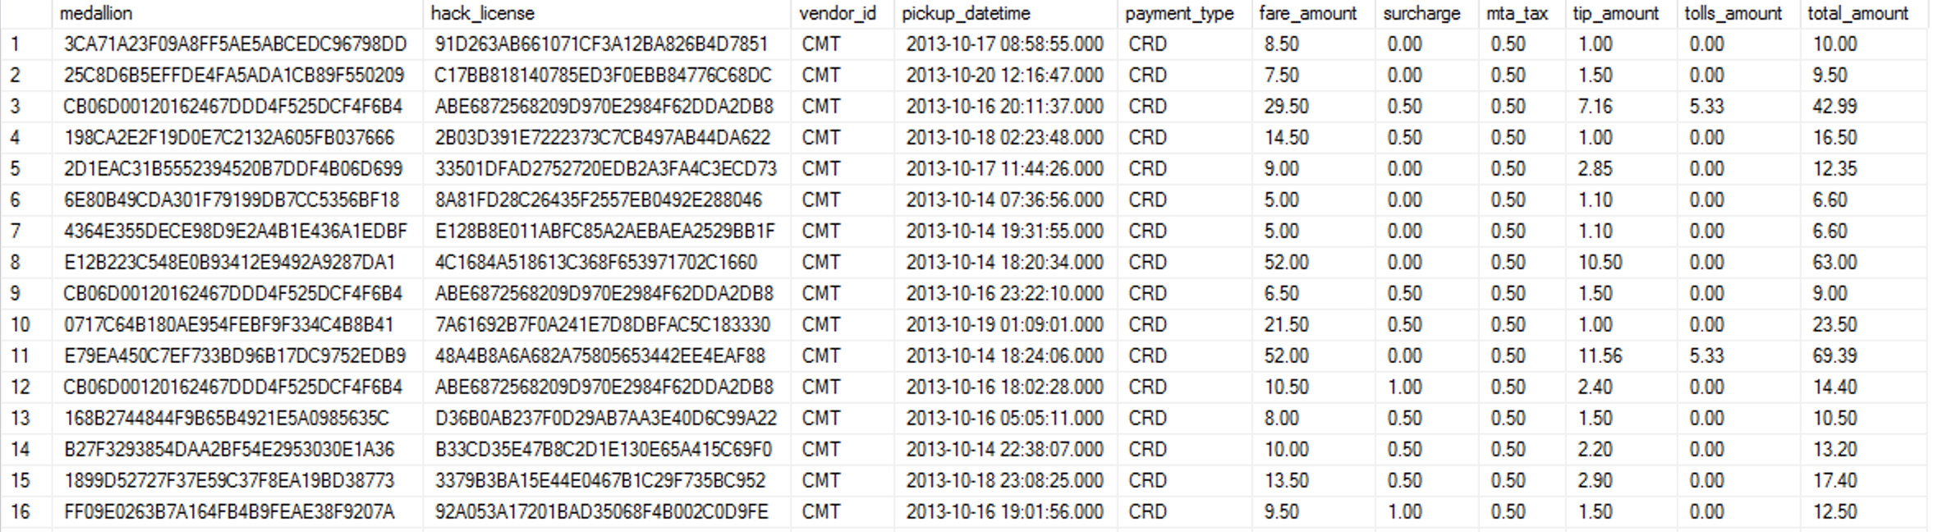
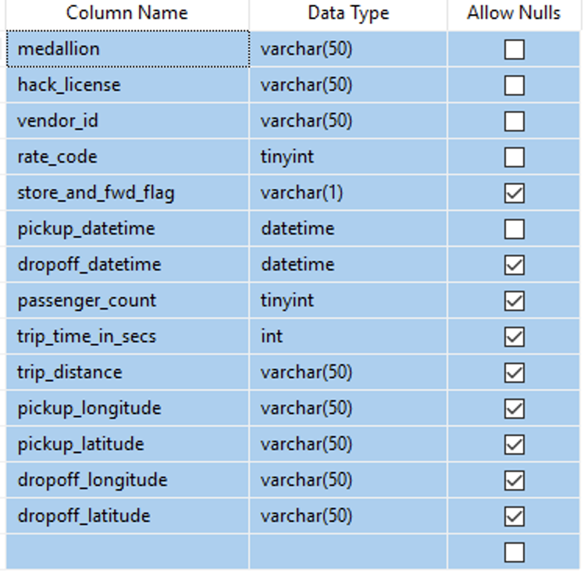
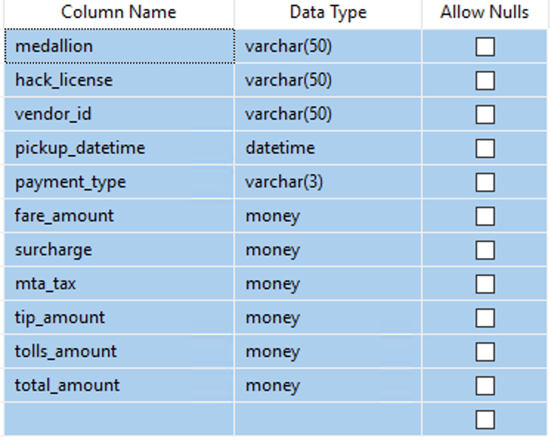
NYC Taxi Ride Tables

Slide 6
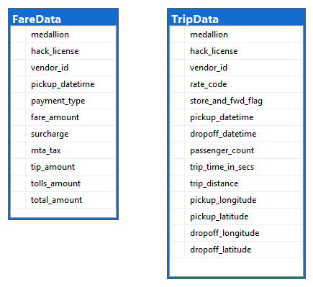
NYC Taxi Ride Tables

Slide 7
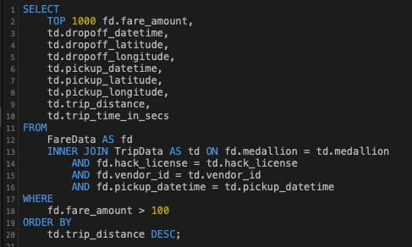
Anatomy of a Select Query

Slide 8
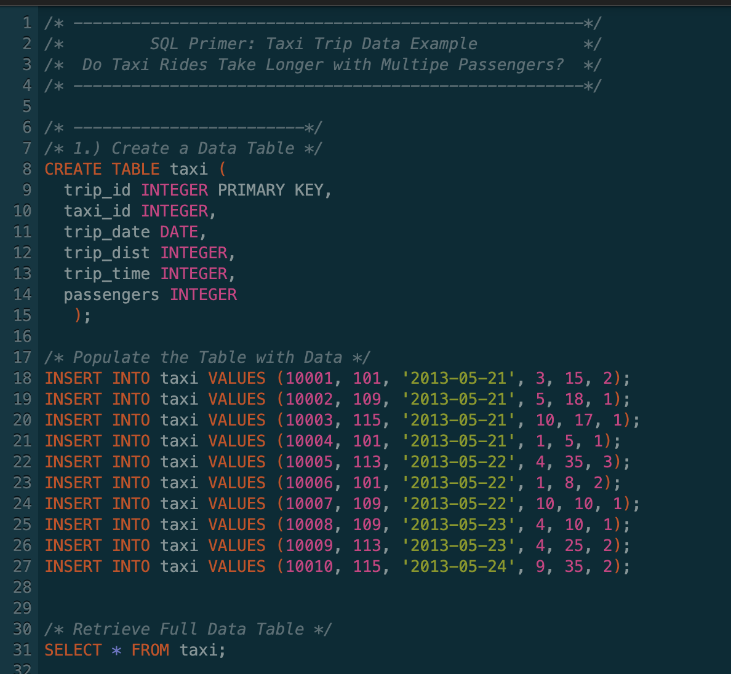
SQL Code Lab
https://sqliteonline.com/

Slide 9
ODBC Connection in STATA
Open a GNOME Terminal Session in FastX and type the
following:
To connect to the ODBC driver, type:
To load and launch STATA 15, type:
export ODBCSYSINI=~/.odbc/
module load stata/15
xstata-mp

Slide 10
ODBC Connection in Python
Open a GNOME Terminal Session in FastX.
To load packages, type:
To create and launch a conda environment, type:
To install libraries, type:
To launch a jupyter notebook, type:
module load python/anaconda3.6
module load firefox/62
conda create -n taxi_env python=3.6
source activate taxi_env
conda install -c conda-forge <library>
jupyter notebook --browser=firefox

Slide 11
Resources
DataCamp:
https://www.datacamp.com/courses/intro-to-sql-for-data-science
LinkedIn Learning:
https://www.linkedin.com/learning/sql-essential-training-3/understanding-sql
Khan Academy:
https://www.khanacademy.org/computing/computer-programming/sql
Safari Books Online:
https://learning.oreilly.com/learning-paths/learning-path-sql/9781492058076/

