Slide 1
Make your Code Bulletproof Data Skills for Empiricists
Winter, 2020
Notes:
Welcome. We are so happy you’re here.

Slide 2
Goals for Today
Learning Objectives
What can go wrong with your code?
Error Handling
Unit Testing
Protect against system Crashes
Save Intermediate output; Elegant restarts
Unit Testing
Error Handling
Porting Code Between Environments
Version Control in Github
branch and commit; Retrieve old version; Preserve random variable draws; repo packages and environments

Slide 3
What can go Wrong with your code?
Suggestions…..

Slide 4
What can go Wrong with your code?
Suggestions…..
… code repeatedly breaks forcing manual restarts
… your computer crashes
… a server goes down ... you accidentally saved over a file?

Slide 5
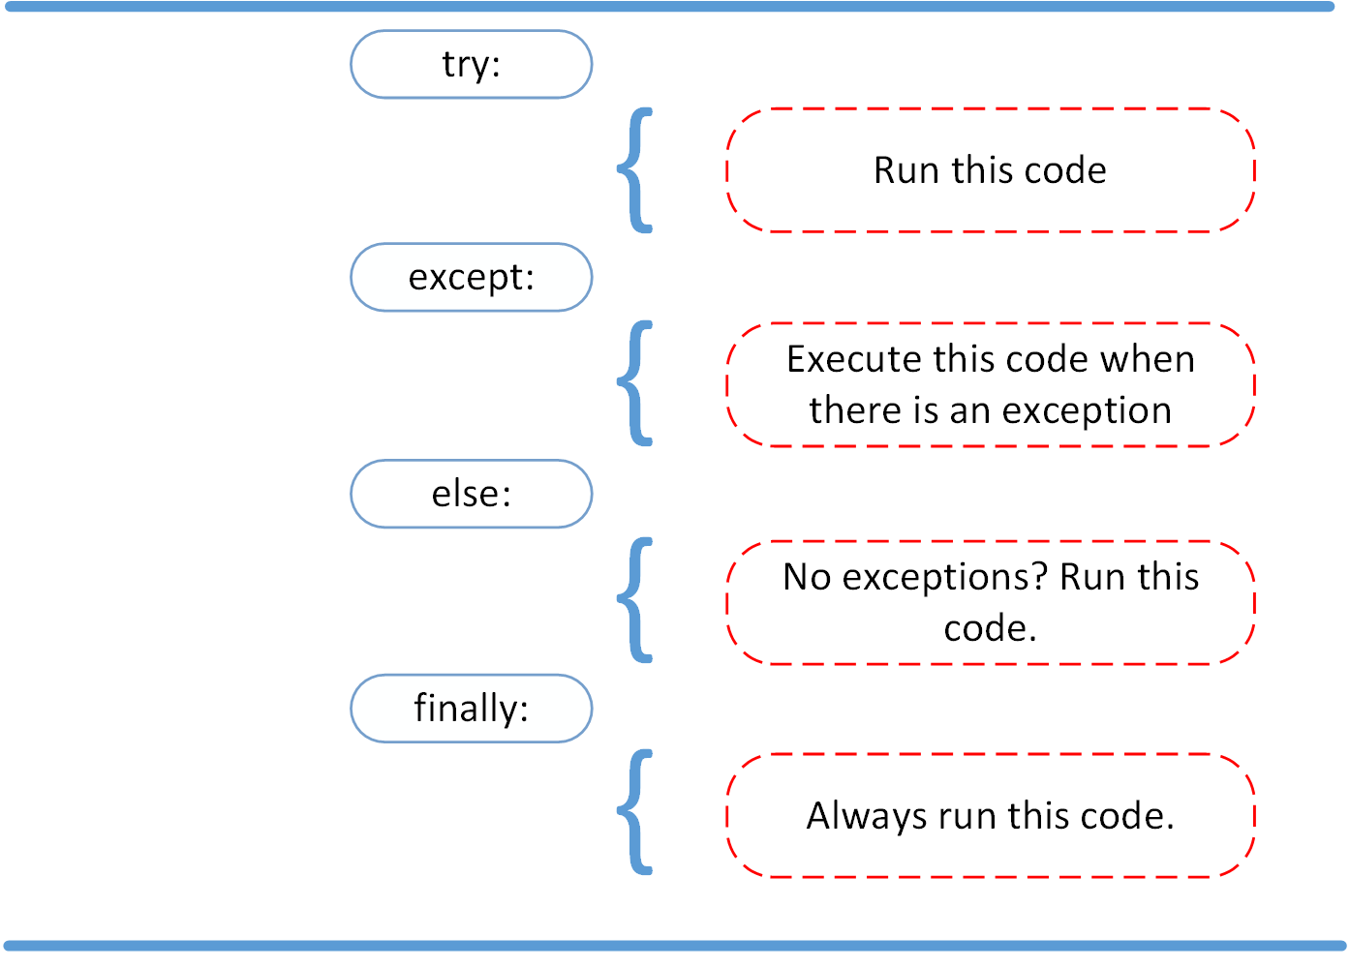
Error Handling in Python
Error handling increases the robustness of your code guarding against uncontrolled exits
https://www.datacamp.com/community/tutorials/exception-handling-python

Slide 6
Types of Errors
Try:
Except <Type>:
Missing Element – except NoSuchElementException:
Time Out – except TimeoutException:
Value Error – except ValueError:
Unreliable Connection – except urllib2.URLError:
Logging Errors – except Exception as e:

Slide 7
Functions and Error Handling in R
statement examples
try < do something > …. Automatically skips arguments that do not work
tryCatch <do something>, warning= …. , error = …
https://www.learnbyexample.org/r-functions/

Slide 8
Unit Tests
Testing writes code (separate from application code) that invokes the code it tests to determine if there are any errors.
It does not prove code is correct, but rather reports if the conditions provided in the tester are handled correctly
Unit tests specifically test a single “unit” of the code in isolation. For instance, testing a single class, function, module etc.

Slide 9
Unit Tests in Python
import unittest
class SimpleTest(unittest.TestCase):
# Returns True or False.
def test(self):
self.assertTrue(True)
if __name__ == '__main__':
unittest.main()

Slide 10
Unit Tests in R
source(“/kellogg/proj/…/mycode.R”)
library(testthat)
testthat(“test name”, {
expect_equal(function(input),
value
})

Slide 11
Oh no! A KLC node crashed….
Any suggestions for what you can do?

Slide 12
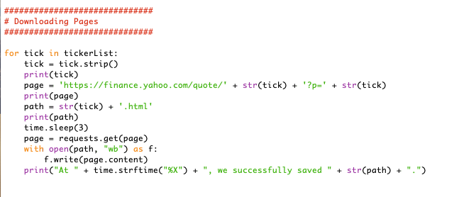
Save Intermediate Output
Print Statements
Saving each html file, one at a time
Save a subset of a list once it is collected…

Slide 13
Elegant Restarts to Python Code
#!/usr/bin/python
from subprocess import Popen
import sys
filename = sys.argv[1]
while True:
print("\nStarting " + filename)
p = Popen("python " + filename, shell=True)
p.wait()

Slide 14
Create and Launch Shell Script
$ nano forever
< Enter file contents >
< Control+x to save file >
$ chmod +x forever
$ ./forever file.py

Slide 15
Takeaways
Exception Handling
Unit Testing
Automate Code Restarts
Porting over Code
Github for Version Control

