Slide 1
SQL Primer Data Skills for Empiricists
Winter, 2020
Notes:
Welcome. We are so happy you’re here.

Slide 2
Goals for Today
Learning Objectives
Primer on SQL Syntax
What is a table?
Anatomy of a select statement
Generating new variables
Types of table joins
Accessing KDC Data from Programs on KLC:
R
Stata
Python

Slide 3
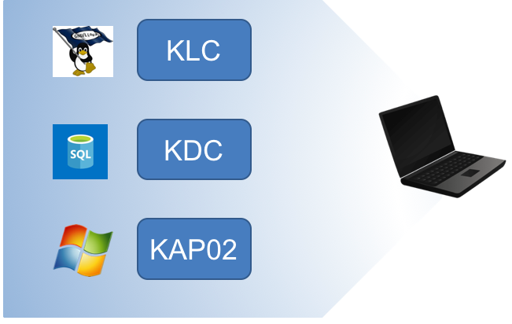
Differences Between Kellogg’s Servers

Slide 4
During the Break:
Login to a terminal window in KLC and
run this:
. /kellogg/bin/freetds_config

